Slide 1
Healthy Thinking
How Philosophy Can Help Us Reason Well in a Time of Sickness
Brendan Shea, PhD (Brendan.Shea@rctc.edu)

Slide 2
Overview of Today’s Talk
Today, we’ll be talking about:
What philosophy is, and how it can help us deal better with uncertainty.
The difference between “inductive” and “deductive” reasoning, and why the former is often more important.
Some of the most common “fallacies” we make when try to reason inductively.
How we can reason better, and why this can help both ourselves and those around is.

Slide 3
What is “Philosophy”?
Philosophy literally means “love of wisdom.” This might suggest that just about any sort of academic study might count as philosophy (and actually, most modern sciences started out as parts of philosophy).
In practice, philosophy generally means something like: trying to answer questions that we don’t (yet) have an agreed-upon method for answering. Once we do find a method, they won’t be philosophical anymore!
Philosophical questions generally concern logic (“How should we reason?”), ethics (“How should we treat one another?”), epistemology (“How can I get knowledge of the world?”) and metaphysics (“What sorts of things really exist?”).
The methods of philosophy are designed to help us make choices under uncertainty—i.e., when we don’t “know” all that we’d like to, but need to lead good, rational lives despite this.

Slide 4
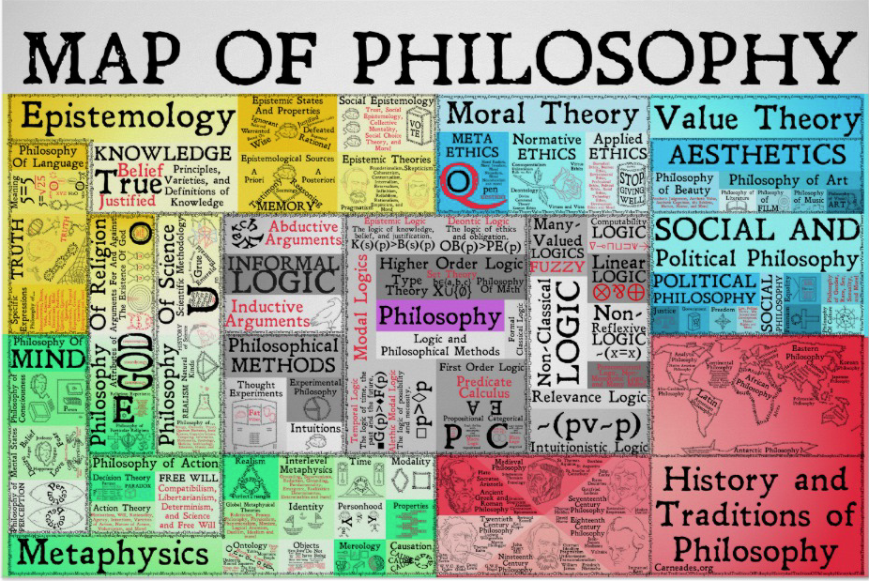

Slide 5
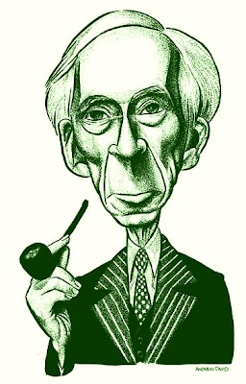
“The demand for certainty is one which is natural to [people], but is nevertheless an intellectual vice. If you take your children for a picnic on a doubtful day, they will demand a dogmatic answer as to whether it will be fine or wet, and be disappointed in you when you cannot be sure. The same sort of assurance is demanded, in later life, of those who undertake to lead populations into the Promised Land. “Liquidate the capitalists and the survivors will enjoy eternal bliss.” “Exterminate the Jews and everyone will be virtuous.” “Kill the Croats and let the Serbs reign.” “Kill the Serbs and let the Croats reign.” These are samples of the slogans that have won wide popular acceptance in our time. Even a modicum of philosophy would make it impossible to accept such bloodthirsty nonsense. But so long as men are not trained to withhold judgment in the absence of evidence, they will be led astray by cocksure prophets, and it is likely that their leaders will be either ignorant fanatics or dishonest charlatans. To endure uncertainty is difficult, but so are most of the other virtues. For the learning of every virtue there is an appropriate discipline, and for the learning of suspended judgment the best discipline is philosophy.” - Bertrand Russell, “Philosophy for Laymen”

Slide 6
COVID Conundrums
Philosophical problems are always “with us” but COVID has made many of them tougher to ignore:
Ethics: How can my behavior (vaccines, masks, distancing, voting, everything!) affect others? What are my obligations to others?
Epistemology: How do I know who to trust? How can I make rational plans for an uncertain future? How can society?
Logic: How can I make sure my own reasoning (about my health, political choices, even my own feelings) is “cogent”?
Metaphysics: What does it mean to die *from* COVID (vs *with* COVID)? What are viruses, anyway? Do I really have “free will” in today’s world? What does it mean to lead a “good” life?

Slide 7
Two Ways of Reasoning
Deductive Reasoning
Inductive Reasoning
“If the evidence I have so far is correct, I can be absolutely, positively 100% certain that my conclusion is true.”
Example 1: “Since I have two apples in my left pocket and two apples in my right pocket (and no other apples), I conclude I have four total apples.”
Example 2: “Out of 1,000 people sick with COVID last week, 20 died. So, the death rate was 2%.”
Deductive reasoning (or “proof”) is very important for math, computer science, and some areas of philosophy. It either works or doesn’t—there is no middle ground. It’s role in many areas of our “everyday lives” is limited.
“If the evidence I have so far is correct, it’s reasonable to believe that conclusion is true as well.”
Example 1: “Drinking coffee has never before given me superpowers, and all my science teachers have told me that this is not physically possible. So, I probably won’t get superpowers from drinking coffee today.”
Example 2: “People my age generally do OK with COVID. So, I probably won’t get very sick.”
Inductive reasoning is hugely important to science and everyday life! It can be *weaker* or *stronger*, depending on just how “confident” I am that my conclusion is true (51% is a lot different than 99.99%).
We’ll be focusing on INDUCTIVE reasoning from here on out.

Slide 8
What are Fallacies?
A fallacy is an argument (or “way of reasoning”) that has something wrong with it besides being based on incomplete/incorrect evidence.
A fallacy occurs when we “should have known better.” Fallacies are not simply “false things we believe.” We all have false beliefs, but some of these are reasonable, given our evidence at the time.
One reason we want to avoid fallacious reasoning is that, it will, in general lead us to have more false beliefs. Fallacious reasoning can often lead us to harm both ourselves (they make us less happy!) and other people.
A major cause of fallacious reasoning is confirmation bias: our (somewhat lazy and partisan) brains “want” the things we currently believe (about ourselves and others) to be true, and don’t deal well with evidence that might require us to change our beliefs.

Slide 9
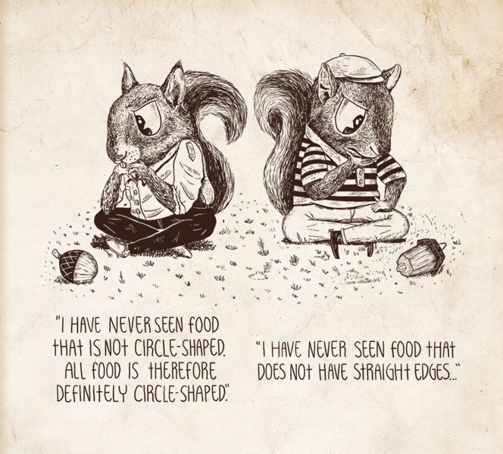
“Well, Based on my Experience”: Hasty Generalization
The fallacy of hasty generalization occurs when we draw general conclusions based on small sample sizes. For example:
“I know six people that got COVID in the last month, and none of them had any problems. I think the authorities are exaggerating the threat it causes.”
“I read a heartbreaking story on social media about a 14-year-old who almost died of COVID. The only reasonable thing to do is to close schools for the rest of the year.”

Slide 10
Hasty Generalization, Cont.
Why Do We Do It? Our brains are “built” to think that our (very limited!) experience is representative of the big picture. They deal really well with things like navigating small-ish social groups (of up to 150 or so), and immediate threats to one’s health (tigers!). They don’t always deal as with science, or social media, or today’s “global” society.
How Can We Do Better? Whenever you are trying to think about “big picture” issues, take the time to explicitly remind yourself that our brains (which do perfectly well in handling many of the problems of our personal lives) don’t always deal well with statistics, and that our “feelings” about what is likely to be true aren’t necessarily good guides.
(Note: It’s actually OK to “talk” to yourself out loud about such things. Research suggests that it can be helpful!).

Slide 11
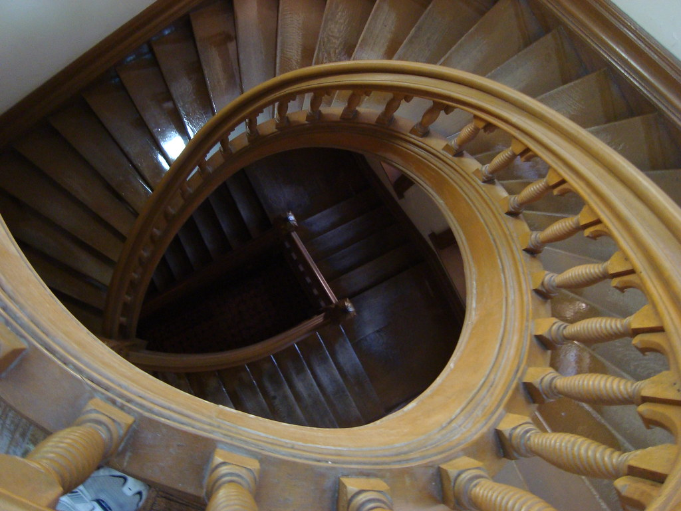
“I Can Imagine Things Going Badly”: Slippery Slopes to Doom
The slippery slope fallacy occurs when we reason from “I can imagine the following sequence of events happening, which would be absolutely terrible (or wonderful)!” to “this sequence of events is actually likely to happen.” Examples:
“If my political opponents get their way about COVID policies, then A will happen, then B, C, D,…and finally all humanity will be wiped out by COVID (or, we’ll be living under a fascist dictatorship, or whatever).”
“Oh no! I think I said something that might have offended Sam. This will lead to X, Y, and Z, and pretty soon Sam will no longer be my friend, and will actively plot my destruction.”

Slide 12
Slippery Slope, Cont.
Why Do We Do It? Our brains are really good at imagining possibilities (especially negative ones!), which is a major source of human creativity/progress. Unfortunately, we don’t have a good sense of how “probable” the things we imagine are, and often “feel” something like “the more vividly I can imagine something, the more likely it is.” This can cause problems:
The gambler “imagines” a series of wins, and is encouraged to continue playing (and eventually losing all of their money).
The person who is consumed by anxiety by “what might happen”, and thus refuses to leave their house.
How Can We Do Better? Always ask yourself “how probable is the thing I’m imagining.” Get in the habit of tracking when your past worries/hopes have NOT panned out in the way you “imagined.” (This can help you defeat current worries).

Slide 13
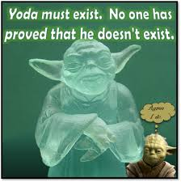
“You Can’t Prove Me Wrong”: Appeals to Ignorance
The appeal to ignorance happens in the following sorts of situations:
We are presented with (good) evidence that the beliefs we currently have about some issue are likely to be wrong.
Rather than change our views (which our brains really dislike), we “shift” the burden on to the person arguing against us, and demand that they *prove* we are wrong.
Since it is literally *impossible* to prove things in inductive reasoning (which is most of our lives, including all of science), you never need to change your mind about anything. Yay?
Examples:
“I’m worried that the vaccines aren’t tested enough…[A ton of evidence regarding safety accumulates]…Well, you can’t prove that they are safe, can you?”
Many conspiracy theories involve appeal to ignorance.

Slide 14
Appeal to Ignorance, Cont.
Why Do We Do It? Our brains don’t “want” to change their views unless they are absolutely forced to (they are lazy!). This leads us to (unconsciously) adopt very different standards of “proof” for (1) things we already agree with (or don’t have an opinion on one way or the other) versus (2) things we DON’T agree with. It can be really, really difficult to convince ourselves that we are wrong about something we care about.
How Can We Do Better? The more strongly we feel about an issue, the more likely this fallacy is to cause problems. To remedy it, periodically remind yourself that “even though I have strong beliefs on this subject [and I might be embarrassed to change my mind], I can’t actually be 100% sure of the truth. It’s worth my while to take seriously the arguments of people who disagree with me.

Slide 15
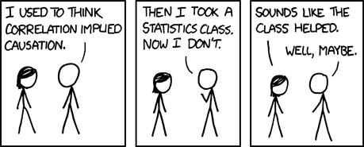
“What Would Make Me Happy Is…”: Causing Ourselves Problems
Fallacies of false cause occur when we think we have better insight into the “true” cause of events than we actually do.
One version of this fallacy is Post hoc ergo propter hoc (“after this, therefore because of this…”) occurs whenever we reason from “A occurred before B” to “A must have caused B”.
Example 1: “When I got COVID, I simply ate nothing but Potato Oles for two days, and I felt much better. Potato Oles must be a miracle cure!”
Example 2: “I took a COVID test yesterday, and today have been having a headache. It’s likely the test is what caused my headache.”
Our brains are “built” to see causes between different events. They do very well at this in some sorts of scenarios, but much worse in others. Unfortunately, we aren’t always great “intuitive” judges of what will cause us to be healthy or happy.

Slide 16
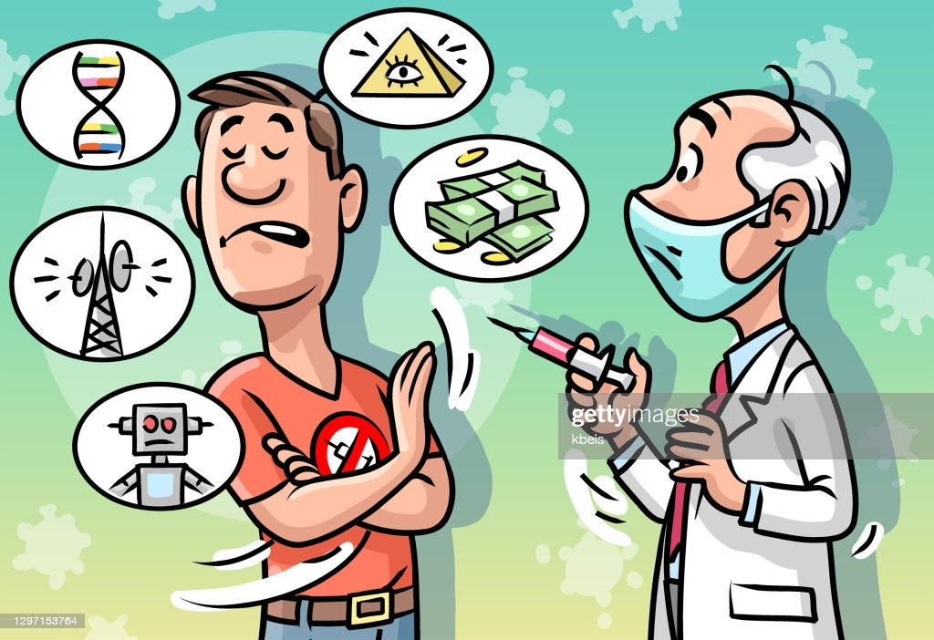
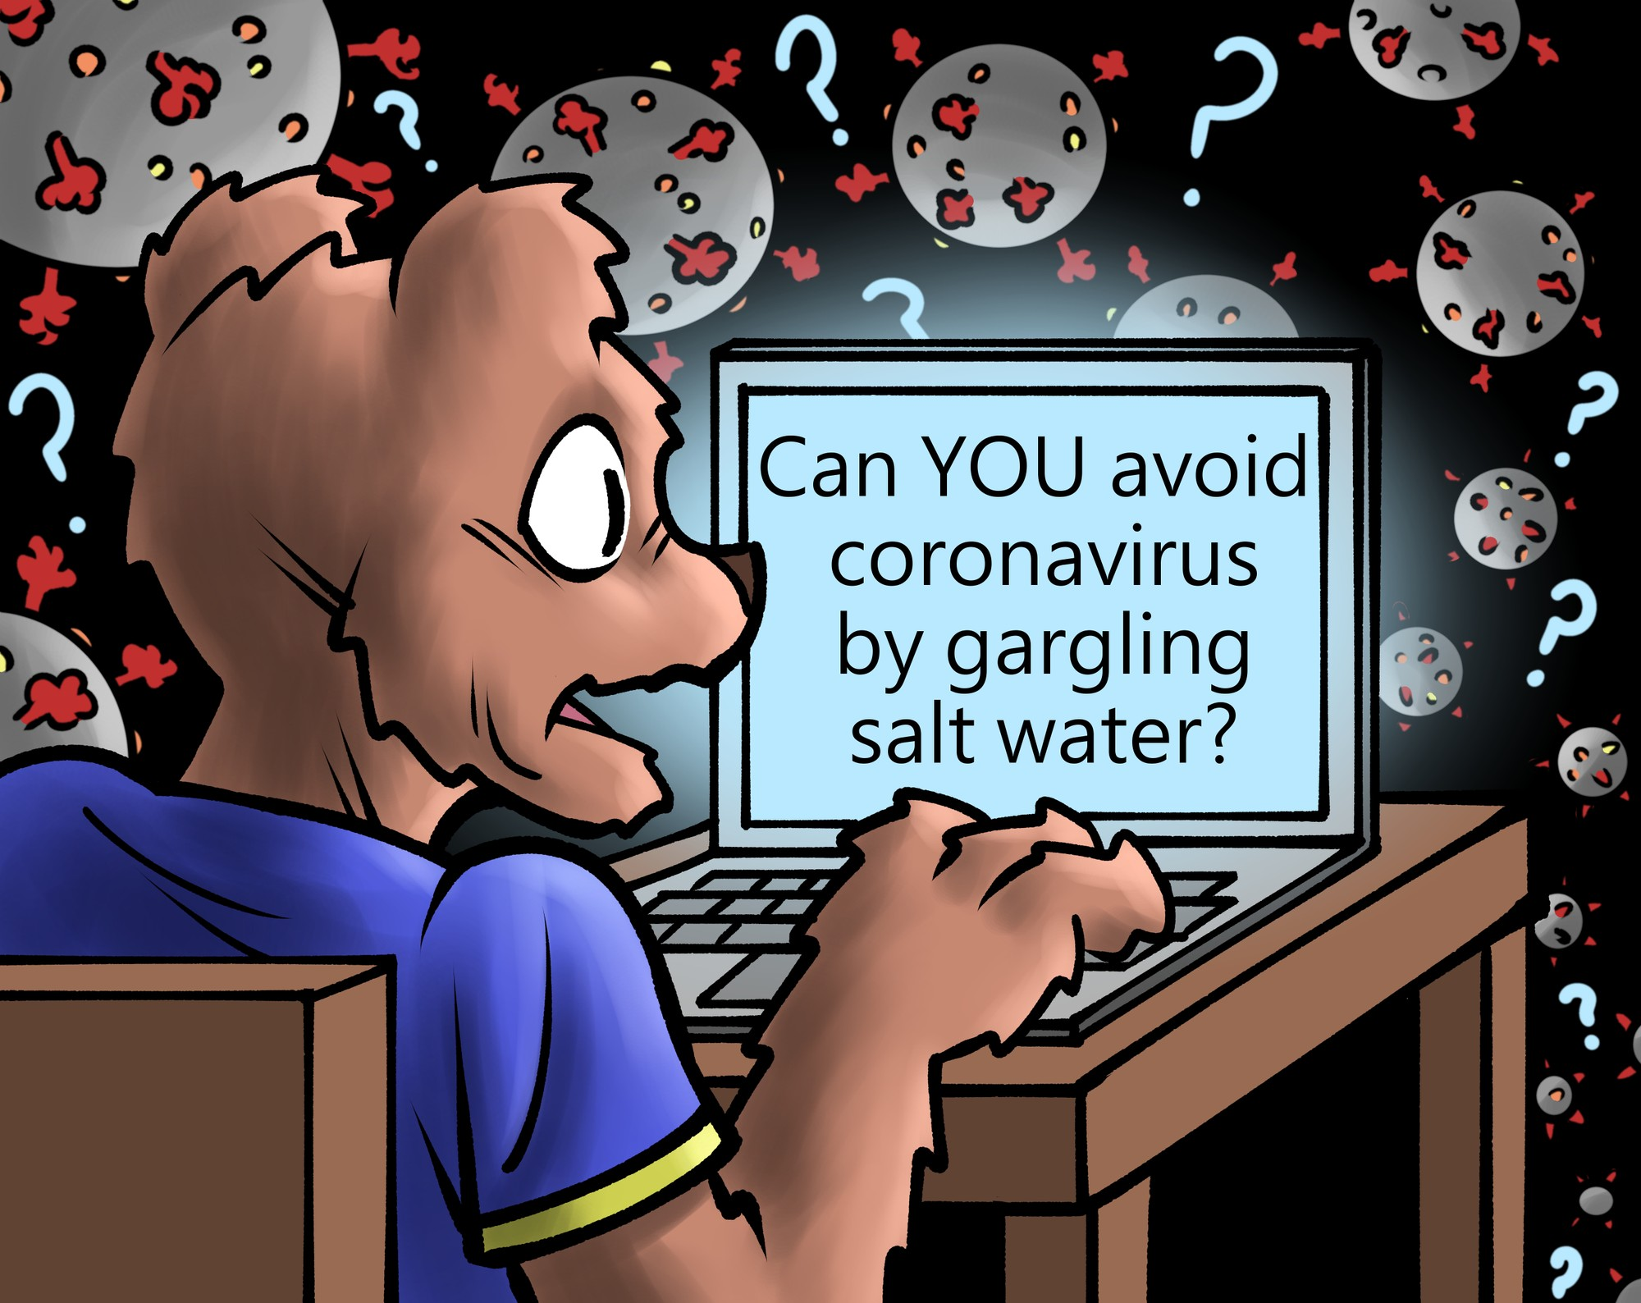
“It’s Simple, Really…” The Fallacy of the Single Cause
The fallacy of the single cause occurs whenever we assume that a given event must have only ONE cause, when in fact most events have multiple causes.
Example: “Anna was vaccinated and nevertheless got COVID. I can only conclude that vaccines have no effect whatsoever.”
One’s risk for getting COVD (and getting really sick with it)is impacted by many factors: behavior, genetics, job, family, vaccination status, and so on. Some of these (like vaccination) are more important than others.
Example 2: “I’ve contracted COVID. I’m likely to die!”
It’s true that COVID can (and does!) kill people. However, like every other illness we know about, it’s simply not true that “If you get disease X, you will die.” There are many other factors (besides simply being infected) that will affect the outcome.
This fallacy, like many others, has its roots in our minds desire to “simplify” matters, sometimes by leaving out important bits.

Slide 17
“I Don’t Know Who to Trust”: Args from Authority
Much (maybe even most!) of the knowledge we have about the world comes from “authorities.” We believe things because we read about them in the newspaper, or were told about them by a friend, or were taught them in class.
This is a perfectly legitimate form of inductive reasoning—we couldn’t survive if we tried to “not take anyone’s word for it” and learn everything “by ourselves.”
BUT, this only works if there is a “consensus of experts”: that is, if the people who are knowledgeable about the topic generally agree on whatever the issue happens to be.
Example 1: In science classes, the material in a typical college textbook represents the “consensus of experts”, and can be trusted.
Example 2: In many social settings (such as a school or workforce), ordinary people can be the “experts.” For example, if all of your friends/coworkers tell you that a certain person is “bad news,” you can often believe them!

Slide 18
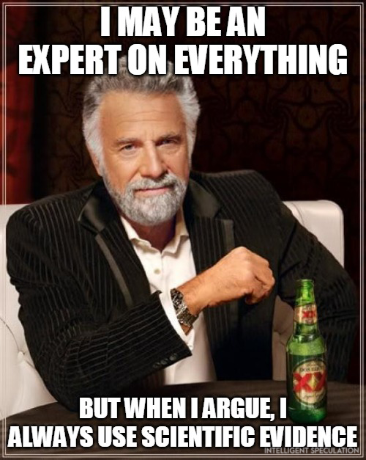
Appeal to Inappropriate Authority
The fallacy of appeal to inappropriate authority occurs whenever we appeal to an (incorrect/flawed authority) in cases where we ought to know better. This can happen in a number of ways:
There isn’t any consensus of experts, but I argue as if there is. Example: “My favorite social media figure said that COVID was the result of a lab leak.” (Problem: Scientists are still debating this. In order to argue for/against, we need to appeal to evidence besides mere “authority.” Also social media figures aren’t experts!).
Putting too much weight on “an exciting new study”. Example: “An exciting new study (done on 15 mice) suggests COVID can be cured by eating Potato Oles! Guess I’m headed to Taco Johns…”
What’s a good authority for public healthy? Groups such as the CDC, FDA, AMA and others often issue guidelines that “interpret’’ the state of scientific evidence for laypeople. In disputed matters, you might compare/contrast local authorities with international ones (e.g., both Canada and the UK have similar sorts of bodies which often, but not always, agree with those in the US).

Slide 19
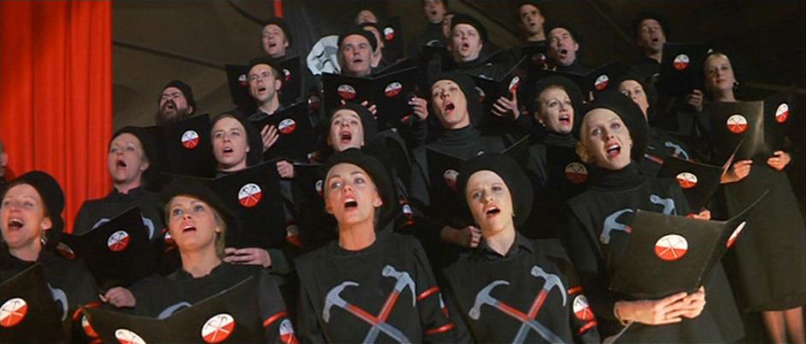
Problems with People: Ad Populum
The appeal to the people fallacy (also called the ad populum fallacy has the form): “I would like to be accepted or admired by members of a certain group. The members of this group all believe C. So, I believe C, as well [even though my other evidence suggest that C is false].”
Example: “My friends and family all believe X about COVID, so I believe X as well [even though the other evidence I have suggests X is false].”
It’s important to distinguish this fallacy from legitimate forms of inductive reasoning. So, for example, it’s perfectly fine to put weight of the opinions of those you know/love on things that they are actually competent to make judgements about.

Slide 20
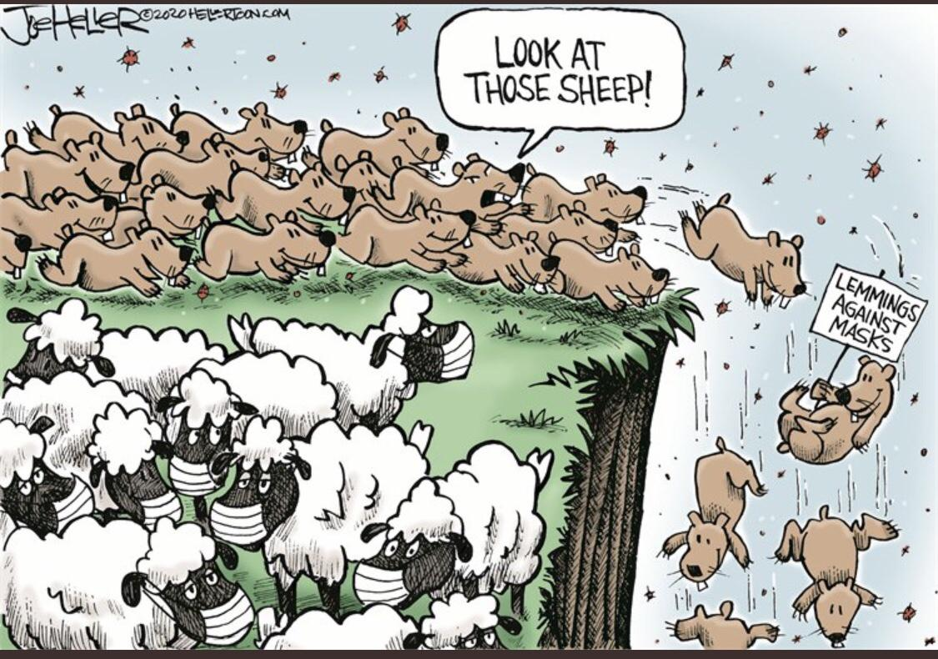
Ad Populum: “I don’t do that. Do I?”
Most people don’t think they commit this fallacy. That is, if you ask them “Why do you believe C?” they generally will NOT reply “It’s just what everyone around me believes.” After all, we a;; know that others won’t accept this as a good reason!
Instead, our brains are excellent at generating “excuses” or “explanations” to explain why/how it’s completely rational for us to believe whatever our tribe/group wants us to believe. (And, in fact, more intelligent people can actually be more susceptible to this fallacy, precisely because they are better at selectively gathering evidence).
So, how do we diagnose this? Think about the ways that your beliefs have changed over the last 10 years or so (especially on currently “controversial” issues). It should be a warning sign if ALL of your changes in belief on these issues have tracked that of your group/tribe.
This is also related to negative partisanship, or rejecting certain ideas simply because they are accepted by a group you dislike.

Slide 21
“But I’m Different…” The Base Rate Blues
The base rate fallacy occurs when we ignore “base rates” when trying to determine the probability of various outcomes.
What’s a base rate? A base rate is simply a measure of how frequently a certain outcome occurs in a given population. So, for example, the base rate among the entire population of needing hospitalization from COVID might 5%”. This means that, for every 100 people who are infected with COVID, 5 are hospitalized.
Populations are different! When thinking about base rates, it is important to remember that different sub-populations have different base rates. For example, the base rate of COVID hospitalization is affected very, very strongly by things like (1) vaccination (and boosters), (2) age, and (3) certain preexisting medical conditions.
We have lots of good evidence that even really smart people are bad at dealing with base rates. For example, suppose a patient has a positive test for breast cancer. She is in population with a base rate of breast cancer of 3%, and the test in 95% “sensitive” and 90% “specific.” Both patients AND their doctors tend vastly overestimate here chance of having cancer (which is only 22%).

Slide 22
Wait! I thought you said there would be no math?
While I’ve described the base rate fallacy in terms of numbers, the fallacy itself is actually a much more general one: We have a tendency to think that we are “exceptions to the rule” even when we shouldn’t.
This can lead us to overestimate risk. In terms of base rates, it’s really uncommon for people to die from terrorist acts, or nuclear reactor meltdowns, or even school shootings. Children are highly unlikely to die from COVID. Over-responding to these threats can be very costly.
This can lead us to underestimate risk. Human history provides plenty of evidence that certain sorts of bad events: earthquakes, volcano eruptions, pandemic diseases, and asset market crashes happen with a non-trivial frequency. On a personal level, things like medical emergencies and job losses fall into the same category. And yet, many people behave as if “this time is different”, and these things couldn’t possibly happen to them.
A base rate about base rates. Most of the reasons that we tell ourselves “I’m different, really!” are likely to be incorrect. As Thedore Sturgeon once observed “90% of everything is crap.” ☺.

Slide 23
Why are (other) people so bad at reasoning?
In general, it is much, much easier to tell when other people are committing fallacies than when ourselves are committing them.
For example, can you think of a time that somebody else:
Made a “hasty generalization” based on their personal experience (that wasn’t representative of your own experience).
Made unreasonable predictions about the future based a “slippery slope.” The person might be unrealistically optimistic (“Once A, B, C, and D happens, my currently terrible relationship will be great!”) or pessimistic (“If A, B, C, and D happen my life is over.”)
Relied on news sources that you think are obviously biased or untrustworthy.
Catching other people in fallacies can make you think “Wow, I’m really good at this! Good thing I don’t commit these fallacies…” This is a dangerous thought! If anything, it should convince you of the opposite—that intelligent people (including you!) can easily be fooled.

Slide 24
Review Questions
Which 1-2 fallacies did you find most interesting? Give their names and describe them in your own words.
Give an example of a time you noticed someone else commit a fallacy of this sort.
Give an example of a time you think that YOU might have committed a fallacy of this sort.
Based on today's talk, what are 1-2 ways you might improve your thinking?
You can complete these questions for proof of attendance at: https://forms.gle/VHywu6tE9iJzAeei7

Slide 25
Thanks for Coming!

