Slide 1
Parallel Processing
Actors
Ron Coleman, Ph.D.

Slide 2
Learning objectives for this week
Introduce actors

Slide 3
Threads
Strengths | Weaknesses
Simplicity | Depend on shared memory
Portability | Note scalable
Universality | Too low-level

Slide 4
Divide-n-conquer algorithm
Key to all parallel processing algorithms:
Decompose problem into smaller tasks.
Distribute tasks to parallel processors
Wait & aggregate results

Slide 5
Actors
Originally invented for AI in 1970s.
They are concurrent objects.
If different JVMs, they’re called remote actors.
Communicate only by message passing.
Each actor has a mailbox.
Processes messages in order received.

Slide 6
Actor model
Actor A
B’s mailbox
Actor B
...
Message sent A to B
B dequeues messages from its mailbox and processes them one-by-one in a single-threaded loop.

Slide 7
DW model w. actors
...
1 big problem
N smaller problems
decompose
D
Dispatcher actor
Mailbox: 1
2
N
...
...
...
W1
W2
WN
Worker actors
Dispatcher mailbox
replies

Slide 8
Consumer-producer (C-P) actors
Producer actor sends goods to consumer actor
Producer produces at own rate.
Consumer consumes at own rate.
Actors ideal for for these problems.
DW pattern addresses C-P problem.

Slide 9
actorlike
See package parascale.thread.actorlike._
Simulates actors using threads.
Contains DW pattern -- for only scale-up.
I.e., actors must be in same JVM.
Does not support remote actors or scale-out concurrency.

Slide 10
LAST Actors
See package parascale.actor.last._
My version of remote actors
Supports scale-out concurrency.
Contains DW pattern.
No 3rd-party libraries -- pure Scala
No configuration files

Slide 11
LAST actor class design
parascale.actor.last._
<<trait>> Runnable
Design points:
1. Actor is a Runnable
2. Every actor has a mailbox.
3. Mailbox is generic (i.e., parameterized by type T).
4. Message sent to target actor reference with !.
5. Sending actor does not wait for processing of T by recipient.
6. Relay actor forwards message to Remote actor in different JVM.
7. Remote receives message from Relay.
8. Remote forwards message to receiving actor to which it is bound.
+ run( ): Unit = 0
extends
<<trait>> Actor
Remote
+ act( ): Unit
+ ! (that: Any): Unit
+ receive: T
Mailbox[T]
Relay
+ act( ): Unit
+ ! (that: Any): Unit
+ add(item: T): Unit
+ remove( ): T

Slide 12
LAST actor design
Bootstraps itself.
Actor inherently scale-up JVM.
Relay, Remote as actors extend Actor
They interoperate remotely w. same actor semantics -- message passing, mailboxes, etc.

Slide 13
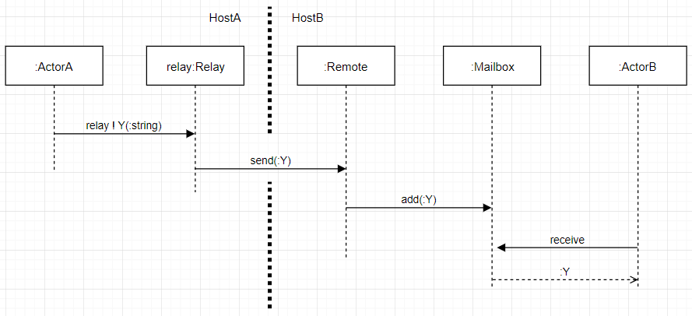
Sending, receiving messages

Slide 14
Actor act method
Invoked automatically on actor construction.
Typically in act, invoke receive.
receive method (inherited from Actor) retrieves message from mailbox when it arrives.
I.e., receive is blocking -- it waits.
Then, decode message using match stt.

Slide 15
Actors: declaring / instantiating
Extend Actor
Override act
Do new on Actor subclass
Control transfers immediately to act
Invoke receive-match

Slide 16
Sending (local) messages
Instantiate a case class instance, m.
Instantiate a target actor, b.
Send message, m, to actor, b, as: b ! m

Slide 17
Sending (remote) messages
Same as local message except also...
Message, m, must be Serializable.
Better a Serializable case class.
Instantiate Relay actor with host:port -- send m to this actor.
On remote host: instantiate actor, b, bound to an instance of Remote actor with port.

Slide 18
Sending replies
In receive-match scope…
sender!m
Note: sender is a keyword in LAST system.

Slide 19
Example: perfect numbers
Over next few weeks…
We define perfect numbers.
Develop serial T₁ algorithm.
Develop scale-up T_{N} algorithm.
Develop scale-out T_{N} algorithm using DW backed by remote actors.

Slide 20
Perfect numbers
Def. a number is perfect if sum of factors equals number
6 is perfect since 1+2+3 == 6
28 is perfect since 1+2+4+7+14 == 28
Sum of factors × 2, we include number itself
See here for the list of perfect number.

Slide 21
PerfectNumberFinder.scala ¹
Uses a higher-order function, ask. ²
It invokes the perfect number predicate
Handles reporting:
true/false Δt (or T₁)
1. Find this code in the package parascale.future.perfect.
2. This HOF is in the “package object”, perfect, also in parascale.future.perfect.

Slide 22
Perfect number predicate: isPerfect
Returns true if number perfect; false otherwise
Invokes sumOfFactors: returns sum of factors
Checks if sum of factors == 2 * candidate
Why 2*?

Slide 23
Parallel perfect number finder
Why is this problem good to parallelize?
We can divide and conquer. How so?
Assign each worker range.
Worker does partial sum of factors in its range.
Dispatcher sums the partial sums.

Slide 24
Parallel perfect number finder
Similar to multiply-add example. How so?
We replace multiply with partial sum finder.
Add operation we can do serially or parallel, depending…
How many ranges there are.

Slide 25
Summary
Actors are concurrent objects.
Actors communicate via message passing.
Received messages processed in single-threaded loop
Messages processed in order received
Sender does not wait for receiver to process message.
LAST actors backed by threads.
LAST actors support scale-up and scale-out.

Slide 26
Tasks to do this week
Work on forum question #4 in Piazza.
Complete Lab #4.
Start Project Assignment #1.
due this week -- see Assignments in iLearn.

Slide 27
Next time
Futures

Slide 28
Sockets
Layer 4 (transport) in OSI stack
IP address & port number
Full-duplex: each socket has pair of streams
InputStream & OutputStream -- byte-oriented
Each stream is half-duplex

Slide 29
Server sockets
Waits for inbound connection
On connection accept, returns a client socket.
Requires only a port number. Why?
App binds to a port -- no other app can use it.
Ports 0-1023 so-called “well-known”
Ports may not be permissioned for security

Slide 30
Client sockets
Initiates an outbound connection
Requires IP address & port
If connection accepted by server…
Depending on app…
Client gets output stream to transmit data or
Client gets input stream to receive data or
Both

Slide 31
Serialization
Converts Java object to byte stream
Class must be serializable
Members variables must be serializable
Only member variables deep-copied
Bytecode not serialized.
All references lost
Popular formats: POJO, JSON, XML

Slide 32
Deserialization
Reconstitutes object data from byte stream
All references reconstructed anew for that JVM
Receiving side requires:
Identical Java .class structure
.jar or class folder in JVM classpath

