Slide 1
Parallel Processing
Futures and Promises
Ron Coleman, Ph.D.

Slide 2
Learning objectives for this week
Introduce futures

Slide 3
Actors
Strengths | Weaknesses
Supported by mathematical theory | High latency
Shared nothing, unlike threads | Nonfunctional ¹
Scalable-up or -out | Complex to set up.
1. Here and here are two criticisms of actors. Discussion that includes these is here.

Slide 4
Futures
Invented in 70s & 80s; see Wikipedia.
Exists in many languages.
Def. proxy for result initially unknown
Proxy starts immediately upon creation.
Appeared in Scala after release 2.10
Effective replacement for Scala (local) actors.

Slide 5
Futures & promises
Go hand-in-hand
Promise: defines a result (type) -- settor
Future: fulfills promise at future time -- gettor
Single promise could be satisfied by different possible futures.

Slide 6
Await class
Specifically designed for three things:
Implicitly creates Promise.
Synchronizes Future completion. Like join on a child thread.
Unwraps the Future.

Slide 7
Example #1
parascale.future.basic.Example1.scala
object Example1 extends App {
val f = Future {
sleep(500)
1 + 1
}
val result = Await.result(f, 1 second)
println(result)
sleep(1000)
}
Starts the future: Future[Int] delivered in 500 ms.
Waits for Future[Int]; implicitly creates a promise for f; & unwraps Future[Int] → Int
After ½ sec when Future arrives, outputs 2.

Slide 8
Example #2
parascale.future.basic.Example2.scala
Creates a collection of 5 Future instances, all running in parallel.
object Example2 extends App {
val futures = for(i <- 0 until 5) yield Future {
sleep(1000)
i
}
futures.foreach { future =>
val result = Await.result(future, 100 seconds)
println(result)
}
def sleep(n: Long): Unit = Thread.sleep(n)
}
Waits for futures to arrive nondeterministically and outputs results.

Slide 9
Scheduler
Scala runtime scheduler manages future pool.
But...to help scheduler we do one of two things:
Limit future creation...
Algorithmically
To number of cores

Slide 10
May be wondering...
What if the next future we wait for isn’t finished while another is? Doesn’t that extend our runtime?
No. Why not?
Suppose future A takes 1 s, B takes 2 s.
Waiting [A, B]= 2 s vs. [B, A] = 2 s
All futures running concurrently

Slide 11
Future waiting sequence
2
2
A already finished
B
B
1 s to wait for B
1
1
Time
A
A
A → B
B → A

Slide 12
Future perfect number finder
Partition 0
Partition 1
Partition k-1
1 2 3
n-1 n
...
RANGE
Future 0
Future 1
Future k-1
...
Partial sum of factors
+
Sum of partial sum of factors

Slide 13
Future PNF code
Algorithm on prior slide found in package:
parascale.future.perfect
See FuturePerfectNumberFinder.scala
Study this code.
Notice it uses ask -- remember that HOF?
Next couple slides look at aspects of algorithm.

Slide 14
RANGE
FuturePerfectNumberFinder.scala, line 40
For large perfect nums.
Small RANGE => too many partitions
Large RANGE => too few partitions
Let’s try RANGE = 1000000L
I.e., 1 million

Slide 15
Number of partitions
FuturePerfectNumberFinder.scala, line 42
numPartitions = ⌈ n / RANGE ⌉
What is numPartitions if n = 6?
n=100,000?
n=33,550,336?
n=8,589,869,056?
How could we use a dynamic RANGE?

Slide 16
Example, k values
FuturePerfectNumberFinder.scala, line 44
candidate=2,000,100; RANGE=1,000,000 =>
numPartitions = 3
partition k | lower limit | upper limit
0 | 1 | 1,000,000
1 | 1,000,001 | 2,000,000
2 | 2,000,001 | 2,000,000

Slide 17
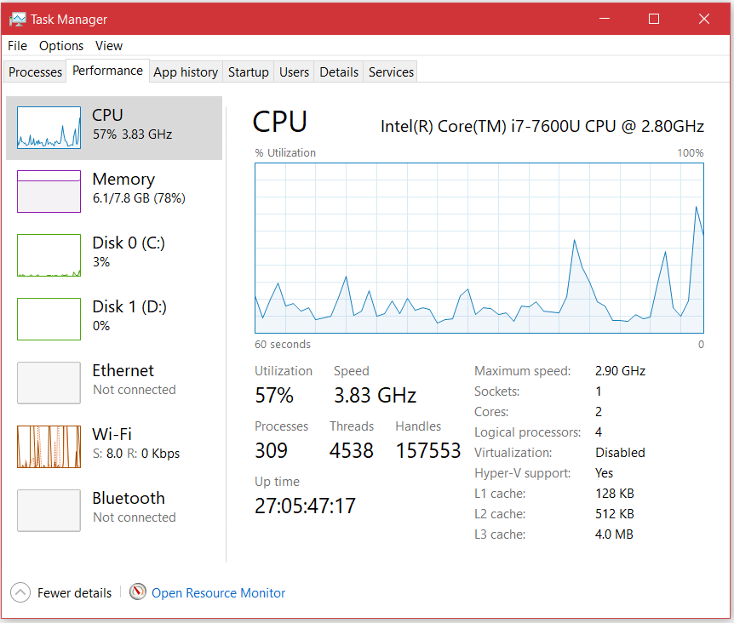
Testing platform
Assume N=..

Slide 18
PNF speedup calculations
Candidate | Perfect | T₁ | T_{N} | R | e
6 | YES | <0.01 | 0.53 | - | -
28 | YES | <0.01 | 0.01 | - | -
496 | YES | <0.01 | 0.01 | - | -
8128 | YES | <0.01 | <0.01 | - | -
33550336 | YES | 0.55 | 0.23 | 2.39 | 119%
33550337 | no | 0.72 | 0.27 | 2.67 | 133%
8589869057 | no | 75.76 | 37.43 | 2.02 | 101%
8589869056 | YES | 73.65 | 33.23 | 2.22 | 111%
137438691328 | YES | 1421.13 | 553.48 | 2.57 | 129%

Slide 19
How can we go even faster?
Need to scale out. Why?
Futures don’t cross hosts. What does?
Use the DW model. How so?
Dispatcher actor calculates partitions.
Transmits partition to workers
Worker sub-partitions and uses futures

Slide 20
Two worker, multi-host config
Dispatcher
Partial(sum, T1)
Partial(sum, T1)
Range
Range
partial sum, T1
Worker 0
Worker 1
1→n/2
n/2+1→n
Future 0
Future m-1
Future m
Future k-1
...
...
Host A
Host B

Slide 21
LAST actors
Contains DW pattern for distributed actors.
It does not know about perfect numbers!
Extend Dispatcher → PerfectDispatcher
Extend Worker → PerfectWorker

Slide 22
Summary
A Promise defines a type
A Future delivers a type
Await implicitly creates Promise given a Future
Await waits for Future arrival
Await unwraps the Future type
Future PNF partitions number range--one Future / partition
Each Future in PNF finds only partial SOF for its partition.
Await in Future PNF sums the partial sums

Slide 23
Tasks to do this week
Work on forum question #5 in Piazza.
Complete Lab #5.
Complete Project Assignment #1.
Note: midterm exam Week 7; see online for more details.
due this week -- see Assignments in iLearn.

Slide 24
Next time
Parallel collections

