Slide 1
Parallel Processing
Concise Intro to Scala
Ron Coleman, Ph.D.

Slide 2
Learning objectives for this week
Introduce basic features of Scala

Slide 3

Concise introduction
Edward Scissorhands
Scala is a large, complex JVM language
Remove lots of boilerplate code.
Yet deceptively simple, permissive syntax, e.g.,
Happy with but does not need “;”
Ditto for “.” (dot)
Often no need for variable names

Slide 4
Start here
There are lots of books on Scala.
Most are large and complex.
Matuszek is concise and free.

Slide 5
Scala (REPL)
Run Execute Print Loop
The Matuszek assumes REPL.
Download Scala command here.
Scroll to “Other ways to install Scala”
Then “Download the Scala binaries”
Install binaries.
Invoke “scala” command
For Windows .msi; for osx, .tgz

Slide 6
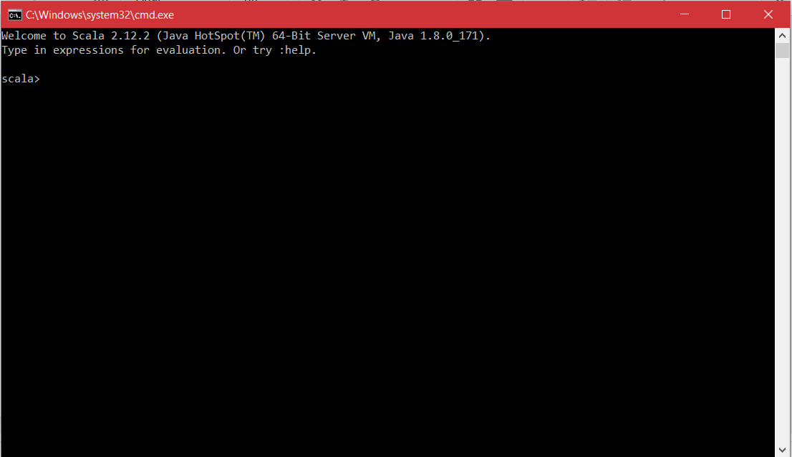
Scala command

Slide 7
IntelliJ
See Lab 1 for installation instructions
Use for Scala development.
Writing code
Testing
Debugging
Project assignments

Slide 8
Scala features
Object vs. class
Identifiers
Declarations
Data types
Collections
Higher-order functions

Slide 9
Scala concurrency
Supports four models of concurrency:
Java threads
Actors (via Akka)
Futures & promises
Parallel collections

Slide 10
Source
Scala files end in .scala.
Unlike Java, file name does not have to be name of class.
E.g., HelloWorld.scala could also be A.scala.
object HelloWorld extends App {
println("Hello, World!")
}

Slide 11
Identifiers
Names just what you expect…
Must start with _ or alpha-character
Can follow with alphanumeric.
No $, @, {, }, etc.

Slide 12
Operators
+, -, *, /, !, &&, || ==, +=, new, etc.
Not supported as you expect: --, ++
= is statement, not an operator!

Slide 13
Literals
5, 99, 3.14, true, false, etc.
“hello”, ‘hola’, “””bonjour”””, `नमस्ते`

Slide 14
Variable declarations
Must be var or val.
var => can be reassigned.
Discouraged, why?
val => cannot be reassigned.
Preferred

Slide 15
References
No primitive types (e.g., int, long, etc.)
Only Int, Long, Double, String, etc.
null (discouraged)
Any, AnyRef--general reference like Object in Java

Slide 16
Static type inference
“Static” => determined at compile-time
“Inference” => Compiler figures out type
But...you can specify type.
Discouraged, why?
val index1 = 1 // Encouraged
val index2: Int = 2 // Permitted but discouraged

Slide 17
Collections
Scala has many standard collections.
Mutable and immutable types
Ordered: Array, Vector, Iterator, Seq, List, etc.
Non-linear: Map, Tree

Slide 18
List
Most valuable in FP
Immutable -- once created cannot be modified
Why is this preferred?
Elements must be of same type
val lis = List(1,2,3,4)
// val lis: List[Int] = List(1,2,3,4)
// val lis = List(1,2,3,4,3.14) // is the type?
lis(0) = 99 // ERROR!

Slide 19
List construction
Notice anything?
No new
Can’t even invoke new on List!
It’s a factory method to make lists
Generally true for all collections

Slide 20
List manipulation
99 :: lis // prepends to list, creates new list
lis ::: lis2 // concats two lists, creates new list
lis ++ lis2 // same but concats any collection
E.g., lis ++ “hello” // List(1,2,3,4,h,e,l,l,o)

Slide 21
Some List functions
(n) => element at index n
length or size => list length
head => first element
tail => last element
reverse => reversed immutable copy
take(n) => first n elements as immutable copy
drop(n) => immutable copy without first n

Slide 22
List higher-order functions
Functions that take functions as arguments.
Consider map function
A member of List
Transforms (or maps) elements, each
Difference: takes another function to do map
Returns a new List with copied elements

Slide 23
Map example
val lis2 = lis.map { n => 2 * n } // lis2 is List(2,4,6,8)
But...where’s the function?
{ n => 2 * n }
Called lambda--an anonymous function object
map runs lamba & copy result into new List

Slide 24
Non-lambda map example
def mult2(n: Int) = 2 * n
val lis2 = lis.map (mult2)
// lis2 is List(2,4,6,8)
mult2 matches map signature reqs: def map(f: (A) ⇒ B): List[B]

Slide 25
Function chaining
You can connection functions together.
E.g., suppose wanted next to sum to elements
// val lis2 = lis.map { n => 2 * n } // val sum = lis2.sum
val sum = lis.map { n => 2 * n }.sum

Slide 26
Fold
A generic aggregation: very important!
Has two main parts:
Initial value
Function object with two parameters
Aggregation so far
Element of operation

Slide 27
List fold as sum
Simplest way to sum a list:
But...with fold:
val sum = lis.sum
val sum = lis.foldLeft(0) { (total, n) => total + n }

Slide 28
Fold left vs. right
foldLeft starts at left to fold -- preferred.
foldRight starts at right but recursively!
Why is foldRight NOT preferred?

Slide 29
Fold example: reverse
How do we write using foldLeft?
val nums_ = lis.reverse
Notes:
val nums = lis.foldLeft(List[Int]()) { (ns, n) => n :: ns }

Slide 30
Sort example: reverse
How do we write using sort?
def sortWith(lt:(A, A) => Boolean): List[A]
Notes:
val nums_ = nums.sortWith { (a, b) => a > b }

Slide 31
FOREACH function
Unlike map, foreach is void (aka Unit) returning
E.g., to output each element of a List:
lis.foreach { n => println(n) }
// lis.foreach(println(_))

Slide 32
FOR statement
Mostly what it looks like but not exactly.
No test, increment parts--just a collection.
FOR can yield a value -- very important!
// Output elements to standard-out
for(n <- lis) println(n)
// Output elements to another collection (lis2)
val lis2 = for(n <- lis) yield n

Slide 33
Comprehensions
yield says output value but...to a collection
Yield type depends on input collection
E.g., suppose wanted List of [0: 2,000) by 2
Going to type List(0, 2, 4, 6, …)?--NO!
You’ll use a Range type with comprehension.
exclusive

Slide 34
Comprehension example
val lis3 = for(n <- 0 until 1000) yield 2*n
// 0 until 1000 is a type: Range 0 until 1000
// You see, it looks like Java FOR but it’s not same
// lis3 type is Vector[Int]
How would you do same thing with map?
Notes:
Answer: (0 until 1000).map { n => n * 2 }

Slide 35
Objects
Contain static members
To run, it must have a main method:
object HelloObject { println("In object") def main(args: Array[String]) { println("In main") } }
Has same signature
as Java main method

Slide 36
Classes
Contain instance members
Objects & classes must be in same .scala file.
Constructor is the class itself!
Members by default public!

Slide 37
Class example #1
class Person(name: String, age: Int) { def getName(): String = { name } def getAge = age } val bugs = new Person(“Bugs Bunny”, 78) println(bugs.getName)
Boilerplate

Slide 38
Class example #2
class Person(val name: String, val age: Int) val bugs = new Person(“Bugs Bunny”, 78) println(bugs.name)

Slide 39
Class example #3
class Person(val name: String,val age: Int) { val PROLOGUE = “What’s up “ def greet(you: String) = println(PROLOGUE+you+”?”) } val bugs = new Person(“Bugs Bunny”, 78) bugs.greet(“Doc”)

Slide 40
Pattern matching
Like switch statement
Basic idea: match on objects
Numbers
Strings
User-defined case class

Slide 41
Case class
Like regular classes except…
Don’t require new to instantiate.
Can pattern match them -- very important!

Slide 42
Case class example #1
case class Person(val name: String,val age: Int) val bugs = Person(“bugs”, 107) val elmer = Person(“elmer”, 105) bugs match { case Person(n,a) => println(a) }

Slide 43
Case class example #2
case class Person(val name: String,val age: Int) val bugs = Person(“bugs”, 107) val elmer = Person(“elmer”, 105) bugs match { case Person(n,a) if n == “elmer” => println(a) case _ => println(“nobody”) }

Slide 44
Match
Works in sequence.
No “fallthrough”
Requires default case -- otherwise you’ll get match exception

Slide 45
Searching
Plays big role, especially databases.
Use find higher-order function.
def find(p: (A) => Boolean): Option[A]
Option instances: Some, None
Stops at first match.

Slide 46
Find example
E.g., suppose wanted find 3 in lis.
How do you write it?
lis.find { _ == 100} match {
case Some(k) =>
println("found "+k)
case None =>
println("none found")
}

Slide 47
What is find complexity?
Unsorted: O(n)
Sorted: O(log n)
Parallel: O(1)

Slide 48
Maps
Mutable & immutable (default) versions
What’s big-O complexity?
Key-value stored as 2-tuple: Tuple2
Like List except…
1. exactly two
2. Returned as single object
2. Referenced using ._1, ._2

Slide 49
Maps
val a = Map("AL" -> "Alabama") a(“AL”) a(“FL”) // Error a(“FL”) = “Florida” // Error a.getOrElse(“FL”,”Florida”) val b = a + ("AK" -> "Alaska")

Slide 50
Iterating through map
b.foreach { e => val (k, v) = e // Each element a 2-tuple println(k+” “+v) // println(e._1+” “+e._2) } val asList = b.toList // List of 2-tuples Val asList.foreach { e => val (k, v) = e println(k+” “+v) }

Slide 51
2-Tuples
val tup = (1, “hello”)
tup._1 // 1
tup._2 // “hello”
val (i, s) = tup
i // 1
s // “hello”
val (j, _) = tup

Slide 52
Summary
Scala blends object and functional styles
A JVM language, it can use Java libraries.
REPL useful for scripts, experiments, etc.
val preferred over var.
Type inference preferred over type declaration
List is the most important collection.

Slide 53
Tasks to do this week
Do homework #1.
Work on forum question #2 in Piazza.
Complete Lab #2
due this week -- see Assignments in iLearn.

Slide 54
Next time
Threads

