Slide 1
Parallel Processing
Threads
Ron Coleman, Ph.D.

Slide 2
Learning objectives for this week
Introduce Scala threads

Slide 3
Threads
Large, diverse topic
Affects many system aspects from…
Hardware design to web design
Different implementations

Slide 4
Thread definition
Def. Single stream of execution
Hyperthreads => managed by hardware/OS
Green threads => managed by JVM
Basis of all JVM parallelism: threads underly…
Actors, futures, parallel collections

Slide 5
Threads pros & cons
Upsides:
Very easy to start: can scale-up
Portable wherever there’s a JVM.
Downsides:
Dependent on shared memory
Can’t cross JVM boundaries: can’t scale-out

Slide 6
Communication
Threads must share info -- eventually.
App not done until all its threads finish.
Leads to need for synchronization.
E.g., need to wait for thread to finish work and send back results

Slide 7
Synchronization & tradeoffs
Method | Upside | Downside
Polling | Simple | Inefficient
Semaphores ¹ | Efficient | Unstructured
Message passing | Elegant | Costly: high communication latency
Callbacks | Cheap | “Who’s calling?”, “Why?”
1. Method used inherently by JVM; all other methods coded by programmer or Java library.

Slide 8
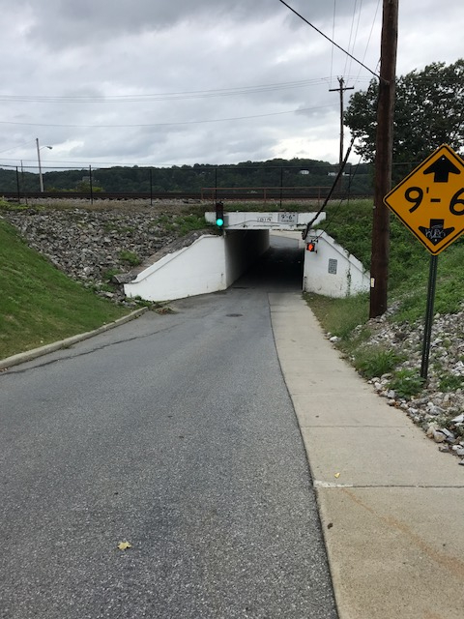
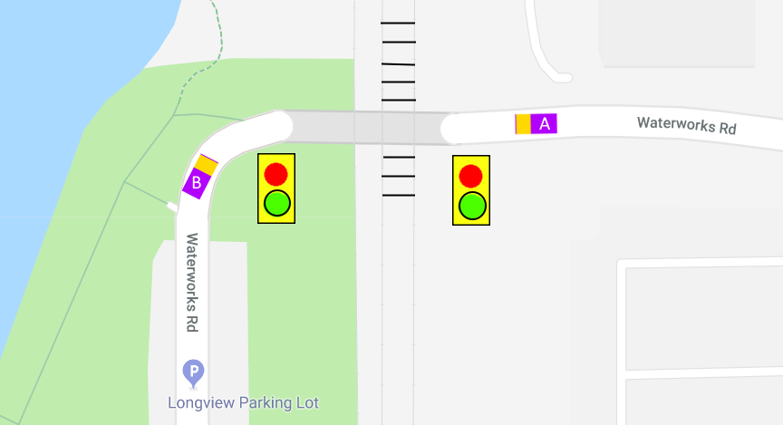
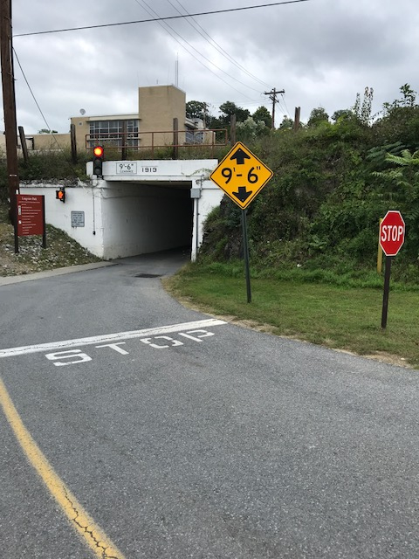
Semaphore
Real world
Marist campus

Slide 9
Tunnel
Allows exactly one car at a time
I.e., car requires mutually exclusive access
Tunnel called critical region

Slide 10

Lights
Called monitors.
Coordinated, spatially distributed
Failure could result in…
crash: race condition -- fail to obey monitor
lockout: deadlock -- stuck in red
Starvation: if green in one direction too long

Slide 11
Synchronization hazards
Too little results in:
Race condition
Too much results in:
Deadlock
Not enough CPU cycles results in:
Starvation

Slide 12
Definitions & symptoms
def. Race condition Correctness of program depends on relative speed of threads.
Symptom? Seemingly random results
Thread gains access to critical region unpredictably

Slide 13
Definitions & symptoms
def. Deadlock Thread needs resource it can’t access.
Symptom? Program appears to hang.
It’s waiting indefinitely.

Slide 14
Thread class
Imported directly from Java.
Extend Thread, override run
Create an instance, t
new Thread(t).start Forks control to run method.
Stops when run reaches} or return
Identical to Java

Slide 15
Runnable interface
In Scala “interface” called “trait”
Works same way…
Extend (rather than implement) Runnable.
Override run.

Slide 16
Synchronized methods
They’re just like the tunnel
Exactly one thread allowed to execute inside
All other threads block outside
Unspecified thread allowed in provided…
One inside exits OR
Waits

Slide 17
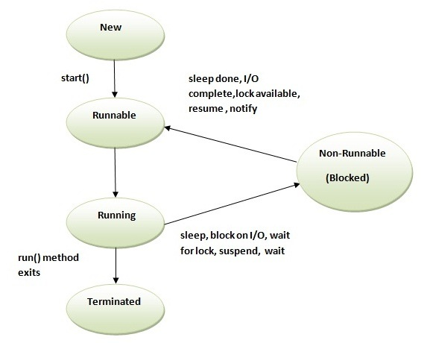
Thread life cycle

Slide 18
Sleep
Form of synchronization
Member of Thread
Can be invoked anywhere.
Causes thread to block for period
Eventually it awakens after timeout.

Slide 19
join method
Form of synchronization
Member of Thread
Blocks or waits for another thread to terminate
join waits indefinitely
join(long millis) -- waits no more than millis -- preferred. Why?
Notes:
Answer: avoids potential deadlock

Slide 20
wait
Form of synchronization
Blocks until awaked with notify.
Can only be invoked in synchronized method
wait waits indefinitely
wait(long millis) -- waits no more than millis -- preferred. Why?
Question: what do you do if timeout?
Notes:
Answer: wait(millis) -- avoids potential deadlock

Slide 21
Notify
Wakes up exactly one thread if one waiting.
Not buffered -- no memory
Can only be invoked inside synchronized block

Slide 22
Thread safety
def. method functions correctly for ≥1 threads concurrently
Two ways to guarantee:
Synchronize shared data structures.
Share nothing.
Use immutable data structures.
Make copies.
Strength of FP

Slide 23
Extend Thread or Runnable?
Which should we prefer?
Both work.
Notes:
Answer: extend Runnable -- it doesn’t use single inheritance

Slide 24
Consumer-producer
A classic concurrency problem
Universal in consumerist economy.
Ubiquitous in process engineering
Producer makes items, consumer buys them
They work in parallel
But...speeds not necessarily matched
Manufacturing, inventory/warehousing, transportation, call centers, etc.

Slide 25
Dispatcher-worker design pattern
Simple yet powerful
Inherently parallelizable
Answer to consumer-producer problems

Slide 26
1 dispatcher, N workers
D. organizes some task(s) & sends to Ws.
A buffer -- work queue -- between D-W
W. does task in order received & waits if its queue empty.
W. sends result to result queue
D. waits for all W. to finish

Slide 27
DW model
...
Tasks
D
Work queue: 1
2
N
...
...
...
W1
W2
WN
Result queue

Slide 28
Why queues?
Flow control
If D. is faster than W., queue is a buffer but…
queue MUST be thread-safe
Could use ListBuffer -- but not thread-safe
Instead use synchronized ListBuffer =>
a.k.a., Mailbox

Slide 29
Dispatcher design
Dispatching could become bottleneck
Tasks handed out merely reference work -- they are not the work themselves
They do not contain lots of data
In fact, want to avoid large data transfers, why?
Increased latency, for Amdahl’s law, increases s.

Slide 30
ParaScale project
Original Scala codes written by me
Two distinct but related packages:
ParaScala
ParaBond
We study these for remainder of semester

Slide 31
ParaScale package
Instructional codes
Demonstrates…
Threads, actors, futures, parallel collections
DW pattern

Slide 32

ParaBond package
Research codes
Demonstrates...
NoSQL database:
Bond portfolio valuation using scale-up -- parallel collections and mapreduce futures
1. As of 30 Jan 2019 according to KDnuggets, “Top NoSQL Database Engines,” MongoDB remains the dominant NoSQL database.

Slide 33
ParaBond extension
You’re going to scale-out ParaBond
Exploit DW using futures & remote actors
Need small cluster configuration -- TBD later

Slide 34
ParaScale thread code examples #1
See package: parascale.thread.basic
ParentWithThread.scala -- parent thread
ChildThread.scala -- child thread
Study ParentWithThread.
Run ParentWithThread to see results. ¹
1. Right-click on ParentWithThread.scala > Run

Slide 35
ParaScale thread code examples #2
See package: parascale.thread.basic
ParentWithRunnable.scala -- parent thread
ChildRunnable.scala -- child runnable
Study ParentWithRunnable.
Run ParentWithRunnmable to see results.

Slide 36
ParaScale thread code examples #1
See package: parascale.thread.basic
ParentWithThread.scala -- parent thread
ChildThread.scala -- child thread
Study ParentWithThread.
Run ParentWithThread to see results. ¹
1. Right-click on ParentWithThread.scala > Run

Slide 37
ParaScale thread code examples #2
See package: parascale.thread.basic
ParentWithRunnable.scala -- parent thread
ChildRunnable.scala -- child runnable
Study ParentWithRunnable.
Run ParentWithRunnmable to see results.

Slide 38
Summary
Threads are basis of all JVM parallelism.
Green threads managed by JVM.
Hyperthreads managed by hardware.
Starting threads is easy.
Synchronizing threads pose concurrency hazards.
DW is powerful pattern for parallel processing.
Actors are concurrent objects dependent on threads.
ParaScale codes used for instruction and research.

Slide 39
Tasks to do this week
Work on forum question #3 in Piazza.
Complete Lab #3.
due this week -- see Assignments in iLearn.

Slide 40
Next time
Actors

