Slide 1


VIDEO GAME SALES
BRENDA ZHU

Slide 2
The videogame industry has shown a great need for accurate sales data. This project aims to explore how a study of a variety of variables can help to predict the videogame sales.
- Our hypothesis is that the sales are related to publisher, platform, genre, critic score, or a combination of all of the above.
- Dataset includes more than 7000 games.
If this model can accurately predict game sales in 2016, such a model could prove useful to forecast sales in future years.

Slide 3

The Purpose of the Project:
Game company – keep track of competitors’ product sales
Investors – keep track of sales when planning investments
Publishers – effects of an advertising campaign
– budget effectively: study demographics
Additionally, if a game is a surprise success in its first weeks, its publisher may use this information to decide whether or not to order more copies from the manufacturer in order to meet consumer demand. An increase in the availability of sales data can be used by the industry when making these kinds of decisions.

Slide 4
VARIABLES IN THE DATASET
Name
Platform
Year_of_Release
Genre
Publisher
NA_Sales
EU_Sales
JP_Sales
Other_Sales
Global_Sales
Critic_score - Aggregate score compiled by Metacritic staff
Critic_count - The number of critics used in coming up with the Critic_score
User_score - Score by Metacritic's subscribers
User_count - Number of users who gave the user_score
Developer - Party responsible for creating the game
Rating - The ESRB ratings (ESRB: Entertainment Software Rating Board)

Slide 5






Slide 6

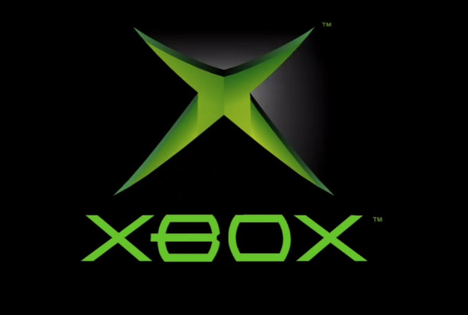



Main Platform

Slide 7
Hypothesis:
1. Does Critic score and video-game sales have any correlation, how significant is the impact
2. Based on the variables most correlated to hits, what 2019 games can still become hits

Slide 8
Risks or limitations:
There’re some missing values in the datasets for critic score, which directly related to our hypothesis. How to wisely handle the missing values could be a challenge for this study.
Data Source from Kaggle (https://www.kaggle.com/rush4ratio/video-game-sales-with-ratings)
we are making the assumption that the available sales data is accurate.

