Slide 1
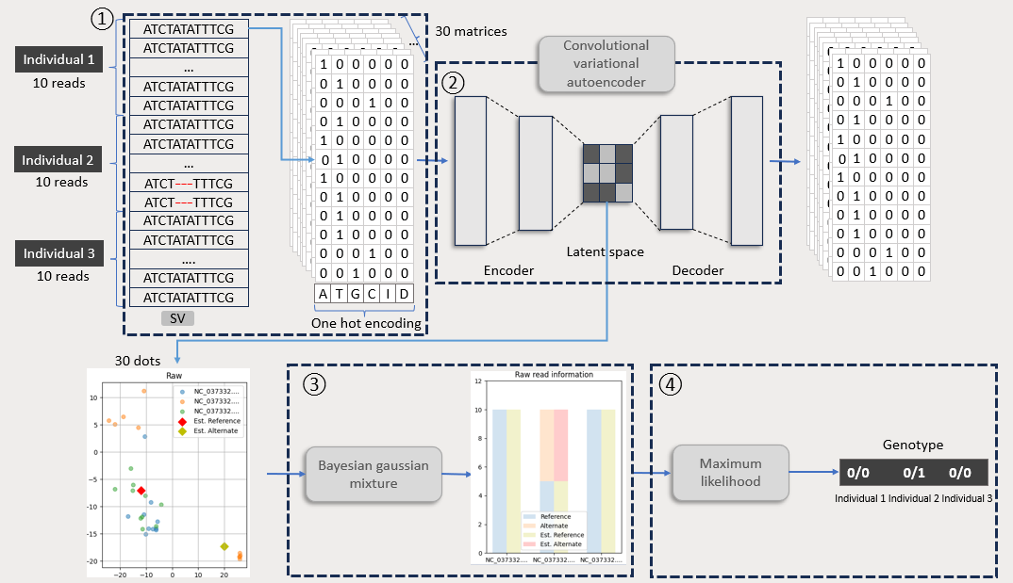
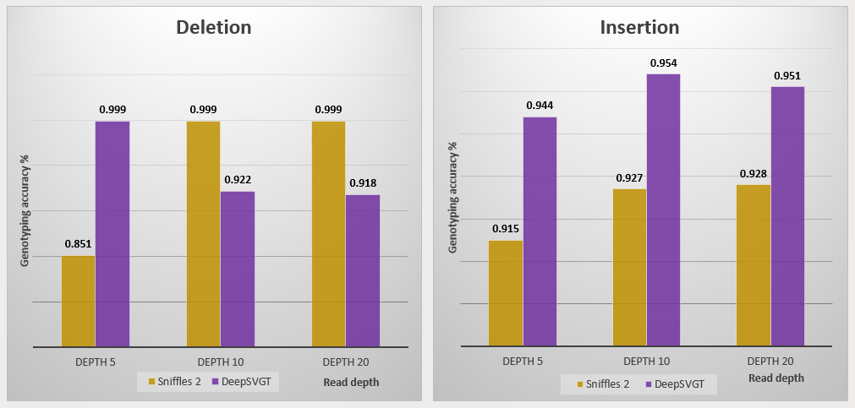

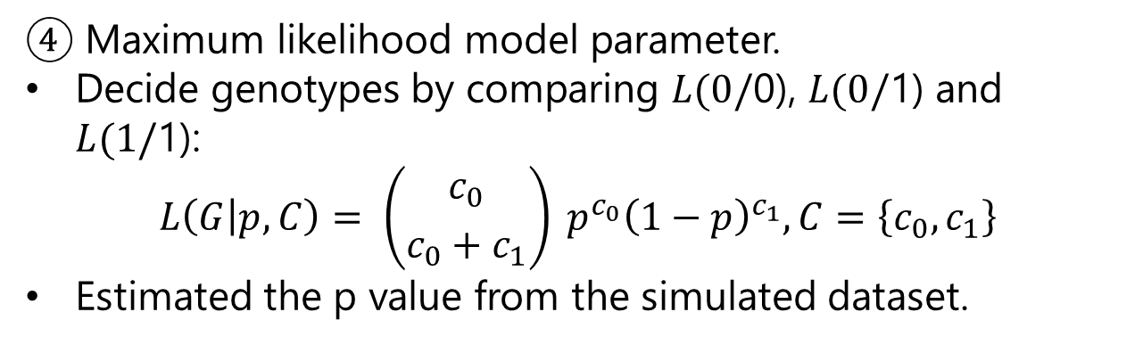
DeepSVGT: a tool for genotyping structural variation with long-reads, at population scale using deep learning
Brendan Jeon¹, Yoni Nazarathy², Elizabeth Ross¹
¹ Queensland Alliance for Agriculture and Food Innovation, The University of Queensland, St Lucia, QLD, Australia
² School of Mathematics and Physics, The University of Queensland, St Lucia, QLD, Australia
Introduction
Aim
Structural variation (SV) is one of the genetic alteration types commonly defined as over 50 base pairs in size and is categorised as deletions, insertions, inversions, duplications, and translocations.
Studies on SV have been revealing new aspects of disease risk, genome evolution, population diversity, and demographic history.
Machine learning (ML) and deep learning (DL) are widely applied to the analysis of complex, large data sets, such as biological data.
A limited number of tools dedicated to SV genotyping with long-read data have been developed in recent years. Especially, the demand for SV genotyping tools at the population level with a large sample size is rapidly increasing.
Use deep learning to improve the accuracy of SV genotyping at the population scale using long read sequencing.
Method
Figure 1: Illustration of the DeepSVGT's 4 steps for genotyping SV. 1) Convert long read sequences from multiple individuals into matrices. 2) Generate features in latent space using a convolutional variational autoencoder. 3) Clustering features with Bayesian gaussian mixture model 4) Estimate the genotype of SV with Maximum likelihood model.
Input: a variant file with SV in VCF format and samples' BAM file.
Output: individual genotype information for each input variant in VCF format.
Implemented in pysam, scikit-learn and PyTorch.
Key steps:
② Convolutional variational autoencoder.
Input read length is changeable.
Epoch is changeable depending on input read length.
The encoder and decoder have 2 layers.
④ Maximum likelihood model parameter.
Decide genotypes by comparing $L(0/$0), $L(0/$1) and $L(1/$1):
$$L\left(G | p,C\right)= \left({c_{0} \atop c_{0}+c_{1}}\right) p^{c_{0}}{\left(1−p\right)}^{c_{1}}, C=\left\{c_{0},c_{1}\right\}$$
Estimated the p value from the simulated dataset.
Simulation
Challenges
To assess the accuracy of DeepSVGT, simulated data that is generated with Sim-it (1) was used:
From the bovine genome, 3 samples were generated with read depths of 5, 10, and 20.
SV count: 1,000 for 1 sample.
Error profile: ONT error profile; alignment tool: Minimap2.
SV Heterozygosity: 70%, SV length: <10k, Read accuracy: 95%
Require optimal parameters for machine learning and deep learning models.
Compare the performance of DeepSVGT on the same real dataset, such as the HG002 individual, the son of the so-called Ashkenazi trio dataset, and the bovine trio dataset, to other genotyping tools.
In order to solve the optimisation challenge, consider replacing steps 3 and 4 with another fully connected deep network.
Figure 2: The genotyping accuracy of Sniffles2 and DeepSVGT for simulated data.
b.jeon@uq.edu.au
(1) Dierckxsens, N., Li, T., Vermeesch, J.R. et al. Genome Biol 22,
342 (2021). https://doi.org/10.1186/s13059-021-02551-4

