Slide 1
STEAM GAME RECEPTION
Most of the instrument failed.
What survived still answers something.
Three of sixteen categories cleared validation. A case study in sampling, validation, and refusing a convenient finding.
19 simulation games • 22,796 English reviews • 3,004 negative reviews
Brenden Andoseh | 2026
Notes:
[Sources]
- Portfolio_Projects/steam-game-reception/README.md
- Portfolio_Projects/steam-game-reception/outputs/denominators.csv
- Portfolio_Projects/steam-game-reception/outputs/coded_negatives.csv

Slide 2
QUESTION
The real question was whether generated stories fail differently
Not whether players dislike a game, but whether generation creates a distinct positioning risk.
FAMILIAR FAILURE
DISTINCT FAILURE
Bugs, grind, price, opacity, weak interfaces and shallow systems
Generated content that feels disjointed, impersonal or unearned
Personal stake
I am building a simulation game around generated lives. Motivated reasoning therefore belongs in the method, not in a footnote.
02
Notes:
[Sources]
- Portfolio_Projects/steam-game-reception/SCOPE.md
- Portfolio_Projects/steam-game-reception/CODEBOOK.md

Slide 3
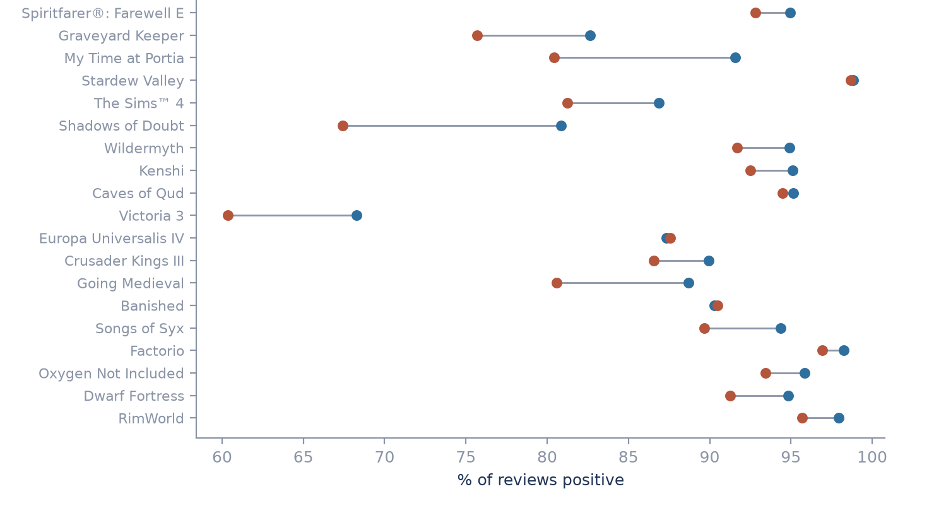
WHAT WAS ANALYZED
The sample is broad, but every inference is narrow
Purposive comparison set; equal-N latest reviews; game-level clustering.
Blue = lifetime positive rate • Orange = sampled positive rate
19
games
22,796
English reviews
3,004
negative reviews
The sample is not a population estimate.
03
Notes:
[Sources]
- Portfolio_Projects/steam-game-reception/outputs/denominators.csv
- Portfolio_Projects/steam-game-reception/outputs/coded_negatives.csv
- Portfolio_Projects/steam-game-reception/visuals/03_reconciliation.png
- Portfolio_Projects/steam-game-reception/SCOPE.md

Slide 4
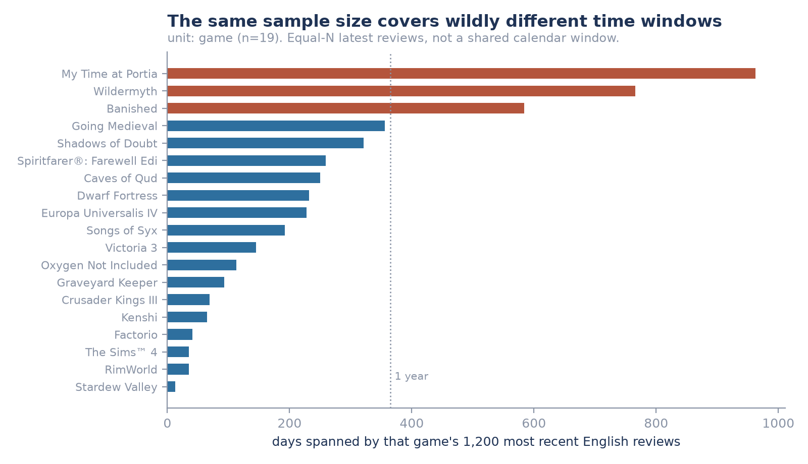
04
Notes:
[Sources]
- Portfolio_Projects/steam-game-reception/outputs/temporal_coverage.csv
- Portfolio_Projects/steam-game-reception/visuals/01_temporal_coverage.png

Slide 5
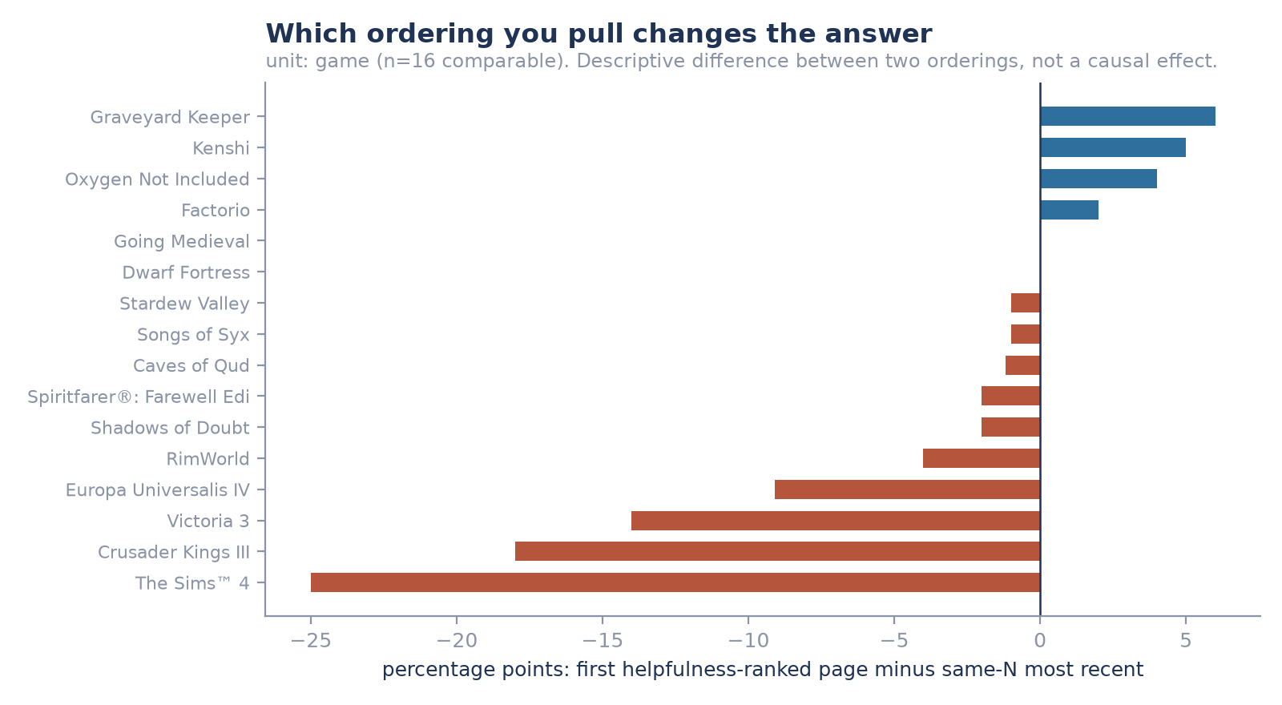
05
Notes:
[Sources]
- Portfolio_Projects/steam-game-reception/outputs/sampling_bias.csv
- Portfolio_Projects/steam-game-reception/visuals/02_sampling_bias.png

Slide 6
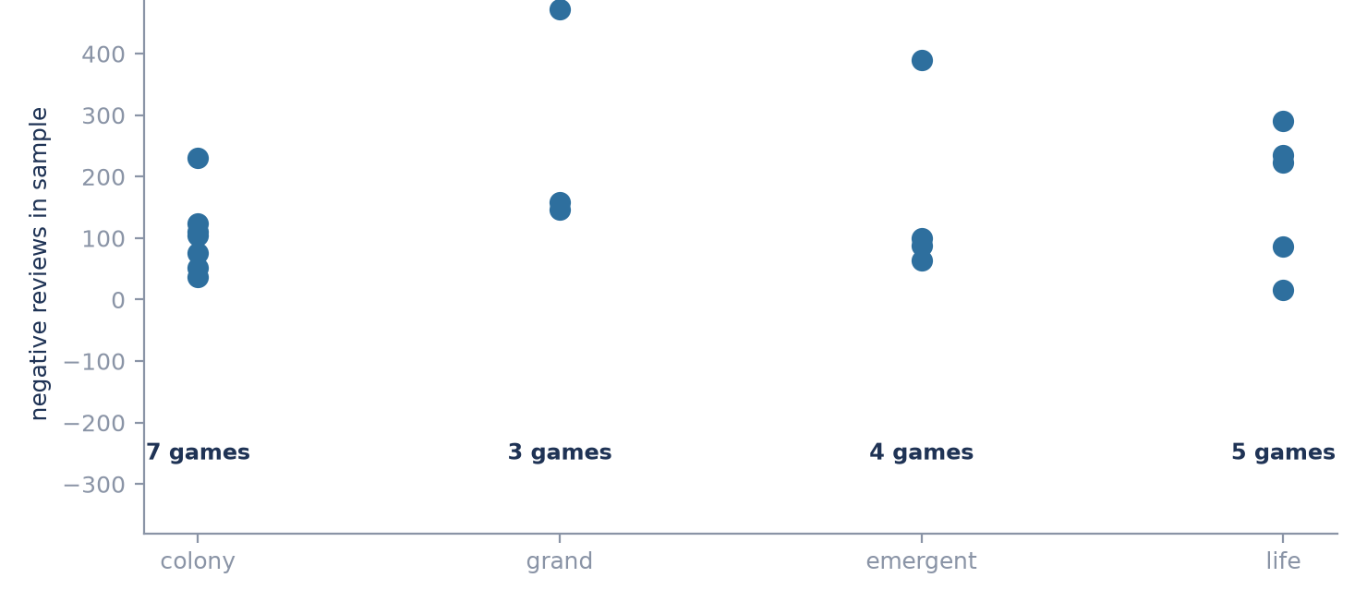
SAMPLING TRAP 3
Thousands of reviews still mean only 3 to 7 games per sub-genre
Unit: game. Pooled review-level tests would be badly overconfident and are not run.
06
Notes:
[Sources]
- Portfolio_Projects/steam-game-reception/outputs/comparison_set.csv
- Portfolio_Projects/steam-game-reception/visuals/04_clustering.png
- Portfolio_Projects/steam-game-reception/README.md

Slide 7
INSTRUMENT CHECK
My own coding confirms the codebook fails where meaning matters
Rule output compared against my hand-coding of all 150 held-out reviews.
Nine of sixteen categories have enough examples on both sides to judge. The other seven are too thin to call.
Category | Rule found | I coded | Precision | Recall | Combined | Verdict
Bugs and crashes | 30 | 38 | 0.800 | 0.632 | 0.706 | usable
Systems never explained | 15 | 12 | 0.600 | 0.750 | 0.667 | usable
Grind and tedium | 21 | 21 | 0.667 | 0.667 | 0.667 | usable
Lacks depth or variety | 14 | 44 | 0.857 | 0.273 | 0.414 | usable
Character behaviour | 19 | 6 | 0.158 | 0.500 | 0.240 | thin
Generated content feels hollow | 4 | 9 | 0.250 | 0.111 | 0.154 | thin
Outcomes feel arbitrary | 14 | 0 | 0.000 | — | — | thin
07
Notes:
[Sources]
- Portfolio_Projects/steam-game-reception/outputs/validation_metrics.csv
- Portfolio_Projects/steam-game-reception/outputs/reference_manifest.json
- Portfolio_Projects/steam-game-reception/src/12_metrics.py

Slide 8
CORE RESULT
The generated-content rule found one real case and missed eight
The keyword concentration cannot be read as evidence about what reviewers meant.
1
3
8
0.15
found correctly
wrongly flagged
missed entirely
combined score out of 1.0; too few cases to be conclusive
What changes
• This rule is rejected as a way of measuring meaning.
• Its per-game rates show where keywords fired, not what players meant.
• No conclusion about generated content survives version 1.
08
Notes:
[Sources]
- Portfolio_Projects/steam-game-reception/outputs/validation_metrics.csv
- Portfolio_Projects/steam-game-reception/CODEBOOK.md
- Portfolio_Projects/steam-game-reception/README.md

Slide 9
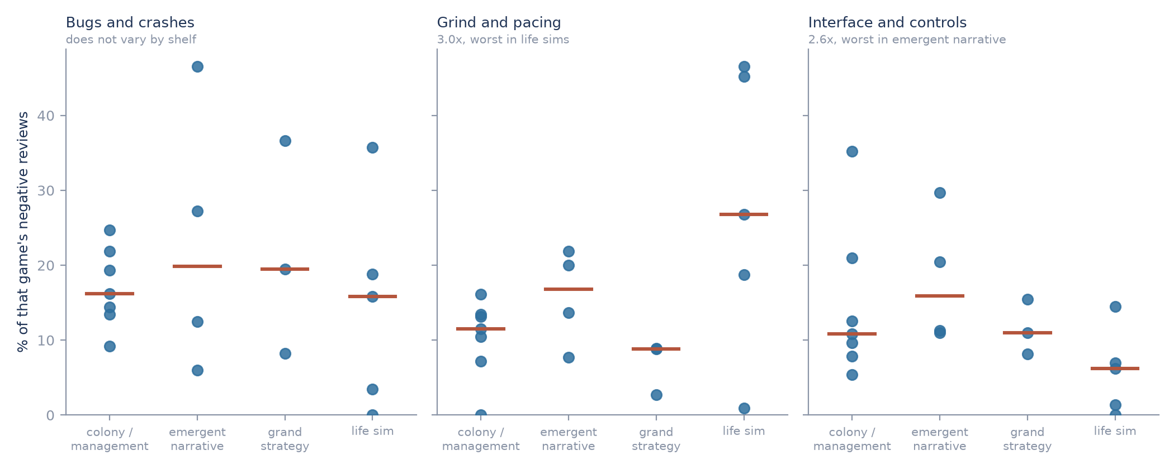
WHAT SURVIVED
Three categories held up, and they name the problem
Only bugs, grind and interface cleared validation. Unit is the game; rates understate, so read this as a ranking rather than levels.
BUGS
GRIND
INTERFACE
Flat across all four shelves (1.2x).
The price of entry, not a lever.
3.0x worse in life sims (27% vs 9%).
2.6x worse in emergent narrative.
Depth brings opacity.
09

Slide 10
WHY IT FAILED
The rules matched subjects, and missed how people actually complain
Two separate failures. Only one of them can be fixed by writing better rules.
31 of 150
22
32 of 44
reviews matched no rule at all
patterns never once fired correctly
depth complaints the rules missed
The clearest example
The word “random” fired 11 times and I agreed with none of them. In these reviews it means “randomly generated”, not “unfair”.
Matching the wrong word is fixable. Missing the words people actually use is not.
10

Slide 11
INDEPENDENT READING
A second reader disagreed with me on half of the 30 checked rows
This sets a realistic ceiling: careful readers agree about half the time.
15 / 30
50.0%
0.588
identical labels
of rows disagreed
overlap in labels used
Biggest disagreement
Grind complaints: I coded 1 of the 30 rows, the second reader coded 6.
Thirty rows, and the second reader is an AI, not a second analyst. Read it as a rough ceiling, not as validation.
11
Notes:
[Sources]
- Portfolio_Projects/steam-game-reception/outputs/codex_ai_spotcheck_summary.json
- Portfolio_Projects/steam-game-reception/outputs/codex_ai_spotcheck_agreement.csv
- Portfolio_Projects/ANALYST_OPERATING_SYSTEM.md section 13

Slide 12
CONCLUSION
Most of the instrument failed. What survived still answers something
What this work establishes, and what it still cannot.
ESTABLISHED
NOT ESTABLISHED
Sampling traps are measured
Codebook v1 is unreliable, and by how much
Sub-genre differences for the 3 validated categories
Freezing and blinding stopped any rescue after the fact
Prevalence for the 13 failed categories
Whether generation draws a distinct complaint
Anything resting on the failed categories
Positioning guidance beyond those three
Thirteen categories failed. The three that held up say the shelf picks the problem.
12
Notes:
[Sources]
- Portfolio_Projects/steam-game-reception/README.md
- Portfolio_Projects/steam-game-reception/CODEBOOK.md
- Portfolio_Projects/ANALYST_OPERATING_SYSTEM.md section 13

Slide 13
METHOD
The protocol made the failure visible before interpretation
Appendix: each phase leaves a frozen, verifiable artifact.
1
2
3
4
Pull + reconcile
Pre-commit split
Freeze v1
My own coding
API responses cached; denominators checked
Discovery and held-out IDs fixed before reading
Rules cannot be patched after seeing failures
Complete: 150 reviews coded blind, on full text
A manifest no one verifies is not a freeze. The verifier fails closed on every required manifest.
13
Notes:
[Sources]
- Portfolio_Projects/steam-game-reception/outputs/freeze_manifest.json
- Portfolio_Projects/steam-game-reception/outputs/split_manifest.json
- Portfolio_Projects/steam-game-reception/outputs/codebook_manifest.json
- Portfolio_Projects/steam-game-reception/src/verify.py
- Portfolio_Projects/steam-game-reception/src/test_gate.py

