Slide 1
BATTER UP
Brent Rossin (Giancarlo Stanton’s Agent)

Slide 2
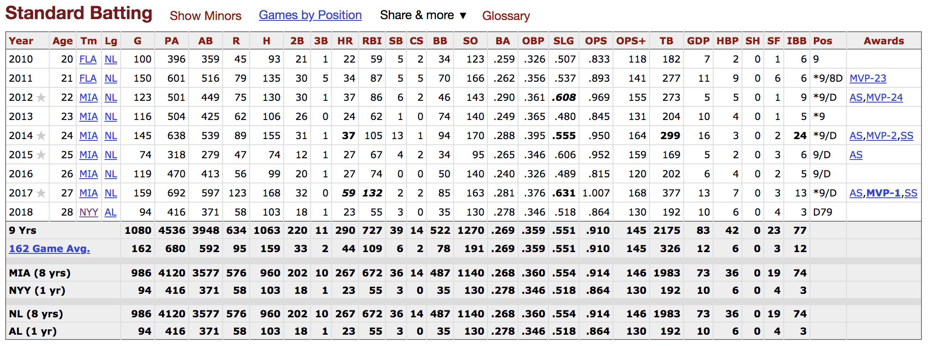
How much $$$ should you be making?
Scraped using BeautifulSoup and Selenium

Slide 3
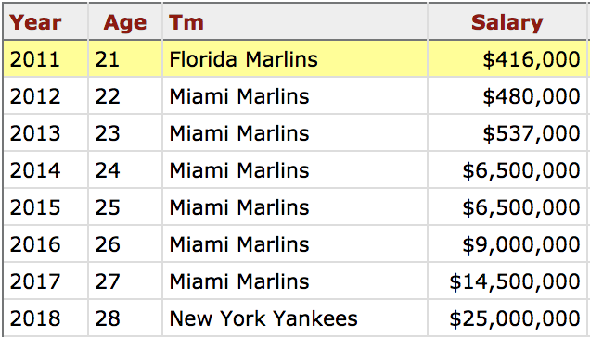
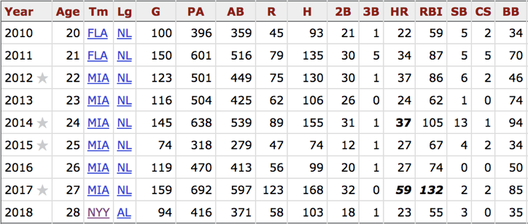
Statistics to look at
2018 Salaries
2011-2017 batting statistics

Slide 4
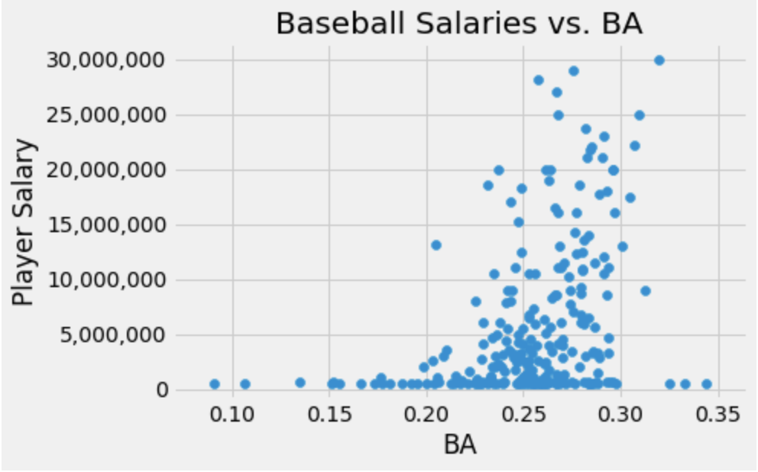
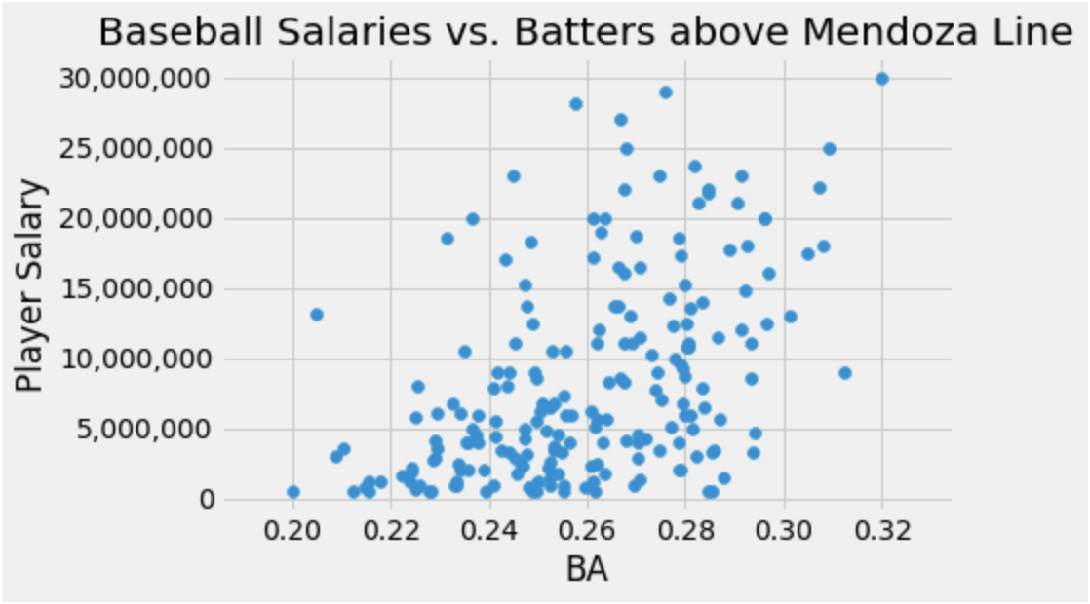
Picking the right players to model after
Pitchers are OUT!
NO ROOKIE CONTRACTS!

Slide 5
Factors impacting salary
Factors | Impact
OBP | Positive
Positional - DH | Positive
All Star Years | Positive
Positional – First Base | Positive
Positional – Second Base | Negative
dWAR | Positive
Age | Negative
RBI | Positive
Total Games Played | Positive

Slide 6
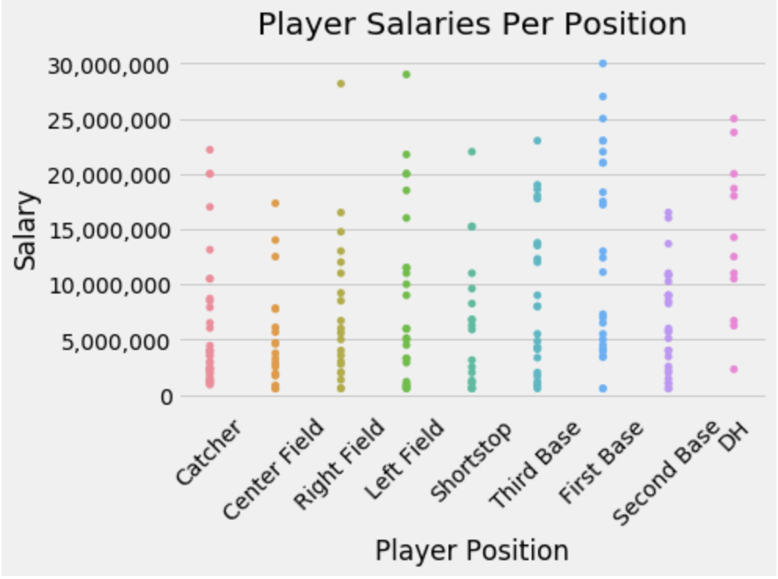
Positional Based Salary Variation

Slide 7
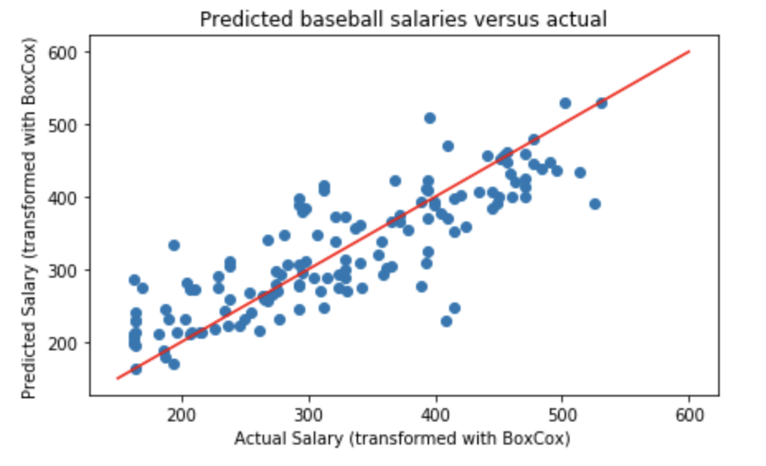
Understanding the Linear Regression model’s performance
Training set R^2, RMSE:
0.605
4,096,244
Test set R^2, RMSE:
0.528
5,639,591

Slide 8
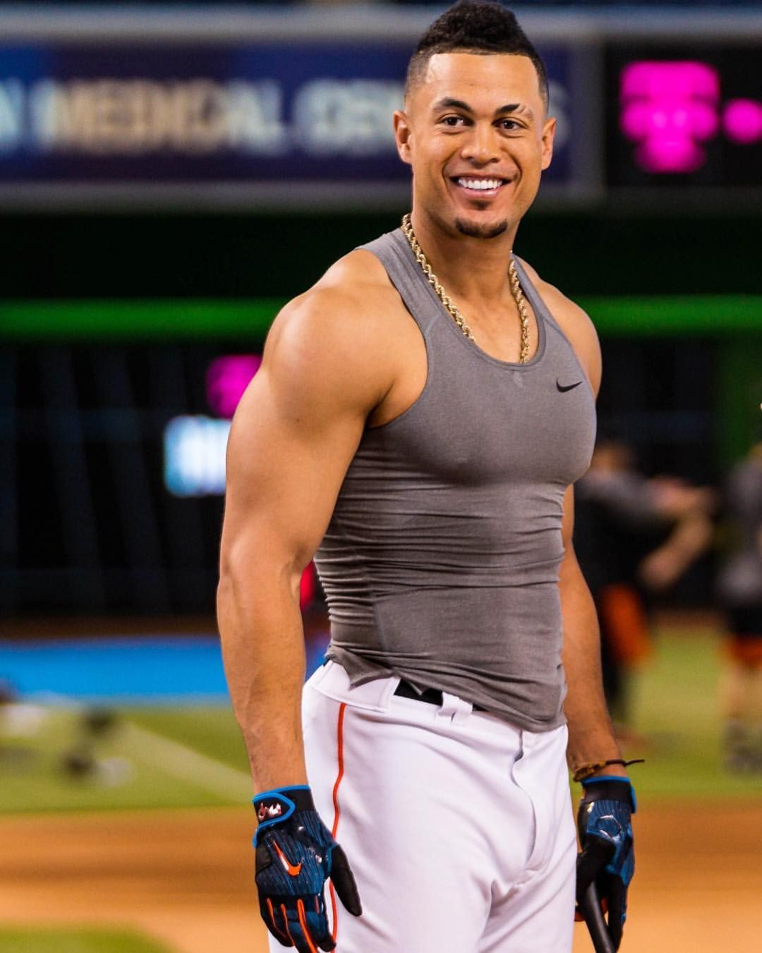
Reviewing your performance
Category | You | MLB Average
OBP | 0.361 | 0.325
RBI | 87.6 | 48.9
Years Named All Star | 4 | ~1
Games Played/Year | 126 | 94
Increase OBP by 100 points, make $3,920,000 more per year!

Slide 9


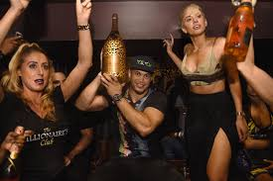
What are you really worth?
Category | 2018 Actual | 2018 Model Prediction
Salary | $25,000,000 | $29,848,072
3%

Slide 10
Future steps to improve model performance
Gather more data points
Perform analysis of scaled salaries of recent years
Gather more parameters to estimate based on in depth defensive statistics
Develop model for pitchers

