Slide 1

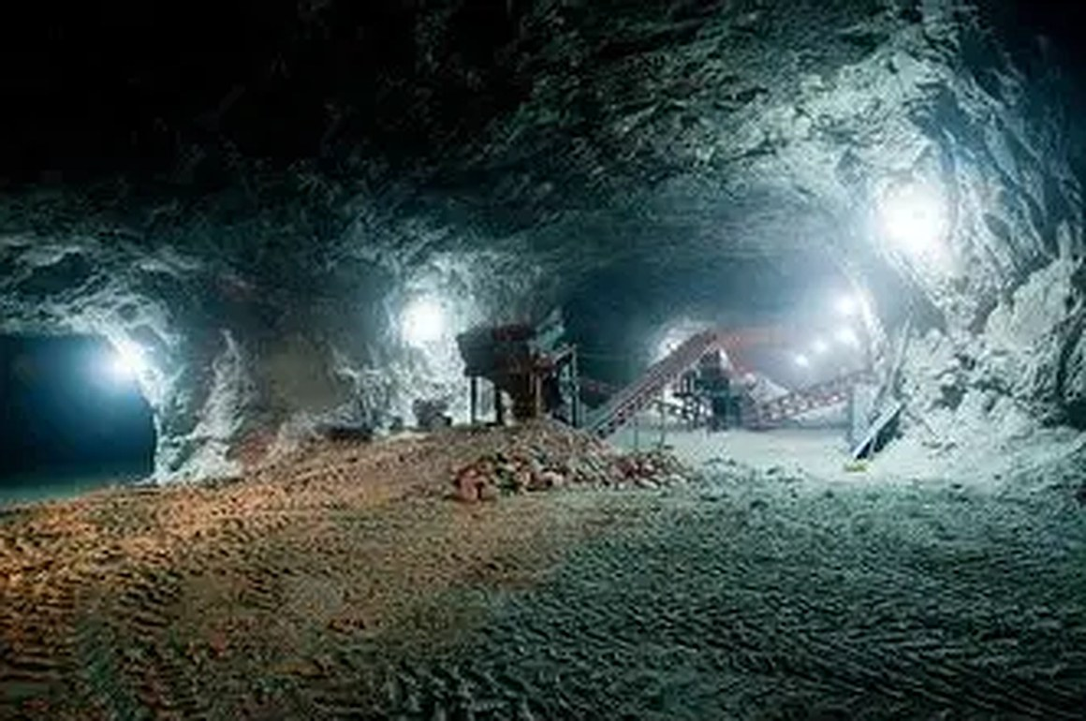
NDARAMA GRID
Commercial case
and pilot path
Business, investment and partnership opportunity
Current application imagery. Demonstration asset, not a live site feed.
MineTech Innovation Challenge Zimbabwe 2026
30 September 2026
Notes:
Sources: public/icon-512.png and public/cv-underground.jpg. The PitGuard image is an in-app demonstration asset, not a camera capture.
Prepared from repository files available in the workspace on 30 September 2026. No external market-size, customer, price, revenue, or investment figures were supplied. Any commercial framing is a hypothesis for validation.
Product scope and readiness: README.md, Android companion and GUI source.

Slide 2
The operating problem to test
The commercial case begins with a site workflow that is costly, frequent and poorly served by current tools.
Disconnected records
Weak connectivity
Unclear accountability
Safety checks, parcel custody and shift information can sit in separate records and handoffs.
Underground and remote work can make cloud-only workflows difficult to use consistently.
Operators need to know which record is current, who owns the next action and what evidence supports it.
Discovery question
Which single handoff creates enough time, risk or rework for a site to pay for a better local workflow?
02
Notes:
Product framing: README.md. The operational problem statements are discovery hypotheses and should be validated with mine operators and worker representatives.
Prepared from repository files available in the workspace on 30 September 2026. No external market-size, customer, price, revenue, or investment figures were supplied. Any commercial framing is a hypothesis for validation.

Slide 3
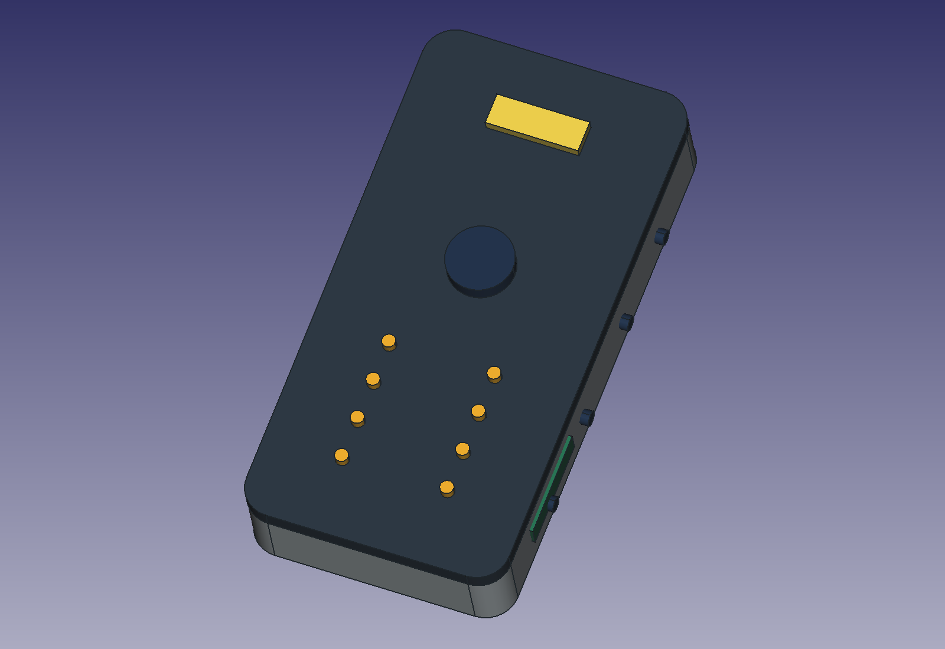
One local operations workspace
Ndarama Grid combines an on-site Edge Hub, a 12-window desktop interface and an Android companion.
THE PROPOSITION
Keep essential records available on site. Sync when the network is available.
PitGuard supports safety review. OreChain records parcels and custody events. Mesh queues messages. Copilot and operations screens support planning and site work.
SafetyTag image shows a prototype concept, not certified deployed hardware.
03
Notes:
Sources: README.md, Documentation/SafetyTag_Assembled.png, GUI and Android companion source. The tag shown is prototype concept artwork; no deployed or certified hardware evidence was supplied.
Prepared from repository files available in the workspace on 30 September 2026. No external market-size, customer, price, revenue, or investment figures were supplied. Any commercial framing is a hypothesis for validation.

Slide 4
Parcel verification workflow
Android camera reads a parcel QR value and checks the matching digital record through the PC Edge Hub.
01
Scan
Android reads the printed QR value.
02
Look up
The PC Hub searches its local parcel ledger.
03
Check
The Hub reports record and chain integrity.
04
Inspect
Receiver follows physical inspection and transaction procedures.
A valid digital check matches the stored record. It does not authenticate the physical contents, legal title or counterparty identity.
04
Notes:
Sources: Android QR lookup implementation and OreChain ledger documentation. Digital integrity checks do not prove the physical contents of a parcel.
Prepared from repository files available in the workspace on 30 September 2026. No external market-size, customer, price, revenue, or investment figures were supplied. Any commercial framing is a hypothesis for validation.

Slide 5
What the current product demonstrates
The software prototype provides a base for a controlled site pilot. Hardware and field performance remain open.
Desktop and local Hub
Local application, Edge Hub service, SQLite site records and a 12-window operations interface.
READINESS BOUNDARY
Prototype software
Concept hardware
No validated field deployment evidence supplied
Android companion
Connects to a PC Hub on the local network and submits a scanned parcel value for lookup.
Integrity workflow
Use safety outputs as decision support until devices, alert paths and site procedures pass qualified validation.
Stored records expose hash and signature checks for digital record verification.
05
Notes:
Sources: repository README, GUI, Android companion, Edge Hub and Documentation. No certified sensor, underground coverage, paid-customer, or audited financial evidence was supplied.
Prepared from repository files available in the workspace on 30 September 2026. No external market-size, customer, price, revenue, or investment figures were supplied. Any commercial framing is a hypothesis for validation.

Slide 6
Deployment architecture
A site computer hosts records and services. Phones connect over the trusted local network.
PC EDGE HUB
Desktop GUI
Local API service
SQLite site records
QR lookup and integrity check
ANDROID APP
SITE DEVICES
Local Wi-Fi
Site link
Camera scan
Local network client
Configured sensors
Radio and alert paths
The repository describes software paths for local access. Radio coverage, sensor calibration and safety response require field validation.
06
Notes:
Sources: Android companion, Edge Hub configuration and application documentation. Diagram shows the documented intended site arrangement; live hardware behavior remains unvalidated.
Prepared from repository files available in the workspace on 30 September 2026. No external market-size, customer, price, revenue, or investment figures were supplied. Any commercial framing is a hypothesis for validation.

Slide 7
Buyer and partner hypotheses
Start with people who own the workflow, the budget and the operating risk.
01
02
03
Mine operator or cooperative
Mineral buying centre
Mine services partner
May want simpler shift records, site coordination and safety workflow visibility.
May value parcel identity, custody history and checkable digital records.
May deploy, maintain and support site computers, devices or training.
Ask: who approves software and who carries the duty of care?
Ask: what evidence is accepted at handover and by whom?
Ask: what equipment and response commitments can the partner sustain?
07
Notes:
Potential segments come from product use cases in README.md and application windows. They are discovery hypotheses; no customer interviews or signed pilots were provided.
Prepared from repository files available in the workspace on 30 September 2026. No external market-size, customer, price, revenue, or investment figures were supplied. Any commercial framing is a hypothesis for validation.

Slide 8
Commercial models to test
Treat pricing, margins and renewal as questions until customer evidence exists.
01
Site software licence
Test willingness to pay for Hub access, updates and support.
Evidence before forecast
Paying pilot
Written scope and buyer
Delivery cost per site
Renewal or expansion signal
02
Deployment and training
Measure installation effort, training time and repeatability across sites.
03
Hardware and support
Price only after parts, certification, service and replacement costs are known.
No pricing or revenue data supplied.
08
Notes:
Candidate models are hypotheses derived from product scope. No prices, costs, revenue or customer commitments were present in the supplied project evidence.
Prepared from repository files available in the workspace on 30 September 2026. No external market-size, customer, price, revenue, or investment figures were supplied. Any commercial framing is a hypothesis for validation.

Slide 9
A staged route into the market
Progress only when the evidence answers the next decision.
01
02
03
04
Discover
Pilot software
Test devices
Repeat
Select one costly recurring handoff.
Run one site workflow under supervision.
Test intended sensors, alerts and network conditions.
Deploy again with a documented support package.
Pass: named owner and budget path.
Pass: uptime, completeness and time saved measured.
Pass: qualified site and safety sign-off.
Pass: delivery effort and buyer renewal signal known.
09
Notes:
Recommended validation sequence based on the project’s prototype status and open deployment dependencies. These are proposed gates, not completed milestones.
Prepared from repository files available in the workspace on 30 September 2026. No external market-size, customer, price, revenue, or investment figures were supplied. Any commercial framing is a hypothesis for validation.

Slide 10
What early investment should establish
Fund evidence that changes a go, revise or stop decision.
01
Customer discovery
Paid problem, buyer, procurement route and one bounded pilot scope.
02
Pilot operations
Installation plan, operator training, support ownership and usage measures.
03
Safety and engineering
Sensor calibration, alert testing, radio coverage and site procedures.
04
Commercial repeatability
Cost to deliver, service burden, buyer acceptance and renewal evidence.
Set budget and release tranches only after a partner, scope and decision measures are agreed.
10
Notes:
Recommended investment gates. Project evidence contains no funding ask, unit economics, runway, valuation or forecast.
Prepared from repository files available in the workspace on 30 September 2026. No external market-size, customer, price, revenue, or investment figures were supplied. Any commercial framing is a hypothesis for validation.

Slide 11
Diligence before a deployment decision
Separate software readiness from mine safety, data governance and support readiness.
BUYER
CONNECTIVITY
Who signs, pays and owns day-to-day use?
What are the measured underground coverage and recovery limits?
SAFETY
SECURITY
Which devices and outputs can influence a safety action?
Who manages users, tokens, backups and signing keys?
HARDWARE
COMMERCIAL
Who calibrates, repairs and replaces equipment?
What is the full deployment and ongoing support cost?
The repository demonstrates prototype software and conceptual hardware. It does not establish regulatory approval, certified sensing, safe underground coverage or audited business results.
11
Notes:
Readiness caveats drawn from repository documentation and current code. This slide is a diligence checklist, not a legal or mine-safety opinion.
Prepared from repository files available in the workspace on 30 September 2026. No external market-size, customer, price, revenue, or investment figures were supplied. Any commercial framing is a hypothesis for validation.

Slide 12
Ndarama Grid
The next decision is
a bounded pilot
Partner needed
One mine or buying-centre partner willing to test one operational workflow and define who owns the result.
Agree the workflow, site responsibilities, safe operating boundary and success measures before funding a larger rollout.
Discussion brief | 30 September 2026
12
Notes:
Requested next step is a proposed discovery and pilot discussion. No partner commitment or funding approval is implied.
Prepared from repository files available in the workspace on 30 September 2026. No external market-size, customer, price, revenue, or investment figures were supplied. Any commercial framing is a hypothesis for validation.

