Slide 1
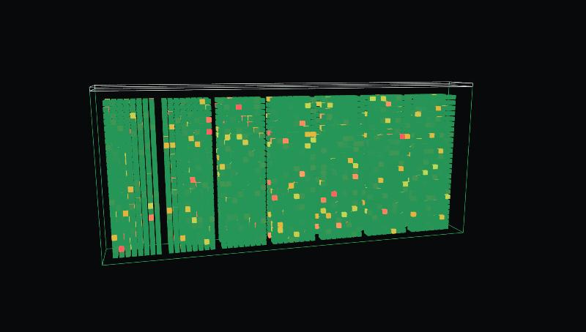
REON CHALLENGE · MIT ENERGY & CLIMATE HACK 2026
CELLSCAPE
REON’s savings, made visible. Simulate your battery and see exactly what cell-level control gives back.
Notes:
This is CELLSCAPE: REON's savings, made visible. Any battery owner can simulate their own fleet and see exactly what cell-level control gives back.

Slide 2


TEAM
Built by
Brendon Wu
Justin Lam
Computer Science, Stanford '29
Course 6-4, MIT '28
Notes:
I'm Brendon Wu, Computer Science at Stanford. I'm Justin Lam, Course 6-4 at MIT.

Slide 3
THE PROBLEM
Easy to claim, hard to price
WHAT A BUYER HEARS
WHAT A BUYER NEEDS TO SIGN
“2–3× more usable capacity”
“What is it worth for my fleet?”
A strong claim, but the same for every customer
In years of service, dollars and tonnes of CO₂
Battery owners approve purchases on spreadsheets. Without a number for their own fleet, the value of cell-level control stays invisible.
Notes:
Battery owners buy on spreadsheets. They hear claims like two to three times more usable capacity, but what they need before they sign is a number for their own fleet: how many more years, how many dollars, how much carbon. Right now, nobody shows them that, so the value of cell-level control stays invisible.

Slide 4
WHY IT MATTERS
At grid scale, weak cells cost billions
307 GWh
18–23%
≈$6–8B
of battery storage installed worldwide in 2025, about $36B of hardware
shorter pack life from cell-to-cell mismatch, measured in real fleets
of value lost from a single year of installs
BNEF 2025
NATURE ENERGY 2026
OUR ESTIMATE · $36B × 18–23%
Notes:
Now scale that up. The world installed 307 gigawatt-hours of grid batteries in 2025, roughly 36 billion dollars of hardware. A Nature Energy study this year found that cell-to-cell mismatch cuts pack life by 18 to 23 percent. That's six to eight billion dollars of value lost from a single year of installs, and every year we install more.

Slide 5
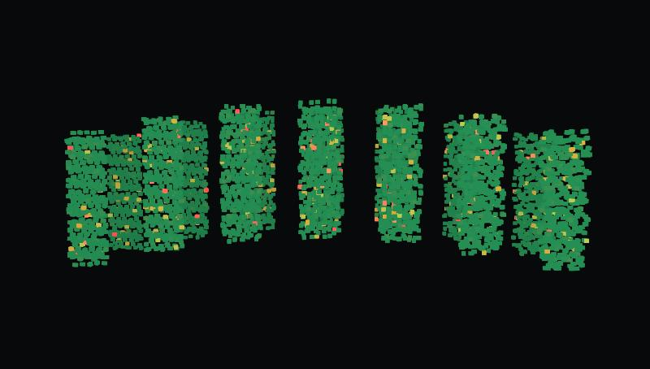
THE PRODUCT
Simulate your battery
Enter your fleet
Fleet size, years in service and how mismatched your cells are
See every cell
5,824 cells per REON CES container, fixed string vs REON control, over 20 years
Get your number
Years of service, augmentation capex, NPV and tCO₂ for your fleet
+1.5 yrs
$707k
+$302k
1,083 tCO₂
more service · 100 MWh fleet
capex avoided · 100 MWh fleet
added NPV · 100 MWh fleet
avoided · 100 MWh fleet
Notes:
CELLSCAPE gives them that number. You enter your fleet: how big it is, how long it has been running, how mismatched your cells are. It simulates every one of the 5,824 cells in each REON container over twenty years, with and without cell-level control. For a typical 100-megawatt-hour fleet, that's a year and a half more service, 700 thousand dollars of augmentation avoided, 300 thousand dollars of added value and over a thousand tonnes of CO2.

Slide 6
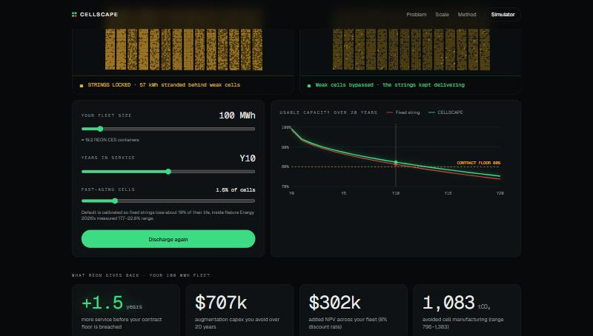
LIVE DEMO
Your battery, with and without REON
Try it
cellscape-beta.vercel.app
Enter your fleet size and years in service
Discharge: see what your weakest cells strand
Read what REON gives back for your fleet
Modeled, not measured. Every input is cited on the site.
Notes:
Here's a 100-megawatt-hour fleet, ten years in. We discharge both versions. With a conventional BMS, the strings lock up with energy stranded behind weak cells. With REON, those cells are bypassed and the strings keep delivering. And the owner sees exactly what that's worth for their own fleet. REON's savings, made visible.

