Slide 1


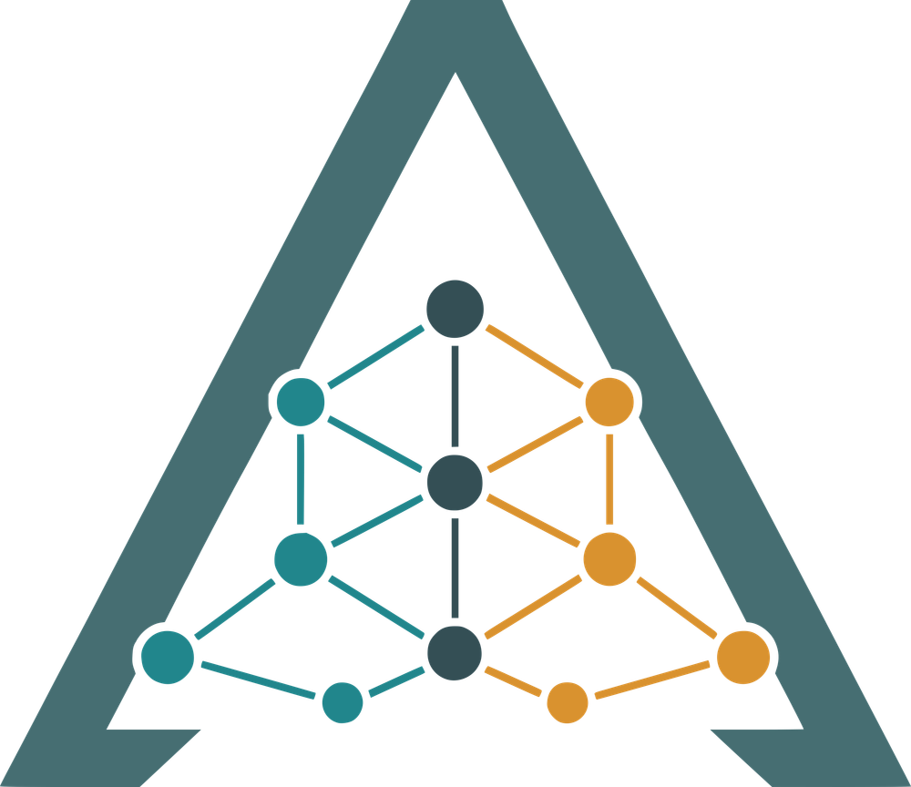
One question.
Answers from many sources.
One analyst question, answered across several security knowledge graphs that speak different query languages, with the record behind every sentence.
Olmo S. Zavala Romero, Principal Investigator · Brendon DGR, Technical Lead
Department of Scientific Computing, Florida State University
Ariadne
federated knowledge for cybersecurity
ReliaQuest Innovation Challenge · Challenge Three: Knowledge Graph Integration · October 19, 2026
1 / 13
Notes:
[0:15] Security knowledge lives in databases that do not speak the same language. Ariadne lets an analyst ask one question across all of them, and shows the record behind every sentence of the answer. I am Brendon, the technical lead; Olmo Zavala Romero is the PI. This is our ReliaQuest Innovation Challenge project from FSU Scientific Computing.

Slide 2

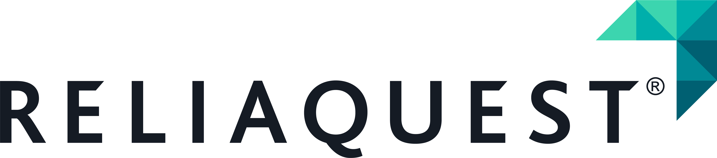
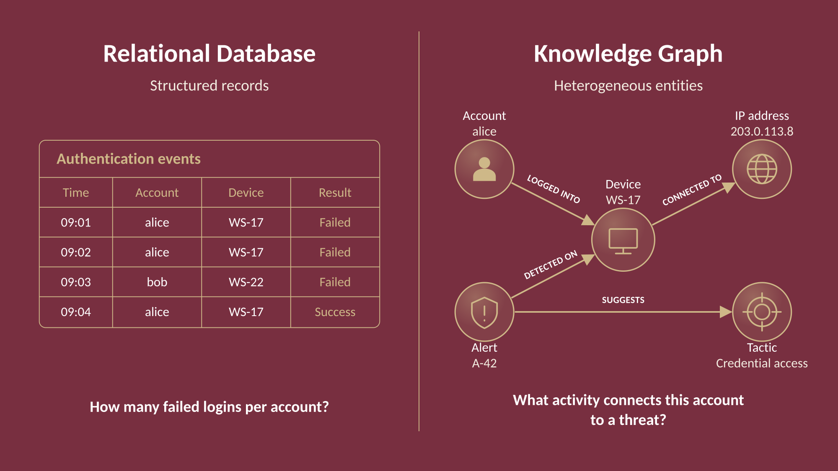
What is a knowledge graph?
1
Entities become nodes
an account, a device, an alert, a tactic
2
Connections are named
logged into · connected to · detected on · suggests
3
Questions become paths
follow the links instead of joining tables
A table answers "how many". A graph answers "what connects".
Figure: relational records vs. a knowledge graph, cybersecurity example.
2 / 13
Notes:
[0:25] A relational database keeps well-structured records in tables. It is very good at "how many failed logins per account". A knowledge graph stores entities as nodes and their connections as named relationships. It is built for "what connects this account to a threat". In security the second question is the one that matters, and it is a path, not a count.

Slide 3
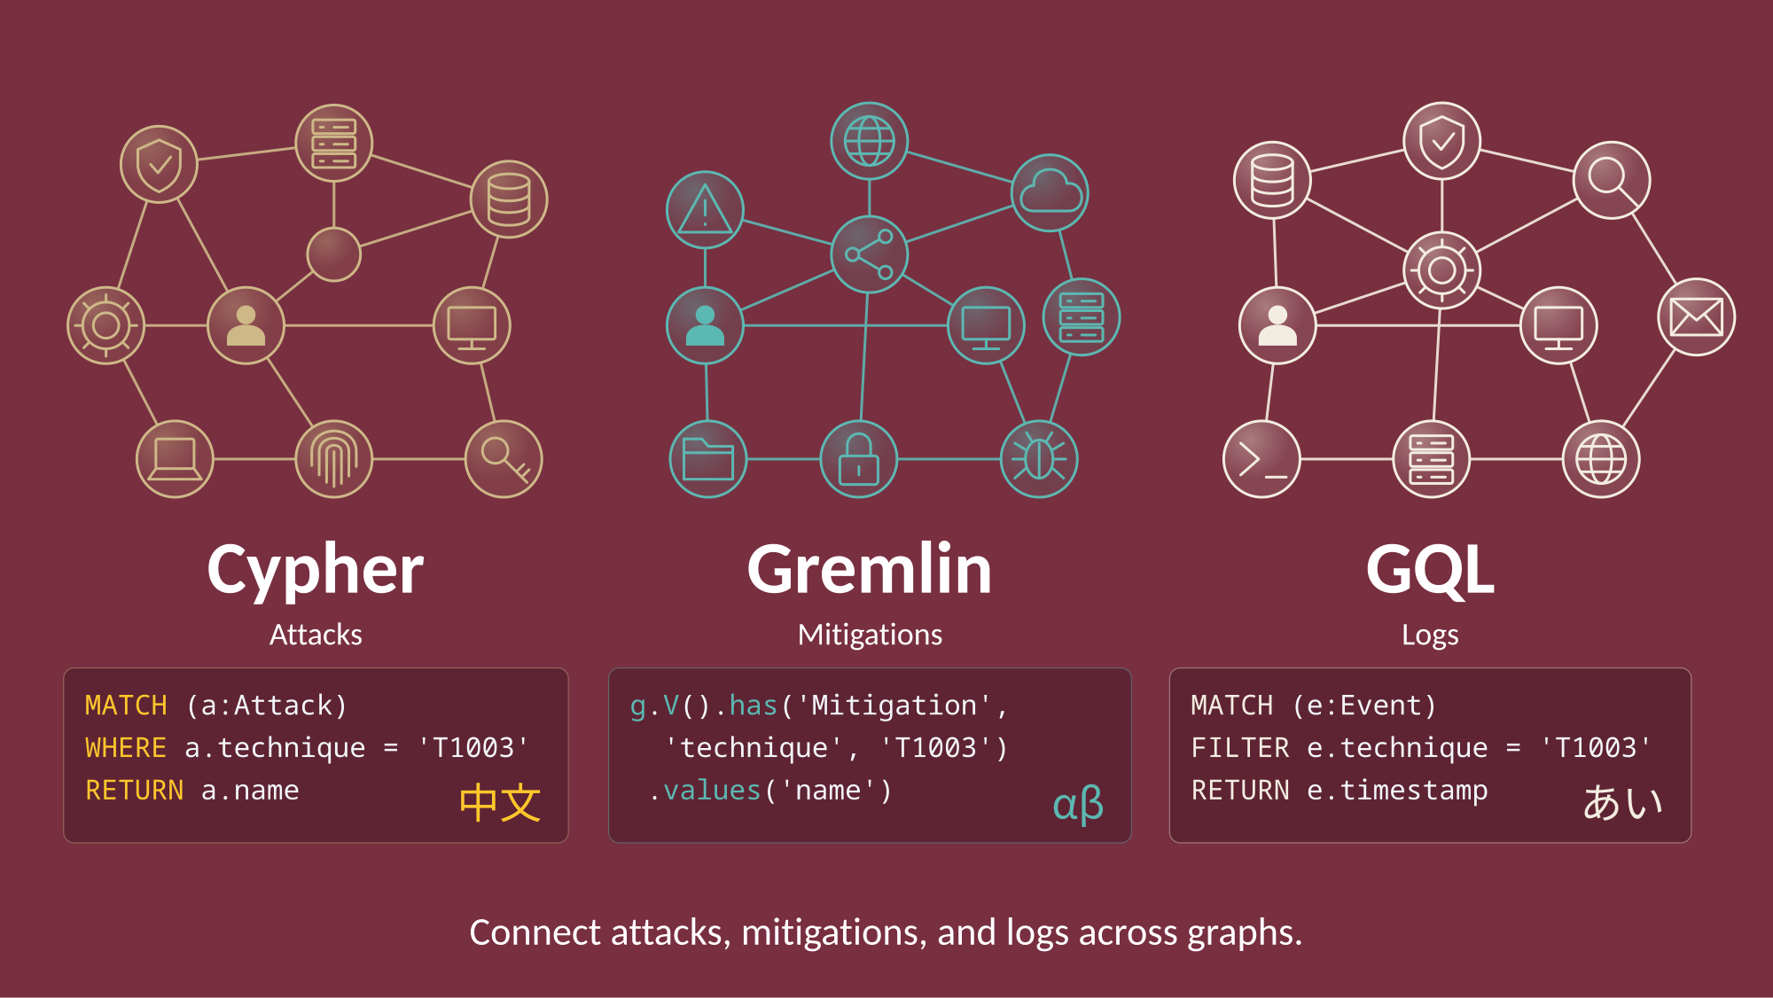
Knowledge graphs speak different languages
1
MITRE ATT&CK
adversary techniques and mitigations
Neo4j · speaks Cypher
2
MITRE CAPEC
attack patterns
Gremlin Server · speaks Gremlin
3
Cloud graph databases
Spanner Graph, Amazon Neptune
speak GQL and openCypher
Same question, three grammars. An analyst who knows one cannot ask the others.
Query languages: Cypher (Neo4j), Gremlin (Apache TinkerPop), GQL (ISO/IEC 39075:2024). Example queries are illustrative.
3 / 13
Notes:
[0:25] Here is the catch. Useful security knowledge is spread across several graphs, and they speak different query languages. MITRE ATT&CK, the catalogue of adversary techniques, we hold in Neo4j and query in Cypher. MITRE CAPEC, the attack-pattern catalogue, sits in a Gremlin server. Cloud graph databases speak GQL. Same question, three grammars. An analyst who knows one cannot ask the others.

Slide 4
How people query across graphs today
1
2
3
Write the query by hand
Ask a chatbot
Copy everything into one database
Gives you Accurate and auditable.
Gives you Fast and easy to ask.
Gives you One language to learn.
Costs you Slow, and it takes an expert per language, every time.
Costs you The query it ran is hidden, and a language model can invent facts.
Costs you Expensive, stale the day it lands, and it rewrites the sources.
Hallucination: when an AI states something as a fact that is not actually in the data.
Each option trades away something an analyst needs: accuracy, speed, or visibility. Ariadne is designed to keep all three.
4 / 13
Notes:
[0:30] Today you have three options. Write the query by hand: accurate and auditable, but slow, and you need an expert per language. Ask a chatbot: fast, but the query it ran is hidden, and a language model can hallucinate, that is, state something as fact that is not in the data. Or copy everything into one database: one language to learn, but it is expensive, stale the day it lands, and you have rewritten the sources. Each option trades away something an analyst needs.

Slide 5
How Ariadne answers one question
ATT&CK source card
ATT&CK specialist
composes a Cypher query
Cypher
MITRE ATT&CK
Neo4j
records + provenance
Analyst
question
Planner
splits and checks the plan
Verifier
checks every claim
Answer
with receipts
records + provenance
CAPEC specialist
composes a Gremlin query
Gremlin
MITRE CAPEC
Gremlin Server
CAPEC source card
If the evidence does not answer the question: revise the plan and ask again, up to 5 rounds
Rule 1 · No model ever writes a query.
Rule 2 · No claim without a record behind it.
Pipeline as shipped in the Ariadne workbench (September 2026). Retrieval loop capped at 5 rounds.
5 / 13
Notes:
[0:40] Ariadne is a different shape. A question comes in. A planner splits it into per-database sub-questions and checks the plan against each database's spec sheet, its source card. One specialist per database reads that card and composes the query in the database's own language: Cypher for ATT&CK, Gremlin for CAPEC. Every query is checked before it runs: read-only, bounded, only the labels and relationships the card declares. Results come back as records with their provenance. A verifier checks every claim against those records. If the evidence does not answer the question, the planner is asked again, up to five rounds. Two rules hold it together: no model ever writes a query, and no claim is made without a record behind it.

Slide 6
The source card: one sheet per database
attack.json the ATT&CK source card
What the specialist does with it
Entities and properties
1
Resolve the entities named in the question against the card, and say so if one is not modeled
what the graph contains: 11 node labels, their attributes
Relationships
2
Compose the query from five schema-derived primitives: describe, neighbors, walk, chain, bridge
how entities connect, and in which direction
Join keys
3
Gate it before it runs: read-only, allowed labels and edges, bounded depth and rows
which identifiers link this graph to another one
Query limits
read-only · max depth · max rows · timeout
4
Execute once, under a timeout, in the database's own language
Provenance
which snapshot, pinned by hash, so an answer can say which version it read
5
Normalize every record with its provenance: source, executed query, record id, timestamp
39 KB of card describes 19.9 MB of graph: two tenths of one percent.
Sizes measured on the repository: data/source_cards/attack.json (39,354 bytes) vs. data/graphs/attack/canonical (19,868,879 bytes).
6 / 13
Notes:
[0:30] The source card is the key idea. One sheet per database: what it contains, how things connect, which identifiers link it to other databases, what a query may never do, and which snapshot it was built from. The specialist resolves the question's entities against the card, composes the query from five schema-derived primitives, gates it, runs it once, and normalizes the records with provenance. For ATT&CK the card is thirty-nine kilobytes describing a twenty-megabyte graph. That is why adding a database is a sheet, not a project.

Slide 7
The verifier: every claim carries its record
✓
Cited
every claim points at records that were actually retrieved
When the data has nothing
"The capec source doesn't establish this. The executed query ran cleanly and returned no matching records."
✓
Resolvable
every identifier in a claim occurs in those records
✓
Grounded
g.V().hasLabel("AttackPattern").has("id", within(ids))
.out("MAPS_TO").hasLabel("TaxonomyEntry") …
what the claim says is in the record it cites
0 claims made · 0 invented mappings · the query is the proof
✓
Correlated
a link across two databases must be backed by the join index
An honest "no", with the receipt. If the evidence does not answer the question, the planner is asked again, up to five rounds, before the answer is composed.
What fails a gate is cut from the prose and kept flagged. The verifier is deterministic code, not a model.
Verifier gates: utils/synthesis/verifier.py. Abstention text quoted from a committed evaluation answer.
7 / 13
Notes:
[0:25] The verifier is deterministic code, not a model. Four gates: every claim cites records that were retrieved; every identifier in a claim appears in those records; the claim is grounded in the record's content; and a cross-database link must be backed by the join index. What fails is cut from the prose and kept flagged. When the data has nothing, the answer says so and shows the query it ran. That is an honest no, with proof.

Slide 8
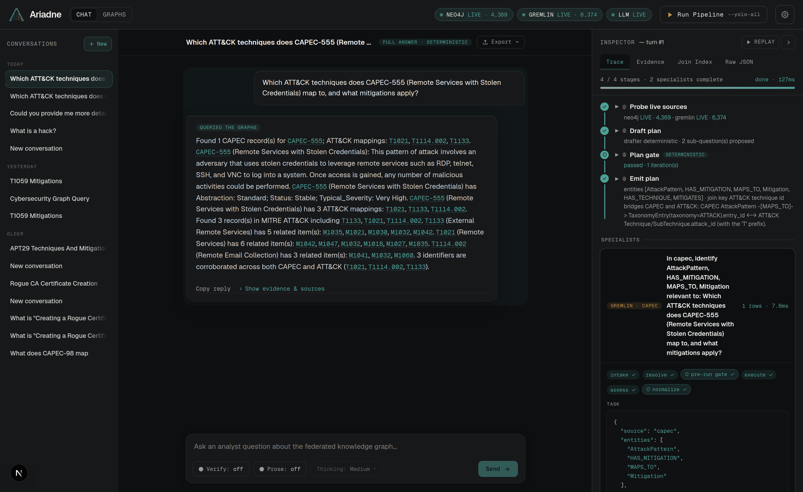
The workbench: ask, watch it run, open the receipts
1
The question
plain English, identifiers optional
1
2
2
The plan and its gate
which sources, which sub-questions, why it passed
4
3
One lane per database
the validated query, in that database's own language
3
4
The answer
every identifier is a citation you can open
5
Three controls, off by default
Verify asks a model for a second opinion; Prose asks a model to write over the verified claims; Thinking sets its budget
5
Live capture of the Ariadne workbench, September 15, 2026, both sources live. A 30-second clip of this run replaces the still in the final deck.
8 / 13
Notes:
[0:35] This is the workbench, captured this week on the live stack. The question at the top. On the right, the plan and its gate, then each specialist's lane with the validated query in the database's own language. In the middle, the answer: every identifier is a citation you can open. The three controls at the bottom are off by default; that is the fast path, deterministic, a fraction of a second. Verify asks a model for a second opinion on whether the evidence suffices. Prose asks a model to write readable text over the verified claims, and it cannot add a claim. [In the final deck a 30-second clip of this run plays here.]

Slide 9
It scales across databases
3 · 2 · 1
0 vs 1,083
240 / 240
databases · query languages · one process
records rewritten to answer across ATT&CK and CAPEC
adversarial queries blocked before execution
Nothing about the questions changed when the third database was added.
Federating edited nothing. Merging the two into one store rewrote 1,083 records, and the edit must be redone on every release.
After we found and closed 15 bypasses ourselves. Read-only, bounded, and card-checked, by code.
Adding a database is a source card, not a project.
Next on the roadmap: Amazon Neptune and Google Spanner Graph, so the same question also runs in GQL and openCypher.
Sources: EXP-2026-08-013 (three sources) · EXP-2026-08-017 (federate vs. merge) · EXP-2026-08-016 (safety audit), docs/research/.
9 / 13
Notes:
[0:25] It scales. Three live databases, two query languages, one process, and adding the third changed nothing about the questions. Federating means the sources stay as their publishers shipped them: zero records rewritten, where merging ATT&CK and CAPEC into one store required editing one thousand and eighty-three. And the pre-run gate blocked two hundred and forty of two hundred and forty adversarial queries, after we found and closed fifteen bypasses ourselves. Next on the roadmap: Amazon Neptune and Google Spanner Graph.

Slide 10
It already runs on ReliaQuest's own schema
What ReliaQuest sent
The bridge to ATT&CK
What happened
Your identity graph
Domain Admins —DC_SYNC→ Domain
The card is the native input: the schema alone was enough. We generated synthetic records that conform to it.
It ran live beside ATT&CK and CAPEC: three sources, two languages, one process, and nothing else changed.
A relationship in your graph resolves to a technique in ATT&CK, and on to its mitigations.
Where no mapped relationship exists, it says so instead of guessing.
72
21
node types
relationship types
is the technique
MITRE ATT&CK
T1003.006 OS Credential Dumping: DCSync
5
0
identity systems: AD · Entra · Okta · AWS · GCP
customer records needed
which is mitigated by
ATT&CK mitigations
M1015 Active Directory Configuration · M1026 Privileged Account Management · M1027 Password Policies
"Which technique is what Domain Admins can do with DC_SYNC, and what mitigates it?"
13 of 21 relationship types carry a technique. The other 8 are declared not to, each with its reason recorded.
Synthetic records conforming to ReliaQuest's real schema; catalogue received 2026-08-21. Sources: EXP-2026-08-011, EXP-2026-08-013 (phase 2), docs/research/.
10 / 13
Notes:
[0:35] ReliaQuest gave us the catalogue of their production identity graph: seventy-two node types, twenty-one relationship types, five identity systems, and zero customer records. The card is the native input, so the schema alone was enough. We generated synthetic records that conform to it, ran it live beside ATT&CK and CAPEC, and declared a bridge: a DC_SYNC relationship in your graph is the technique ATT&CK calls T1003.006, and that technique has mitigations. Where no mapped relationship exists, the system says so instead of guessing. The records are synthetic; the schema is real. [Q&A backup: on a 64-question blind set the schema-derived engine named the right technique on 20 of 24 and refused all 12 that had none; retrieval only, not judged for answer quality.]

Slide 11
Where it stops today
1
Ask by identifier
Works
Also open
"What mitigates T1003?" · "What does CAPEC-555 map to?"
Answer quality through the workbench's own planner has not been judged yet. Every headline in the record replays a human-authored plan.
The identity records were synthetic. The schema was real.
The schema-derived engine is what makes the system open-ended; its ceiling is set by the plan it is given. The planner is the next target.
The rewrite stage helps questions without an identifier and is skipped when one is present.
2
Reword the question
About half survive
same entity, different verb or phrasing
3
Paraphrase the name
About a third, with the rewrite stage shipped this week
the entity without its identifier
4
Describe it without naming it
Not yet
no identifier, no recognisable name
We know the next gap precisely, and it is measurable.
Sources: EXP-2026-09-021 (paraphrase robustness) · EXP-2026-09-020 (workbench plan source) · EXP-2026-08-011 (synthetic identity records), docs/research/.
11 / 13
Notes:
[0:25] Here is where it stops today. Ask by identifier and it works. Reword the question and about half survive. Paraphrase the name and about a third, with the rewrite stage we shipped this week. Describe something without naming it: not yet. And answer quality through the workbench's own planner has not been judged yet. We know the next gap precisely, and it is measurable.

Slide 12
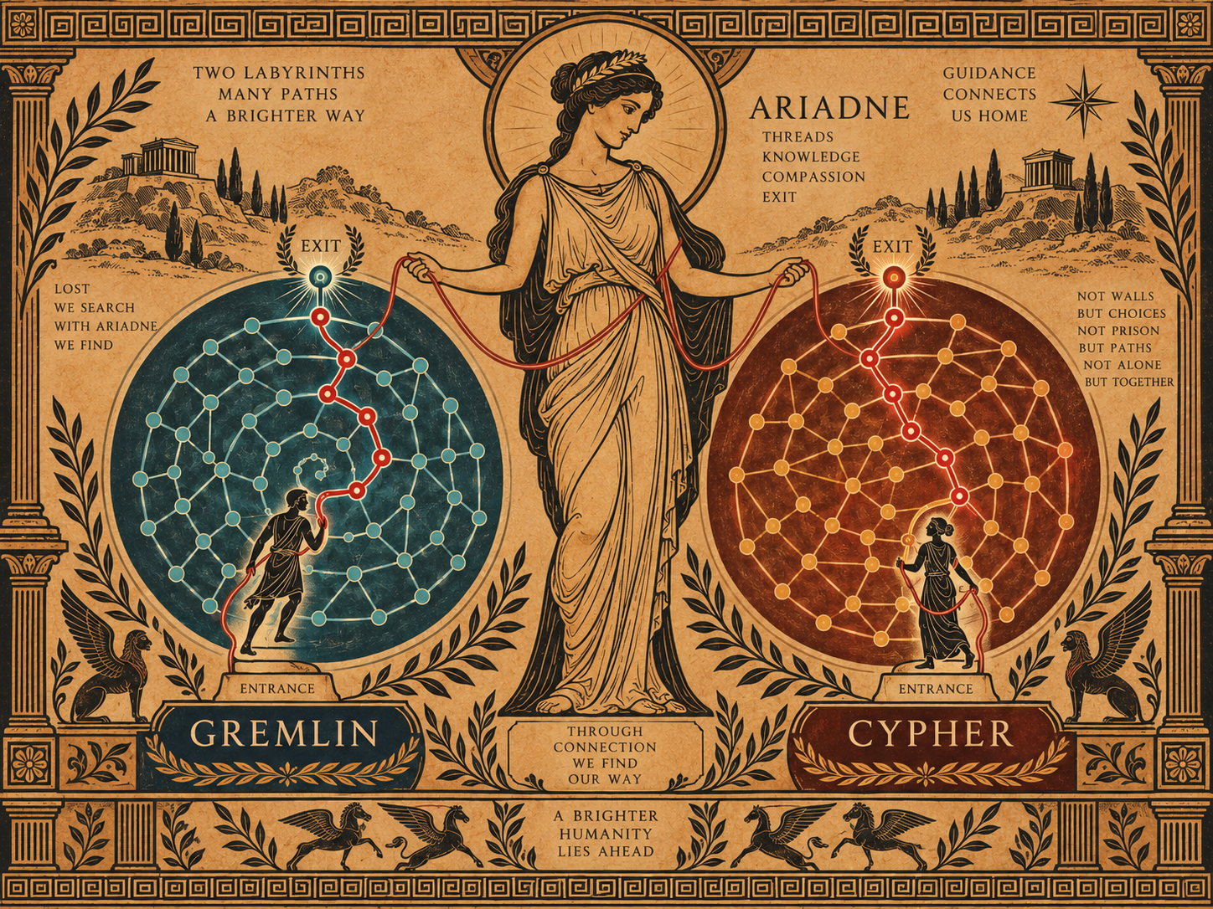
Thank you
Questions?
One question. Answers from many sources.
Olmo S. Zavala Romero · PI
Brendon DGR · technical lead
Department of Scientific Computing, Florida State University
github.com/brendondgr/Ariadne
Ariadne's thread guides travelers through the Gremlin and Cypher labyrinths.
12 / 13
Notes:
[0:05] Thank you. One question, answers from many sources. Questions?

Slide 13
Works cited
Data and tools
Prior and related work
1. MITRE ATT&CK®. Enterprise ATT&CK, STIX 2.1 data. https://github.com/mitre-attack/attack-stix-data
2. MITRE CAPEC™. Common Attack Pattern Enumeration and Classification, version 3.9. https://capec.mitre.org
3. Neo4j. Cypher Manual. https://neo4j.com/docs/cypher-manual/
4. Apache TinkerPop. The Gremlin Graph Traversal Language. https://tinkerpop.apache.org/gremlin.html
5. ISO/IEC 39075:2024. Information technology — Database languages — GQL. https://www.iso.org/standard/76120.html
6. LangChain. LangGraph. https://github.com/langchain-ai/langgraph
7. Amazon Web Services. Amazon Neptune documentation. https://docs.aws.amazon.com/neptune/
8. Google Cloud. Spanner Graph documentation. https://cloud.google.com/spanner/docs/graph
9. Kurniawan, K., Ardian, R. F., Kiesling, E., & Ekelhart, A. (2025). AgCyRAG: an Agentic Knowledge Graph based RAG Framework for Automated Security Analysis. RAGE-KG @ ISWC 2025, CEUR-WS Vol. 4079, 132–144.
10. Ozsoy, M. G. (2026). Toward Multi-Database Query Reasoning for Text2Cypher. arXiv:2605.10373.
11. Szlobodnyik, G. (2026). Feedback-Guided Prompt Injection Defense in Retrieval-Augmented Text-to-Cypher Generation. Analytics, 5(3), 25. https://doi.org/10.3390/analytics5030025
12. Leung, Belbahri, Sui, Labach, Zhang, Rose, & Cresswell (2026). Classifying and Addressing the Diversity of Errors in Retrieval-Augmented Generation Systems. Proceedings of EACL 2026, 3185–3207.
13. Zavala Romero, O. S., & DGR, B. (2026). Ariadne: federated agentic access to cybersecurity knowledge graphs. Research record, docs/research/, https://github.com/brendondgr/Ariadne
ATT&CK® and CAPEC™ are trademarks of The MITRE Corporation. The ReliaQuest and Florida State University marks belong to their owners. Closing illustration and figures on slides 2–3: Ariadne project, O. Zavala Romero, 2026.
13 / 13
Notes:
No spoken content. Left on screen during questions.

