Slide 1
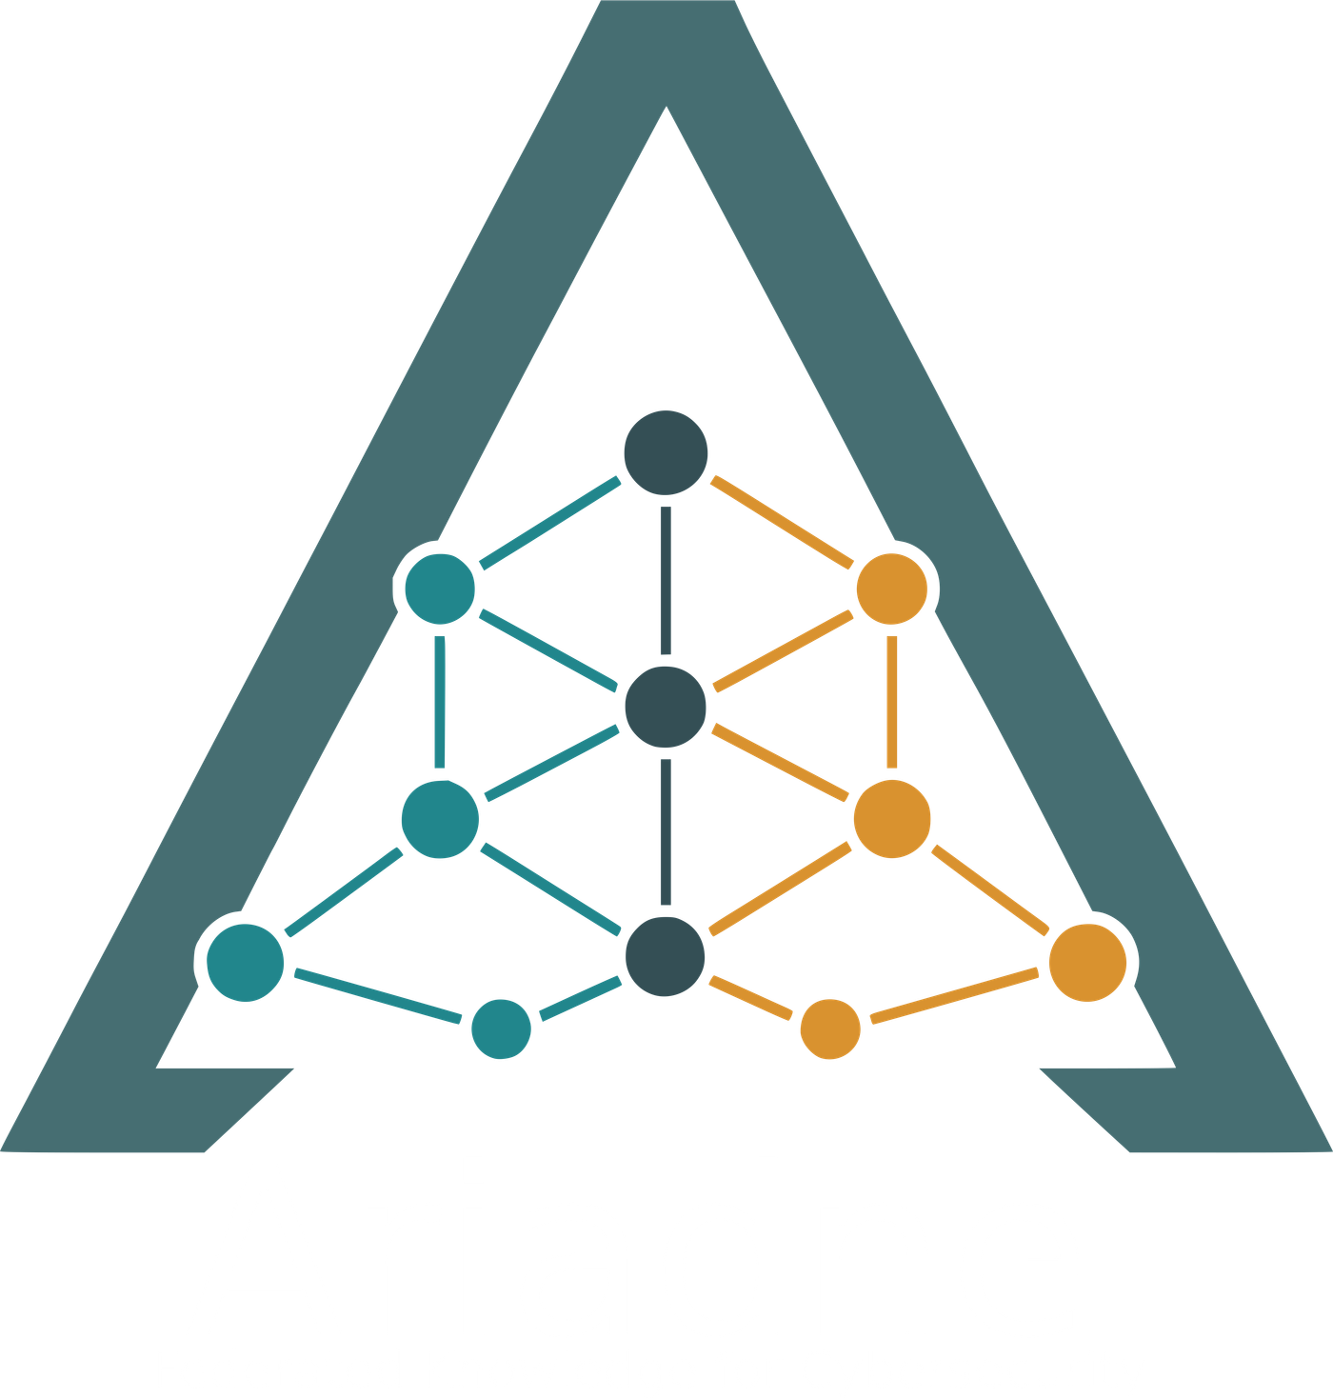
One question.
Every database.
A receipt for every sentence.
Ariadne · federated knowledge for cybersecurity
Olmo S. Zavala Romero, PI · Brendon DGR, technical lead · FSU Scientific Computing
ReliaQuest Innovation Challenge · October 19, 2026
Notes:
HOOK — target 0:25.
SAY:
One question. Every database. A receipt for every sentence.
I'm Brendon, and this is Ariadne. It lets a security analyst ask one question across databases that don't share a language — without copying any of them — and every sentence of the answer comes with the record and the query that produced it. Here's the problem it solves.
HOW: Say the three lines slowly, with a beat between each. Look up, not at the slide. The word 'receipt' is the hook — hit it. Do not introduce the grant, the challenge number or the team; the slide does that.
IF LONG, CUT: Nothing. This is 25 seconds.
SOURCES: —

Slide 2
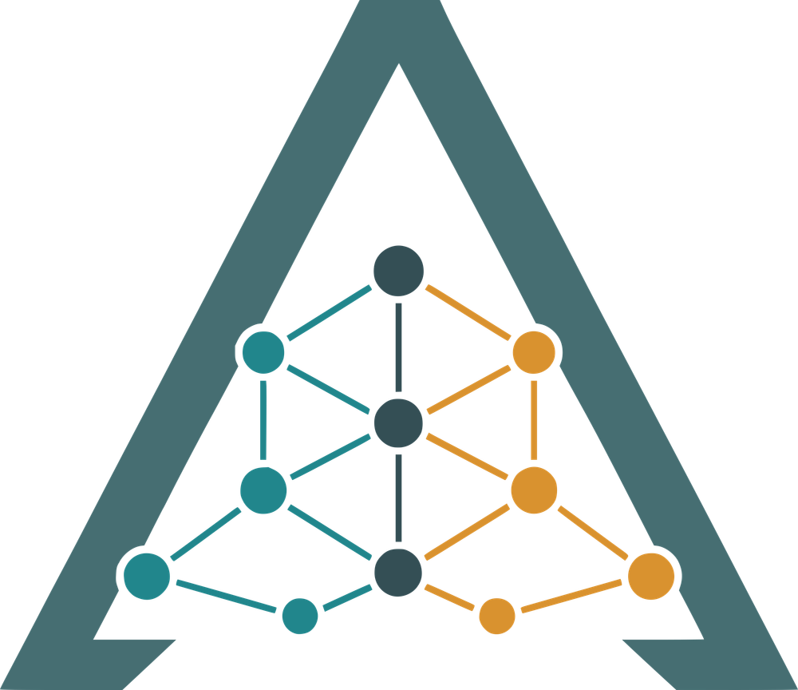







Security knowledge lives in databases that don't speak the same language
MITRE ATT&CK
speaks Cypher
The options today
By hand — slow, every time
MITRE CAPEC
speaks Gremlin
Copy it all into one warehouse — stale the day it lands
Customer identity graph
AD · Entra · Okta · AWS · GCP
Ask a chatbot — it hallucinates
Hallucination — the AI states something as a fact that is not actually in the data.
Notes:
THE PROBLEM — target 0:40.
SAY:
Imagine two encyclopedias on the same subject — one in French, one in German — and no way to ask both a question at once. That is security knowledge today.
ATT&CK in one database, one language. CAPEC in another. A customer's own identity graph in a third.
So today you have three options. Do it by hand — every time. Copy everything into one warehouse — stale the day it lands. Or ask a chatbot — which hallucinates.
A hallucination is when the AI states something as a fact that is not actually in the data. In security, an answer you can't trace is an answer you can't act on.
HOW: The encyclopedia line is for the non-technical half of the room; give it a full sentence of silence after. Point at the three option cards as you name them. Define 'hallucination' word-for-word from the slide — the interview feedback said people didn't know what it meant. Do not say 'ETL', 'Cypher', 'Gremlin' or 'federated' on this slide.
IF LONG, CUT: The 'customer's own identity graph is a third' sentence — it comes back on slide 7.
SOURCES: docs/purpose.md · docs/proposal/RFP.md (Challenge Three text)

Slide 3





Don't merge the databases. Federate the question.
›
›
›
Spec sheet
Planner
Translators
Verifier
one page per database
a plan you can check, first
one per database, read-only
every claim carries its record
No AI ever writes a query.
No claim without a record behind it.
Notes:
HOW IT WORKS — target 0:40.
SAY:
So we don't merge the databases. We federate the question — and we keep the receipts. Four parts.
One: every database gets a one-page spec sheet — what it holds, how to connect, what a query may never do.
Two: a planner reads those sheets and writes a plan we can check, before anything is queried.
Three: one translator per database asks it in its own language. Read-only.
Four: a verifier. Every claim is built from a record that actually came back, and carries that record and the query with it.
Two rules. No AI ever writes a query. And no claim without a record behind it.
HOW: Point at each card as you number it — the back of the room can't read the body text and doesn't need to. The two rules at the bottom are the technical-credibility line: say them slowly and stop. If an engineer is in the room, they will want to ask about rule one; let them ask in Q&A (answer in the appendix). Say 'source card' once, in passing, so the term on later slides isn't new.
IF LONG, CUT: The descriptions under parts 2 and 3 — name them and move on.
SOURCES: README.md ('What actually runs') · docs/source_cards.md · docs/planner_agent.md · docs/specialist_agents.md · utils/synthesis/verifier.py

Slide 4

What an answer looks like
Two real outputs from the evaluation record.
ASKED
When the data has nothing
“Which ATT&CK techniques does CAPEC-555 (Remote Services with Stolen Credentials) map to, and what mitigations apply?”
“Which ATT&CK techniques does CAPEC-116 map to?”
RAN (two databases, two languages, read-only)
g.V().hasLabel("AttackPattern").has("id", within(ids)).out("MAPS_TO")…
MATCH (t) WHERE t.attack_id IN $ids OPTIONAL MATCH (t)<-[:MITIGATES]-(m:Mitigation) …
“The capec source doesn't establish this — the executed query ran cleanly and returned no matching records.”
ANSWERED
CAPEC-555 maps to three ATT&CK techniques — T1021, T1114.002 and T1133 — with their mitigations. Every sentence cites the record it came from.
0 claims made
0 invented mappings
capec · CAPEC-555
attack · T1021
attack · T1114.002
attack · T1133
Notes:
WHAT AN ANSWER ACTUALLY LOOKS LIKE — target 0:40.
SAY:
A real question: which ATT&CK techniques does this stolen-credentials attack pattern map to, and what mitigations apply?
The plan splits it — CAPEC first, then ATT&CK. Two queries, two languages. The answer: three techniques, their mitigations — and every chip is a citation to the actual record.
Now the one I care about more. A question the data cannot answer. It says so — and attaches the query it ran, as proof. Zero claims. Zero invented mappings.
A chatbot can invent a mapping here. Ariadne can't — there is no record to build a claim from.
HOW: This is the slide Reviewer 3 asked for: a tangible output. Left card: walk top to bottom with your hand — question, plan, queries, answer — don't read the queries. Right card: slow down. 'Zero claims, zero invented mappings' is the practical-impact line for a security buyer. Both outputs are verbatim from committed answer files; say 'these are real outputs from our evaluation record, not mock-ups' if you have time.
IF LONG, CUT: The 'two queries, two languages' sentence.
SOURCES: docs/evaluation/experiments/untruncated-loop/llm_loop/answers/F-CTM-02.json · F-NEG-01.json · docs/agent-interfaces.md

Slide 5
288 held-back questions · three ways of answering
4 s vs 2 days
hand-written vs AI-written queries, same questions
0
made-up claims — by construction
240 / 240
Two independent graders agree on the order.
adversarial queries blocked
Notes:
THE EVIDENCE — target 0:45.
SAY:
In August we showed you ninety-nine percent — on questions we had written ourselves. So we did this properly.
Two hundred and eighty-eight questions held back from development and never graded until this run. Three ways of answering, graded by two independent models.
Reading the database's own structure: point six five. Hand-written queries: point four nine. Letting the AI write the query: point four zero. Both graders agree on that order. These are the blind numbers — the honest ones.
And cost. Same questions: hand-written took four seconds. Letting the AI write the queries took two days. Forty thousand times.
But the number that matters most for security is zero. Zero made-up claims — by construction, not by filtering. And every one of two hundred and forty adversarial queries blocked.
HOW: Never cut this slide. Own the August-to-now change before anyone asks: 'we refuted our own headline and wrote it down' is the most credible sentence in the deck. Point at the top bar when you say 0.65. Say '40,000 times' and stop for a beat. The words 'arm', 'deterministic', 'generic', 'holdout' and 'template cascade' do not appear anywhere in this script — keep it that way.
IF LONG, CUT: Nothing here. Cut slide 6 instead.
SOURCES: EXP-2026-09-007 (holdout n=288; grader qwen38-27B-v2; gemma4-31B agrees on ordering) · docs/reports/2026-09-05-full-report.md (cost, 284-question dev half) · EXP-2026-08-016 (240 probes) · EXP-2026-08-014 (verifier: unsupported claims are unconstructible)

Slide 6
Adding a database is a spec sheet, not a project
3 databases · 2 languages · 1 process
ATT&CK
Neo4j · Cypher
nothing changed when the third was added
CAPEC
Gremlin
0 vs 1,083
records rewritten: federating vs merging
Identity graph
Neo4j · Cypher
Next: Neptune, Spanner Graph
one process · one answer
four documented swap points per engine
Notes:
IT SCALES ACROSS DATABASES — target 0:30.
SAY:
Does it scale? Three live databases, two query languages, one process — and when we added the third, not one of a hundred and seventeen results changed.
Compare merging: to fit ATT&CK and CAPEC into one warehouse we had to rewrite one thousand and eighty-three records. Federation rewrote zero.
A new query language is four documented swap points. Neptune and Spanner Graph are next.
HOW: Reviewer 1's slide. The '0 vs 1,083' number is the one to land — it is the structural answer to 'why not just merge?'. Do NOT say federation is more accurate than merging; it isn't measurably, and the backup slide says so. Name Neptune and Spanner because the challenge text names them.
IF LONG, CUT: The whole slide, if you are past 3:15 when you reach it — fold the 'three databases, one process' line into slide 7's opening.
SOURCES: EXP-2026-08-013 (tri-source; zero answers changed 1→3 sources, n=117) · EXP-2026-08-017 (1,083 of 9,138 nodes edited by merging) · docs/migration-guide.md (four swap points)

Slide 7



It already runs on ReliaQuest's own schema
What we received
What happened
Bridge to ATT&CK
72
0.66 vs 0.13
DC_SYNC = T1003.006
node types
right records found: reading the schema vs hand-written queries
a relationship in your graph is a technique in theirs
5
12 / 12
“Which technique is what Domain Admins can do with DC_SYNC — and what mitigates it?”
identity systems: AD · Entra · Okta · AWS · GCP
unanswerable questions refused — no false claims
0
customer records — the spec sheet is enough
Notes:
IT ALREADY RUNS ON RELIAQUEST'S SCHEMA — target 0:40.
SAY:
And this is where it meets ReliaQuest. In August you shared the structure of your customer identity graph — seventy-two node types across Active Directory, Entra, Okta, AWS and GCP — and zero customer records.
The spec sheet is all Ariadne needs. Customer data never has to leave the customer.
First run: nothing. Five generic fixes later, reading the schema retrieves the right records on two-thirds of the questions; hand-written queries on one in eight — on synthetic records shaped to the real schema.
And the bridge. A DCSync relationship in that graph is ATT&CK technique T1003.006. One question can now span your own graph and the public catalogues. And where there is no mapping, it refused — twelve out of twelve. Zero false claims.
HOW: Reviewer 2's slide, and the practical-impact slide. Say 'synthetic records shaped to the real schema' out loud — if you don't, an engineer will ask and it will sound like you hid it. Read the example question in the amber box in an analyst's voice. If ReliaQuest engineers are in the room, look at them for 'customer data never has to leave the customer'.
IF LONG, CUT: The 'first run: nothing' sentence — go straight to the 0.79.
SOURCES: EXP-2026-08-011 A-10 (retrieval recall 0.657 vs 0.127, precision 0.136 vs 0.057; n=117, synthetic instances; five fixes in commit 74d027e; 1,250 MITRE tests unchanged) · EXP-2026-08-013 (bridge: 13 of 21 edges mapped; 12/12 refusals) · docs/research/datasets/cards/reliaquest-identity-catalog.md

Slide 8


We know where it breaks — that is the next step
Ask by identifier
Reword the question
Paraphrase the name
works
about half
0 of 104
1
2
3
4
Close the vocabulary gap
Put a person in the loop
Pilot inside ReliaQuest
Neptune and Spanner Graph
Notes:
WHERE IT BREAKS — AND THE NEXT STEPS — target 0:35.
SAY:
Here is the weakness, before you ask. Ask by identifier — it works. Reword the question — about half. Paraphrase the name — zero of a hundred and four.
Notice what it does. It stops finding the right record — it never fabricates one, and the query it ran is attached, so a miss is visible. That is a retrieval problem, and it is measured. So it is the next step.
Close the vocabulary gap, tracked weekly. Put a person in the loop — today every score is a model grading a model. Pilot inside ReliaQuest's environment, on real records, where nothing leaves. And Neptune and Spanner Graph as engines three and four.
HOW: Leading with the weakness is what makes the rest of the deck credible — do not soften it. 'It stops finding things; it does not start inventing them' is the line to memorise. The four steps are outcomes, not a budget; if asked for a dollar figure, the Q&A appendix has the answer.
IF LONG, CUT: Step 4 (engines) — it was already said on slide 6.
SOURCES: EXP-2026-08-020 (variant robustness: T1 0.4667, T4 0.0000 on 104; abstains rather than dumps) · docs/research/OPEN_QUESTIONS.md · docs/research/paper/venue-readiness-2026-09.md ('No person has ever checked a single answer')

Slide 9
Questions?
Olmo S. Zavala Romero · Brendon DGR · FSU Scientific Computing
Notes:
QUESTIONS — target 0:10.
SAY:
Disparate databases. One question. A receipt for every sentence. Thank you.
HOW: Say it, stop, and wait. The slide says 'Questions?' so you don't have to.
IF LONG, CUT: Nothing.
SOURCES: Counts: 248 commits since Aug 6, 41 experiments on record (30 since Aug 6), ~100k lines of Python (utils/api/scripts), 1,746 test functions in 182 test files.

Slide 10
Backup
For questions. Every number sourced to the research record.
Notes:
Divider. Do not show in the 5 minutes.

Slide 11
Backup · The full blind comparison
288 held-out questions (never seen, never graded before this run) and the 284-question development half. Paired bootstrap, 2,000 resamples.
Way of answering | Held-out (n=288) | 95% CI | Dev half (n=284) | Second grader (gemma)
Reads the database's own structure (schema-assembled, no templates, no model) | 0.6546 | 0.622 – 0.688 | 0.6569 | 0.6464
Hand-written queries (template cascade) | 0.4862 | 0.453 – 0.520 | 0.4946 | 0.4320
AI writes the query (given schema, seeds, constraints, repair loop) | 0.4039 | 0.372 – 0.435 * | 0.3781 | 0.3678
Contrasts (held-out, qwen38-27B-v2): schema − hand-written +0.168 [+0.134, +0.205] · schema − AI-written +0.251 [+0.203, +0.300] · hand-written − AI-written +0.082 [+0.036, +0.131] (positive under both graders; significant under one). * CI from the first grading pass (0.4031); completed two-family pass reads 0.4039.
Cost: hand-written ≈ 4 s for 284 questions; AI-written ≈ 2 days of machine time (five attempts to make the baseline fair, all recorded).
Why these are lower than July's 0.99: July's 120 questions were co-authored with the code (bias measured at +0.03 to +0.05, same system, same grader). These are blind and hard on purpose. The finding is the ordering, which survives two grader families.
Sources: EXP-2026-09-007 data/judged-two-family-final.json (final) · EXP-2026-09-007/RESULTS.md (CIs) · docs/reports/2026-09-06-overnight-report.md · docs/reports/2026-09-05-full-report.md · C-021 (co-authorship bias)
Notes:
Backup for 'how many runs / error bars / why lower than August'.

Slide 12
Backup · The July study, kept as history
What we showed in August, and why we no longer lead with it.
What still stands
• Letting the AI plan is the biggest single loss (−0.12 to −0.14).
• Binding the AI narrator to verified claims costs 0.0015 — readable prose is free.
• Only 2 of 36 failures were the AI making things up; 26 were planning or retrieval.
What does not stand
• The 0.99 level: on 30 blind questions the same system scored 0.69. The questions were co-authored with the code.
• 'The templates hold the accuracy' (C-003): refuted. A schema-read path matches them on MITRE and beats them by roughly 0.5 on ReliaQuest's schema.
• The model that ran the AI-planned arms no longer exists behind that endpoint; the grader was an independent Sonnet 5 panel.
Sources: docs/evaluation/2026-07-26/README.md · docs/research/CLAIMS.md (C-001, C-002, C-003, C-005, C-013, C-016) · README.md 'The July arm study, kept as history'
Notes:
Backup if someone asks about the August numbers. Say: we refuted our own headline and wrote it down.

Slide 13
Backup · Federate vs. merge, and the safety audit
Federating vs. merging into one warehouse
Query safety audit
Accuracy: no demonstrable difference. Six readings across two blind banks and three graders — federation at or above merging in all six (0.00 to +0.06), demonstrably ahead in none (±0.06 question-sampling floor at n=30). We do not claim federation is more accurate.
Structure: the difference is real. Merging ATT&CK and CAPEC into one store required adding a property to 1,083 of 9,138 nodes (894 CAPEC nodes given an identifier the upstream record does not carry; 189 ATT&CK entries re-prefixed). The store is no longer what MITRE published, the edit must be re-applied on every release, and a consumer cannot tell the publisher's field from ours. Federation edited 0. The customer identity graph loaded unmodified.
Why it matters for ReliaQuest: customer telemetry and licensed feeds have different owners, retention rules and access controls. They cannot always be copied. They can always be asked.
240 / 240
15
adversarial probes blocked, 0 leaks
real bypasses found by us — and closed
The original 17 hand-written probes all passed — weak evidence of a strong property. Generating 240 by crossing rejection categories with syntactic mutations found 15 genuine gaps: TinkerPop's mutating mergeV/mergeE steps that no spec sheet named (8), a server-side Groovy closure (1), un-checked repeat() depth (2), a literal 4-hop chain that evaded the depth cap (1), a USE-database switch (1) and two label-smuggling variants. All closed; block rate now 1.000.
Cross-tenant isolation: 14 probes across three live sources; the shipped routing rule leaks 5 records on 1 probe vs. 568 on 3 for the naive rule (−99.1%). One residual leak is recorded, not hidden.
Sources: EXP-2026-08-009 + A-1 · EXP-2026-08-017 · EXP-2026-09-006 (C-022 across grader families) · EXP-2026-08-016 (240 probes) · CLAIMS.md C-008, C-022
Notes:
Backup for 'why not just merge?' and 'how do you know it is safe?'.

Slide 14
Backup · What a spec sheet (source card) looks like
One JSON file per database. The planner routes only on what it declares; the translators bound every query by it.
{
"dataset": "attack",
"runtime_backend": "neo4j",
"provenance": {
"source_name": "MITRE ATT&CK", "dataset_version": "v19.0",
"snapshot_pinned": true, "raw_sha256": "…"
},
"node_labels": [ 11 labels ], "relationship_types": [ 9 types ],
"identity": {
"join_key": ["attack_id", "stix_type"],
"policy": "Two records may be joined only if BOTH
attack_id AND stix_type match."
},
"safety": {
"read_only": true,
"disallowed_clauses": ["CREATE","MERGE","DELETE","SET","REMOVE","DROP"],
"max_result_rows": 1000,
"max_traversal_depth": 3,
"query_timeout_ms": 5000
}
}
Provenance
Which snapshot, pinned by hash. Every answer can say which version it read.
Identity
What counts as 'the same thing' across databases — the join rule. For ReliaQuest's identity graph, where no shared ID exists, a reviewed correspondence table (DC_SYNC → T1003.006) plays this role.
Safety
What a query may never do. Enforced before execution, on every query, by code — not by asking a model nicely.
Adding a database = writing this file (a generator drafts it from the live schema) plus, for cross-database questions, the correspondence table.
Sources: data/source_cards/attack.json (excerpt, abridged) · docs/source_cards.md · utils/planner/edge_correspondence.py
Notes:
Backup for 'what does it take to add our database?'.

