Slide 1

Introduction to Docker For .NET Developers

Slide 2
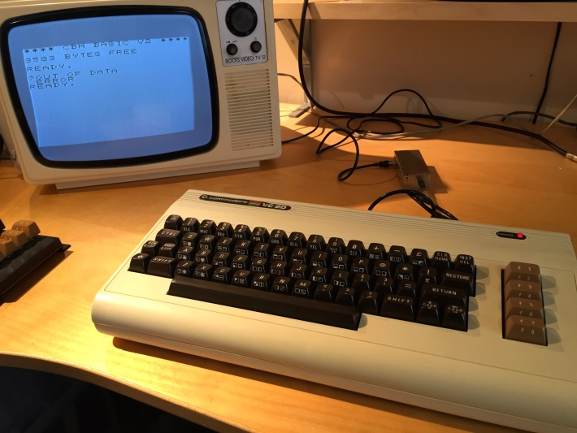
Your Presenter
Brendon Matheson
Australian
11yr Bangkok Resident
Currently Working On
Healthcare (Architect at Orion Health)
Cloud / Multi-Tenant / SaaS
Functions-as-a-Service (FaaS)

Slide 3
Docker

Slide 4
Agenda
What is Docker?
Exercise 1 – hello-world
Exercise 2 – Externalities
Exercise 3 – Build a .NET Core app on Linux
Exercise 4 – Dockerize a .NET Core app on Linux
Exercise 5 – Customize the dotnetcore SDK container
Exercise 6 – Dockerize nginx and CIFS on Linux
Exercise 7 – Serve static content in IIS on Windows
Exercise 8 – Serve web app in IIS on Windows

Slide 5
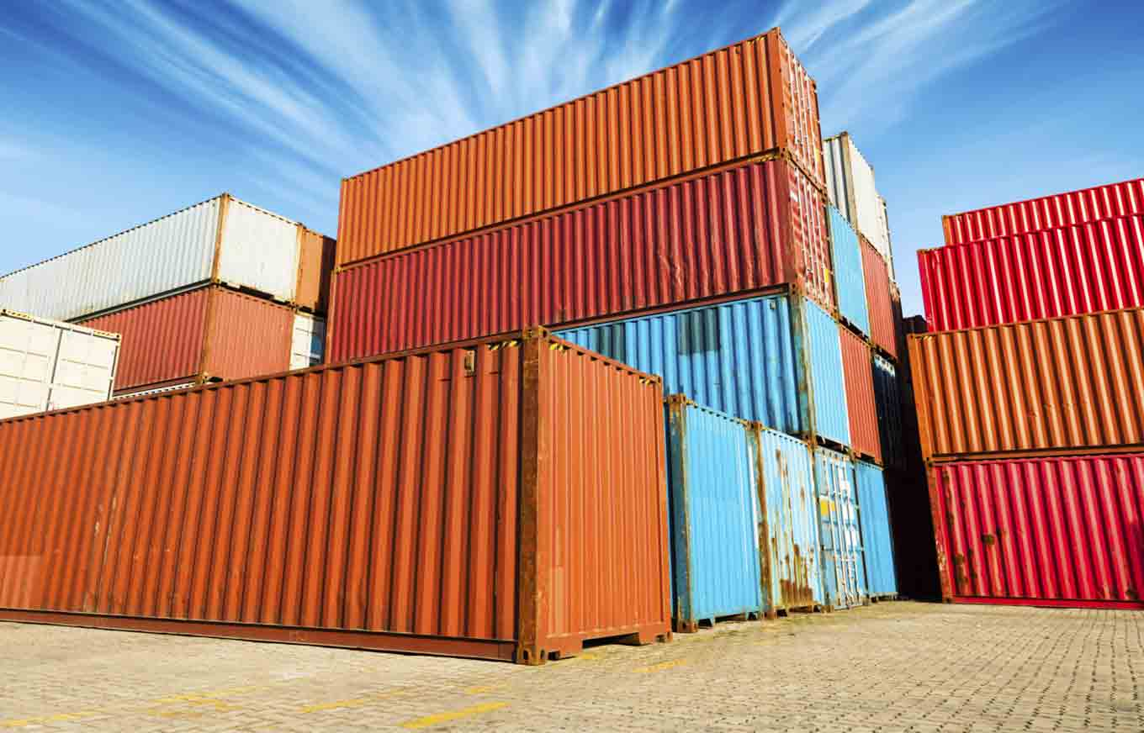
What is Docker?
Packaging, deployment and execution tool
Problems
Environmental differences
Complex deployment processes
Conflicting dependencies
Solution
Process isolation
Bundle app and dependencies into containers
Consistency and portability

Slide 6




Virtualization vs Containerization
Docker is a cool new virtualization technology

Slide 7
What is Docker?
Virtualization
Virtual hardware
CPU
Disk
Memory
Devices
Guest OS and software installed into VM
VM’s => System-Oriented
Containerization
Native hardware – no hypervisor
Allocate resources with control groups (on Linux)
Host kernel is used by containerized process
Containers => Service-Oriented

Slide 8
Docker on Windows
Docker on Windows – Two Models:
Windows Containers – Kernel-level support like Linux
Windows Server 2016
Hyper-V Isolation – Virtualization-based shim
Windows Server 2016
Windows 10
Version 1511 / November 2016 Update / Build 10586

Slide 9
Windows Containers
D CLI
D CLI
D CLI
C
C
C
DE
C
C
C
DE
C
C
C
DE
KERNEL
KERNEL
KERNEL
WIN SRV 2016
WIN SRV 2016
WIN SRV 2016
HYPERVISOR (VMWare; Hyper-V; etc)

Slide 10
Hyper-V Isolation
D CLI
D CLI
D CLI
C
C
DE
C
C
DE
C
C
DE
VM
VM
VM
HYPER-V
HYPER-V
HYPER-V
KERNEL
KERNEL
KERNEL
WIN SRV 2016 / WIN 10
WIN SRV 2016 / WIN 10
WIN SRV 2016 / WIN 10
HYPERVISOR (Hyper-V)

Slide 11
References
Background Reading
https://docs.docker.com/engine/docker-overview/#what-can-i-use-docker-for
http://www.haifux.org/lectures/299/netLec7.pdf
Installation
https://docs.docker.com/docker-for-windows/install/

Slide 12
Exercise 1 – hello-world
Run it!
docker run hello-world
Review https://hub.docker.com/_/hello-world/
Pull
docker pull debian:9
Check C:\Users\Public\Documents\Hyper-V\Virtual hard disks

Slide 13
Exercise 1 – hello-world
Run an interactive session in Debian 9
docker run –i -t debian:9 /bin/bash
Run a detached nginx instance
docker run –d nginx
Launch a bash process in the detached nginx instance
docker exec -it <id> /bin/bash

Slide 14
Exercise 1 – hello-world
Attach to the detached nginx instance
docker attach <id>
Housekeeping commands
docker stop
docker rm
docker images
docker rmi

Slide 15
Exercise 2 – Externalities
Mounting file system volumes
docker run –it –v W:\data:/data debian:9 /bin/bash
Exposing ports
docker run -it -p 8080:80 nginx
Environment variables
docker run -it -e "FOO=bar" debian:9 /bin/bash
root@8e035b9c48d9:/# echo $FOO

Slide 16
Exercise 3 – Build a dotnetcore app
Launch a build environment
docker run –it –v W:\wrk\bjm_str_px_docker_dotnet\hello:/hello-world microsoft/dotnet:2-sdk /bin/bash
Navigate to the mounted project directory
cd /hello-world

Slide 17
Exercise 3 – Build a dotnetcore app
Build as a FDD (Framework Dependent Deployment)
dotnet build –c Release hello.csproj
dotnet publish –c Release hello.csproj
References:
https://docs.microsoft.com/en-us/dotnet/core/deploying/index
https://docs.microsoft.com/en-us/dotnet/core/tools/dotnet-build
https://docs.microsoft.com/en-us/dotnet/core/tools/dotnet-publish
https://docs.microsoft.com/en-us/dotnet/core/rid-catalog

Slide 18
Exercise 3 – Build a dotnetcore app
Run the app
dotnet bin/Release/netcoreapp2.0/publish/hello.dll
Quit the container
docker ps –a
Clean up the container
docker rm <id>

Slide 19
Exercise 4 – Dockerize a dotnetcore app
Create the Dockerfile
FROM microsoft/dotnet:2-runtime
RUN mkdir -p /hello-world/
COPY bin/Release/netcoreapp2.0/publish/* /hello-world/
CMD ["dotnet", "/hello-world/hello.dll"]
Build the image
docker build –t bren/hello .

Slide 20
Exercise 4 – Dockerize a dotnetcore app
Run it
docker run bren/hello

Slide 21
Exercise 7 – Serve static content in IIS on Windows
Review the base IIS image at https://hub.docker.com/r/microsoft/iis/
Note: nanoserver vs windowsservercore
Start with the tutorial Dockerfile:
FROM microsoft/iis:nanoserver-10.0.14393.1715
RUN mkdir C:\site
RUN powershell -NoProfile -Command \
Import-module IISAdministration; \
New-IISSite -Name "Site" -PhysicalPath C:\site -BindingInformation "*:8000:"
EXPOSE 8000
ADD content/ /site

Slide 22
Exercise 7 – Serve static content in IIS on Windows
Build
docker build -t my/iis .
Run
docker run --rm -it --name iis my/iis
Connect browse to <IP>:8000 – get IP from inspect:
docker inspect iis
docker inspect -f "{{ .NetworkSettings.Networks.nat.IPAddress }}" iis

Slide 23
Exercise 7 – Serve static content in IIS on Windows
Create a volume for our static site:
docker volume create --name website
Drop content into C:\ProgramData\Docker\volumes\website
Remove ADD from Dockerfile and rebuild
Run with external volume mounted
docker run --rm -it --name iis -v C:\ProgramData\Docker\volumes\website:C:\site my/iis

Slide 24
Exercise 8 – Serve web app in IIS on Windows
Review the base aspnet image at https://hub.docker.com/r/microsoft/aspnet/
Test the sample webapp – mvcrandomanswers
Create Dockerfile, publish app and build image
FROM microsoft/aspnet:windowsservercore-10.0.14393.1715
RUN mkdir C:\randomanswers
RUN powershell -NoProfile -Command \
Import-module IISAdministration; \
New-IISSite -Name "ASPNET" -PhysicalPath C:\randomanswers -BindingInformation "*:8000:"
EXPOSE 8000
ADD MVCRandomAnswerGenerator/bin/Release/PublishOutput /randomanswers

Slide 25
Exercise 8 – Serve web app in IIS on Windows
Build
docker build –t bren/webapp .
Run
docker run --rm -it --name webapp bren/webapp

Slide 26
Exercise 8 – Serve web app in IIS on Windows
References:
https://hub.docker.com/r/microsoft/aspnet/
https://github.com/dotnet/docs/tree/master/samples/framework/docker/MVCRandomAnswerGenerator

Slide 27
Homework!
Core skills and workflow
Development environment – one of:
Install Docker for Windows 10
Windows Server 2016
hello-world
.NET Core build and Dockerize
ASP.NET Core Dockerize
Continued study
docker-compose
docker-swarm

