Slide 1

Docker For .NET Developers

Slide 2


Slide 3
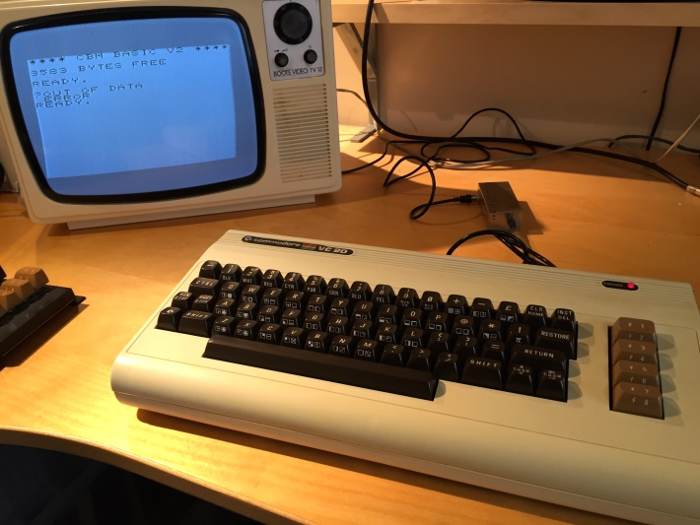
Your Presenter
Brendon Matheson
Australian
11yr Bangkok Resident
Currently Working On
Healthcare (Architect at Orion Health)
Cloud / Multi-Tenant / SaaS
Functions-as-a-Service (FaaS)

Slide 4
Session Plan
Basics
What is Docker?
Docker Basics
Serve static content in IIS (nanoserver)
Real
Dockerize a .NET Core WebAPI microservice (nanoserver & linux)
Production
Multi-container solution with docker-compose (linux)
Multi-container solution with docker-compose (nanoserver)
Scheduling a cluster with Docker Swarm
Cloud
Deploying to AWS ECS
Dev
Continuous Integration
Testing Containers
Tooling Etc
Docker Cloud
Visual Studio 2017 Support for Docker

Slide 5
What is Docker?

Slide 6
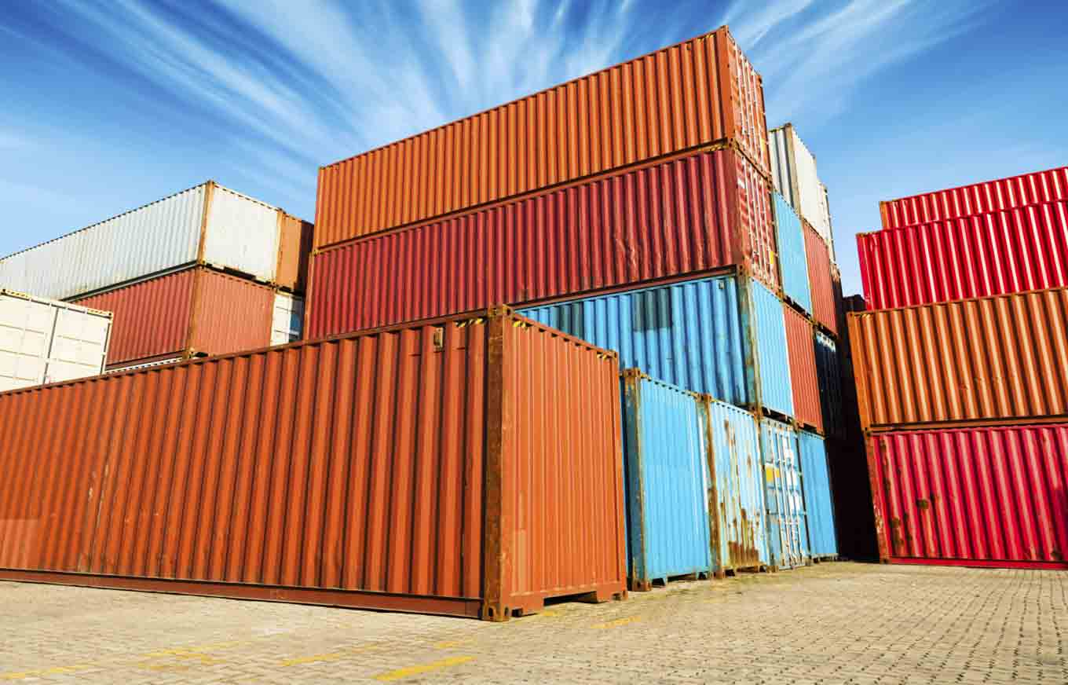
What is Docker?
Packaging, deployment and execution tool
Problems
Environmental differences
Complex deployment processes
Conflicting dependencies
Solution
Process isolation
Bundle app and dependencies into containers
Consistency and portability

Slide 7
TODO
https://www.datadoghq.com/docker-adoption/

Slide 8
Docker on Linux
D CLI
D CLI
D CLI
C
C
C
DE
C
C
C
DE
C
C
C
DE
KERNEL
KERNEL
KERNEL
LINUX
LINUX
LINUX
HYPERVISOR (VMWare; Hyper-V; etc)

Slide 9
Docker on Windows
Docker on Windows – Two Models:
Windows Containers – Kernel-level support like Linux
Windows Server 2016
Hyper-V Isolation – Virtualization-based shim
Windows Server 2016
Windows 10
Version 1511 / November 2016 Update / Build 10586

Slide 10
Windows 10
TODO
https://docs.microsoft.com/en-us/virtualization/windowscontainers/quick-start/quick-start-windows-10

Slide 11
Windows Containers
D CLI
D CLI
D CLI
C
C
C
DE
C
C
C
DE
C
C
C
DE
KERNEL
KERNEL
KERNEL
WIN SRV 2016
WIN SRV 2016
WIN SRV 2016
HYPERVISOR (VMWare; Hyper-V; etc)

Slide 12
Hyper-V Isolation
D CLI
D CLI
D CLI
C
C
DE
C
C
DE
C
C
DE
VM
VM
VM
HYPER-V
HYPER-V
HYPER-V
KERNEL
KERNEL
KERNEL
WIN SRV 2016 / WIN 10
WIN SRV 2016 / WIN 10
WIN SRV 2016 / WIN 10
HYPERVISOR (Hyper-V)

Slide 13

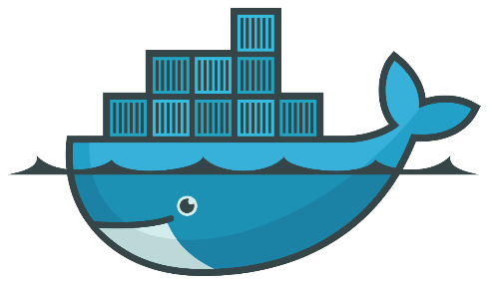


Virtualization vs Containerization
Docker is a cool new virtualization technology

Slide 14
Virtualization vs Containerization
Virtualization
Virtual hardware
CPU
Disk
Memory
Devices
Guest OS and software installed into VM
VM’s => System-Oriented
Containerization
Native hardware – no hypervisor
Allocate resources with control groups (on Linux)
Host kernel is used by containerized process
No additional OS install
Supporting software and libraries are bundled into the container
Containers => Service-Oriented

Slide 15
Docker Basics

Slide 16
hello-world
Run it!
docker run hello-world
Review https://hub.docker.com/_/hello-world/
Pull
docker pull debian:9
Check C:\Users\Public\Documents\Hyper-V\Virtual hard disks

Slide 17
hello-world
Run an interactive session in Debian 9
docker run –i -t debian:9 /bin/bash
Run a detached nginx instance
docker run –d nginx
Launch a bash process in the detached nginx instance
docker exec -it <id> /bin/bash

Slide 18
hello-world
Attach to the detached nginx instance
docker attach <id>
Housekeeping commands
docker stop
docker rm
docker images
docker rmi
docker container prune
docker image prune

Slide 19
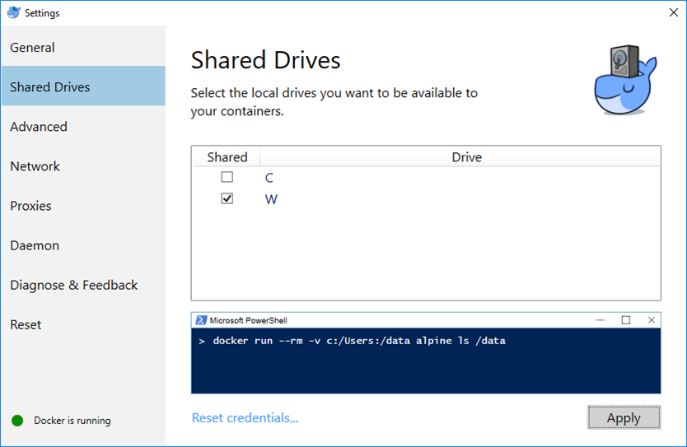
Exercise 2 – Externalities

Slide 20
Externalities
Mounting file system volumes
docker run –it –v W:\data:/data debian:9 /bin/bash
Exposing ports
docker run -it -p 8080:80 nginx
Environment variables
docker run -it -e "FOO=bar" debian:9 /bin/bash
root@8e035b9c48d9:/# echo $FOO

Slide 21
Serve static content in IIS (nanoserver)

Slide 22

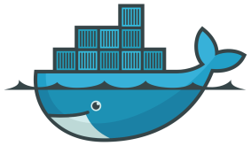
Switch to Windows Containers

Slide 23
Serve static content in IIS (nanoserver)
Review the base IIS image at https://hub.docker.com/r/microsoft/iis/
Note: nanoserver vs windowsservercore
Start with the tutorial Dockerfile:
FROM microsoft/iis:nanoserver-10.0.14393.1715
RUN mkdir C:\site
RUN powershell -NoProfile -Command \
Import-module IISAdministration; \
New-IISSite -Name "Site" -PhysicalPath C:\site -BindingInformation "*:8000:"
EXPOSE 8000
ADD content/ /site

Slide 24
Serve static content in IIS (nanoserver)
Build
docker build -t my/iis .
Run
docker run --rm -it --name iis my/iis
Connect browse to <IP>:8000 – get IP from inspect:
docker inspect iis
docker inspect -f "{{ .NetworkSettings.Networks.nat.IPAddress }}" iis

Slide 25
Serve static content in IIS (nanoserver)
Create a volume for our static site:
docker volume create --name website
Drop content into C:\ProgramData\Docker\volumes\website
Remove ADD from Dockerfile and rebuild
Run with external volume mounted
docker run --rm -it --name iis -v C:\ProgramData\Docker\volumes\website:C:\site my/iis

Slide 26
Dockerize a .NET Core WebAPI microservice (nanoserver & linux)

Slide 27
Dockerize a .NET Core WebAPI microservice (nanoserver & linux)
Goal: Create a ASP.NET Core WebAPI microservice that runs identically under both nanoserver and linux

Slide 28
Switch to Windows Containers

Slide 29
Dockerize a .NET Core WebAPI microservice (nanoserver & linux)
Review the tasksapp code
Launch an interactive container for build
docker run --rm -it -v <your root path>\tasksapp\MyCo.Tasks:/build microsoft/aspnetcore-build:2.0.0 /bin/bash
Build
dotnet clean
dotnet restore
dotnet publish -c Release -o out
Exit the “build” container

Slide 30
Dockerize a .NET Core WebAPI microservice (nanoserver & linux)
Define the “runtime” container in a new Dockerfile
FROM microsoft/aspnetcore:2.0.0
RUN mkdir /service
WORKDIR /service
COPY MyCo.Tasks/out .
EXPOSE 80
ENTRYPOINT ["dotnet", "MyCo.Tasks.dll"]
Build
docker build –t myco/tasks .

Slide 31
Dockerize a .NET Core WebAPI microservice (nanoserver & linux)
Run
docker run --rm -it --name tasks –p:9871:80 myco/tasks
Find out the container IP – due to the Windows Container networking flaw
docker inspect tasks
Browse to http://<ip address>:80
Kill the container

Slide 32
Better Builds with Docker
Dockerfile.build approach
FROM microsoft/aspnetcore-build:2.0.0
WORKDIR /build
RUN dotnet clean
RUN dotnet restore
RUN dotnet publish -c Release -o out
Build the build container image – this actually runs the build
docker build -t myco/tasks-build -f Dockerfile.build .
Retrieve the build result from the image
docker create --name tasks-build myco/tasks-build
docker cp tasks-build:/build/out .
docker rm tasks-build

Slide 33
Better Builds with Docker
From Docker 17.05 – multi-stage build approach
# Build Stage
FROM microsoft/aspnetcore-build:2.0-jessie AS tasks-build
RUN mkdir /build
WORKDIR /build
COPY MyCo.Tasks/ ./
RUN dotnet clean
RUN dotnet restore
RUN dotnet publish -c Release -o out
# Run Stage
FROM microsoft/aspnetcore:2.0-jessie
RUN mkdir /service
WORKDIR /service
COPY --from=tasks-build /build/out .
EXPOSE 80
ENTRYPOINT ["dotnet", "MyCo.Tasks.dll"]
References
https://docs.docker.com/engine/userguide/eng-image/multistage-build/
https://blog.alexellis.io/mutli-stage-docker-builds/

Slide 34
Dockerize a .NET Core WebAPI microservice (nanoserver & linux)
Build and run
docker build –t myco/tasks .
docker run --rm -it --name tasks –p:9871:80 myco/tasks
Find out the container IP – due to the Windows Container networking flaw
docker inspect tasks
Browse to http://<ip address>:80
Kill the container

Slide 35

Switch to LinuxContainers

Slide 36
Dockerize a .NET Core WebAPI microservice (nanoserver & linux)
Build and run
docker build –t myco/tasks .
docker run --rm -it --name tasks –p:9871:80 myco/tasks
Browse to http://localhost:9871
Kill the container

Slide 37
Multi-container solution with docker-compose (linux)

Slide 38
Multi-container solution with docker-compose (linux)
docker-compose
Create multi-container stacks
Define stack in a single YAML file
Single command to launch all containers in the stack
docker-compose –f mystack.yml up

Slide 39
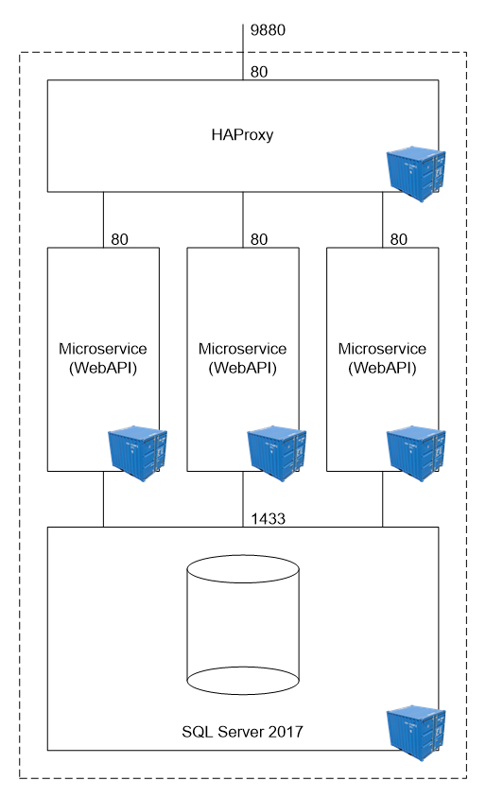
Multi-container solution with docker-compose (linux)

Slide 40
Switch to Linux Containers

Slide 41
Multi-container solution with docker-compose (linux)
Initial docker-compose.yml
version: "3"
services:
api:
build: .
Run and examine
docker-compose up
Destroy
docker-compose down

Slide 42
Multi-container solution with docker-compose (linux)
Map port
ports:
- "9871:80“
Run again and browse http://localhost:9870/api/tasks

Slide 43
Worker Nodes
Build out three API worker nodes
version: "3"
services:
api1:
build: .
ports:
- "9871:80"
api2:
build: .
ports:
- "9872:80"
api3:
build: .
ports:
- "9873:80"

Slide 44
Worker Nodes
Explicitly label the images built by docker-compose:
version: "3"
services:
api1:
image: myco/tasks
build: .
ports:
- "9871:80"
api2:
image: myco/tasks
build: .
ports:
- "9872:80"
api3:
image: myco/tasks
build: .
ports:
- "9873:80"

Slide 45
Worker Nodes
Browse to
http://localhost:9871/api/tasks
http://localhost:9872/api/tasks
http://localhost:9873/api/tasks
Stop the stack
docker-compose –f docker-compose.lin.yml down

Slide 46
Load Balancer
Add haproxy service
haproxy:
image: library/haproxy:1.7
volumes:
- haproxy_cfg:/usr/local/etc/haproxy
ports:
- "9880:80"
- "9881:70"
links:
- api1
- api2
- api3

Slide 47
Load Balancer
Declare the volume
volumes:
haproxy_cfg:
external: true
Launch – observe volume error
docker-compose up
ERROR: Volume haproxy_cfg declared as external, but could not be found. Please create the volume manually using `docker volume create --name=haproxy_cfg` and try again.

Slide 48
Load Balancer
Create the volume to hold the haproxy configuration:
docker volume create haproxy_cfg
Import the haproxy.cfg file into the volume via a temporary container:
scripts\haproxy_copy_config.cmd

Slide 49
Load Balancer
Run and observe roundrobin load balancing
docker-compose up
Browse to http://localhost:9880/api/tasks
Each node has its own in-mem data, so each refresh will be different
Drop the worker-node ports

Slide 50
Load Balancer
Create docker-compose.lin.dev.yml to mixin worker-node ports for debugging
version: "3"
services:
api1:
ports:
- "9871:80"
api2:
ports:
- "9872:80"
api3:
ports:
- "9873:80«
Launch stack with ports mixed in
docker-compose -f docker-compose.lin.yml -f docker-compose.lin.dev.yml up

Slide 51
Add SQL Server 2017
Create a data directory – e.g mine is W:\data
Launch a SQL Server 2017 instance – in Docker!
docker run ^
-e "ACCEPT_EULA=Y" ^
-e "MSSQL_SA_PASSWORD=p@ssw0rz!@#" ^
-p 1401:1433 ^
-v W:\data:/var/opt/mssql ^
--name sql1 ^
-d ^
microsoft/mssql-server-linux:2017-GA
Shortcut scripts/start_sql_linux.cmd

Slide 52
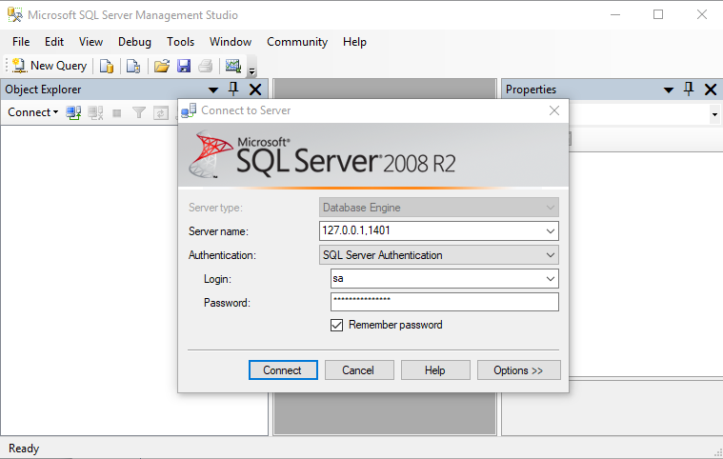
Add SQL Server 2017
Edit the microservice config to connect to a database
Create the database on a temporary SQL Server instance
Create a volume for the data files
docker volume create tasks-db
Review and run the script:
scripts\start_sql_linux.cmd
Connect via SSMS

Slide 53
Add SQL Server 2017
Create a new database with the script at Database\tasks_database.sql
Terminate SQL Server
docker stop sql1

Slide 54
Add SQL Server 2017
Add a new “db” service to docker-compose.lin.yml:
db:
image: microsoft/mssql-server-linux:2017-GA
environment:
ACCEPT_EULA: "Y"
MSSQL_SA_PASSWORD: "p@ssw0rz!@#"
volumes:
- tasks-db:/var/opt/mssql
expose:
- "1433"
ports:
- "1402:1433"

Slide 55
Add SQL Server 2017
Declare the external volume
volumes:
haproxy_cfg:
external: true
tasks-db:
external: true

Slide 56
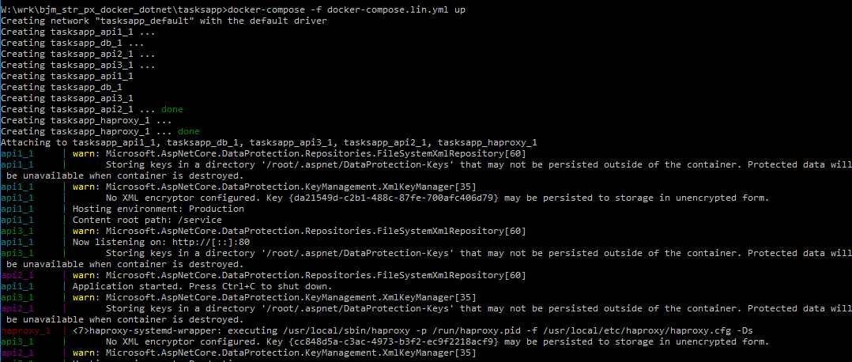
Add SQL Server 2017
Launch the stack
docker-compose -f docker-compose.lin.yml up
Browse to http://localhost:9880/api/tasks

Slide 57
Multi-container solution with docker-compose (nanoserver)

Slide 58
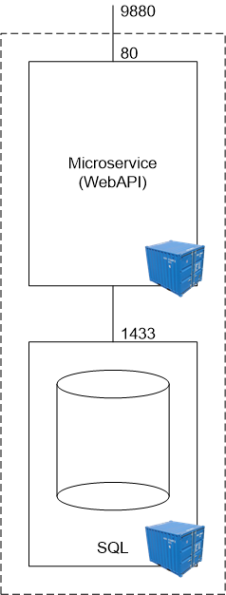
Multi-container solution with docker-compose (nanoserver)
Notes:
Limited example because HAProxy and Nginx only available on Linux

Slide 59
Switch to Windows Containers

Slide 60
Create Database
Create the managed volume
docker volume create tasks-db
Launch SQL Server 2017 on Windows via helper script
scripts\start_sql_win.cmd

Slide 61
Connect – note NAT limitation for Windows Containers
Find IP of the container on the host-only-network
docker inspect sql1
References
https://blog.sixeyed.com/published-ports-on-windows-containers-dont-do-loopback/
https://blogs.technet.microsoft.com/virtualization/2016/05/25/windows-nat-winnat-capabilities-and-limitations/

Slide 62
Define Single Worker Node
version: "3"
services:
api:
build: .
image: myco/tasks
environment:
ASPNETCORE_ENVIRONMENT: "Production«
ports:
- "9871:80"

Slide 63
Define Database
Database service:
db:
image: microsoft/mssql-server-windows-developer:2017
environment:
ACCEPT_EULA: "Y"
SA_PASSWORD: "p@ssw0rz!@#"
ATTACH_DBS: "[{'dbName':'Tasks','dbFiles':['C:\\\\data\\\\Tasks.mdf', 'C:\\\\data\\\\Tasks.ldf']}]"
volumes:
- "tasks-db:C:\\data"
ports:
- "1401:1433"
Declare volume
volumes:
tasks-db:
external: true

Slide 64
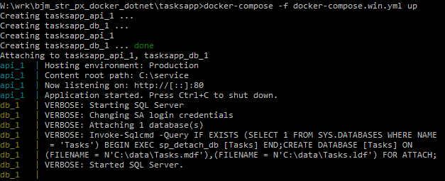
Launch Stack
docker-compose -f docker-compose.win.yml up

Slide 65
Scheduling a cluster with Docker Swarm

Slide 66
Scheduling a cluster with Docker Swarm
Docker Swarm is a Docker-native clustering system that exposes the same API as the standalone Docker Engine
References:
https://docs.docker.com/compose/swarm/

Slide 67
Deploying to AWS ECS

Slide 68
Deploying to AWS ECS
TODO

Slide 69
Tooling Etc

Slide 70
CI and Build Containers
TODO

Slide 71
Testing Containers
TODO

Slide 72
Docker Cloud
TODO

Slide 73
Visual Studio 2017 Support for Docker
TODO

