Slide 1
Pre-Flight Checks
Call for help if needed:
Docker Installed?
SQL Server Management Studio (SSMS) installed?
Git installed?
Can use git?
Docker pulls done?
Will join the AWS exercise?
Please let Bren know
Bitlocker fix:
Set-ItemProperty -Path "HKLM:\SYSTEM\CurrentControlSet\Policies\Microsoft\FVE" -Name FDVDenyWriteAccess -Value 0
https://github.com/docker/kitematic/wiki/Common-Issues-and-Fixes
# Clone the repo!!
$ git clone https://github.com/brendonmatheson/docker_fu.git
Cloning into 'docker_fu'...
$ cd docker_fu
$ git checkout agoda_ex1

Slide 2

Docker Fu

Slide 3


Slide 4
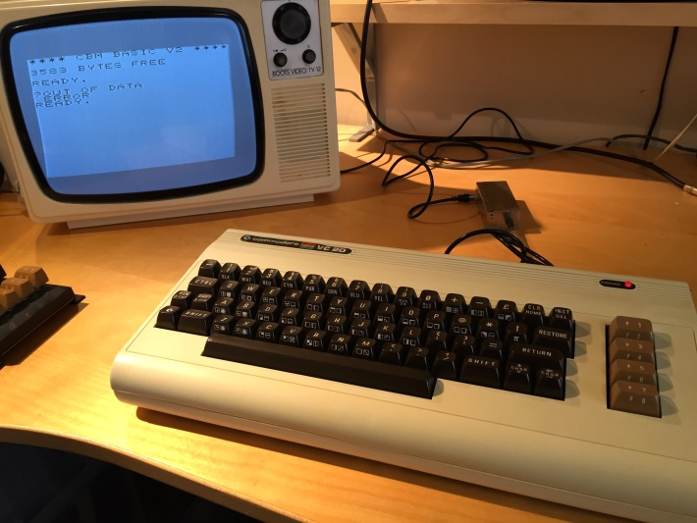
Your Presenter
Brendon Matheson
ชื่อเล่น เบรน
Australian - 11yr Bangkok Resident
Currently Working On
Healthcare (Architect at Orion Health)
Cloud / Multi-Tenant / SaaS
Functions-as-a-Service (FaaS)

Slide 5

I Know Docker Fu

Slide 6
Session Plan
Basics
What is Docker?
Docker Basics
Serve static content in IIS (nanoserver)
Real
Dockerize a .NET Core WebAPI microservice (nanoserver & linux)
Production
Multi-container solution with docker-compose (linux)
Multi-container solution with docker-compose (nanoserver)
Scheduling a cluster with Docker Swarm
Cloud
Deploying to AWS ECS
Tooling Etc
Docker Cloud
Continuous Integration
Kitematic

Slide 7
What is Docker?

Slide 8

What is Docker?
Packaging, deployment and execution tool
Problems
Environmental differences
Complex deployment processes
Conflicting dependencies
Solution
Process isolation
Bundle app and dependencies into containers
Consistency and portability

Slide 9
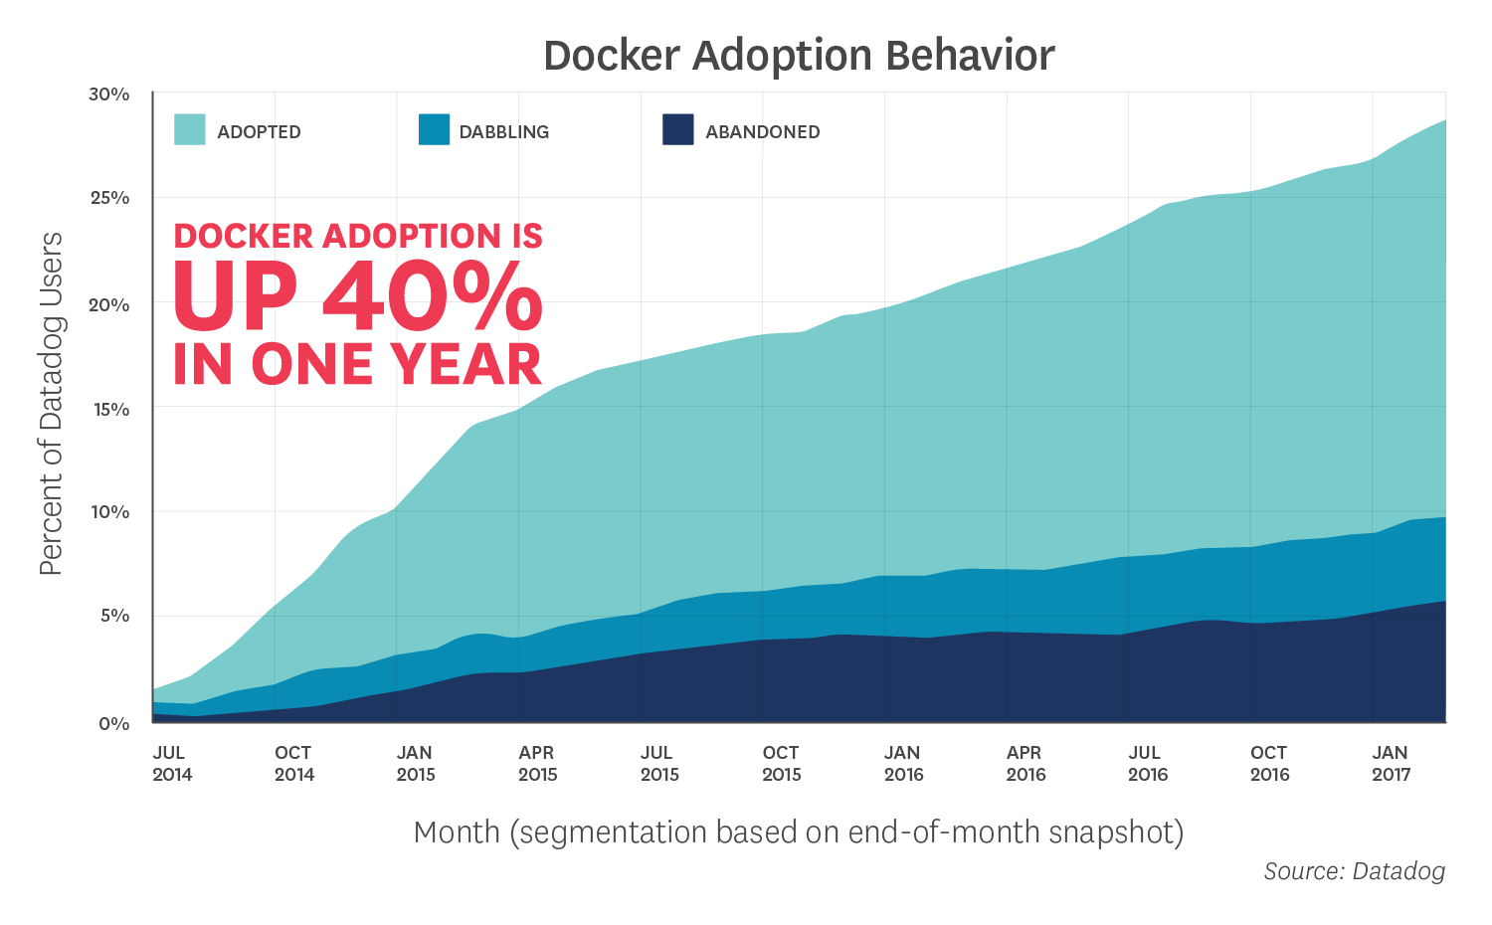
Adoption
Source: https://www.datadoghq.com/docker-adoption/

Slide 10
Docker on Linux
D CLI
D CLI
D CLI
C
C
C
DE
C
C
C
DE
C
C
C
DE
KERNEL
KERNEL
KERNEL
LINUX
LINUX
LINUX
HYPERVISOR (VMWare; Hyper-V; etc)

Slide 11
Docker on Windows
Docker on Windows – Two Models:
Windows Containers – Kernel-level support like Linux
Windows Server 2016
Hyper-V Isolation – Virtualization-based shim
Windows Server 2016
Windows 10
Version 1511 / November 2016 Update / Build 10586
References:
https://docs.microsoft.com/en-us/virtualization/windowscontainers/quick-start/quick-start-windows-10
https://docs.docker.com/docker-for-windows/install/

Slide 12
Windows Containers
D CLI
D CLI
D CLI
C
C
C
DE
C
C
C
DE
C
C
C
DE
KERNEL
KERNEL
KERNEL
WIN SRV 2016
WIN SRV 2016
WIN SRV 2016
HYPERVISOR (VMWare; Hyper-V; etc)

Slide 13
Hyper-V Isolation
D CLI
D CLI
D CLI
C
C
DE
C
C
DE
C
C
DE
VM
VM
VM
HYPER-V
HYPER-V
HYPER-V
KERNEL
KERNEL
KERNEL
WIN SRV 2016 / WIN 10
WIN SRV 2016 / WIN 10
WIN SRV 2016 / WIN 10
HYPERVISOR (Hyper-V)

Slide 14

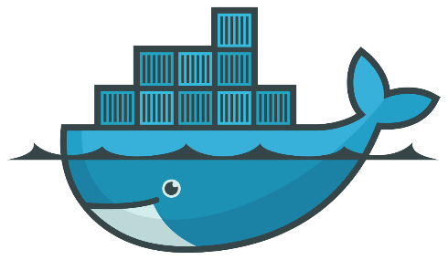
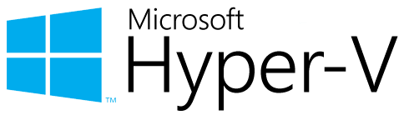
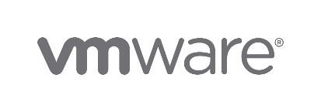
Virtualization vs Containerization
Docker is a cool new virtualization technology

Slide 15
Virtualization vs Containerization
Virtualization
Virtual hardware
CPU
Disk
Memory
Devices
Guest OS and software installed into VM
VM’s => System-Oriented
Containerization
Native hardware – no hypervisor
Host kernel is used by containerized process
Allocate resources with control groups
No additional OS install
Supporting software and libraries are bundled into the container
Containers => Service-Oriented

Slide 16
Docker Basics

Slide 17
hello-world
Run it!
docker run hello-world
Review https://hub.docker.com/_/hello-world/
Pull
docker pull alpine:3.5

Slide 18
hello-world
Run an interactive session in Alpine Linux
docker run –i -t alpine:3.5 /bin/sh
Linux kernel?
Review Hyper-V Manager
Run a detached nginx instance
docker run –d nginx:1.13-alpine
Launch a shell process in the detached nginx instance
docker exec -it <id> /bin/sh

Slide 19
hello-world
Housekeeping commands
docker ps
docker stop
docker rm
docker images
docker rmi
docker container prune
docker image prune

Slide 20
Externalities
Mounting file system volumes
docker run –it –v W:\data:/data alpine:3.5 /bin/sh
Exposing ports
docker run -it -p 8080:80 nginx:1.13-alpine
Environment variables
docker run -it -e "FOO=bar" alpine:3.5 /bin/sh
root@8e035b9c48d9:/# echo $FOO

Slide 21
Serve static content in IIS (nanoserver)

Slide 22

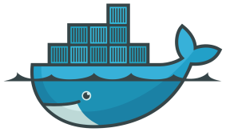
Switch to Windows Containers

Slide 23
Serve static content in IIS (nanoserver)
Review the base IIS image at https://hub.docker.com/r/microsoft/iis/
Note: nanoserver vs windowsservercore
Start with the tutorial Dockerfile:
FROM microsoft/iis:nanoserver-10.0.14393.1715
RUN mkdir C:\site
RUN powershell -NoProfile -Command \
Import-module IISAdministration; \
New-IISSite -Name "Site" -PhysicalPath C:\site -BindingInformation "*:8000:"
EXPOSE 8000
ADD content/ /site

Slide 24
Serve static content in IIS (nanoserver)
Build
docker build -t my/iis .
Run
docker run --rm -it --name iis my/iis
Connect browse to <IP>:8000 – get IP from inspect:
docker inspect iis
docker inspect -f "{{ .NetworkSettings.Networks.nat.IPAddress }}" iis

Slide 25
Dockerize a .NET Core WebAPI microservice (nanoserver & linux)

Slide 26
Dockerize a .NET Core WebAPI microservice (nanoserver & linux)
Goal: Create a ASP.NET Core WebAPI microservice that runs identically under both nanoserver and linux

Slide 27

Switch to Linux Containers

Slide 28
Dockerize a .NET Core WebAPI microservice (nanoserver & linux)
Review the tasksapp code
Launch an interactive container for build
docker run --rm -it -v <your root path>\tasksapp\MyCo.Tasks:/build microsoft/aspnetcore-build:2.0.0 /bin/bash
Build
dotnet clean
dotnet restore
dotnet publish -c Release -o out
Exit the “build” container

Slide 29
Dockerize a .NET Core WebAPI microservice (nanoserver & linux)
Define the “runtime” container in a new Dockerfile
FROM microsoft/aspnetcore:2.0.0
RUN mkdir /service
WORKDIR /service
COPY MyCo.Tasks/out .
EXPOSE 80
ENTRYPOINT ["dotnet", "MyCo.Tasks.dll"]
Build
docker build –t myco/api .

Slide 30
Dockerize a .NET Core WebAPI microservice (nanoserver & linux)
Run
docker run --rm -it --name api –p:9871:80 myco/api
Browse to http://localhost:9871/api/tasks
Kill the container

Slide 31
Better Builds with Docker
Dockerfile.build approach
FROM microsoft/aspnetcore-build:2.0.0
WORKDIR /build
RUN dotnet clean
RUN dotnet restore
RUN dotnet publish -c Release -o out
Build the build container image – this actually runs the build
docker build -t myco/api-build -f Dockerfile.build .
Retrieve the build result from the image
docker create --name tasks-build myco/api-build
docker cp tasks-build:/build/out .
docker rm tasks-build

Slide 32
Better Builds with Docker
From Docker 17.05 – multi-stage build approach in a single Dockerfile
# Build Stage
FROM microsoft/aspnetcore-build:2.0.0 AS tasks-build
RUN mkdir /build
WORKDIR /build
COPY MyCo.Tasks/ ./
RUN dotnet clean
RUN dotnet restore
RUN dotnet publish -c Release -o out
# Run Stage
FROM microsoft/aspnetcore:2.0.0
RUN mkdir /service
WORKDIR /service
COPY --from=tasks-build /build/out .
EXPOSE 80
ENTRYPOINT ["dotnet", "MyCo.Tasks.dll"]
References
https://docs.docker.com/engine/userguide/eng-image/multistage-build/
https://blog.alexellis.io/mutli-stage-docker-builds/

Slide 33
Dockerize a .NET Core WebAPI microservice (nanoserver & linux)
Build and run
docker build –t myco/api .
docker run --rm -it --name api –p:9871:80 myco/api
Browse to http://localhost:9871/api/tasks
Kill the container

Slide 34
Switch to Windows Containers

Slide 35
Dockerize a .NET Core WebAPI microservice (nanoserver & linux)
Build and run
docker build –t myco/api .
docker run --rm -it --name api –p:9871:80 myco/api
Find out the container IP – due to the Windows networking NAT limitation
docker inspect tasks
Browse to http://<ip address>:80/api/tasks
Kill the container

Slide 36
Windows NAT Limitation
Linux can NAT through the loopback interface 127.0.0.1 / localhost
Windows cannot (yet)
https://blog.sixeyed.com/published-ports-on-windows-containers-dont-do-loopback/
https://blogs.technet.microsoft.com/virtualization/2016/05/25/windows-nat-winnat-capabilities-and-limitations/
Port forwards DO work from outside – i.e. limitation only applies locally
Already fixed and in preview
https://blogs.technet.microsoft.com/networking/2017/11/06/available-to-windows-10-insiders-today-access-to-published-container-ports-via-localhost127-0-0-1/

Slide 37
Multi-container solution with docker-compose (linux)

Slide 38
Multi-container solution with docker-compose (linux)
docker-compose
Create multi-container stacks
Define stack in a single YAML file
Single command to launch all containers in the stack
docker-compose –f mystack.yml up

Slide 39
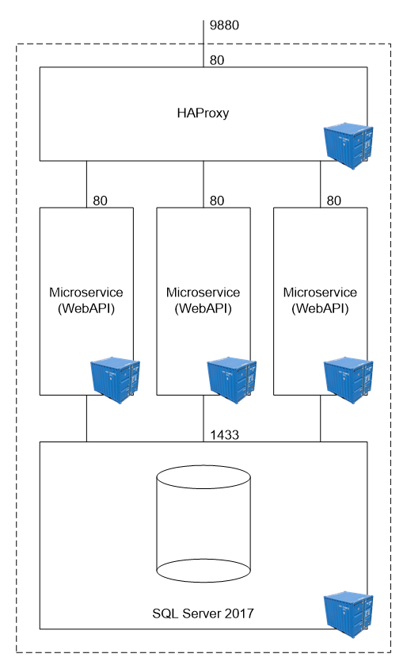
Multi-container solution with docker-compose (linux)

Slide 40
Switch to Linux Containers

Slide 41
Multi-container solution with docker-compose (linux)
Initial docker-compose.yml
version: "3"
services:
api:
build: .
Run and examine
docker-compose up
Destroy
docker-compose down

Slide 42
Multi-container solution with docker-compose (linux)
Map port
ports:
- "9871:80“
Run again and browse http://localhost:9870/api/tasks

Slide 43
Worker Nodes
Build out three API worker nodes
version: "3"
services:
api1:
build: .
ports:
- "9871:80"
api2:
build: .
ports:
- "9872:80"
api3:
build: .
ports:
- "9873:80"

Slide 44
Worker Nodes
Explicitly label the images built by docker-compose:
version: "3"
services:
api1:
image: myco/api
build: .
ports:
- "9871:80"
api2:
image: myco/api
build: .
ports:
- "9872:80"
api3:
image: myco/api
build: .
ports:
- "9873:80"

Slide 45
Worker Nodes
Browse to
http://localhost:9871/api/tasks
http://localhost:9872/api/tasks
http://localhost:9873/api/tasks
Stop the stack
docker-compose –f docker-compose.lin.yml down

Slide 46
Load Balancer
Add haproxy service
haproxy:
image: library/haproxy:1.7
volumes:
- haproxy_cfg:/usr/local/etc/haproxy
ports:
- "9880:80"
- "9881:70"
links:
- api1
- api2
- api3

Slide 47
Load Balancer
Declare the volume
volumes:
haproxy_cfg:
external: true
Launch – observe volume error
docker-compose up
ERROR: Volume haproxy_cfg declared as external, but could not be found. Please create the volume manually using `docker volume create --name=haproxy_cfg` and try again.

Slide 48
Load Balancer
Create the volume to hold the haproxy configuration:
docker volume create haproxy_cfg
Import the haproxy.cfg file into the volume via a temporary container:
scripts\haproxy_copy_config.cmd

Slide 49
Load Balancer
Run and observe round-robin load balancing
docker-compose up
Browse to http://localhost:9880/api/tasks
Each node has its own in-mem data, so each refresh will be different
Drop the worker-node ports

Slide 50
Load Balancer
Create docker-compose.lin.dev.yml to mixin worker-node ports for debugging
version: "3"
services:
api1:
ports:
- "9871:80"
api2:
ports:
- "9872:80"
api3:
ports:
- "9873:80«
Launch stack with ports mixed in
docker-compose -f docker-compose.lin.yml -f docker-compose.lin.dev.yml up

Slide 51
Add SQL Server 2017
Create a data directory – e.g mine is W:\data
Launch a SQL Server 2017 instance – in Docker!
docker run ^
-e "ACCEPT_EULA=Y" ^
-e "MSSQL_SA_PASSWORD=p@ssw0rz!@#" ^
-p 1401:1433 ^
-v W:\data:/var/opt/mssql ^
--name sql1 ^
-d ^
microsoft/mssql-server-linux:2017-GA
Shortcut scripts\start_sql_linux.cmd

Slide 52
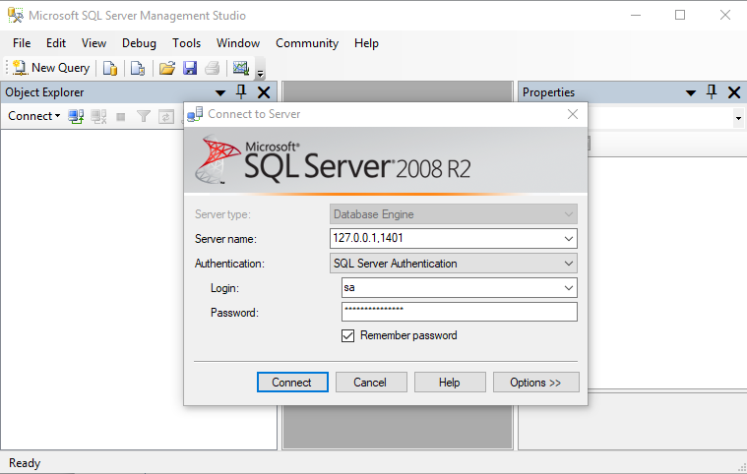
Add SQL Server 2017
Edit the microservice config to connect to a database
Create the database on a temporary SQL Server instance
Create a volume for the data files
docker volume create tasks-db
Review and run the script:
scripts\start_sql_linux.cmd
Connect via SSMS

Slide 53
Add SQL Server 2017
Create a new database with the script at Database\tasks_database.sql
Terminate SQL Server
docker stop sql1

Slide 54
Add SQL Server 2017
Add a new “db” service to docker-compose.lin.yml:
db:
image: microsoft/mssql-server-linux:2017-GA
environment:
ACCEPT_EULA: "Y"
MSSQL_SA_PASSWORD: "p@ssw0rz!@#"
volumes:
- tasks-db:/var/opt/mssql
expose:
- "1433"
ports:
- "1402:1433"

Slide 55
Add SQL Server 2017
Declare the external volume
volumes:
haproxy_cfg:
external: true
tasks-db:
external: true

Slide 56
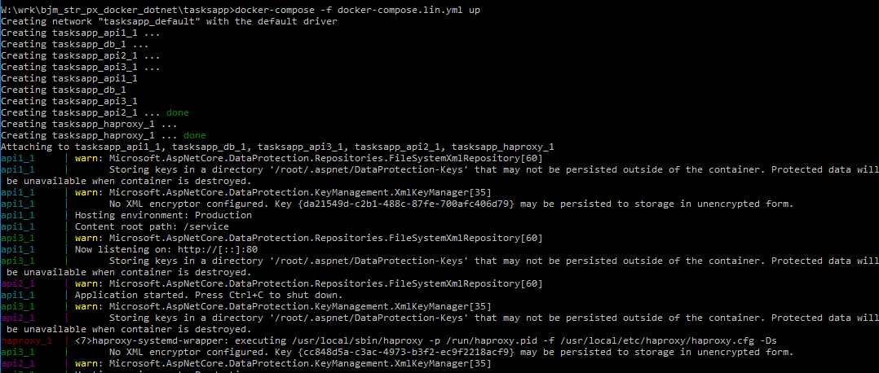
Full System in One File
Launch the system
docker-compose -f docker-compose.lin.yml up
Browse to http://localhost:9880/api/tasks

Slide 57
Multi-container solution with docker-compose (nanoserver)

Slide 58
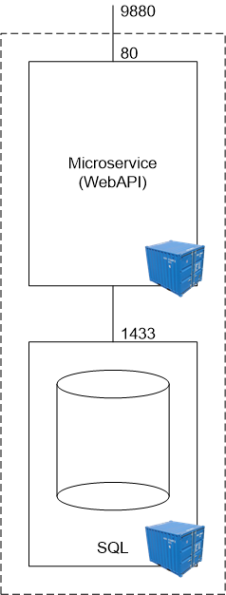
Multi-container solution with docker-compose (nanoserver)
Notes:
Limited example because HAProxy and Nginx only available on Linux

Slide 59
Switch to Windows Containers

Slide 60
Create Database
Create the managed volume
docker volume create tasks-db
Launch SQL Server 2017 on Windows via helper script
scripts\start_sql_win.cmd

Slide 61
Define Single Worker Node
version: "3"
services:
api:
build: .
image: myco/api
environment:
ASPNETCORE_ENVIRONMENT: "Production"
ports:
- "9871:80"

Slide 62
Define Database
Database service:
db:
image: microsoft/mssql-server-windows-developer:2017
environment:
ACCEPT_EULA: "Y"
SA_PASSWORD: "p@ssw0rz!@#"
ATTACH_DBS: "[{'dbName':'Tasks','dbFiles':['C:\\\\data\\\\Tasks.mdf', 'C:\\\\data\\\\Tasks.ldf']}]"
volumes:
- "tasks-db:C:\\data"
ports:
- "1401:1433"
Declare volume
volumes:
tasks-db:
external: true

Slide 63
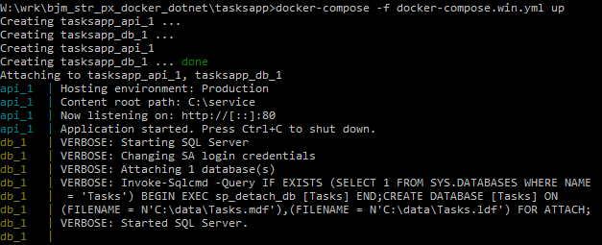
Launch Stack
docker-compose -f docker-compose.win.yml up

Slide 64
Multi-Container Solution Further Reading
SQL Server for Linux
https://docs.microsoft.com/en-us/sql/linux/sql-server-linux-release-notes

Slide 65
Clusters and Schedulers

Slide 66
Clusters and Schedulers
A scheduler automatically deploys and runs containers according to your specifications
Health-checks and auto-healing
Higher-order conceptual unit based on containers
Many options
Kubernetes
Rancher
Swarm
Mesos
DC/OS
AWS ECS

Slide 67
Scheduling a cluster with Docker Swarm

Slide 68
Scheduling a cluster with Docker Swarm
Docker Swarm is a Docker-native clustering system that exposes the same API as the standalone Docker Engine
Health checks
Launch a set number of containers and scale up or down
Rolling updates
References:
https://docs.docker.com/compose/swarm/

Slide 69
Plan
Multi-Node Swarm – hands-off due to complexity
Manual – Step-by-Step
Automated with Compose
Single-Node Swarm – hands-on
Try the multi-node swarm yourself after our workshop

Slide 70
Multi-Node Swarm

Slide 71
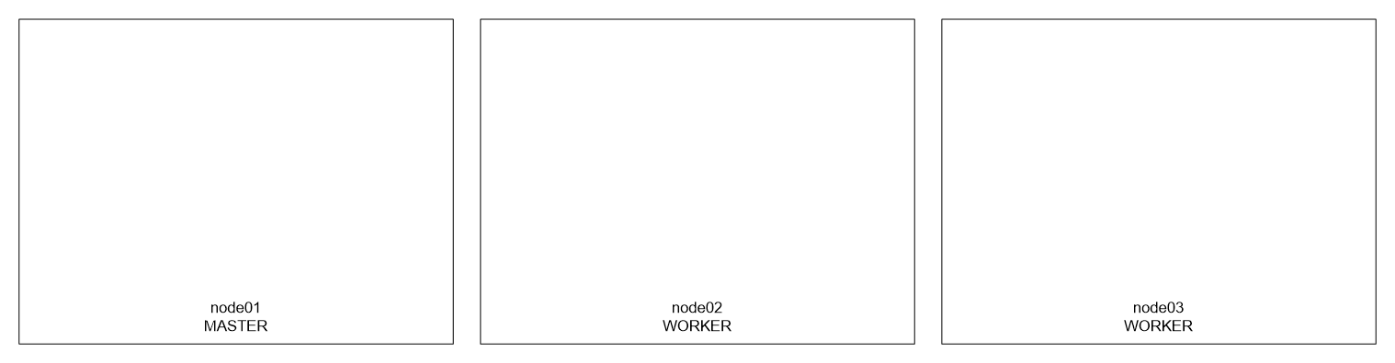
Physical Architecture

Slide 72
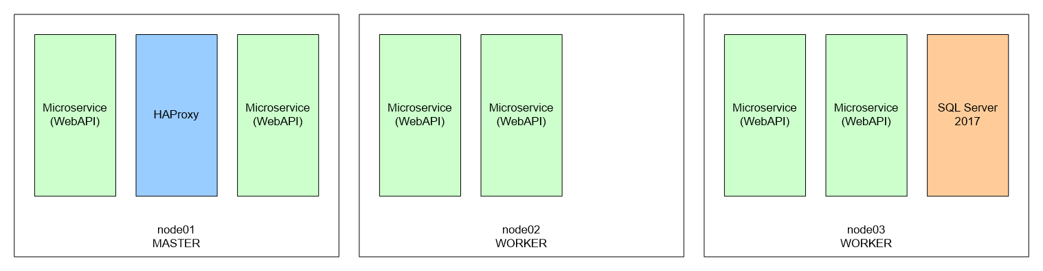
Physical Architecture

Slide 73
Multi-Node Swarm Manual Setup – Build Cluster
Create an external vswitch in Hyper-V named “External”
Create a cluster using docker-machine:
docker-machine create --driver hyperv --hyperv-virtual-switch "External" manager1
docker-machine create --driver hyperv --hyperv-virtual-switch "External" worker1
docker-machine create --driver hyperv --hyperv-virtual-switch "External" worker2
Reconfigure manager1 to have 4GB RAM since we’ll run SQL Server on that later
Check machines and note their IP’s:
docker-machine ls
Turn these separate nodes into a Swarm cluster
docker-machine ssh manager1
docker swarm init --advertise-addr <manager1’s ip>
docker-machine ssh worker1/2 # paste the join command from manager1
Use docker-machine to point local Docker CLI at manager1
docker-machine env manager1

Slide 74
Multi-Node Swarm Manual Setup – Trial API Workers
Build and push the in-mem version of api for Linux
Launch the api service with a single replica
docker service create -d --name api -p 9870:80 --replicas 1 brendonmatheson/api:lin
Browse the running service
Review networking and ingress routing
docker service ls
docker service inspect tasks
docker ps
docker inspect <container_id>

Slide 75
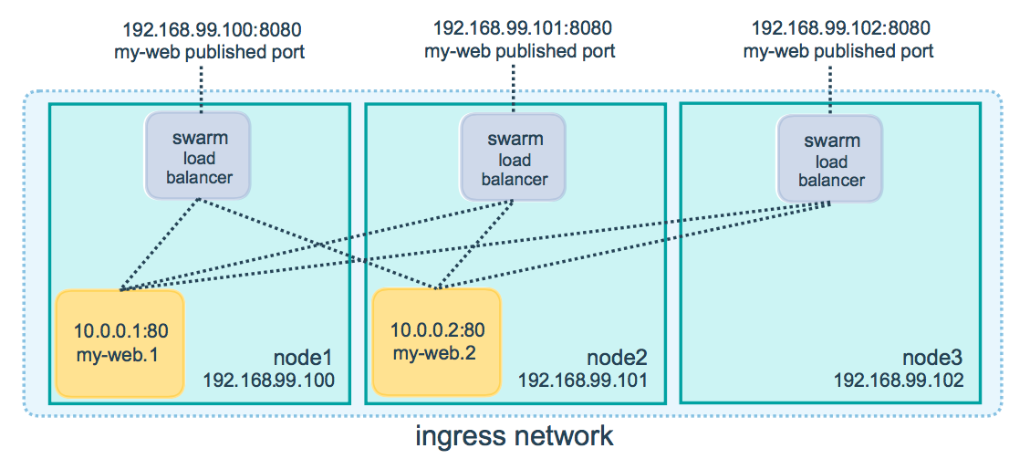
Ingress Routing
Reference:
https://docs.docker.com/engine/swarm/ingress/#publish-a-port-for-a-service

Slide 76
Multi-Node Swarm Manual Setup – Trial API Workers
Update the service to have 4 replicas
docker service update --replicas 4 tasks
docker scale tasks=4
Review again
Kill a machine observe Swarm react
Restore the machine and force a rebalance
docker service update --force
Tear down the service
docker service rm tasks

Slide 77
Multi-Node Swarm Manual Setup – Create Database
Create the volume to hold the database files
docker volume create tasks-db
Launch a temporary SQL Server instance and create the Tasks database
scripts\start_sql_lin.cmd
Connect via SSMS and use db\tasks_database.lin.sql to create the database
Throw away the temporary SQL Server instance:
docker stop sql1

Slide 78
Multi-Node Swarm Manual Setup – DB Service
Create a network for API to talk to database
docker network create --driver overlay tasksbackend
Launch database service on Swarm connected only to backend network
docker service create \
-d \
-e "ACCEPT_EULA=Y" \
-e "MSSQL_SA_PASSWORD=p@ssw0rz@#" \
--network tasksbackend \
--mount type=volume,source=tasks-db,destination=/var/opt/mssql \
--name db \
--replicas 1 \
--constraint "node.role==manager" \
microsoft/mssql-server-linux:2017-GA
References:
https://docs.docker.com/engine/reference/commandline/service_create/#specify-service-constraints-constraint

Slide 79
Multi-Node Swarm Manual Setup – API Service
Build and push the database version of api for Linux
Launch the api service with four replicas and connected to the backend network
docker service create \
-d \
--name api \
-p 9870:80 \
--network tasksbackend \
--replicas 4 \
brendonmatheson/api:lin
Browse the running service
Review networking and routing again
Shell into one of the API containers to further examine VIP’s and DNS resolution

Slide 80
Multi-Node Swarm – Automated with Compose
version: '3'
services:
db:
image: microsoft/mssql-server-linux:2017-GA
environment:
ACCEPT_EULA: "Y"
MSSQL_SA_PASSWORD: "p@ssw0rz@#"
volumes:
- tasks-db:/var/opt/mssql
networks:
- tasksbackend
deploy:
replicas: 1
placement:
constraints:
- "node.role==manager"
volumes:
tasks-db:
external: true
networks:
tasksbackend:
driver: overlay

Slide 81
Multi-Node Swarm – Automated with Compose
api:
image: brendonmatheson/api:lin
ports:
- "9870:80"
networks:
- tasksbackend
deploy:
replicas: 5
Deploy the stack:
docker stack deploy --compose-file docker-compose.stack.yml ts
Reference:
https://docs.docker.com/engine/swarm/stack-deploy/

Slide 82
Single-Node Swarm

Slide 83
Switch to Linux Containers

Slide 84
Single-Node Swarm
Create your single-node swarm
docker swarm init
Deploy the stack – identical config to our multi-node exercise!
docker stack deploy --compose-file docker-compose.stack.lin.yml tasks
Inspect the components of the running stack and make sure you understand them

Slide 85
Swarm Further Reading
Rolling Updates - https://docs.docker.com/engine/swarm/swarm-tutorial/rolling-update/

Slide 86
Deploying to AWS ECS

Slide 87
Deploying to AWS ECS
Registry - ECR
Host our images on AWS
Alternative to Docker Hub
Cluster
Set of virtual machines for running container workloads
Launch from wizard – runs CloudFormation template
Task
Image plus execution meta-data
Service
Clustered set of instances of a Task

Slide 88
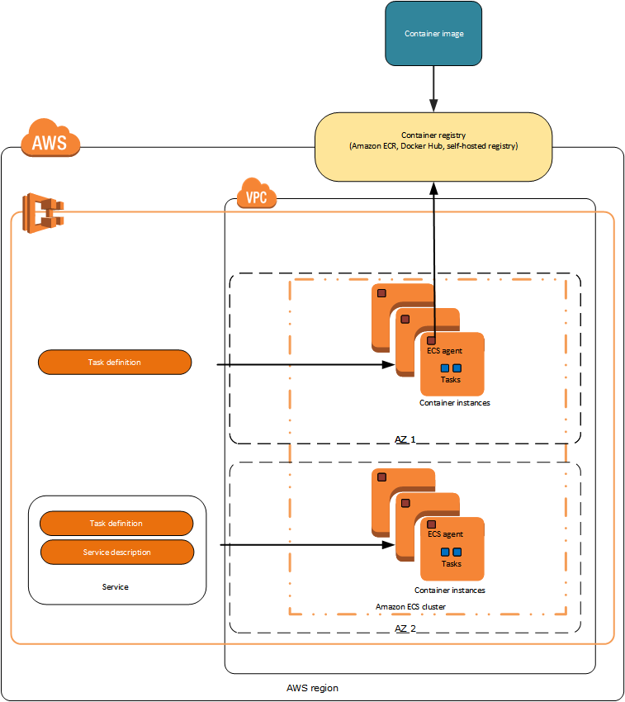

Slide 89
Tooling Etc

Slide 90
Docker Cloud

Slide 91
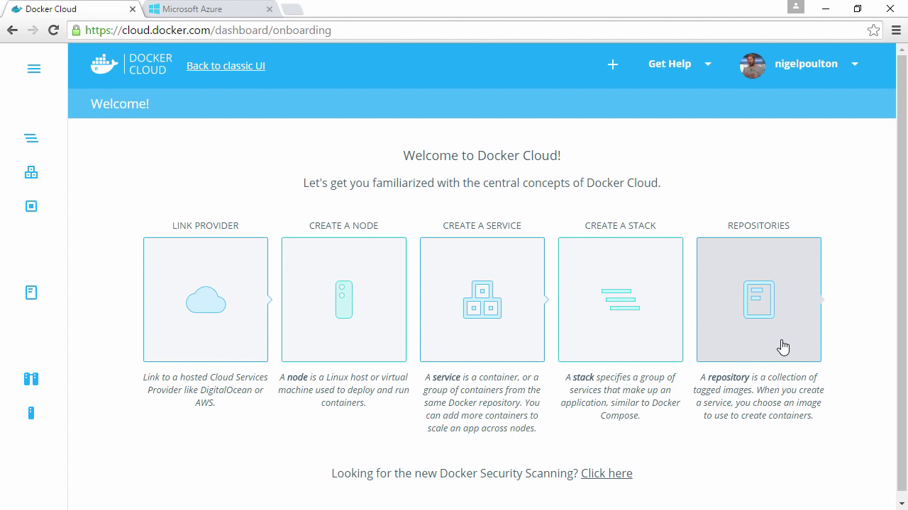
Docker Cloud

Slide 92
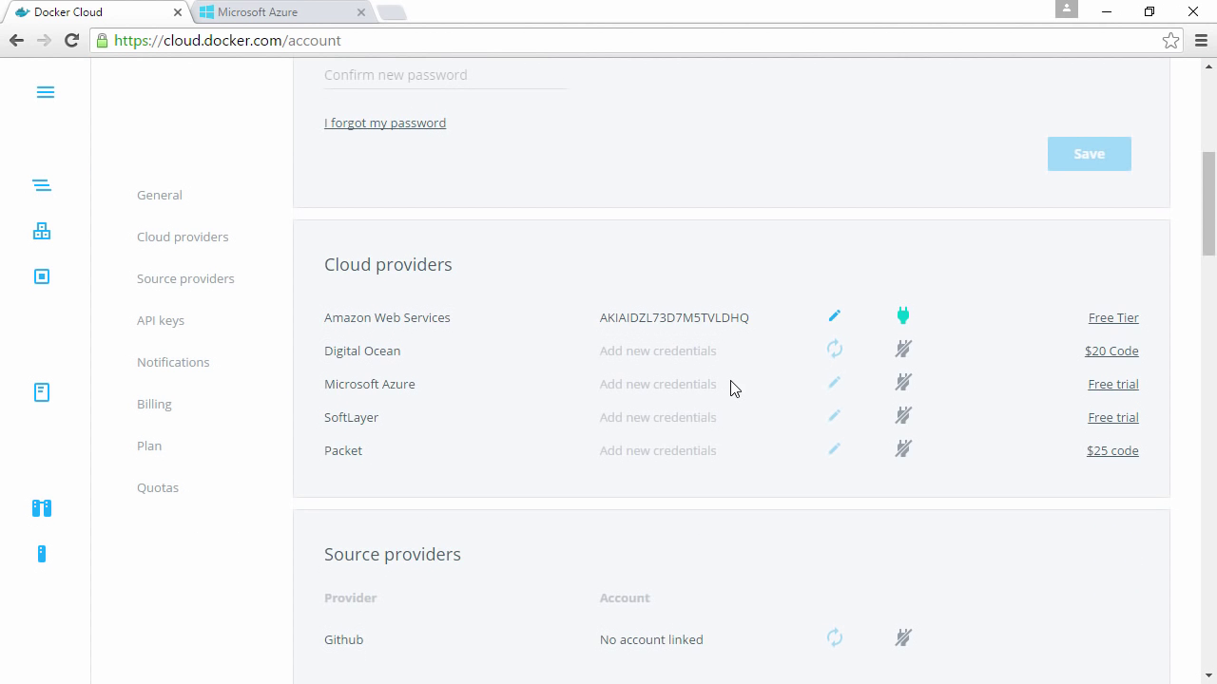
Docker Cloud

Slide 93
Continuous Integration with Docker

Slide 94
Continuous Integration with Docker
Naive approach
Add a docker build to the end of your build configuration
Better approach
Use multi-stage Builds for your whole build process
CI just runs docker build and docker push
Repeatable locally
Also
Run build infrastructure on Docker
docker run -v /var/run/docker.sock:/var/run/docker.sock

Slide 95
Kitematic

Slide 96

Kitematic

Slide 97
Kitematic
GUI Tool for Mac and Windows
May be useful for simple cases when learning

Slide 98
Brens Recommended Docker Learning Curve
Single-Container Use-Cases
Services
CI system
https://hub.docker.com/r/jetbrains/teamcity-server/
https://hub.docker.com/r/jetbrains/teamcity-agent/
https://hub.docker.com/_/jenkins/
VCS – gitlab; git+ssh
https://hub.docker.com/r/gitlab/gitlab-ce/
JetBrains Upsource - https://hub.docker.com/r/jetbrains/upsource/
SonarQube - https://hub.docker.com/_/sonarqube/
Plex(!) - https://github.com/plexinc/pms-docker
Dev / test environments
Build configurations
Study Networking!
Networking - https://docs.docker.com/engine/userguide/networking/
Embedded DNS - https://docs.docker.com/engine/userguide/networking/configure-dns/
Clustered Use-Cases – Your Apps
Test / Staging environments
Production environments

Slide 100
I want more!
Basics
What is Docker?
Docker Basics
.NET Core hello-world in Docker (nanoserver & linux)
Serve static content in IIS (nanoserver)
Visual Studio .NET Framework hello-world (linux / windowsservercore)
Dockerize a .NET Framework hello-world (nanoserver)
Real
Dockerize nginx and CIFS (linux)
Dockerize a .NET Core WebAPI microservice (nanoserver & linux)
Dockerize a .NET Framework WebAPI microservice (windowsservercore)
Production
Multi-container solution with docker-compose (linux)
Multi-container solution with docker-compose (nanoserver)
Clusters and Scheduling
Private Docker Registry
Scheduling a cluster with Docker Swarm
Scheduling a cluster with Kubernetes
Deploying across heterogeneous container engines
Cloud
Deploying to AWS ECS
Deploying on Azure ACS
Deploying to Google Container Engine
Deploying to Digital Ocean
Tooling Etc
Docker Cloud
Continuous Integration
Testing Containers
Visual Studio 2017 Support for Docker
Kitematic
Customize the dotnetcore SDK container
Follow YouTube (http://u.bren.cc/youtube) and Twitter (http://u.bren.cc/twitter) for new content:

