Slide 1

Introduction to Docker For .NET Developers

Slide 2
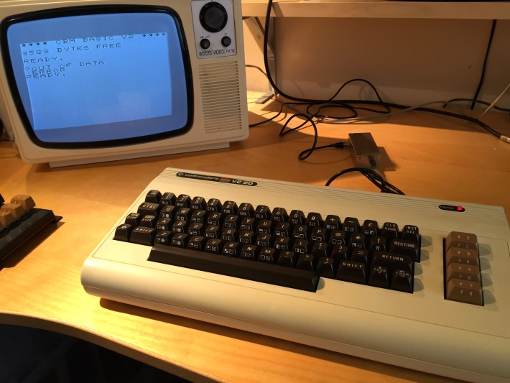
Your Presenter
Brendon Matheson
Australian
11yr Bangkok Resident
Currently Working On
Healthcare (Architect at Orion Health)
Cloud / Multi-Tenant / SaaS
Functions-as-a-Service (FaaS)

Slide 3
Docker

Slide 4
Agenda
What is Docker?
Exercise 1 – hello-world
Exercise 2 – Externalities
Exercise 3 – Build a .NET Core app on Linux
Exercise 4 – Dockerize a .NET Core app on Linux
Exercise 5 – Customize the dotnetcore SDK container
Exercise 6 – Dockerize nginx and CIFS on Linux
Exercise 7 – Serve static content in IIS on Windows
Exercise 8 – Serve web app in IIS on Windows

Slide 5

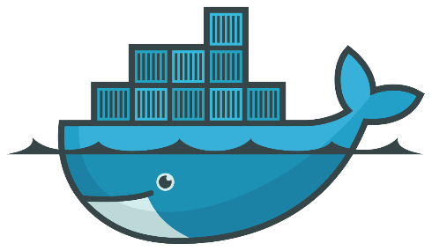
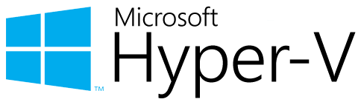

Virtualization vs Containerization
Docker is a cool new virtualization technology

Slide 6
What is Docker?
Virtualization
Virtual hardware
CPU
Disk
Memory
Devices
Guest OS and software installed into VM
VM’s => System-Oriented
Containerization
Native hardware – no hypervisor
Allocate resources with control groups (on Linux)
Host kernel is used by containerized process
Containers => Service-Oriented

Slide 7
References
Background Reading
https://docs.docker.com/engine/docker-overview/#what-can-i-use-docker-for
http://www.haifux.org/lectures/299/netLec7.pdf
Installation
https://docs.docker.com/docker-for-windows/install/

Slide 8
Exercise 1 – hello-world
Run it!
docker run hello-world
Review https://hub.docker.com/_/hello-world/
Pull
docker pull debian:9
Check C:\Users\Public\Documents\Hyper-V\Virtual hard disks

Slide 9
Exercise 1 – hello-world
Run an interactive session in Debian 9
docker run –i -t debian:9 /bin/bash
Run a detached nginx instance
docker run –d nginx
Launch a bash process in the detached nginx instance
docker exec -it <id> /bin/bash

Slide 10
Exercise 1 – hello-world
Attach to the detached nginx instance
docker attach <id>
Housekeeping commands
docker stop
docker rm
docker images
docker rmi

Slide 11
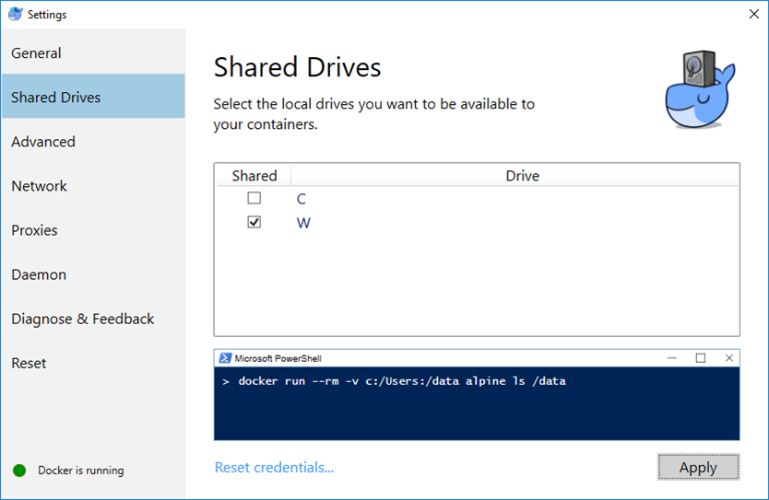
Exercise 2 – Externalities

Slide 12
Exercise 2 – Externalities
Mounting file system volumes
docker run –it –v W:\data:/data debian:9 /bin/bash
Exposing ports
docker run -it -p 8080:80 nginx
Environment variables
docker run -it -e "FOO=bar" debian:9 /bin/bash
root@8e035b9c48d9:/# echo $FOO

Slide 13
Exercise 3 – Build a dotnetcore app
Launch a build environment
docker run –it –v W:\wrk\bjm_str_px_docker_dotnet\hello:/hello-world microsoft/dotnet:2-sdk /bin/bash
Navigate to the mounted project directory
cd /hello-world

Slide 14
Exercise 3 – Build a dotnetcore app
Build as a FDD (Framework Dependent Deployment)
dotnet build –c Release hello.csproj
dotnet publish –c Release hello.csproj
References:
https://docs.microsoft.com/en-us/dotnet/core/deploying/index
https://docs.microsoft.com/en-us/dotnet/core/tools/dotnet-build
https://docs.microsoft.com/en-us/dotnet/core/tools/dotnet-publish
https://docs.microsoft.com/en-us/dotnet/core/rid-catalog

Slide 15
Exercise 3 – Build a dotnetcore app
Run the app
dotnet bin/Release/netcoreapp2.0/publish/hello.dll
Quit the container
docker ps –a
Clean up the container
docker rm <id>

Slide 16
Exercise 4 – Dockerize a dotnetcore app
Create the Dockerfile
FROM microsoft/dotnet:2-runtime
RUN mkdir -p /hello-world/
COPY bin/Release/netcoreapp2.0/publish/* /hello-world/
CMD ["dotnet", "/hello-world/hello.dll"]
Build the image
docker build –t bren/hello .

Slide 17
Exercise 4 – Dockerize a dotnetcore app
Run it
docker run bren/hello

Slide 18
Exercise 5 – Customize the dotnetcore SDK container
Create the Dockerfile
FROM microsoft/dotnet:2-sdk
RUN apt-get update -y; apt-get upgrade -y;
RUN apt-get install -y \
nano \
vim
Build and run your custom SDK environment
docker build –t bren/dotnetsdk .
docker run –it bren/dotnetsdk /bin/bash

