Slide 1
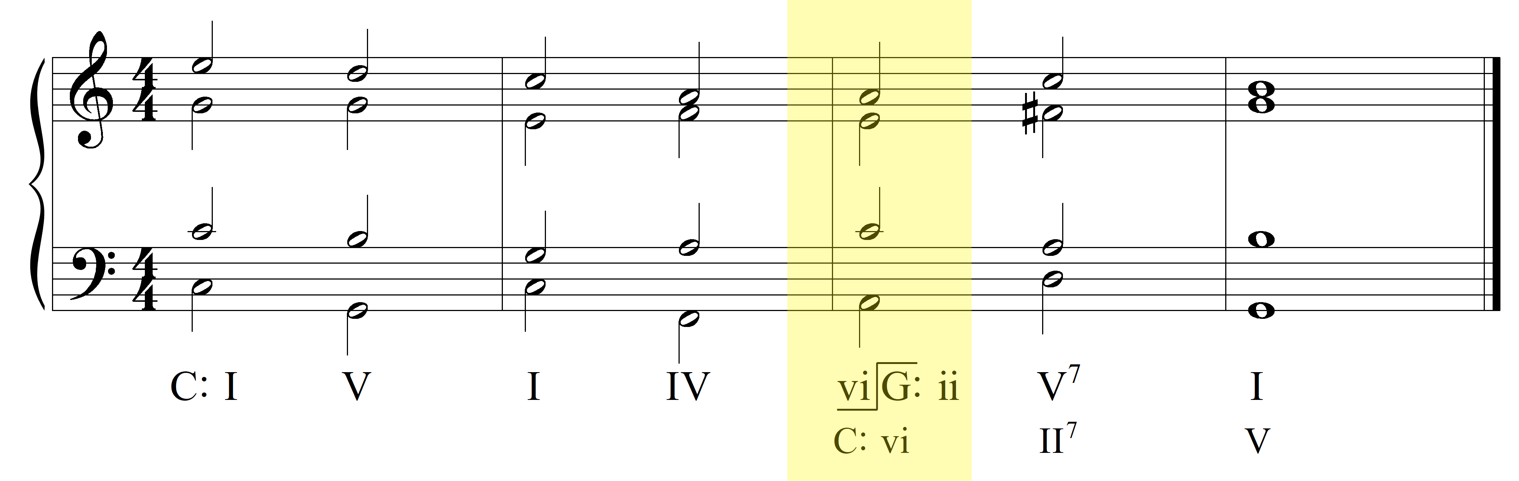
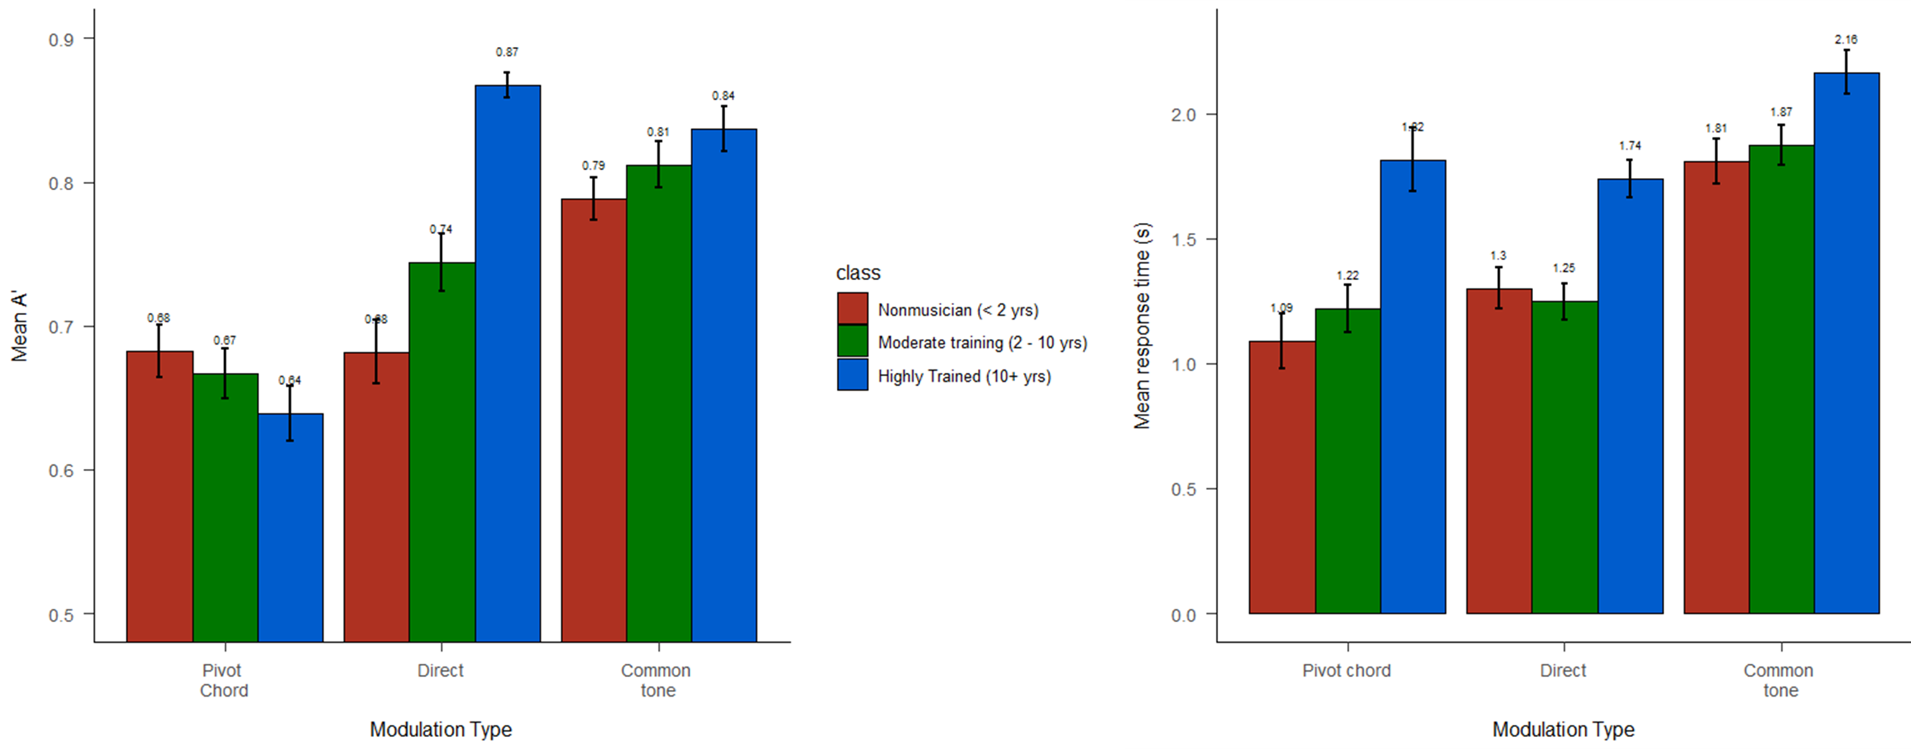

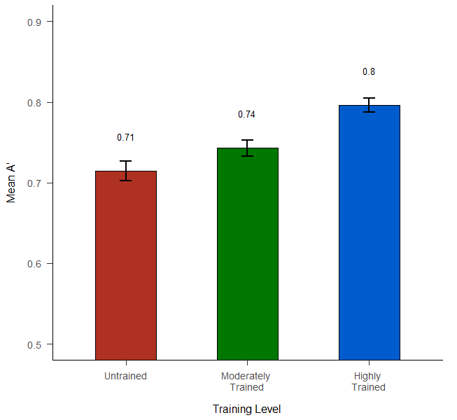
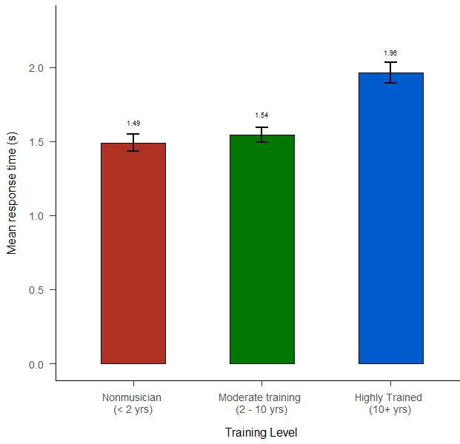
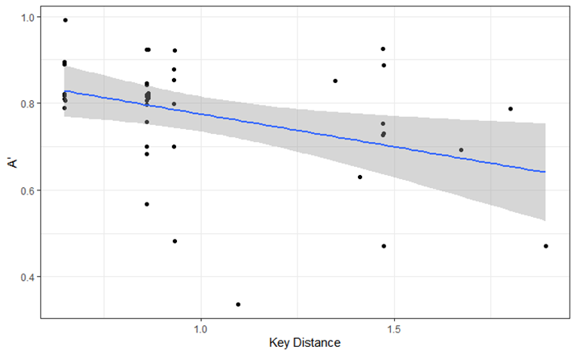
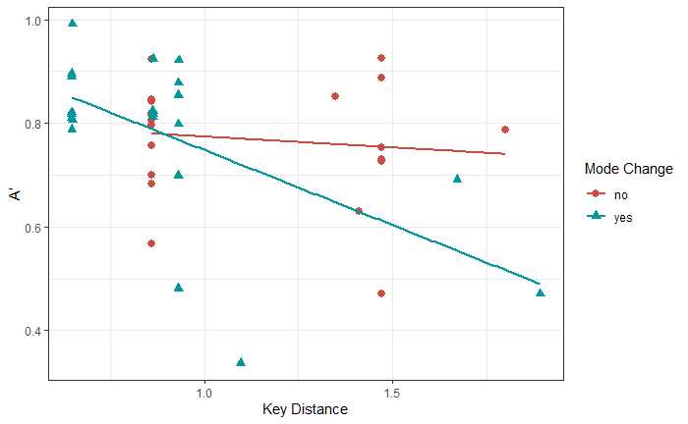
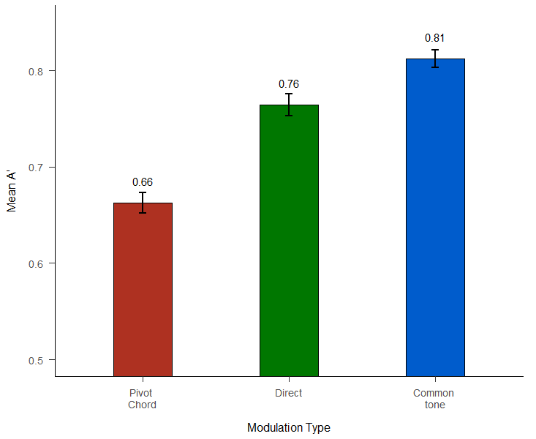
Real-Time Modulation Perception
In Western Classical Music
Music
Perception and
Cognition
Lab
https://www.utdallas.edu/research/mpac/
For questions or correspondence,
contact: bmizener@utdallas.edu
Simple pivot chord example
References
¹Cuddy, L. L. & Thompson, W. F. (1992). Asymmetry of perceived key movement chorale sequences. Converging evidence from a probe-tone analysis. Psychological Research, 54, 51-59.
²Krumhansl, C. & Kessler, E. (1982). Tracing the dynamic changes in perceived tonal organization in a spatial representation of musical keys. Psychological Review, 89(4), 334-368. 10.1037/0033-295X.89.4.334
³Krumhansl, C. & Shepard, R. (1979) Quantification of the hierarchy of tonal functions within a diatonic context. Journal of Experimental Psychology: Human Perception and Performance, 5(3), 579-594.
⁴Raman, R. & Dowling, W. J. (2016) Real-time probing of modulations in South Indian classical (Carnātic) music by Indian and Western musicians. Music Perception, 33(3), 367-393. 10.1525/MP.2016.33.03.367
⁵Toiviainen, P. & Krumhansl, C. L. (2003) Measuring and modeling real-time responses to music: The dynamics of tonality induction. Perception, 32, 741-766. 10.1068/p3312
Summary
Listeners, across training levels, track tonic region independent of surface features.
Training helps, but only when that training is at or approaches a professional level.
The most helpful surface feature is a sustained pitch that both provides reference and time to allow for listener comprehension.
Trained listeners take longer to respond, but are overall more accurate.
Prior evidence regarding key distance and modulation perception, specifically cognitive lag in processing greater key distance, is supported.
Highly trained listeners seem to be able to consciously access the information regarding pitch set content and the specific function of each pitch in the set.
When we listen to music, we track key and key changes, not just music surface features.
*
Acknowledgements
We would like to thank the UTD MPaC, specifically Dr. Rachna Raman, Kieth Gryder, and Cynthia Chan for their input and help running participants.
We would also like to thank the NSULA CAPA Music Faculty, especially Dr. Mitch Davis and Dr. Adam Hudlow for their assistance in recruiting participants. We would like to thank Rance Hawthorne for his help in auditing and evaluating stimuli.
***
***
***
***
***
**
***
Significance indicators:
.05 > p < .1 †
p < .05 *
p < .01 **
p < .001 ***
Overall *
Key Distance n.s.
Mode Change †
Interaction *
Notes:
Welcome, I am… BBS, MPAC, Thank you for coming to my poster presentation.
We asked Highly-trained, moderately-trained, and untrained listeners to listen to excerpts of string quartets, quintets, and sextets from the classical and romantic eras and react if and when they heard a modulation. A modulation is a compositional technique that a composer uses to change keys. There are numerous theoretically distinct types of modulation. We selected three types of modulation for this experiment that were maximally distinct. Each excerpt featured either a pivot chord modulation, a direct modulation, a common tone modulation, or no modulation. Responses were analyzed using A’ and reaction time, using modulation type, key distance, mode change and training level, as factors.
A musical key is the set of notes that are defined relative to a key center, or tonic.
Key Distance is the perceived psychophysical distance between the tonal center of any two keys. We calculated the Euclidean distance between two key centers using the key similarity profiles compiled in Krumhansl (1990).
Background
Understanding of key in music listening may be separate from, but informed by, topical features such as melody.³ Previous work^{1,2,4,5} explored listener responses to modulations using a probe-tone method, which may or may not interfere with the fundamental listening task by creating an auditory reference point against which to compare the auditory scene. This work raises the question as to whether or not listeners are aware of key area independent of that auditory reference pitch. Here I use ecologically valid stimuli to examine whether or not the process of tracking key region is independent of the process of tracking surface cues, and what surface cues may influence that process.
Results
A 3 x 3 anova featuring modulation type and training level found significant effects for both modulation type and training level, as well as an interaction between the two.
Additionally, a regression analysis revealed a significant effects of key distance, and a multiple regression including key distance and mode change was significant overall, but in this model, key distance alone was not significant. However, there were marginal effects of mode change and a significant interaction between mode change and key distance. It’s possible that the observed effects of Key Distance and Mode Change were an effect of the stimuli used, as there were far more ‘close’ modulations than ‘distant’ modulations that featured a mode change.

Slide 2
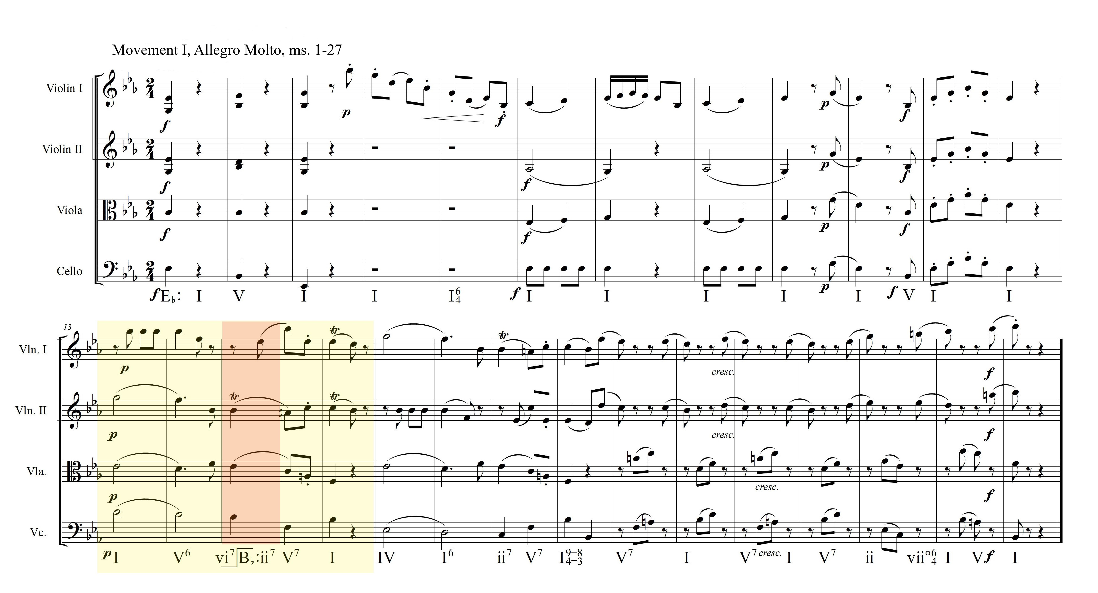
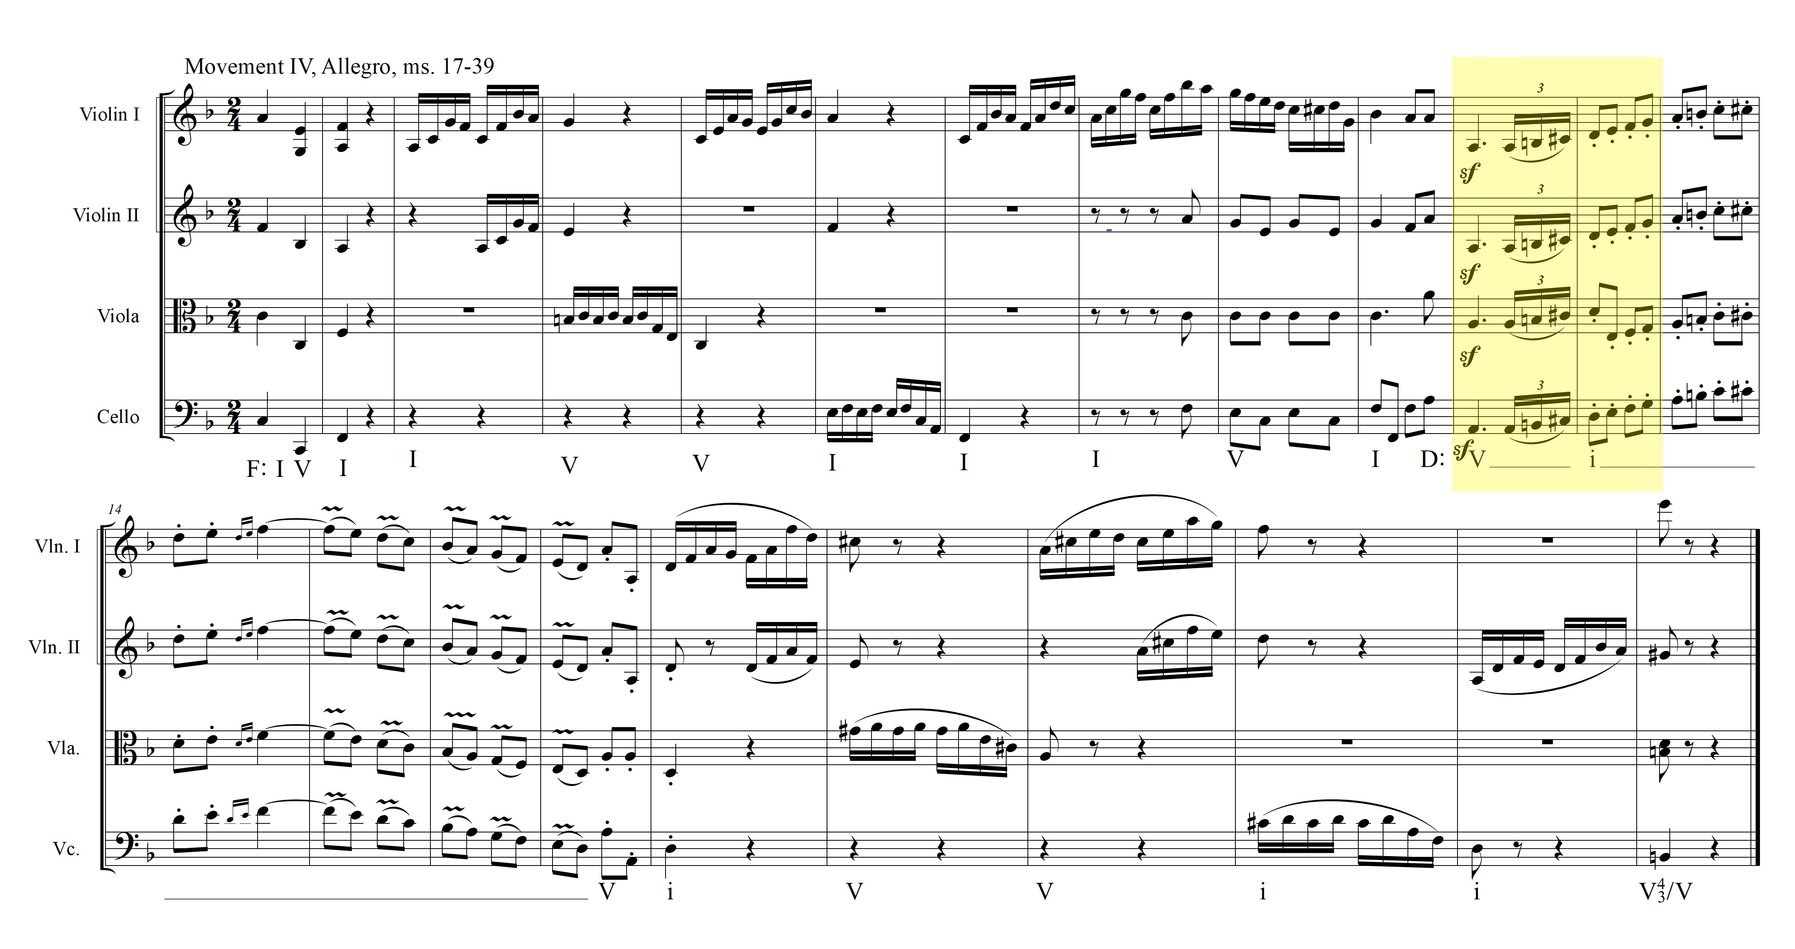
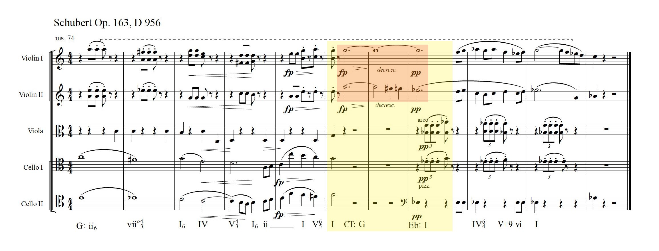
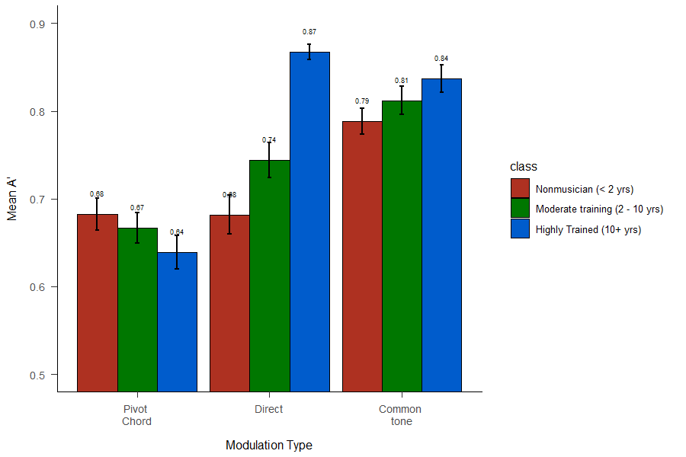
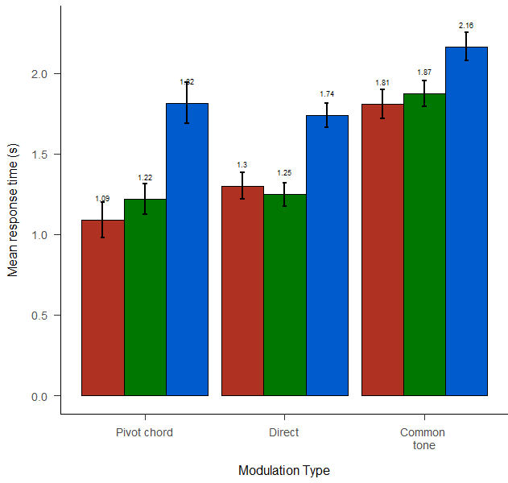
Real-Time Modulation Perception
In Western Classical Music
Music
Perception and
Cognition
Lab
For questions or correspondence, contact:
bmizener@utdallas.edu
https://www.utdallas.edu/research/mpac/
Simple pivot chord example
Haydn, Op 2, No. 3
Beethoven Op. 18, No. 1
Movement 1, Allegro ma non troppo
Brendon Mizener, MMus W. Jay Dowling, PhD
Abstract
Modulation
Modulation is the process by which a composer changes tonal center in a piece of music. The three modulation types for this experiment were selected because they are maximally distinct. The three types of modulations are:
Pivot chord modulation: (center left) A composer uses a chord common to two different keys as a bridge between the. Often used to modulate to the dominant or the relative minor.
Direct modulation: (center right) A composer changes keys abruptly, with no musical forewarning. In the classical era, this is regularly used to modulate to the dominant or the relative minor. In the romantic era, composers used this to modulate much greater distances.
Common tone modulation: (far right) A composer uses a single sustained or repeated tone as a bridge between keys. This type of modulation allows for efficient movement to keys that are a much greater harmonic distance apart than other types of modulations.
A’: Key Distance | A’: Key Distance and Mode Change
Background
Understanding of key in music listening may be separate from, but informed by, topical features such as melody.³ Previous work^{1,2,4,5} explored listener responses to modulations using a probe-tone method, which may or may not interfere with the fundamental listening task by creating an auditory reference point against which to compare the auditory scene. This work raises the question as to whether or not listeners are aware of key area independent of that auditory reference pitch. Here I use ecologically valid stimuli to examine whether or not the process of tracking key region is independent of the process of tracking surface cues, and what surface cues may influence that process.
Significance indicators:
.05 > p < .1 †
p < .05 *
p < .01 **
p < .001 ***
Overall *
Key Distance n.s.
Mode Change †
Interaction *
*
A’: Training Level | A’: Modulation Type | Reaction Time: Training Level
Participants
Untrained/Non-musicians (n = 60)
0 – 2 years of music training (M = 0.63, SD = 0.92)
Moderately trained musicians (n = 60)
3 – 9 years of music training (M = 5.53, SD = 1.75)
Highly trained musicians (n = 60)
10+ years of music training (M = 16.07, SD = 7.75)
OR had < 10 years formal training but had successfully completed a university-level ear-training course (n = 4)
Task
Participants listened to excerpts and clicked a mouse when they thought they heard a modulation.
***
***
***
**
***
***
***
References
¹Cuddy, L. L. & Thompson, W. F. (1992). Asymmetry of perceived key movement chorale sequences. Converging evidence from a probe-tone analysis. Psychological Research, 54, 51-59.
²Krumhansl, C. & Kessler, E. (1982). Tracing the dynamic changes in perceived tonal organization in a spatial representation of musical keys. Psychological Review, 89(4), 334-368. 10.1037/0033-295X.89.4.334
³Krumhansl, C. & Shepard, R. (1979) Quantification of the hierarchy of tonal functions within a diatonic context. Journal of Experimental Psychology: Human Perception and Performance, 5(3), 579-594.
⁴Raman, R. & Dowling, W. J. (2016) Real-time probing of modulations in South Indian classical (Carnātic) music by Indian and Western musicians. Music Perception, 33(3), 367-393. 10.1525/MP.2016.33.03.367
⁵Toiviainen, P. & Krumhansl, C. L. (2003) Measuring and modeling real-time responses to music: The dynamics of tonality induction. Perception, 32, 741-766. 10.1068/p3312
A’: Modulation Type by Training Level | Reaction Time: Training Level & Modulation Type
Summary
Listeners, across training levels, track tonic region independent of surface features.
Training helps, but only when that training is at or approaches a professional level.
The most helpful surface feature is a sustained pitch that both provides reference and time to allow for listener comprehension.
Trained listeners take longer to respond, but are overall more accurate.
Prior evidence regarding key distance and modulation perception, specifically cognitive lag in processing greater key distance, is supported.
Highly trained listeners seem to be able to consciously access the information regarding pitch set content and the specific function of each pitch in the set.
Acknowledgements
We would like to thank the UTD MPaC, specifically Dr. Rachna Raman, Kieth Gryder, and Cynthia Chan for their input and help running participants.
We would also like to thank the NSULA CAPA Music Faculty, especially Dr. Mitch Davis and Dr. Adam Hudlow for their assistance in recruiting participants. We would like to thank Rance Hawthorne for his help in auditing and evaluating stimuli.
Notes:
Highly-trained, moderately-trained, and untrained listeners were asked to respond to ecologically valid stimuli excerpts in the form of from string quartets, quintets, and sextets from the classical and romantic eras and react if and when they heard a modulation. Each excerpt featured either a pivot chord modulation, a direct modulation, a common tone modulation, or no modulation. Responses were analyzed using A’ and reaction time, using modulation type, key distance, and mode change as factors.

