Slide 1
Music Listening Space
A multivariate analysis of cognitive listening space
Brendon Mizener¹, Mathilde Vandenberghe², Hervé Abdi¹, Sylvie Chollet²
Correspondence & questions should be addressed to bmizener@utdallas.edu

Slide 2
Maybe- Something about the problem here

Slide 3
Variables & Stimuli

Slide 4
And the Statistical Methods Here

Slide 5
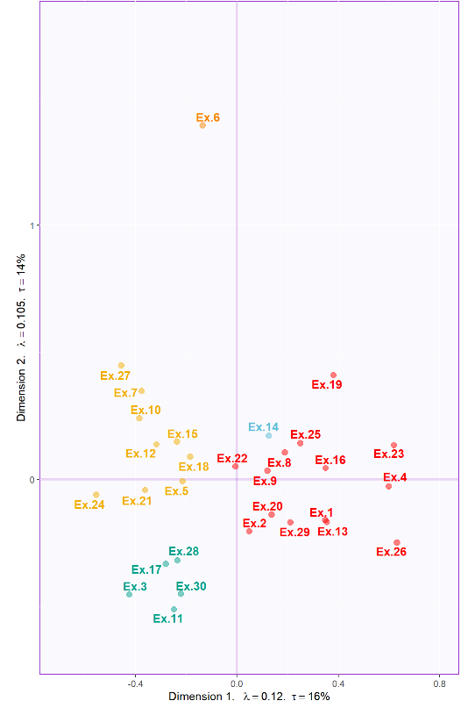
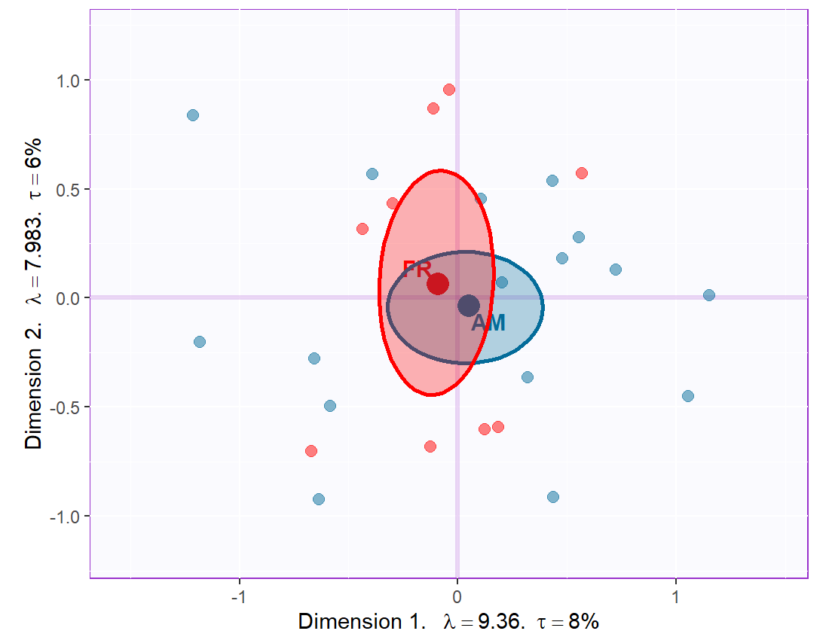
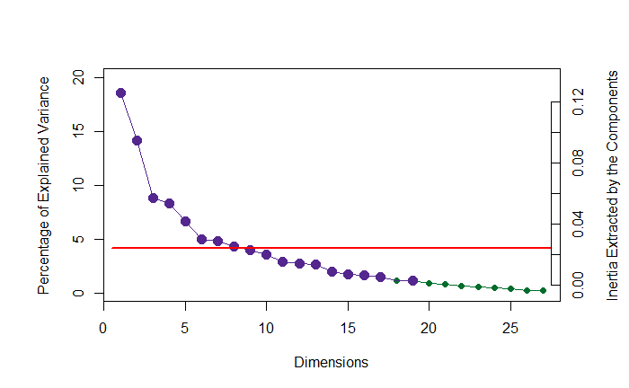
Experiment 1: Musical Qualities
N_{US} = 18 N_{France} = 9
No significant group differences

Slide 6
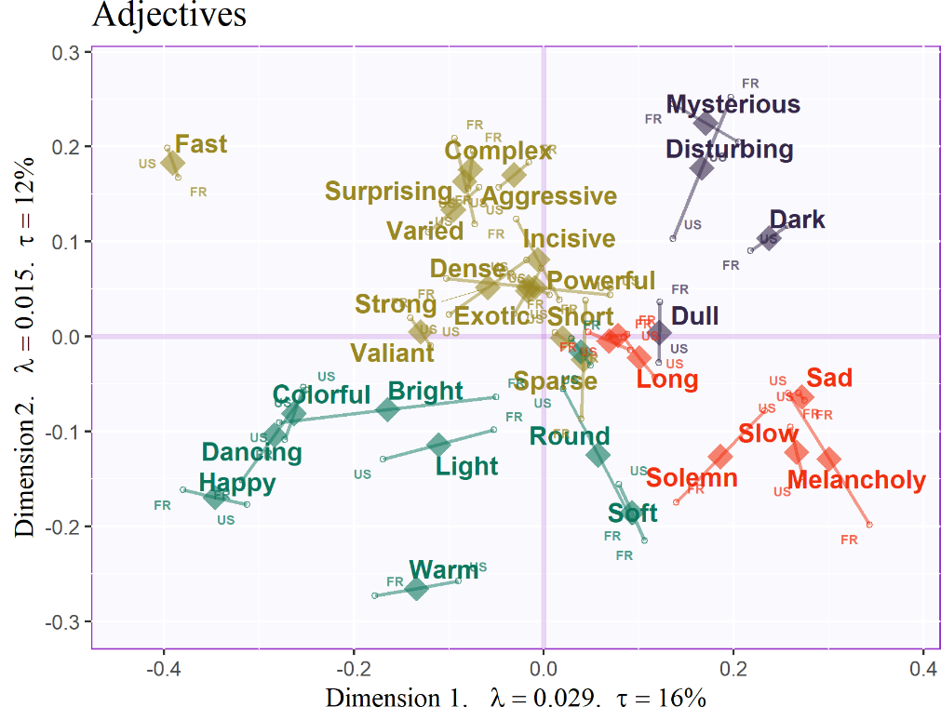
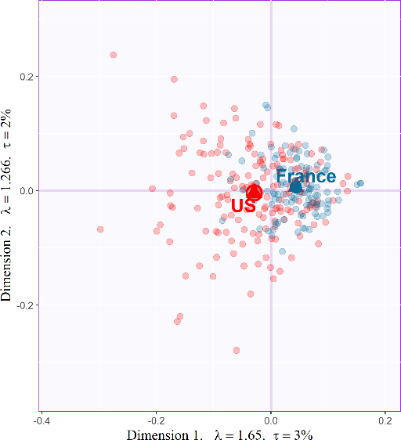
Experiment 2: Adjectives
N_{US} = 171 N_{France} = 111
Significant group differences (p < .001)
Notes:
Are you sure that the t value is < .001 (i.e., that confidence intervals were computed with an alpha of .001; this is not the same thing as having used 1000 iteration for the bootstrap test)?

Slide 7
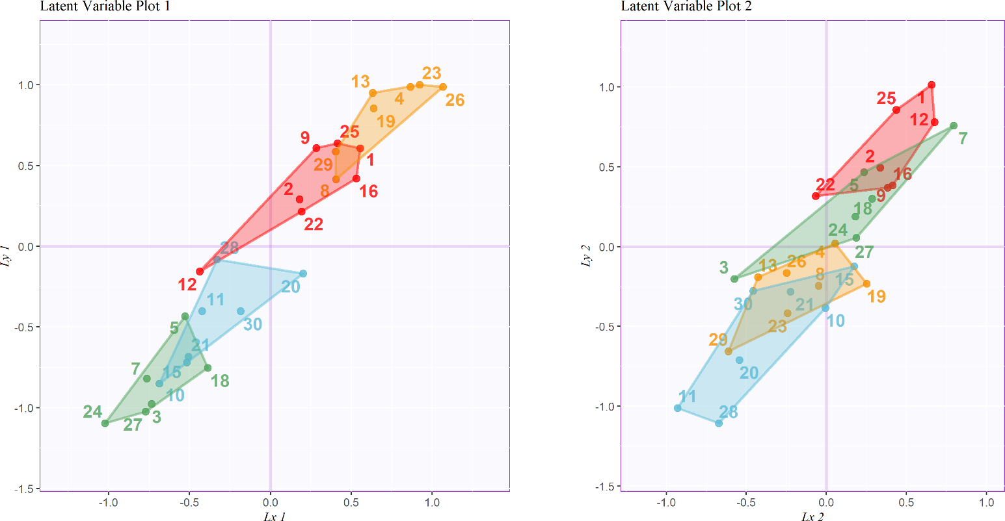
Experiment 3: The combined Surveys
Excerpt groupings:
Gold: positive valence, low arousal
Green: negative valence, high arousal
Red: positive valence, high arousal
Blue: negative valence, low arousal

Slide 8

Conclusions
Participants from different countries describe music differently, but those differences appear to be semantic, not perceptual.
Even when using adjectives that are not explicitly emotional, multivariate analysis of the adjectives used to describe the excerpts reveals the valence-arousal plane in the two strongest dimensions.
Describing music using explicit musical qualities reveals a high dimensionality; the strongest dimension can be interpreted as arousal and the second dimension can be interpreted as complexity, not arousal.
The latent variables common to the two data sets separates the excerpts by positive and negative valence and high and low arousal
OSF Repository
Notes:
Replace People by Participants, those by these, replace factor analysis by multivariate analysis (some people may think that we used “Factor Analysis,” but we did not)
I am not sure that I understand the meaning of: “Describing music using explicit musical qualities reveals a high dimensionality; ”
Maybe replace: ” Evaluating the covariance of the latent structures between the ” by “The latent variables common to the”

