Slide 1
Music Listening Space
A multivariate analysis of cognitive listening space
Brendon Mizener¹, Mathilde Vandenberghe-Descamps², Herve Abdi¹, Sylvie Chollet²
Correspondence & questions should be addressed to bmizener@utdallas.edu

Slide 2







Problem
Notes:
Our problem was …
Performed as a collaboration between the UT Dallas Music Perception & Cognition Lab and the Applied consumer and sensory sciences lab at Junia ISA Lille, in Lille, Fr.
Consisted of 3 bilingual experiments run in the US and in France
Musical experts rating stimuli on quantifiable musical dimensions
Participants recruited without respect to musical training describing musical excerpts using adjectives
A 3rd experiment not including analyzing the data together

Slide 3
Variables & Stimuli
Stimuli:
30 novel excerpts composed in a range of western styles
Variables:
Participant nationality (Ex. 1 & 2)
Level of music training (Ex. 1)
Quantifiable musical qualities (Ex. 1)
Adjectives (Ex. 2)
Notes:
Excerpts: approx. 30 seconds long

Slide 4
Statistical Methods
Correspondence Analysis (CA)
Benzécri (1973); Escofier-Cordier (1965); Greenacre (1984)
Multidimensional Scaling (MDS)
Borg & Groenen (2005); Gower (1966); Torgerson (1958)
Multiple Factor Analysis (MFA)
Abdi et al. (2013); Escofier & Pagès (1994)
Partial Least Squares Correlation (PLSC)
Abdi & Williams (2013); Tucker (1958)
Hierarchical Cluster Analysis (HCA)
Pielou (1984)
Bootstrapping & Permutation Testing
Hesterberg (2011); Fisher (1925); Geary (1927); Berry et al. (2011)
Notes:
CA – similar to PCA, but can be performed on qual data, allows visualization of variables and observations in the same space
MDS – distance analysis that evaluates a group of items and plots the similarity among them as proximity in a factor space
HCA – evaluates clusters of items in a set, used here to evaluate a posteriori clusters of stimuli that arose during description
MFA – extension of PCA that computes partial factor scores from multiple data tables and then computes a compromise from those, essentially showing how each table contributes to each item in the factor space.
PLSC – evaluates the covariance of laten variables in two data tables. Used commonly in brain imaging.
Boots & Perm – resampling with replacement & shuffling

Slide 5
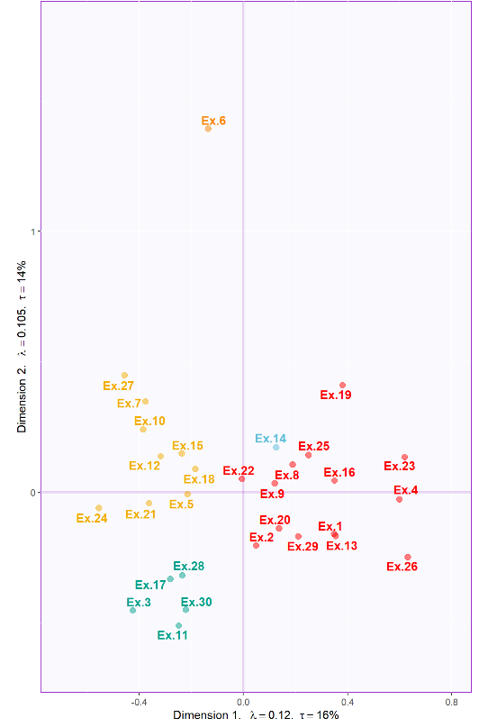
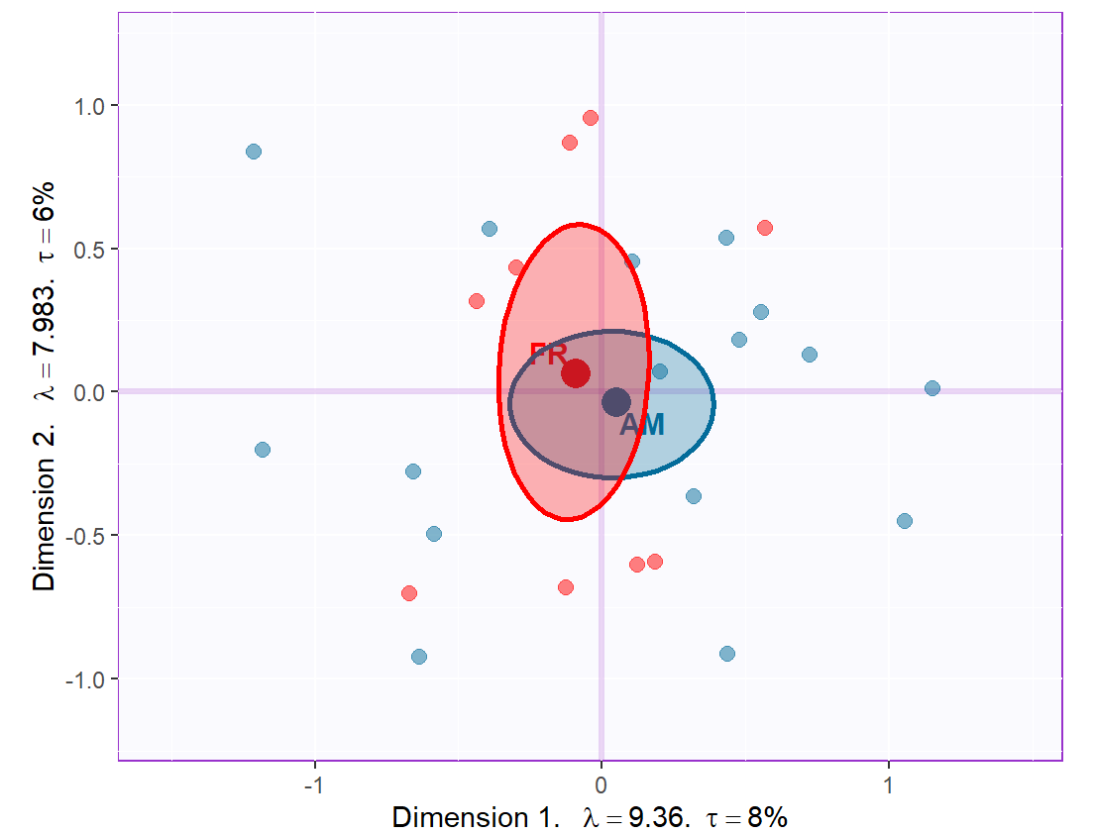
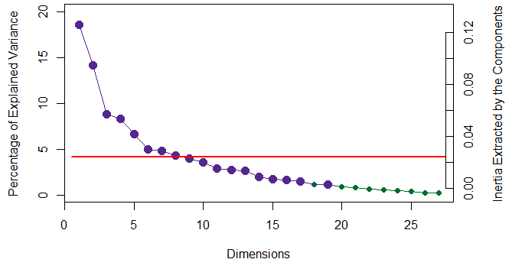
Experiment 1: Musical Qualities
Correspondence Analysis (CA)
Multidimensional Scaling (MDS)
Scree Plot with Permutation Testing
N_{US} = 18 N_{France} = 9
No significant group differences
Notes:
Key points:
No significant group differences between French & American musical experts in how they described the musical excerpts
High dimensionality revealed by this – by any metric (permutation testing, Kaiser line, elbow test), suggesting that there are a number of significant elements that go into participant judgments of musical qualities
CAUTION: “significant” and “important” are not synonyms here, and both are limited by interpretability. If we can’t tell what the dimension represents, it’s not helpful.
Separates excerpts approximately by genre, 2 Excerpts that are wildly different - #6 and #14, (minimalist, jazz-y) dominate the 2nd and 3rd dimensions, respectively.
The others, which are largely tonal and could be classified as western art music (baroque, classical, romantic periods),

Slide 6
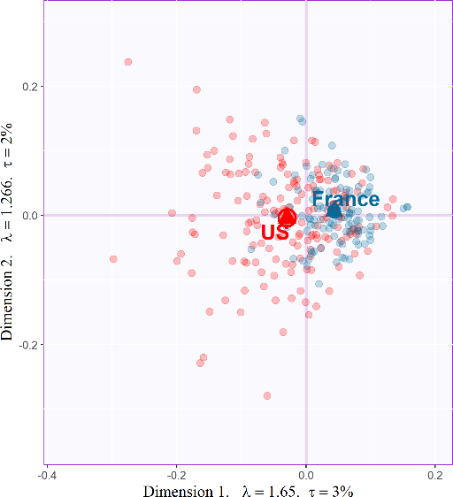
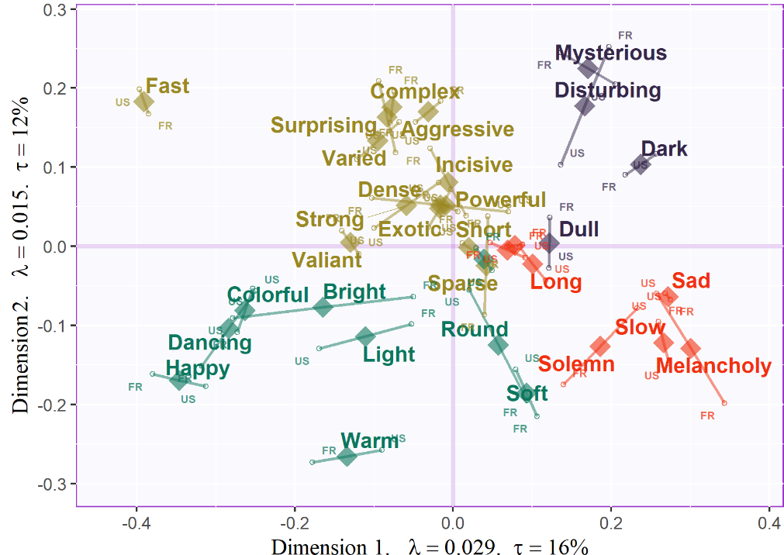
Experiment 2: Adjectives
Multidimensional Scaling (MDS)
Multiple Factor Analysis (MFA)
N_{US} = 171 N_{France} = 111
Significant group differences (p < .001)
Notes:
Significant group differences between participants – in the plot, the means and bootstrapped confidence intervals are plotted for the two groups. This significance was confirmed by a t-test of the first dimension factor scores.
Plot on the right shows how different words were used differently by participants from different nationalities.
These differences appear to be semantic, not perceptual
Examples: Melancholy, Bright

Slide 7
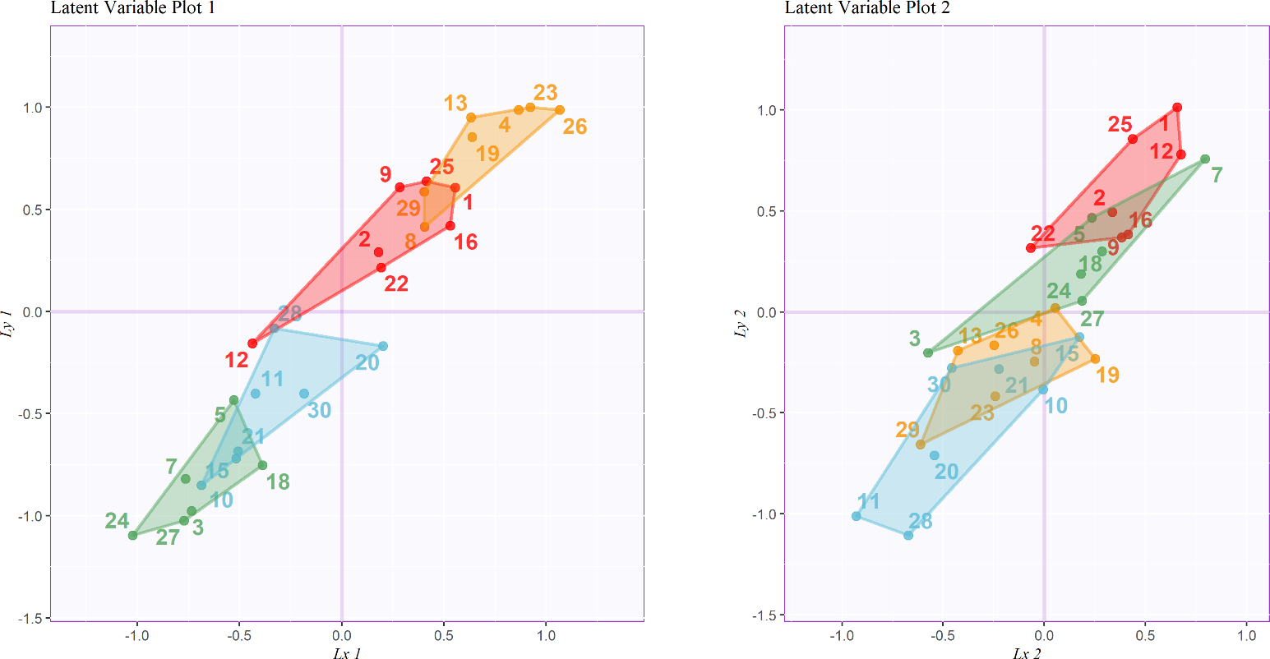
Experiment 3: The combined Surveys
Partial Least Squares Correlation (PLSC)
Excerpt groupings:
Gold: positive valence, low arousal
Calm, content
Green: negative valence, high arousal
Anger, fear
Red: positive valence, high arousal
Joy
Blue: negative valence, low arousal
Sadness or depression

Slide 8

Conclusions
Participants from different countries describe music differently, but those differences appear to be semantic, not perceptual.
Even when using adjectives that are not explicitly emotional, multivariate analysis of the adjectives used to describe the excerpts reveals the valence-arousal plane in the two strongest dimensions.
Multivariate analysis of the musical quality ratings revealed many significant dimensions, the first of which can be interpreted as arousal and the second dimension can be interpreted as complexity, not arousal.
The latent variables common to the two data sets separate the excerpts by positive and negative valence and high and low arousal
OSF Repository
bmizener@utdallas.edu

