Slide 1

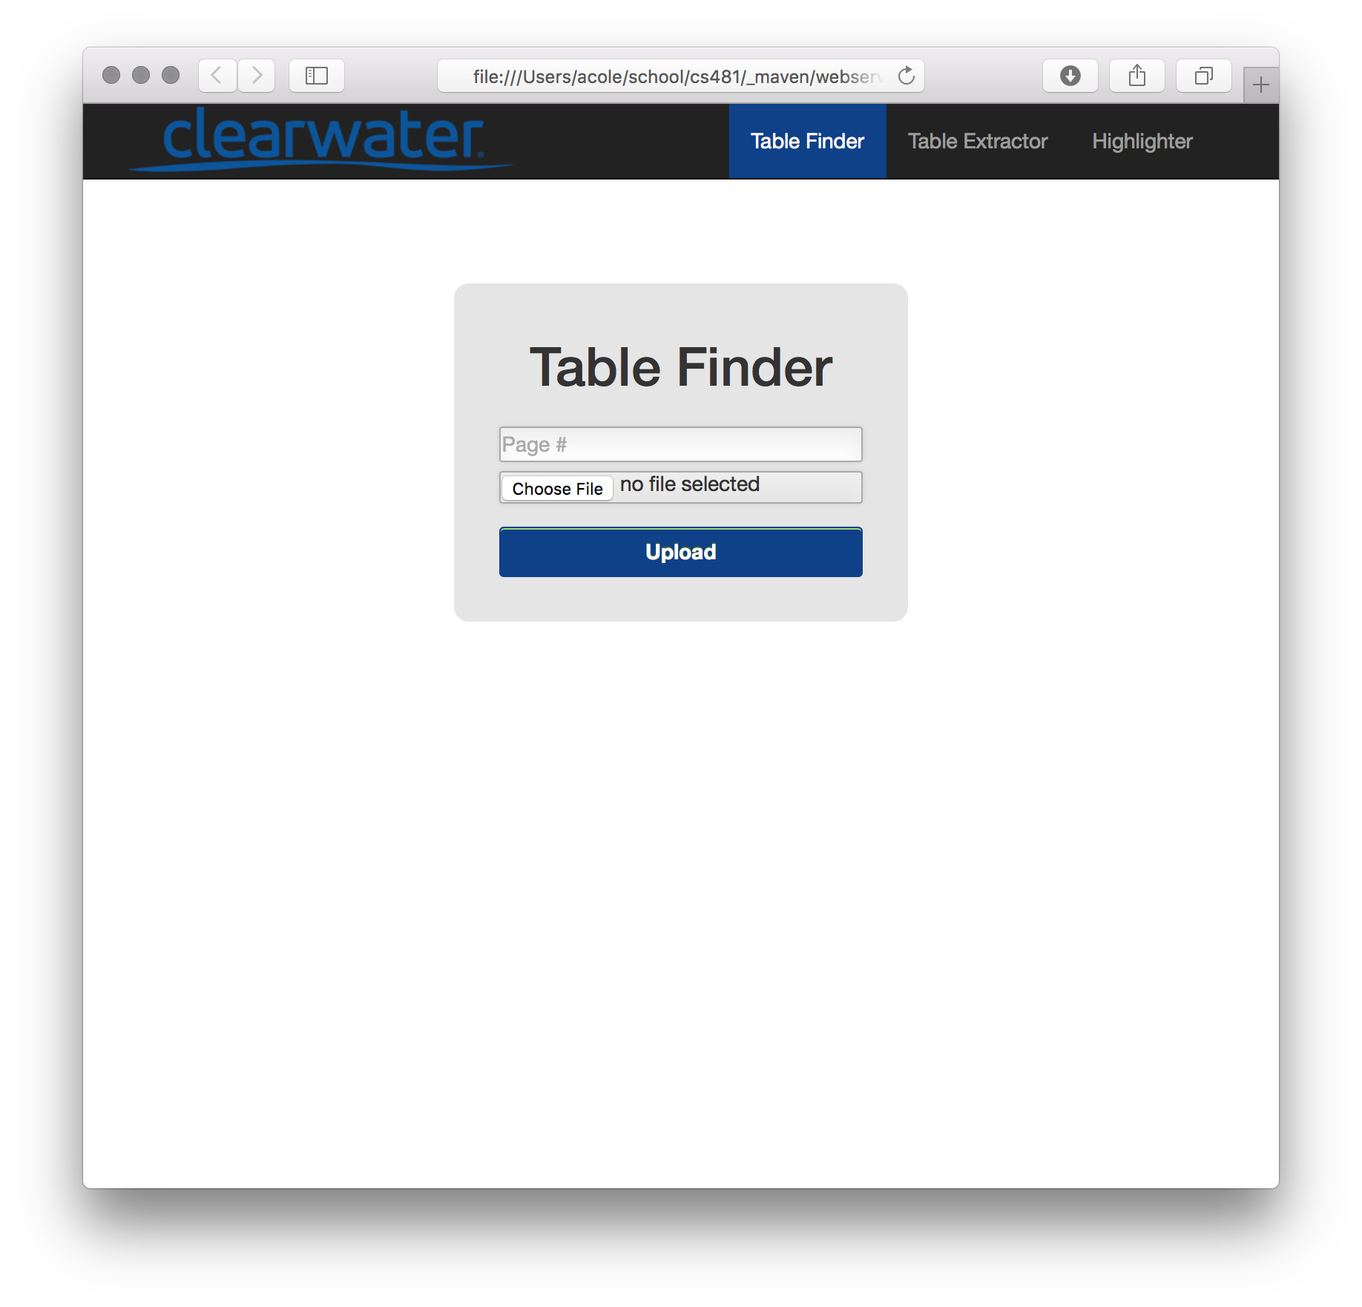
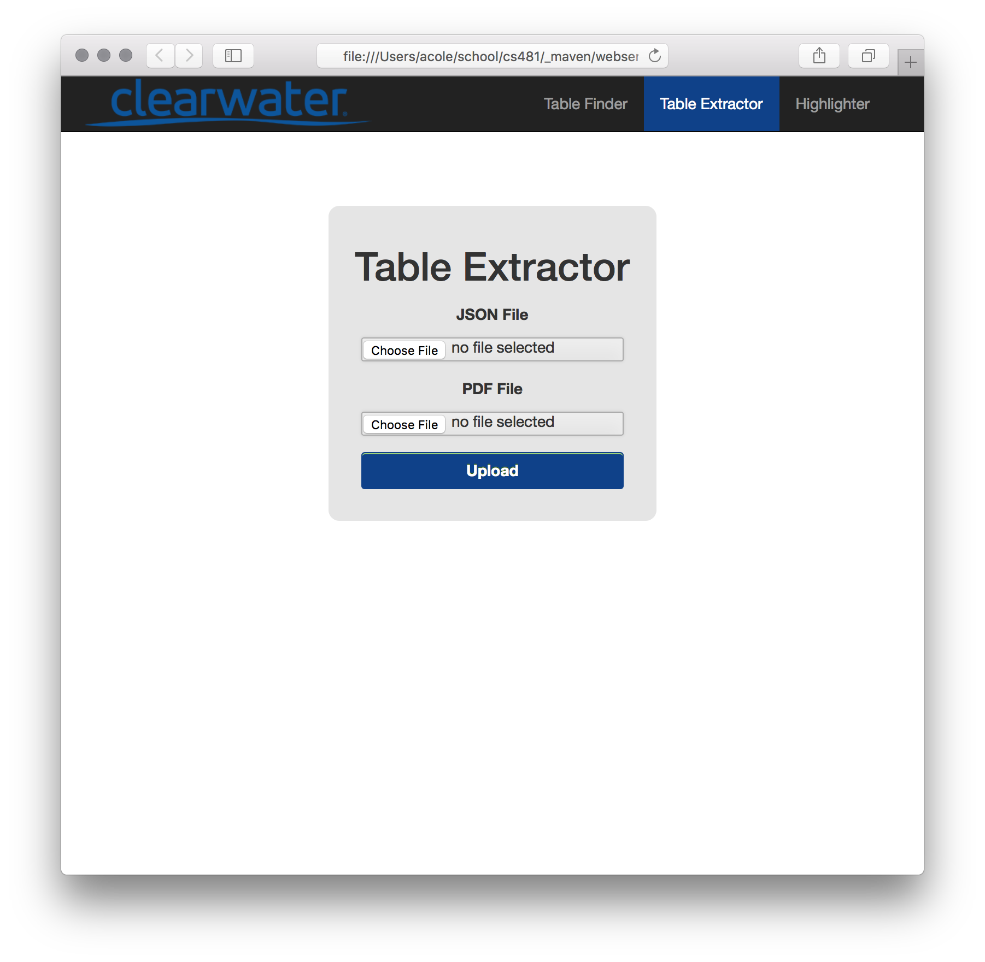
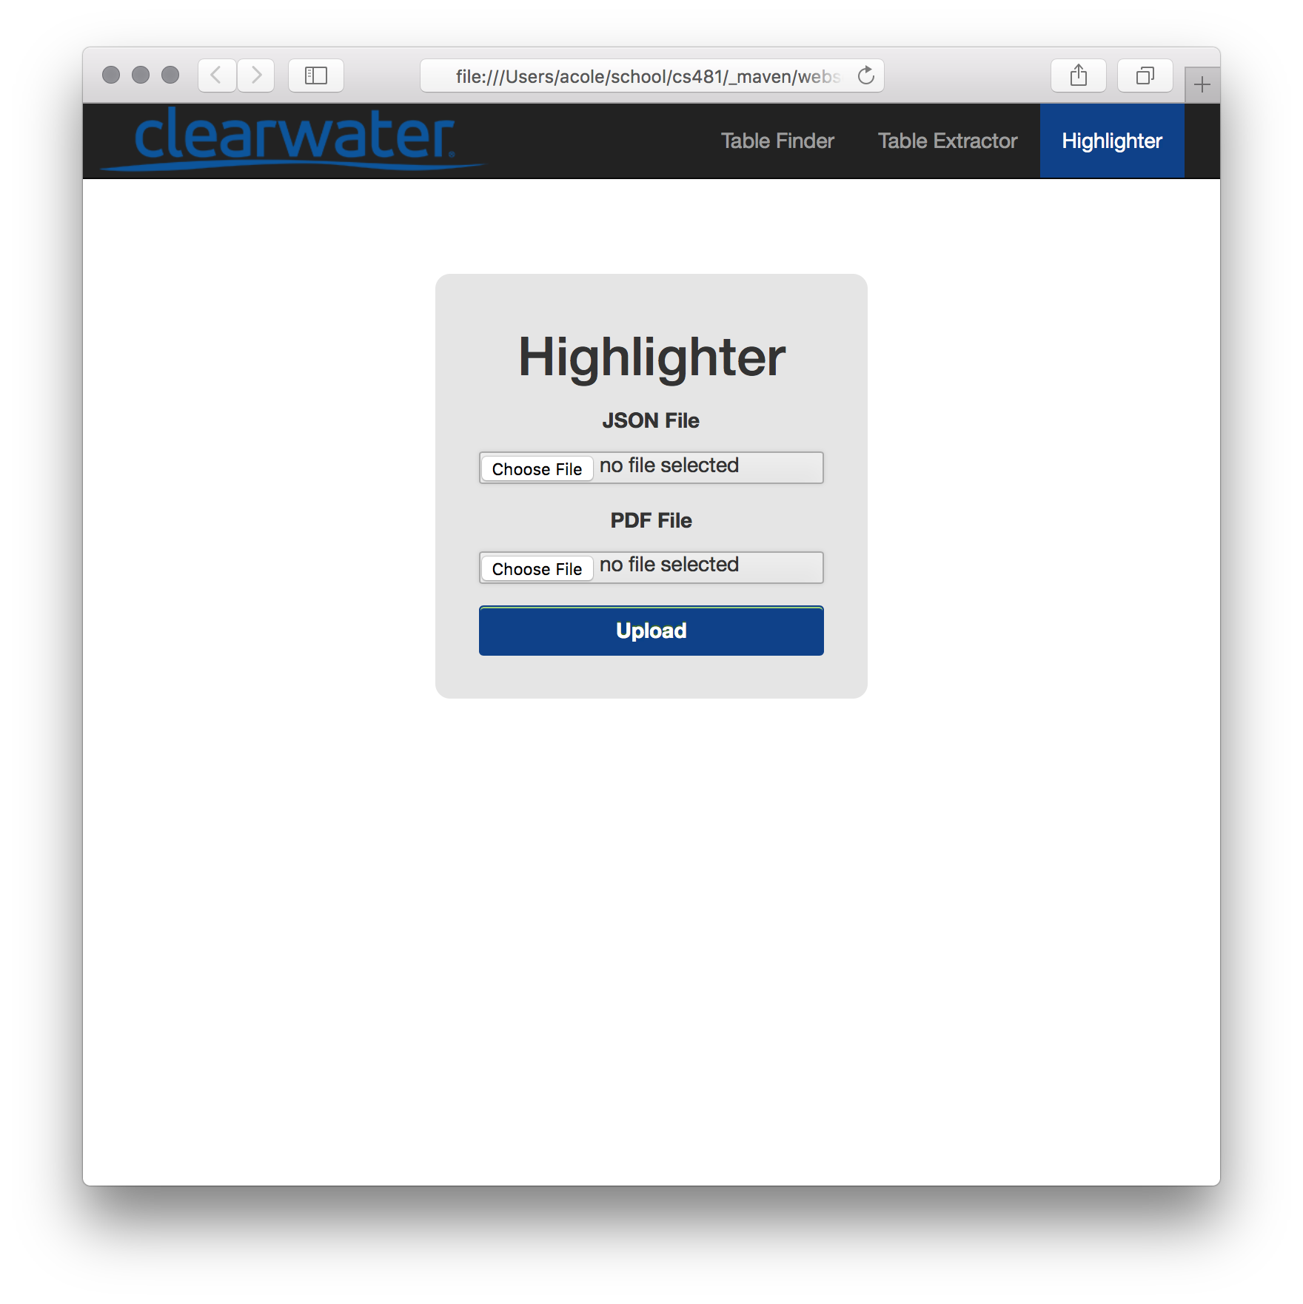




Business Need
PDF Parser
Design
“Clearwater Analytics is an innovative provider of investment portfolio reporting and analytics for institutional investors in over 4,500 organizations.”
“Clearwater's daily-aggregated and reconciled solutions deliver the highest level of portfolio transparency on the market today. ”
Clearwater’s success and commitment to their customers is directly dependent on the amount and quality of the data they are able to collect and aggregate. Much of this data is trapped within public PDF documents. Due to the inability to programmatically parse these documents Clearwater has to rely on other providers such as Bloomberg to supply this crucial data. Providers such as Bloomberg are extremely costly, the only alternative is to extract the data themselves. This is currently done manually which is very taxing on resources.
With the ability to programmatically parse these public PDF documents Clearwater can more efficiently and effectively serve their clients.
PDF documents are used daily by business professionals, financial institutions, and individuals going about everyday tasks. PDF documents are used so widely by so many due to their portable properties. PDF documents can be viewed on nearly any platform making them an ideal choice to transmit data between people.
While PDF documents have a host of invaluable properties they exhibit one fatal flaw. This flaw is the inability to be easily read or rather parsed by a computer. Due to the internal architecture of the PDF format it is extremely difficult to extract data from. It is for this inability to programmatically extract data that the Clearwater PDF Parser was built.
In order to demonstrate the use of the web services we put together a front end website which runs on local host.
Implementation
In order to meet the needs of Clearwater Analytics We were asked to architect a completely automated system in which a PDF document could be feed in as input and then, without human involvement, a computer-readable JSON document would be returned as output.
As a team we chose to tackle this problem by designing and implementing three distinct web services which could be chained together to complete the automated system.
Table Finder
The first web service finds all tables in the supplied PDF document and returns the coordinates of the discovered tables in a JSON document. This document can then be feed into Table Extractor to extract the data from within the table.
Table Extractor
The second web service takes the coordinates of various tables extracted from Table Finder and the original PDF document. It then returns all data discovered within the table defined by the coordinates.
Table Highlighter
The third and final web service takes in a PDF document and a list of coordinates contained in a JSON document. It then uses these coordinates to highlight portions of the original PDF document and returns an annotated version.
Build System
The build system relies on the Maven project management suite. We chose this build system implementation to seamlessly integrate with Clearwater’s current systems. Maven allows us to pull in open source code bases as well as compile, test and run the complete code base.
Technologies
Authors
Alex Cole Ben Shewmake
Brendon Sida Time Wilder

