Slide 1
The Technology Value Stream
From Months-Long Releases to Minutes
Brennan Cheatwood
DevOps
Assignment 1.2

Slide 2
What is the Technology Value Stream?
In DevOps, the technology value stream is the set of activities that turn a business request into a working, running service for customers.
It usually starts at code commit and ends when the change is successfully deployed to production.
The main goal is to improve flow: reduce delays, reduce waste, and deliver value faster and more reliably.
Kim et al., 2021

Slide 3
Lead Time vs. Processing Time
Lead Time | Processing Time (Cycle Time) | Why it Matters
Time from request/commit until the change is running in production. This is what the customer feels as responsiveness. | Time when people are actively working on the change (design, code, test) until that work is done. Does not include all the waiting between steps. | DevOps tries to shorten lead time, not just speed up one step, so value flows smoothly across the whole stream.
Kim et al., 2021
https://itrevolution.com/articles/understanding-work-as-a-flow/

Slide 4
Visualizing Lead vs. Processing Time
Customer Request
Analysis
Development
Testing
Deployment
In Production
PROCESSING TIME
LEAD TIME
Lead time = Waiting + work across the whole stream.
Processing time = Only the hands-on work in the middle.

Slide 5
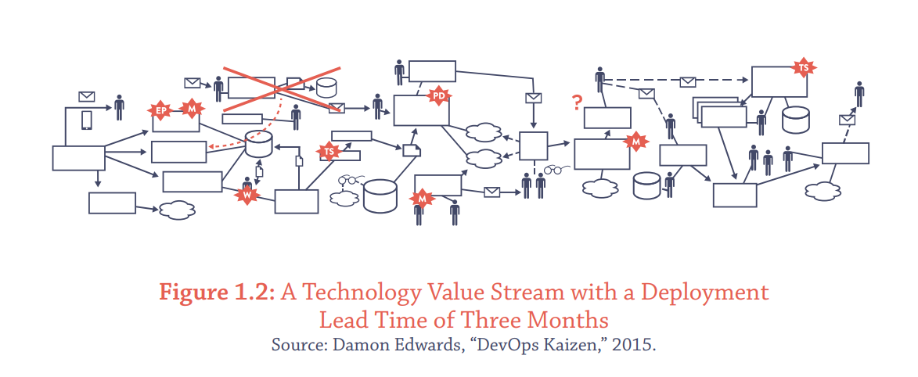
Common Scenario: Lead Times of Months
In many traditional environments, deployment lead time can be three months or more.
Causes: Big-Batch releases instead of small changes.
  Many handoffs between Dev, QA, Ops, and change-management boards.
  Heavy manual testing and manual approvals.
Result: releases feel risky, feedback is slow, and fixing problems takes longer.

Slide 6
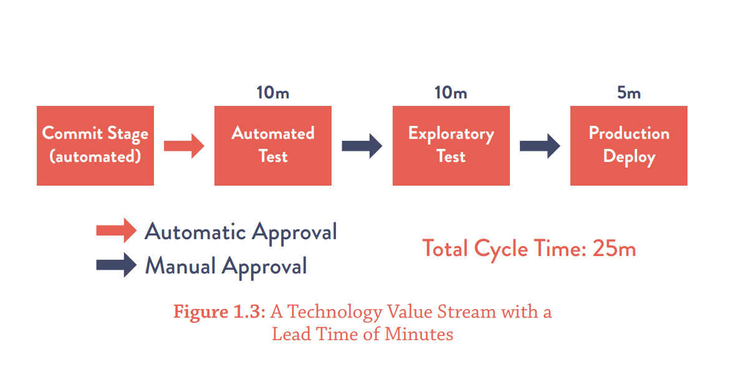
DevOps Ideal: Lead Times of Minutes
The DevOps “ideal state” shows a technology value stream with a total cycle time of about 25 minutes.
Work flows through an automated CI/CD pipeline:
  Commit > automated build > automated tests > quick exploratory testing > deploy.
Changes are small and frequent, often with deployments happening many times per day.
Benefits: faster feedback, safer releases, and the ability to respond quickly to customer needs.

Slide 7
Key Takeaways & References
The technology value stream describes how ideas become running services for customers.
Lead Time is from request/commit to production; processing time is just the hands-on work.
Moving from months-long deployment lead times to minutes is a core DevOps goal and drives better speed, quality, and business outcomes.
References:
  Kim, G., Humble, J., Debois, P., Willis, J., & Forsgren, N. (2021). The DevOps Handbook (2nd ed.). IT Revolution (Website) [I have not received the printed version yet, so I used this (hopefully) identical copy online]. https://itrevolution.com/wp-content/uploads/2022/06/DOHB2_Audio-Companion_111521_r2.pdf
  IT Revolution. (2021–2024). Articles on value streams and flow (e.g., “Improve flow in the DevOps value stream,” “Value Stream Mapping”).

