Slide 1
BOOTSTRAP
Prof. Moacir Degasperi Junior.

Slide 2
Nav Bar (menu)
Div (seções)
Responsivel
Media Query
Escala

Slide 3
Grid do Bootstrap
Fluido – 100% na tela
<div class=“container-fluid”>
</div>
Fixo - varios tamanho ( não preenche totalmente a tela)
<div class=“container”>
</div>

Slide 4
Padrao 12 colunas
Hierarquia
Container
row - linhas
col - colunas (grid)
Lnha: Class = “row”
Coluna: class “col-xxxx”
Coluna: class “col-xxxx”

Slide 5
Col - coluna
col-tp-n
n de 1 a 12 (grades)
Tp xs
sm
md
lg

Slide 6
Col - coluna
Xs < 768px
Sm > 768p
Md > 992 px
Lg > 1200 px
small
medium
large

Slide 7
** sempre colunas dentro da linha **
<div class = “row”>
<div class = “col-md-1”>
</div>
<div class = “col-md-1”>
</div>
<div class = “col-md-1”>
</div>
<div class = “col-md-1”>
</div>
<div class = “col-md-1”>
</div>
<div class = “col-md-1”>
</div>
<div class = “col-md-1”>
</div>
<div class = “col-md-1”>
</div>

Slide 8
** sempre colunas dentro da linha **
<div class = “col-md-1”>
</div>
<div class = “col-md-1”>
</div>
<div class = “col-md-1”>
</div>
<div class = “col-md-1”>
</div>
</div>
12 colunas de tamanho 1

Slide 9
** sempre colunas dentro da linha **
<div class = “row”>
<div class = “col-md-4”>
</div>
<div class = “col-md-4”>
</div>
<div class = “col-md-4”>
</div>
</div>
3 colunas de tamanho 4 = 12

Slide 10
** sempre colunas dentro da linha **
<div class = “row”>
<div class = “col-md-4”>
</div>
<div class = “col-md-4”>
</div>
<div class = “col-md-4”>
</div>
</div>
3 colunas de tamanho 4 = 12

Slide 11
Tamanho 6
Tamanho 6
Tamanho 9
Tamanho 3
Tamanho 12
Exercicio
Como seria estrura <div> para o layout acima – (contairner / row / col)

Slide 12
http://output.jsbin.com/cusife/1/
http://jsbin.com/cusife/1/edit?html,output
https://www.w3schools.com/bootstrap/default.asp

Slide 13
<!DOCTYPE html>
<html>
<head>
<script src="https://code.jquery.com/jquery.min.js"></script>
<link href="https://maxcdn.bootstrapcdn.com/bootstrap/3.3.4/css/bootstrap.min.css"
rel="stylesheet" type="text/css" />
<script src="https://maxcdn.bootstrapcdn.com/bootstrap/3.3.4/js/bootstrap.min.js"></script>
<meta charset="utf-8">
<title>JS Bin</title>
</head>
<body>
<div class="container">
<div class="row">
<div class="col-md-6">
<div class="well">
<p>class="col-md-6"</p>
</div>
</div>

Slide 14
<div class="col-md-6">
<div class="well">
<p>class="col-md-6"</p>
</div>
</div>
</div>
<div class="row">
<div class="col-md-9">
<div class="well">
<p>class="col-md-9"</p>
</div>
</div>
<div class="col-md-3">
<div class="well">
<p>class="col-md-3"</p>
</div>
</div>
</div>
<div class="row">
<div class="col-md-12">
<div class="well">
<p>class="col-md-12"</p>
</div>
</div>

Slide 15
</div>
</div>
</body>
</html>

Slide 16
<style>
Body {
backgroud-color: #ccc;
}
.container {
backgroud-color: #fff;
}
</style>
#ccc – cinza
#fff - blanco

Slide 17
Espaço entre cada lado da grid – 15 px
<h1> h1.Boostrap 36 px >/h1>
<h2> h1.Boostrap 30 px >/h2>
<h3> h1.Boostrap 24 px >/h3>
<h4> h1.Boostrap 18 px >/h4>
<h5> h1.Boostrap 14 px >/h5>
<h6> h1.Boostrap 126 px >/h6>

Slide 18
Class = text-left
Class = text-right
Class = text-center
Class = text—justify
<p class = “text-left”>
texto
</p>

Slide 19
class = text-nowrap ( não respeita a margem direita do componente pai como as outras classes)
text-lowercase (todas letras minusculo)
text-uppercase (todas letras maiscula)
text-capitalise (só a primeira maiscula)

Slide 20
Topicos
<ul class =“list-unstyled” > sem marcador
Ou
<ul class =“list-list” > com marcador

Slide 21
Topicos
<ul class =“list-unstyled” >
<li> item 1 </li>
<li> item 2 </li>
<li> item 3 </li>
<ul>
<li> item 3.1 </li>
<li> item 3.2 </li>
<li> item 3.3 </li>
</ul>
</ul>

Slide 22
Topicos
<ul class =“list-line” >
<li> item 1 </li>
<li> item 2 </li>
<li> item 3 </li>
<ul>
<li> item 3.1 </li>
<li> item 3.2 </li>
<li> item 3.3 </li>
</ul>
</ul>

Slide 23
<ul> <li>Café</li> <li>Chá</li> <li>Leite</li>
</ul>
Html

Slide 24
<!DOCTYPE html>
<html>
<body>
<h4>Lists inside a list:</h4>
<ul>
<li>Coffee</li>
<li>Tea
<ul>
<li>Black tea</li>
<li>Green tea
<ul>
<li>China</li>
<li>Africa</li>
</ul>
</li>
</ul>
</li>
<li>Milk</li>
</ul>
</body>
</html>

Slide 25
Lists inside a list:
Coffee
Tea
Black tea
Green tea
China
Africa
Milk

Slide 26
Documentação Oficial do bootstrap
getbootstrap.com
----------------------------------------
https://www.w3schools.com
https://www.w3schools.com/bootstrap/default.asp

Slide 27
Tabela responsiva
<div class=“table-responsive”>
<table class = “table”>
….
…..
….
</table>
</div>
Scroll automatico

Slide 28
Botões .btn
.btn-xs .btn-md .btn-lg
.btn-sm
.btn-primary (principal)
.link (sem formato de botão)

Slide 29
<button class=btn”>
botao 1
</button >
<button type="button" class="btn btn-primary btn-lg">Large</button>
<button type="button" class="btn btn-primary btn-md">Medium</button>
<button type="button" class="btn btn-primary btn-sm">Small</button>
<button type="button" class="btn btn-primary btn-xs">XSmall</button>
-------------------
Grupo de botão
Class btn-group

Slide 30
Classes auxiliares
<img src = “arquivo.jpg” class= “img-responsive” alt = “minha imagem “ />
Imagem responsivel
Class = img-responsive
Class = img-center-block
Class = img-rouded
Class = img-circle
Class = img-thumbnail (moldura)

Slide 31
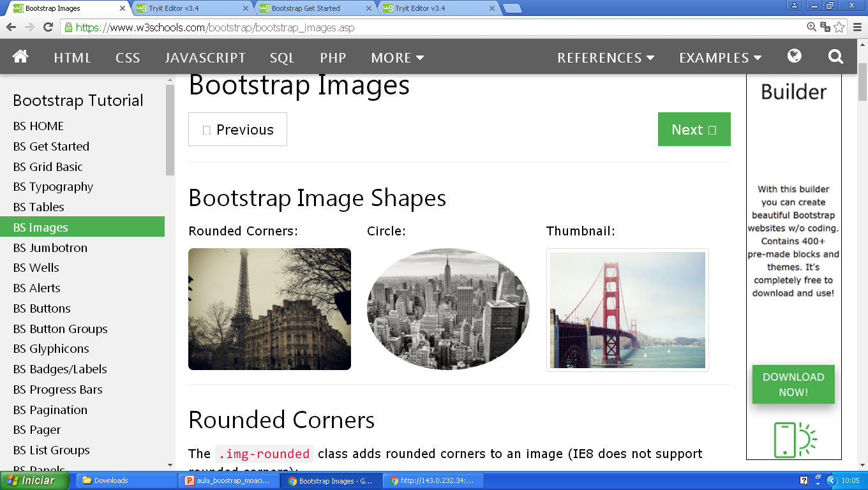

Slide 32
Video Responsivel
<div class = “embed-responsivel” “embed-responsive-16by9” >
<iframe class="embed-responsive-item" src="//www.youtube.com/embed/ePbKGoIGAXY">
</iframe>
</div>

Slide 33
Hidden / visible (esconde / mostra)
Show mostrar
hidden esconde
hidden-xs esconde formato xs
Hidden-sm esconde formato sm
Hidden-md esconde formato md
Hidden-lg esconde formato lg
visible-xs 12 mostra formato xs no tamanho 12
visible-sm 12 mostra formato sm no tamanho 12
visible-md 12 mostra formato md no tamanho 12
visible-lg 12 mostra formato lg no tamanho 12

