Slide 1
Deep Learning Methods for Lift Risk Assessment
Brennan Thomas
Advisor: Dr. Rashmi Jha

Slide 2
Goals
Determine if deep learning is a viable solution to detect risk of back pain caused by lifting heavy objects
Develop a machine learning approach to detecting the level of risk

Slide 3
Intellectual Merits
Traditional human activity recognition systems focus on recognition of easily separable activities – walking, running, jumping, sitting, etc.
There is little research on different classes of similar activities
Provide insight into capabilities of machine learning for this use case

Slide 4
Broader Impacts
Workplace ergonomics is a very important field
Unsafe workplaces can have lasting impact on quality of life
Determining the usefulness of machine learning for monitoring workplace safety
Provides a framework for safer work environments using unintrusive wearable sensor monitoring

Slide 5
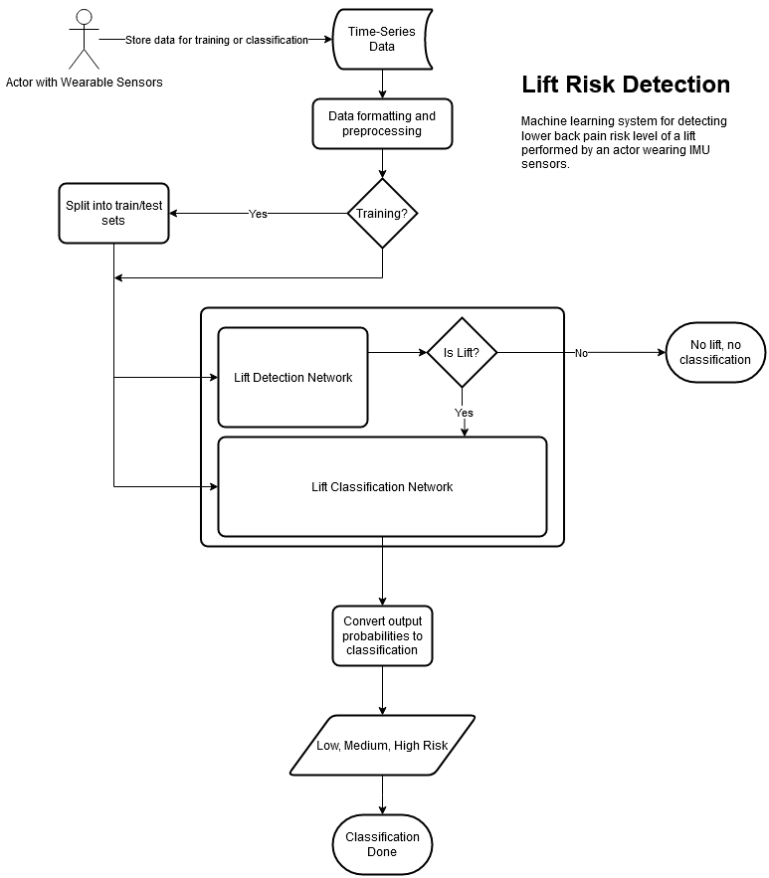
Design Specifications
Consists of three components
Preprocessing
Prepares training/testing data
Lift Detection
Detects if a lift is occurring given a segment of IMU data
Lift Risk Classification
Classifies the risk level of a lift in a segment of IMU data

Slide 6
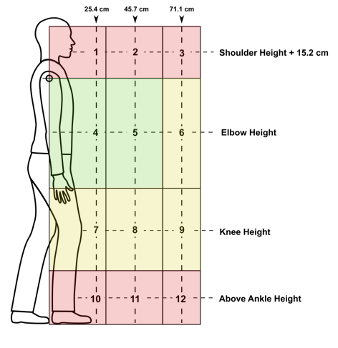
Data Specification
Data collected by National Institute of Occupational Safety and Health (NIOSH)
Ten subjects, six lift trials in each zone defined by the American Conference of Governmental Industrial Hygienists (ACGIH) Threshold Limit Values (TLV) for lifting
Additional non-lifting trials

Slide 7
Design Specifications - Preprocessing
Data split using leave-one-subject-out cross-validation
Samples segmented using sliding window for detection using binary labeling
Entire sample used as input for classification
No further preprocessing

Slide 8
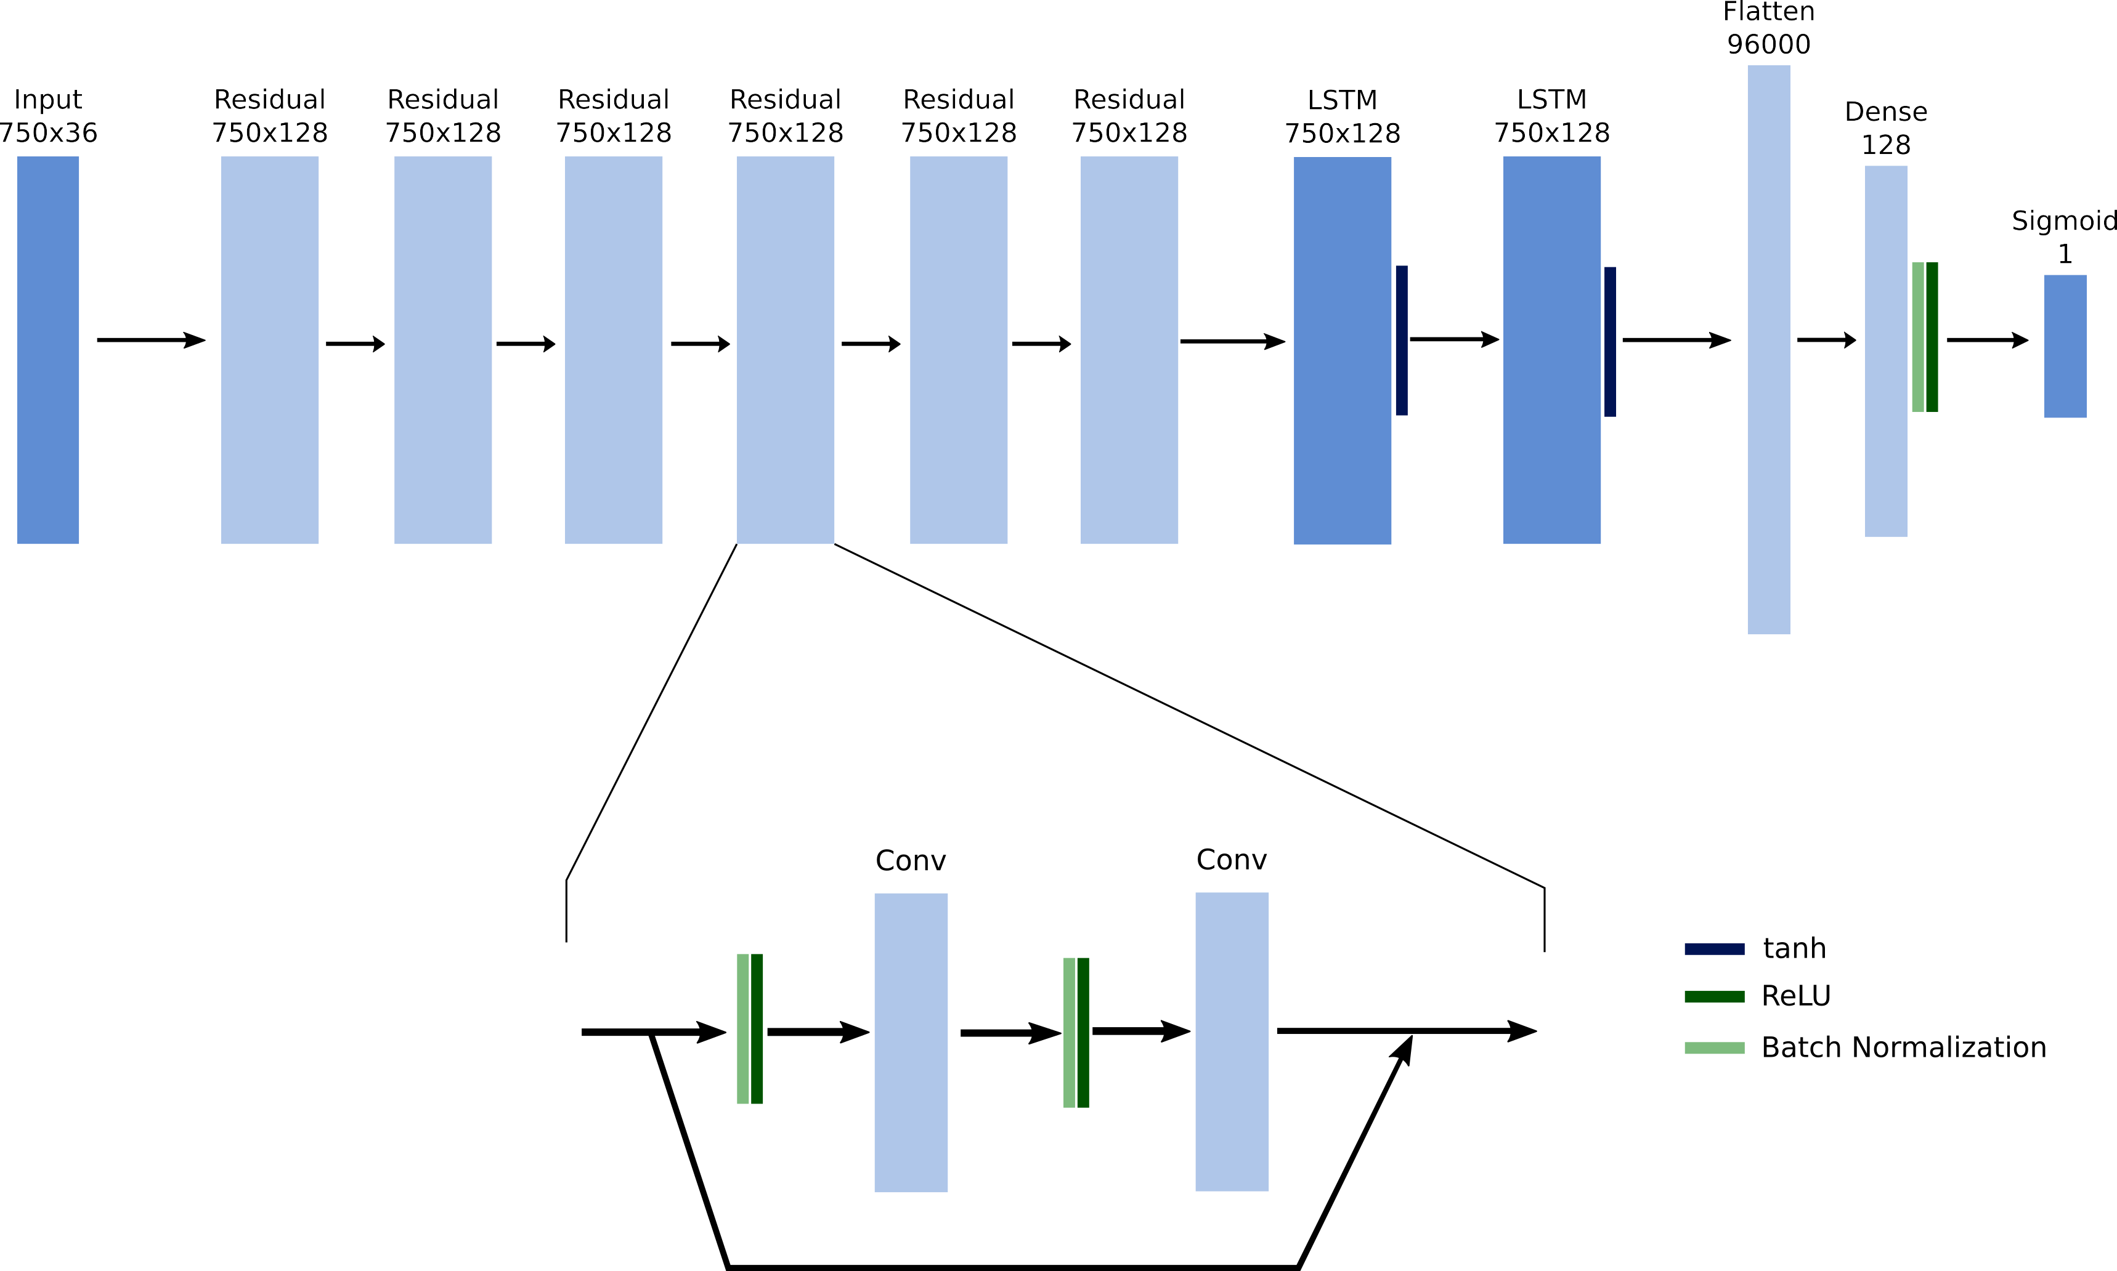
Design Specifications – Detection Model
6 Residual Blocks
2 LSTM layers
Fully-connected layer
Sigmoid output

Slide 9

Design Specifications – Classification Model
Similar to detection
Softmax output
1 unit for each class

Slide 10




Technologies
Code is written in Python
Tensorflow used for model implementations
Numpy and Pandas for data preprocessing
Scikit Learn for metrics
Machine Learning models
Both models are implementations of deep learning networks
Long Short-Term Memory Networks (LSTM) and convolutional layers form the core of the networks
IMU Sensors provide training and testing data

Slide 11
Milestones
Preprocessing – Oct 26th, 2020
Python code for preparing data for model consumption
Lift Detection – Dec 1st, 2020
Python implementation of a machine learning model capable of detecting if a lift is occurring in a segment of IMU data
Lift Classification – Jan 5th, 2021
Python implementation of a machine learning model capable of classifying a lift’s risk level from a segment of IMU data
Refinement – Feb 28th, 2021
Modifications to previous milestones based on possible improvements

Slide 12
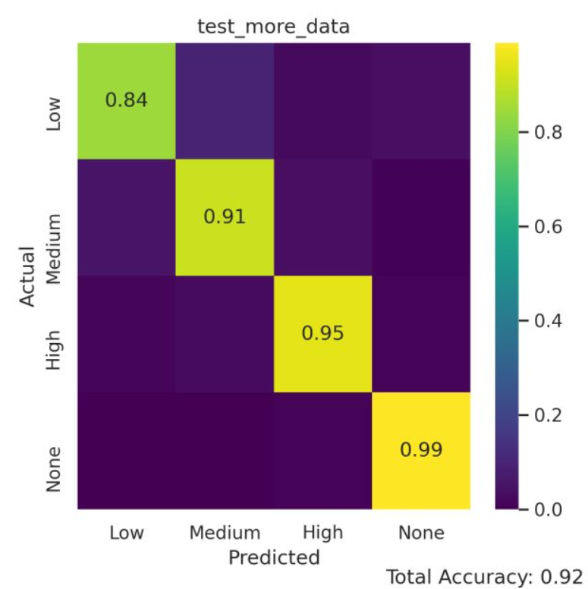
Results – Lift Classification
Balanced Accuracy (BAC): 89.5%
Slightly biased towards samples with more data
Very good at separating lift and non-lift

Slide 13
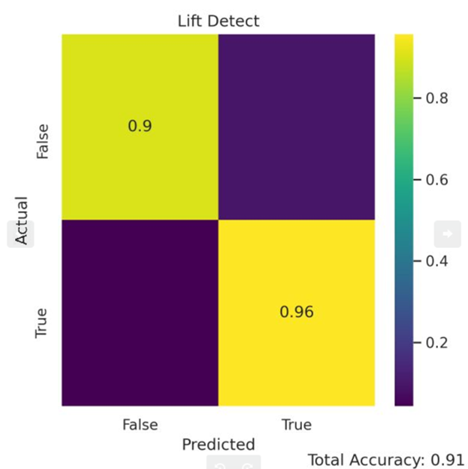
Results – Lift Detection
BAC: 92.9%
Suffers from poor precision due to unbalanced dataset
F1 Score: 0.835
Positive predictions have around 50% chance to be negative
Must be caught by classification model
 | Predicted Negative | Predicted Positive
Actual Negative | 35791 | 3858
Actual Positive | 185 | 4027

Slide 14
Results
Comparative tests show that deep learning is a valid strategy for lift risk detection
Proposed implementation outperforms baseline
 | SVM | DeepConvLSTM | Proposed
Classification (BAC) | 0.609 | 0.832 | 0.895
Detection (F-score) | 0.450 | 0.732 | 0.835

Slide 15
Challenges
Lift detection dataset is imbalanced
Lifting action happens significantly less often than other activities
Mitigated with rebalancing and data augmentation
Limited computing power and long train times
Limit complexity of models and plan ahead for testing

Slide 16

Thanks!
thoma2bm@mail.uc.edu

