Slide 1
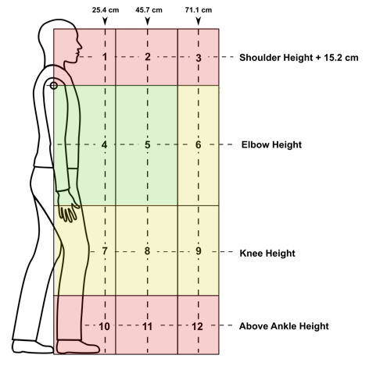
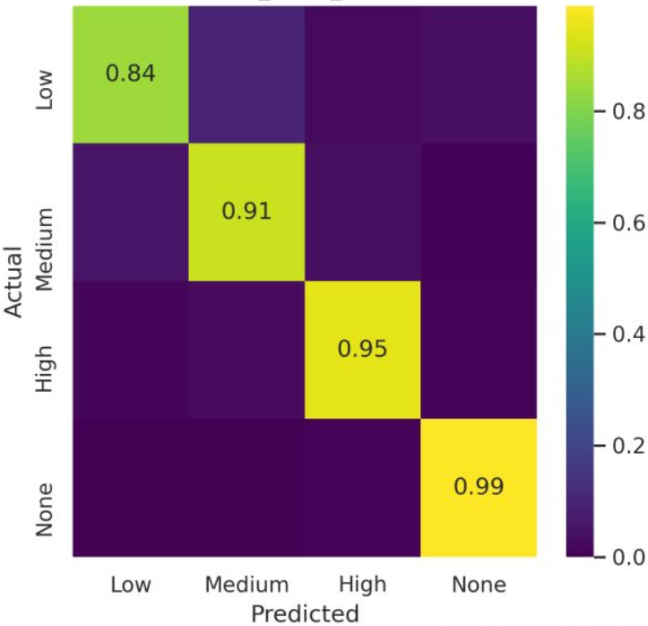

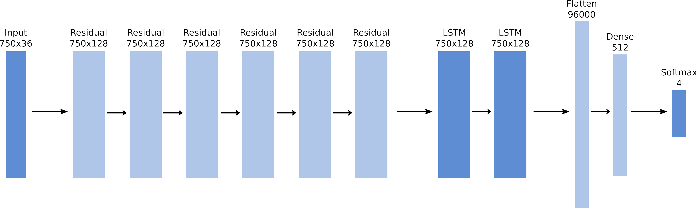
Deep Learning Methods for Lift Risk Assessment
Brennan Thomas
Advisor: Dr. Rashmi Jha
INTRODUCTION
METHODS
RESULTS
CONCLUSION
Repeated lifting of heavy objects has been shown to create increased risk for incidences of lower back pain. While lifting objects cannot be entirely avoided in daily life, proper technique mitigates these risks. Determining when a person is lifting in a risky way can help a worker learn to avoid dangerous lifts and help the employer determine if the workplace layout is prone to requiring them. Common safety guidelines suggest workers keep backs straight while lifting with their legs (i.e., squat lifting technique). However, it is difficult to ensure that guidelines are followed consistently in all situations, and a worker may be unable to lift a heavy object following these guidelines due to strength limitations imposed by the squat lifting technique. Additionally, lifting a large object in this manner may place additional strain on the lower back if it cannot fit between the knees¹. Several guidelines exist for measuring risk levels and acceptable lifting conditions, such as the American Conference of Governmental Industrial Hygienists (ACGIH) Threshold Limit Values (TLV) for lifting², but these are difficult for a worker to calculate and use in real time. Ultimately, guidelines such as these are useful as planning tools for designing ergonomic workspaces, but are impractical for use in real-time working conditions. Currently, observing the worker’s lifting postures throughout the shift is a common risk assessment method. This type of assessment, however, is labor-intensive and prone to bias due to the subjective observations. Additionally, the observation method can only be applied to shorter observation periods for avoiding observational fatigue and high cost for long observations. An automated system that provides real-time feedback on lifting would alert the worker to any risk and help prevent health complications that could be caused by high-risk activities, and scale easily to many workers. While human activity recognition is a well-studied field, it is more difficult to differentiate similar activities (such as different types of lifting) compared to distinct activities (such as running, walking, and sitting). The goal of this project is to develop a machine learning approach for detecting the risk level of an individual lift based on accelerometer and gyroscope data from various sensors placed on a worker’s body.
The data used in this project were collected in a previous study performed by NIOSH³. Sensor data for two-handed lifting motion were collected from ten subjects (five male and five female) fitted with six IMU sensors on the dominant thigh, dominant upper arm, waist, upper back, and each wrist. Each IMU sensor sampled tri-axial accelerometer and gyroscope data at 25 Hz. Lifts were performed in one of the 12 zones defined by the ACGIH TLV for lifting. Each zone corresponds to a specific level of risk, defined as low, medium, and high risk.
The model developed for both detection and classification is a modification of the DeepConvLSTM architecture⁴, which utilizes convolutional and long short-term memory layers to act as an automatic feature extractor and classifier, so that raw data can be used as input without any preprocessing. The architecture was modified using residual skip-connections to reduce gradient problems and allow for a deeper network. A leave-one-subject-out cross-validation was employed to reduce variation in performance due to the small size of the dataset. Classification was performed on full samples, detection was performed using a sliding window to segment samples into lift or non-lift segments.
The classification model achieved impressive results, with greater than 80% recall in all classes and an overall balanced accuracy (BAC)⁵ of 89.5%. The model showed a slight bias towards higher-risk lifts, likely because there is a larger proportion of high-risk zones compared to low-risk zones in the ACGIH TLV for lifting. This bias is acceptable because there is a higher cost penalty for misclassifying a high-risk lift compared to a low-risk lift.
Lift detection achieved similar recall values, but suffered from slightly lower precision due to the unbalanced dataset caused by the relative rarity of lifting action compared to other activities. The overall performance of the lift detection model was measured using the f-score, with a value of 0.835.
The results show that deep learning is a valid approach to the lift classification problem, as the deep learning methods greatly outperform the statistical SVM method. The proposed model also outperforms the baseline DeepConvLSTM model it is derived from. Both the detection and classification models achieve high performance based on the objectives, meaning they are able to detect and classify high risk lifting action based on IMU data, despite the relatively small size of the dataset compared to other HAR problems. These models could be implemented in a real-time classification system to help protect workers from dangerous lifting activity in the workplace. Future work includes improving the precision of the detection model for better performance, determining memory usage and requirements of an in-place system, and identifying optimal sensor configurations for minimally intrusive recognition systems.
REFERENCES
[1] 1981. Work practices guide for manual lifting. Technical Report. https://doi.org/10.26616/nioshpub81122
[2] R. Splittstoesser, D. O’Farrell, J. Hill, T. McMahon, N. Sastry, and M. Tiemeier. [n.d.]. 2005 ACGIH Lifting TLV:
Employee-Friendly Presentation and Guidance for Professional Judgment. Energy Facility Contractor’s Group ([n. d.]).
[3] Menekse Barim, Ming-Lun Lu, Shuo Feng, Grant Hughes, Marie Hayden, and Dwight Werren. 2019. Accuracy of An Algorithm Using Motion Data Of Five Wearable IMU Sensors For Estimating Lifting Duration And Lifting Risk Factors. Proceedings of the Human Factors and Ergonomics Society Annual Meeting 63 (11 2019), 1105–1111. https://doi.org/10.1177/1071181319631367
[4] Francisco Ordóñez and Daniel Roggen. 2016. Deep Convolutional and LSTM Recurrent Neural Networks for Multimodal Wearable Activity Recognition. Sensors 16, 1 (Jan. 2016), 115. https://doi.org/10.3390/s16010115
[5] L. Mosley. [n.d.]. A balanced approach to the multi-class imbalance problem.
 | SVM | DeepConvLSTM | Proposed
Classification (BAC) | 0.609 | 0.832 | 0.895
Detection (F-score) | 0.450 | 0.732 | 0.835
OBJECTIVES
CONTACT
This project targeted deep learning as a possible solution for lift detection and classification. A lift classification system must have two major components, a lift detection model and a lift classification model. The detection model determines when a lift is occurring in the input data and passes the detected lift data to the classification model for the final classification. The overall objective of this project is to determine if deep learning is a valid approach to the problem, and if so, to develop deep learning models that are able to perform this task with a high degree of accuracy. For this project, “high accuracy” was determined to be greater than 80%.
Brennan Thomas
Computer Science ‘21
thoma2bm@mail.uc.edu

