Slide 1
THBI on ERI nodes

Slide 2
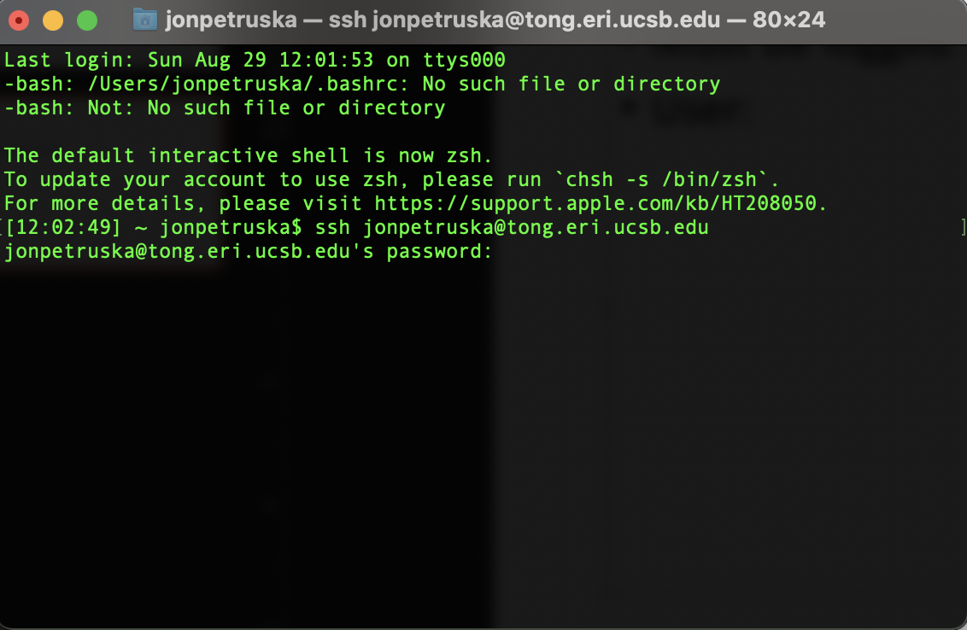
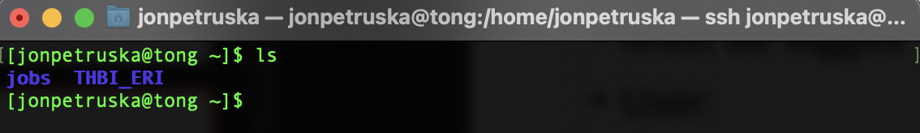
SSH method
Must be logged into UCSB VPN
User: jonpetruska@____.eri.ucsb.edu.
Only Tong, Anvil have
matlab

Slide 3
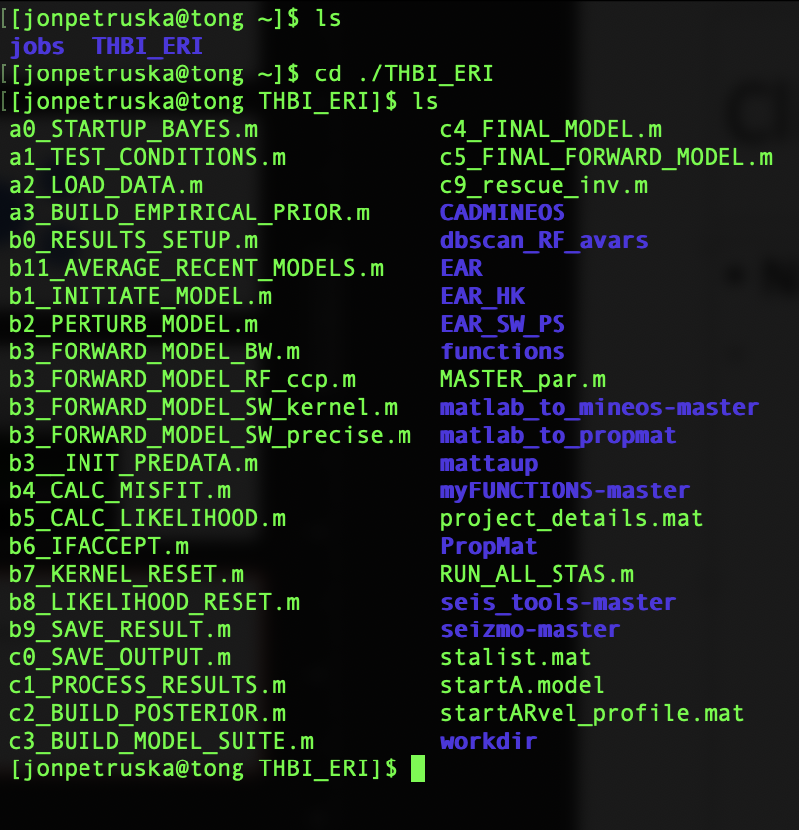
Package basics
THBI_ERI Important contents:
Mineos
Propmat
TauP
Contains RF’s, PhV, and HK stacks
All functions for THBI included (gtimeout, Zach’s functions etc.).

Slide 4
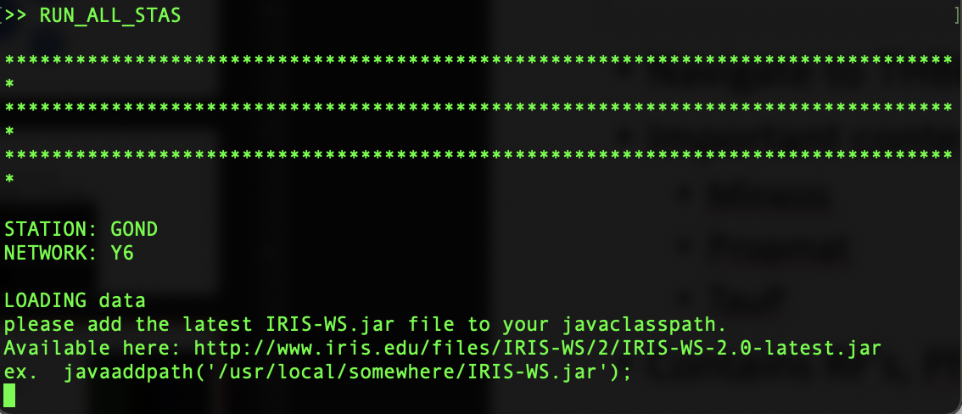
Startup
Within THBI_ERI folder:
Type ‘matlab’
Type: RUN_ALL_STAS
Will begin running for station GOND.

Slide 5
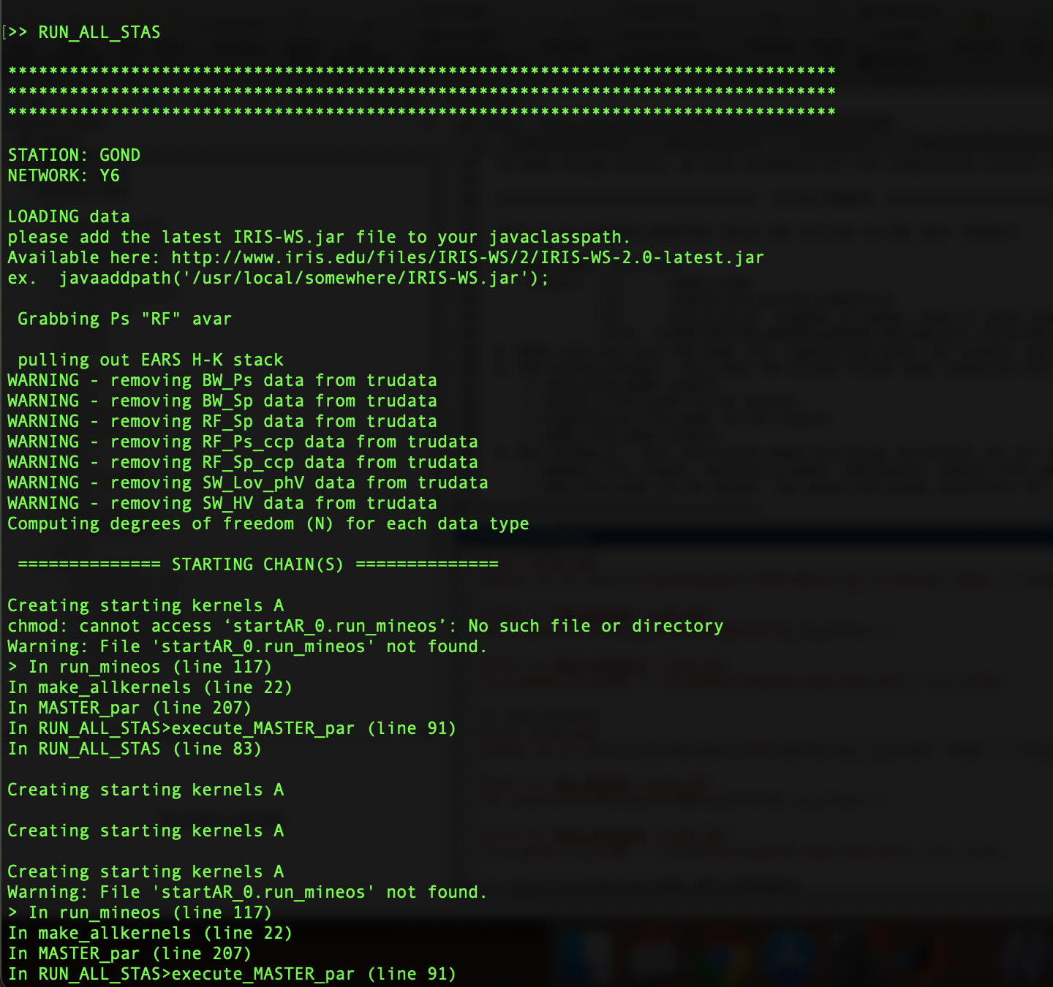
Iris part takes a long time to run.
Correct data types loaded properly
Cannot make kernels because no mineos start file generated, so no initial kernel created for starting model.

Slide 6
Basic methodology for compiling
cd /home/jonpetruska/THBI_ERI/CADMINEOS
./MAKEALL.bash
cd /home/jonpetruska/THBI_ERI/PropMat/src
make
*Live example here*

Slide 7
Mineos nohang example
./mineos_nohang
/home/jonpetruska/THBI_ERI/CADMINEOS/test/tst.mod

Slide 8
Examples cont’d
vi bayes_inv_parms.m – change parameters for inversion

Slide 9
Main Question
Why isn’t the modefile being created?
Why isn’t the compilation working properly, despite paths being correct? Incompatibilities in gfortran compiler?
Why do the MINEOS subfunctions run properly (apparently) when initiated from the command line, but not from Matlab?

Slide 10
Slurm/parallel pool method – not recommended
Home bar → parallel → create or manage cluster
Add cluster profile → slurm (requires additional plugin)
Edit → job storage location = ~/THBI_ERI
Additional Slurm Properties:
Additional command line arguments: where you dictate the number of cores to use
Files and Folders → Manually specify files and folders to copy…
RF, SW, HK data folders.

Slide 11
https://de.mathworks.com/help/parallel-computing/discover-clusters-and-use-cluster-profiles.html
https://de.mathworks.com/help/parallel-computing/scale-up-from-desktop-to-cluster.html
https://de.mathworks.com/help/compiler/use-the-parallel-computing-toolbox.html#bt1v68z-1
https://de.mathworks.com/help/compiler_sdk/cxx/use-the-parallel-computing-toolbox.html
https://de.mathworks.com/help/matlab-parallel-server/troubleshoot-common-problems.html#f0-17622

