Slide 1
Day 1, Part 1: R Introduction

Slide 2
Welcome!

Slide 3
Welcome to R!
R is a user-friendly, intuitive programming language that allows researchers to efficiently manage, analyze, and visualize data.
R is widely used and has become the de facto language for data management and analysis in the scientific community; thus, it is important to learn and can be immensely helpful for you in the future!

Slide 4
Why Use R?
R is difficult and time-consuming to learn. However, learning R will be worth your while if you want to become a pro at data analysis!
The benefits of processing your data via R include:
You can wrangle and analyze your data more efficiently and without mistakes from manual data entry.
You can re-run your analysis as many times as you want!
You can easily share your analysis with others by sending them your scripts.
Your analysis is fully reproducible - you have an exact record of what you did with your data from start to finish

Slide 5
Reproducibility
Reproducible science is the name of the game!¹
Methods reproducibility: Same procedures on data can be exactly repeated by the same team
Results reproducibility: Same results can be obtained from an independent study with the same procedures
Inferential reproducibility: Same conclusions can be drawn from an independent replication or a reanalysis
Analysis via R addresses methods reproducibility & can help with other forms of reproducibility

Slide 6
Reproducibility
Using reproducible workflows via R will mitigate/solve:
Poor statistical analysis
Unavailable methods/code
Unavailable raw data

Slide 7
Advantages of Coding in R
Code is independent of data
Code handles large or in-progress datasets
Code is documentation
Code outlives your research team
Code generates the visualizations that you actually want
R has an amazing community & resources
You become a coder!

Slide 8
1. Code is independent of data
Your data is sacrosanct. You shouldn’t ever mess with it.
Code lets you analyze data without touching it.
It follows that we shouldn’t be analyzing data using spreadsheets.

Slide 9
What Not to Do

Slide 10
What Not to Do
Caution
““operated through a series of Excel spreadsheets, which had to be completed manually, by a process of copying and pasting data from one spreadsheet to another”, and “that it should be automated” but never was.”
Caution
“After subtracting the old rate from the new rate, the spreadsheet divided by their sum instead of their average, as the modeler had intended.” ²

Slide 11
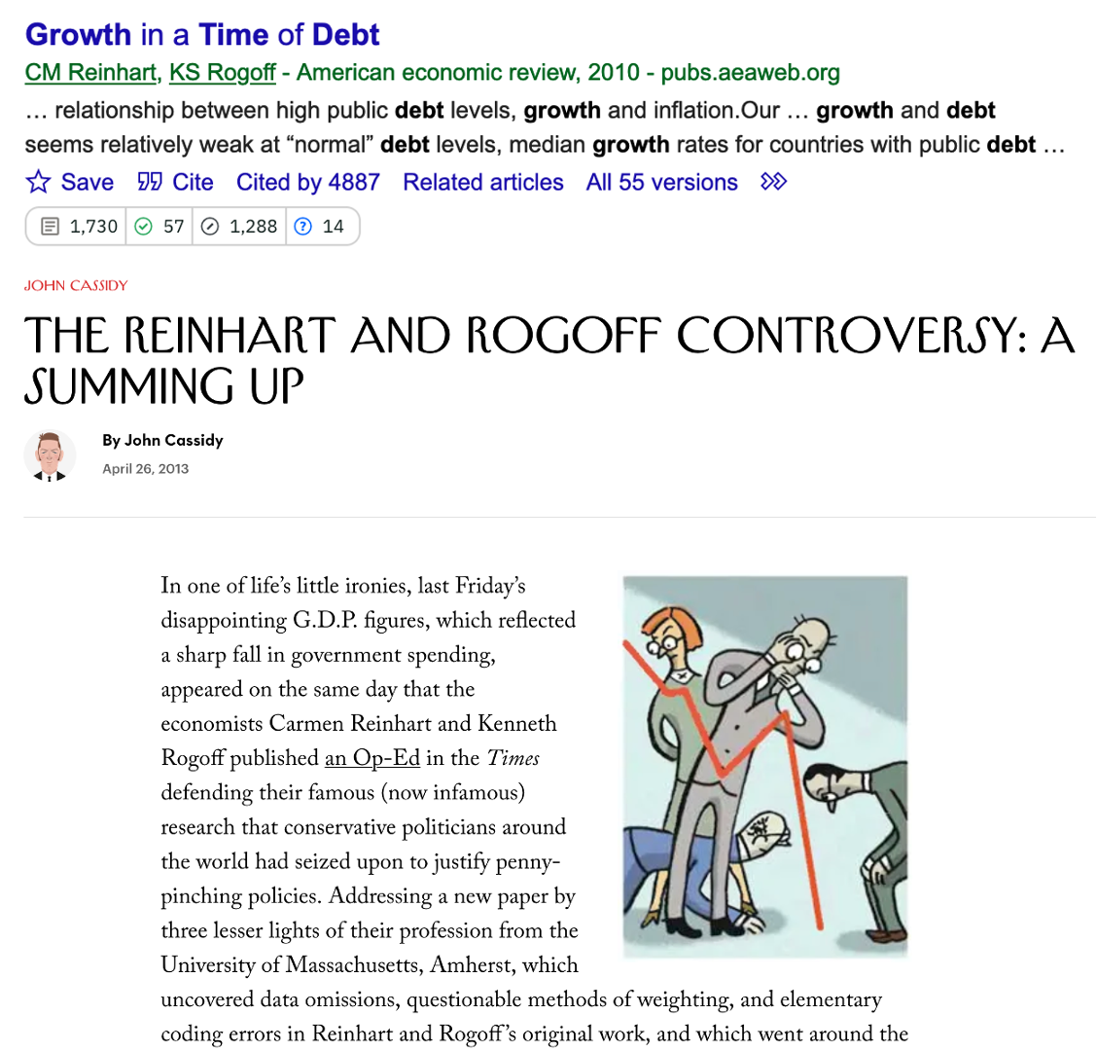
What Not to Do, Part Two

Slide 12
Cleaning Up Data Manually
subjid | age_deaf | age_exposed_asl | learn_asl_from
1 | 0 | 0 | Parents, Siblings, Friends, Teachers
2 | 0 | 0.2 | Parents, Friends, Teachers
3 | 0 | birth | Parents, Siblings, Friends, Teachers, Other
4 | 0 | 1 | Friends, Teachers
5 | 0 | birth | Friends, Other
6 | 0 | 2 years old or older | Siblings, Friends, Teachers
Suppose you have survey data from 16 deaf subjects. It looks like this…

Slide 13
Cleaning Up Data Manually
This data needs to be cleaned up before analysis. You could do this manually via Excel. To be able to get a mean ASL age of exposure, you:
replace “birth” with “0”
replace “2 years old or older” with “2”
However:
you have no documentation of what you did (unless you write it down manually)
other people cannot see what decisions you made
if you get more data, you will have to manually recode the data again.
This leads to mistakes, especially if the project spans multiple researchers and/or years!

Slide 14
Cleaning Up Data via R
Alternatively, you could use R:
library(tidyverse) # for pipe (i.e., %>% ) library(dplyr) # for mutate() and case_when() cleaner_data <- messy_data %>% mutate(age_exposed_asl = case_when(age_exposed_asl == "birth" ~ "0", age_exposed_asl == "2 years old or older" ~ "2", TRUE ~ age_exposed_asl ) )
This code uses the mutate() and case_when() functions in the dplyr package to replace the two non-numeric values while keeping the rest of the values the same.

Slide 15
Cleaning Up Data via R
subjid | age_deaf | age_exposed_asl | learn_asl_from
1 | 0 | 0 | Parents, Siblings, Friends, Teachers
2 | 0 | 0.2 | Parents, Friends, Teachers
3 | 0 | 0 | Parents, Siblings, Friends, Teachers, Other
4 | 0 | 1 | Friends, Teachers
5 | 0 | 0 | Friends, Other
6 | 0 | 2 | Siblings, Friends, Teachers
See the results!

Slide 16
2. Code handles in-progress datasets
You can write the code before you collect all of your data
Then you add new files to your project folder, and rerun your code
The code will find the new data and update everything!

Slide 17
Cleaning up Data via R
Suppose a few months later you add two more subjects:
Instead of manually recoding the data, and hoping it stays consistent from the last time, you can simply rerun the script on the whole dataset to get:
R allows you to code your data once and apply it consistently to any dataset you have, including future data!

Slide 18
3. Code is documentation
R code is self-documenting!
Well-written and commented code tells you what you did with the data.
You can always go back and see what the code does if you’re not sure what you did.

Slide 19
4. Code outlives your research team
Code allows consistency across researchers as well as subjects and time.
Can you be sure your RAs are doing manual work right every single time? Are they doing it the same way as previous RAs?
Code automates the manual and repetitive work that humans often make mistakes on.

Slide 20
5. Code generates the visualizations you want
You can use ggplot2 in R to generate a stunning array of visualizations, limited only by your imagination
No more wrestling with Excel or Google charts

Slide 21
6. R has an amazing community & resources
If you have a problem, other people have had & solved that problem before.
There are open-source packages for almost everything under the sun.
There is extensive documentation for everything in R.
StackExchange and ChatGPT work really well for solving problems with R.
Hadley Wickham has a free and well-written R textbook.

Slide 22
7. You become a coder!
Welcome to the world of computer programming!
R is a great way to get started via a user-friendly language which can be applied to things you actually use (i.e., data).

Slide 23
What to expect…

Slide 24
Structure of this workshop
This workshop will teach you R in an accessible way (coming from someone who only took one formal programming class and none in R!).
The primary purpose of this workshop is to teach you the basics of R programming and get you started on using R for your own research.
Some of you have more experience with R than others, so:
We will be giving lectures half of the time.
The other half will be lab time where you can:
practice the concepts we’ve taught or
work on improving your own R skills using your own data, with our help (OYOLabs)

Slide 25
On Your Own (OYO) Labs
The hardest part of learning R is applying it to your own specific situation and your own data/projects.
OYOLabs are meant for you to build your own workspace (or workspaces) with R so that you have a foundation to continue using R with your own projects after the Institute
You will have Brennan, Matt, and each other to help you work through the problems that will inevitably crop up!
We encourage you to use the OYOLabs to work on your projects as they relate to that day. For example, on Tuesday (data visualization day!) you should try to write or refine scripts which visualize your data.
However, if you wish to work on other aspects of your R project instead, use your time the best way you feel fit

Slide 26
R Clinic
We will have an R Clinic on Saturday afternoon.
This is time for you to meet with me and/or Matt for help and advice with your analysis.
Length of appointments will depend on how many people are interested.
You are encouraged to also come up to us any other time during the Institute (such as lunchtime) if you desire answers, help, or conversation!

Slide 27
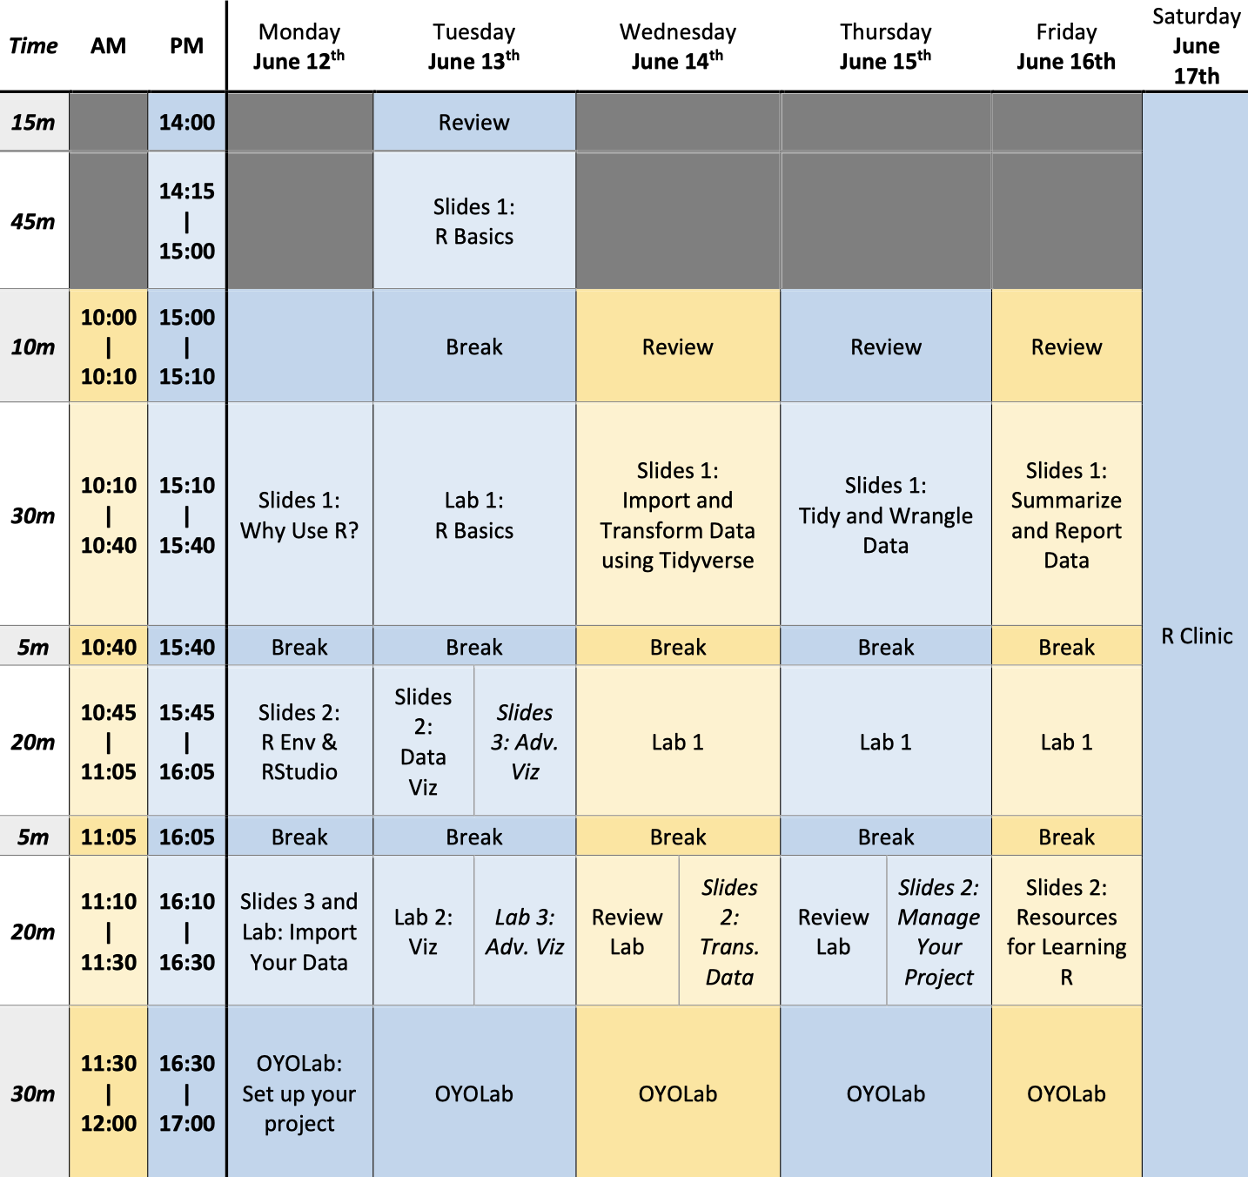
Workshop schedule (in COURSE OVERVIEW)

Slide 28
Notes
1. Plesser, H. E. (2017). Reproducibility vs. Replicability: A Brief History of a Confused Terminology. Frontiers in Neuroinformatics, 11, 76.
2. https://blog.revolutionanalytics.com/2013/02/did-an-excel-error-bring-down-the-london-whale.html

