Slide 1
Day 5, Part 2: Resources for Learning R
Brennan & Matt

Slide 2
A quick list of useful packages in R
To manipulate data
tidyverse - An opinionated collection of R packages designed for data science that share an underlying design philosophy, grammar, and data structures. This collection includes all the packages in this section, plus many more for data import, tidying, and visualization listed here.
dplyr - Essential shortcuts for subsetting, summarizing, rearranging, and joining together data sets. dplyr is our go to package for fast data manipulation.
stringr - Easy to learn tools for regular expressions and character strings.
lubridate - Tools that make working with dates and times easier.
To visualize data
ggplot2 - R's famous package for making beautiful graphics. ggplot2 lets you use the grammar of graphics to build layered, customizable plots.
ggvis - Interactive, web based graphics built with the grammar of graphics.
rgl - Interactive 3D visualizations with R
htmlwidgets - A fast way to build interactive (javascript based) visualizations with R. Packages that implement htmlwidgets include:
leaflet (maps), dygraphs (time series), DT (tables), diagrammeR (diagrams), network3D (network graphs), threeJS (3D scatterplots and globes).
To model data
tidymodels - A collection of packages for modeling and machine learning using tidyverse principles. This collection includes rsample, parsnip, recipes, broom, and many other general and specialized packages listed here.
lme4/nlme - Linear and non-linear mixed effects models
randomForest - Random forest methods from machine learning
multcomp - Tools for multiple comparison testing
vcd - Visualization tools and tests for categorical data
survival - Tools for survival analysis
To report results
shiny - Easily make interactive, web apps with R. A perfect way to explore data and share findings with non-programmers.
R Markdown - The perfect workflow for reproducible and automated reporting. Write R code in your markdown reports.
xtable - The xtable function takes an R object (like a data frame) and returns the latex or HTML code you need to paste a pretty version of the object into your documents. Copy and paste, or pair up with R Markdown.

Slide 3
How to Write Good Code

Slide 4
Commenting
Commenting is your inline documentation of your code and analysis
Especially as a beginning coder, there is no such thing as too little commenting
Comments should:
explain what your code is doing
explain decisions you made and why
not repeat the code, but clarify & contextualize it

Slide 5
Naming Variables and Objects
How you name variables and objects can make life much easier for you.
Use long & descriptive variable or object names if you have to. Text is cheap, brain capacity is not.
Which dataframe name is clearer?
df3 average_EEG_response_times
Variables and objects should never have spaces; use underscores instead
Names with spaces must be surrounded by ` ` every time you call them, which is super annoying
Variable names should be lowercase

Slide 6
Coding Style
Don’t use run-on code lines; most functions should start on a new line.
Use blank lines often to separate code blocks! You can’t have too many blank lines.
Add spaces around operators: + - == < != <- etc.
Add spaces after comments like in English.
new_df <- mutate(df, new_name = old_name, new_name2 = old_name2, new_name3 = old_name3) newer_df <- filter(new_df, group = "deaf")

Slide 7
Debugging
Overwriting objects (or not!)
When you assign the same name to an object, you overwrite that object.
Assigning different names allows you to look at the object in between your steps so you can figure out where you went wrong.
Rerunning code
You should make a habit of rerunning your entire code with a clean dataset pretty often.
This helps you catch mistakes early on.

Slide 8
Other tips for coding in R
Delete old objects you no longer need with rm(). This helps keep your environment clean.
If you need to quote something, highlight it and press " or '. This also works with (.
Use sectioning comments (# Section title -----) which allow you to “minimize” sections.

Slide 9
How to keep learning R

Slide 10
Learning R
There are so many resources for learning R!
A great textbook by Hadley (can read only chapters of interest)
Swirl is an R package for learning R
Online courses, including:
Codecademy
Harvard on edX (and other edX courses) (paid; can audit)

Slide 11
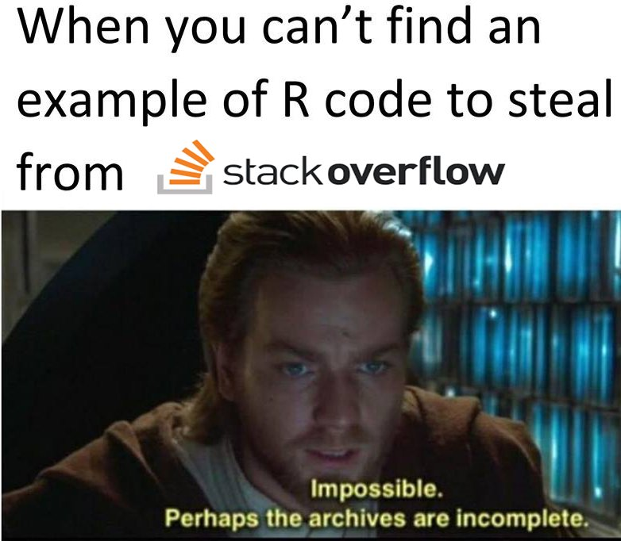
Troubleshooting R
ChatGPT!
StackExchange
Google
A note of caution…
ALWAYS be sure you know what code does before copying it from a rando on google
Or at least know it doesn’t do anything bad
If something is highly upvoted, it’s usually fine
I’ve never had a problem

Slide 12
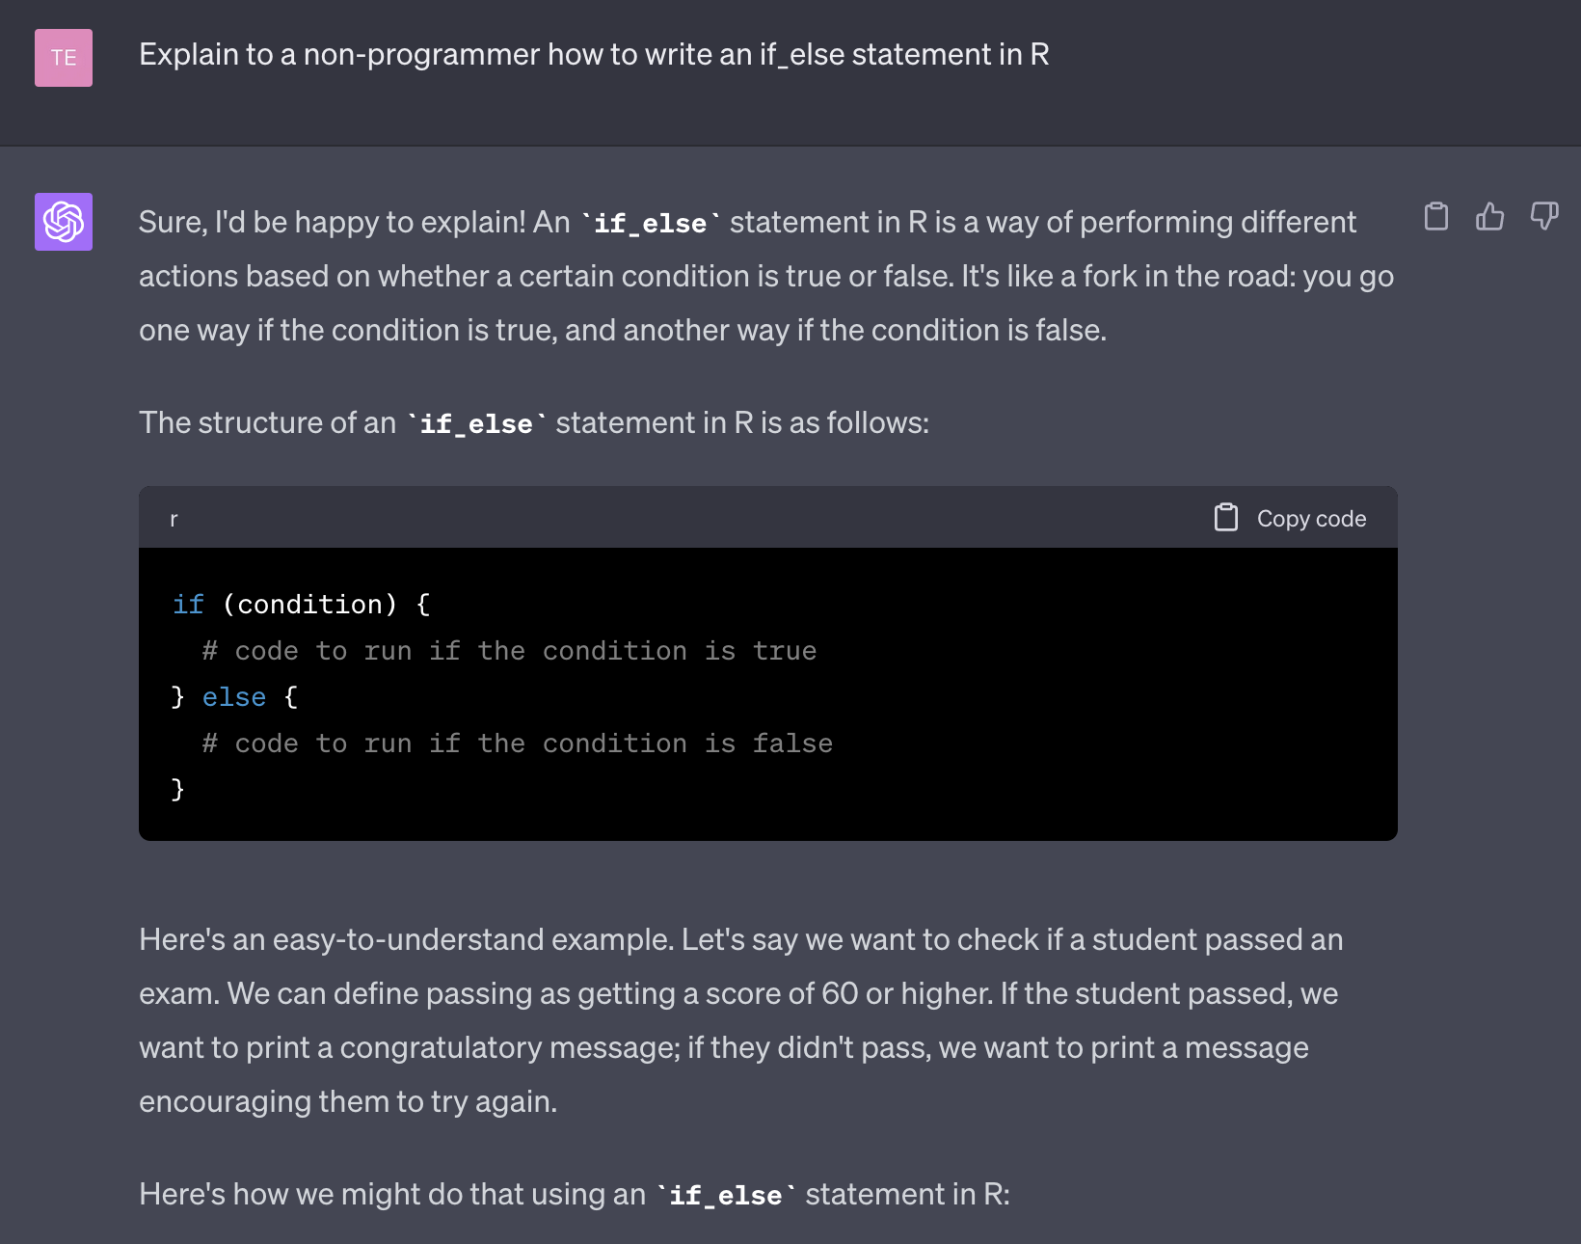
ChatGPT

Slide 13
Cool Stuff

Slide 14
Text Analysis in R
Elana shared this workshop for analyzing text in R:
https://www.youtube.com/watch?v=KnkfSOZNMkg&list=PL2ltQwWwJ4izi1RBEQaSlJheLdcxG0dXA&index=3

Slide 15

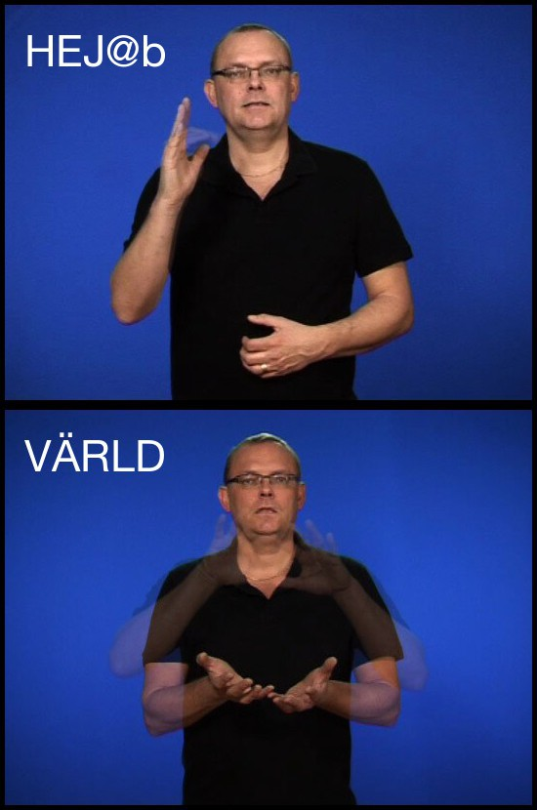
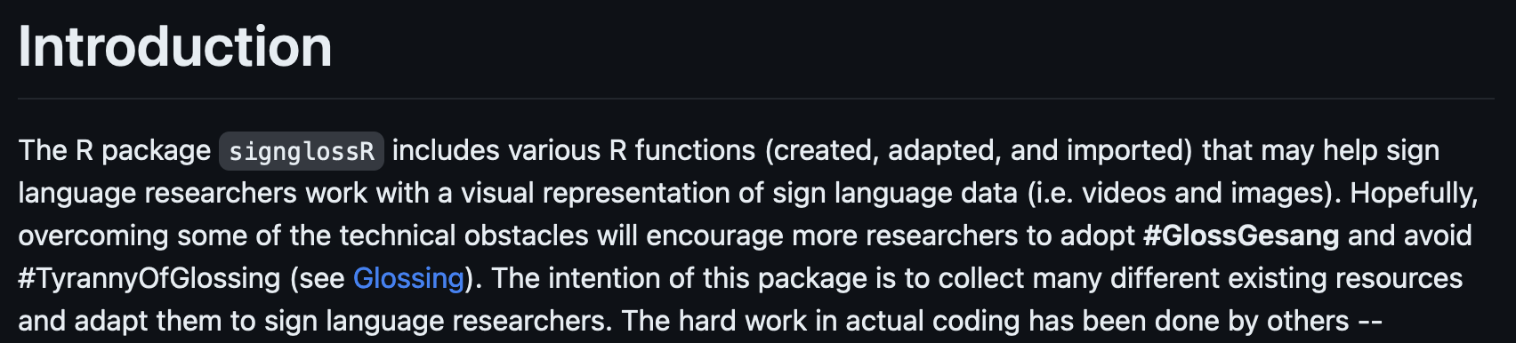
signglossR
A package by Carl Börstell
Can create images and gifs from online sign language dictionaries
Has a function for importing ELAN data?

