Slide 1
Parallelization of the Traveling Salesman Problem
Brennan Reamer
ELEC5975 Parallel Computer Architecture

Slide 2
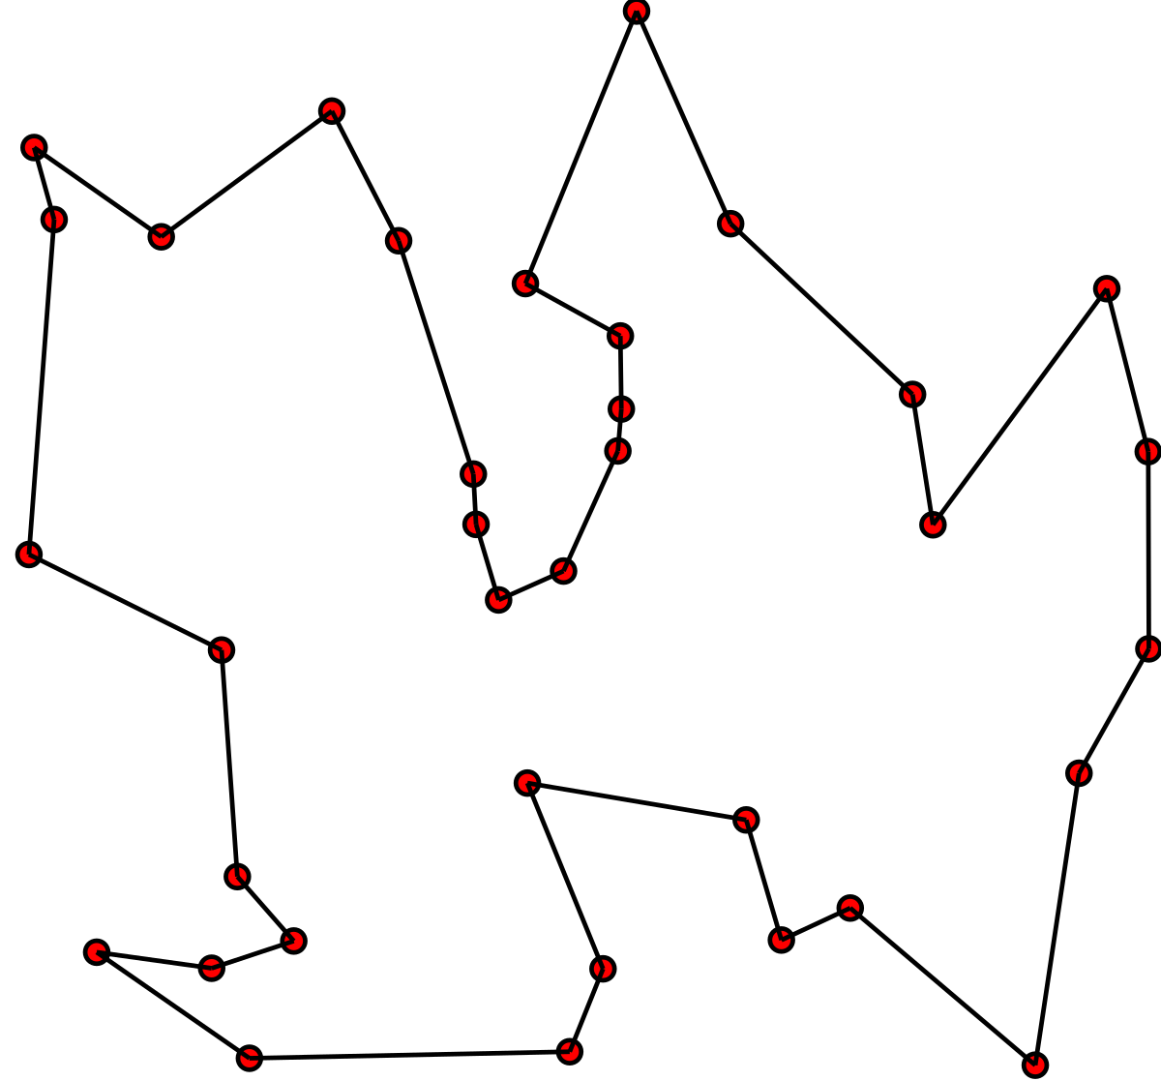
The Traveling Salesman Problem (TSP)
Goal:
Find the shortest possible route
Must visit every city exactly once
Must return to the starting point.
TSP has many real-world applications:
Logistics
Transportation
Google Maps
[1]
Notes:
The goal of the Traveling Salesman Problem is to find the shortest possible route between a given set of cities, visiting every city exactly once and returning to the starting point. This problem is applicable to many areas and industries, such as logistics, navigation, and even Pokemon Go.

Slide 3
Problem Approach
Brute force approach – consistently correct answer, but expensive computation times.
Parallelization – can help alleviate the main drawback of the brute force approach.
Data Parallelism – Split up the data into smaller ‘chunks’ based on the number of processors
Notes:
I chose to use a Brute-Force approach when developing my solution as it consistently results in the correct answer and has expensive computation times, leaving greater room for me to provide speedup with parallelism. Some other possible TSP methods include Branch-and-Bound and Matrix Reduction. I chose to use Data Parallelism by splitting up the data into smaller chunks based on the number of processors. This allows the calculations to be done parallelly and execution time to be reduced.

Slide 4
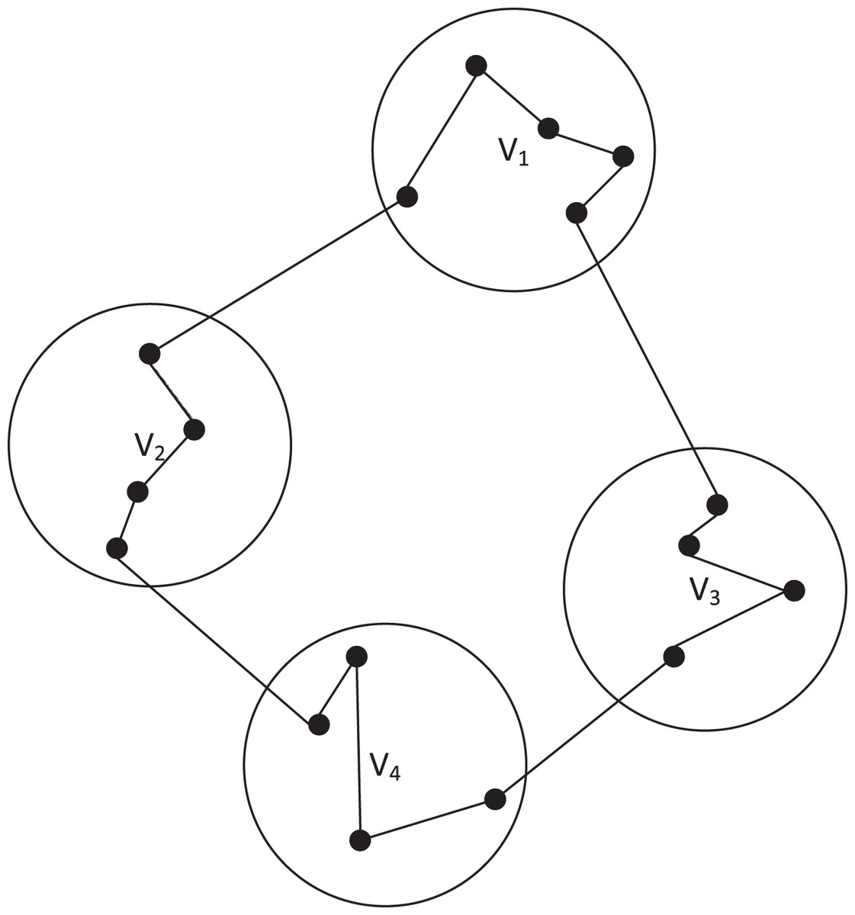
Decomposition
Implement Data Parallelism:
Divide the cities into smaller groups
Solve the TSP for each group in parallel
Combine the solutions to find the optimal route that visits all cities
[2]
Notes:
In order to implement data parallelism, I first divide the cities into smaller groups. Then, I perform the TSP calculations for each group in parallel, determining the minimum distance based on their given cities. Finally, I combine the solutions to find the overall minimum distance to travel to all cities.

Slide 5
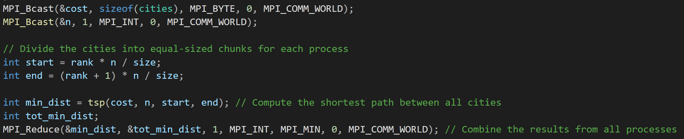
Implementation
MPI_Bcast: Send the array of distances and number of cities to all processes
MPI_Reduce: Combine final distance results from all processes
Notes:
Initially, the master process reads the inputted dataset, labelled cost, and number of cities, labelled n, from a text file. Then, it uses MPI_Bcast to send the cost array and n value to all other processes. The cities then calculate their own start and end values, splitting up the cost array into chunks for themselves. They then perform their calculations, and use MPI_Reduce to return the minimum distance necessary for travel.

Slide 6
Results
When run using a dataset of 312 cities:
Speedup obtained with 40 processors:
Without Torque: 0.53x
With Torque: 0.53x
Notes:
My results for the overall speedup were not very promising. The overall speedup decreased as the number of processors increased. This could be due to communication costs or serial code dependent on the number of processes.

Slide 7
Parallel Execution Results
When run using a dataset of 312 cities:
Speedup obtained with 40 processors:
Without Torque: 38.12x
With Torque: 39.31x
Notes:
I chose to look into the speedup of the parallel section of code in more detail in order to determine if there was at least speedup in that section. The parallel section of code did result in a speedup, as the average time to complete the parallel section of code decreased as the number of processes increased.

Slide 8
Parallel Execution Results
As the number of processes increase,
Overall execution time may be longer, but
Parallel sections of the code execute significantly faster
Notes:
Here is a graph of the execution time of the parallel section of code without using Torque. It decreases logarithmically as the number of processes increases. While the overall execution time may increase as the number of processes increases, the parallel section of code speeds up significantly.

Slide 9
Parallel Execution Results
With Torque, the parallel section of the code performs slightly better
Notes:
With Torque, I found similar results, with only a slight decrease in execution time over the previous test without Torque.

Slide 10
Conclusions
Overall speedup is decreasing as processors increase due to:
The serial section of the code
Communication costs
Speedup of the parallel section of the code increases due to:
Data parallelism – For each additional processor, the data is split up into smaller chunks, allowing shorter execution times
A parallelized brute-force approach allows for consistently correct answers, while being efficiently sped up where there is parallelization.
Notes:
In conclusion, the overall speedup may decrease as processors increase, but the speedup of the parallel section of code actually increases due to the data parallelism used. The communication costs and serial code slow down the program more than the parallelization is able to speed up the program.

Slide 11
References
[1] https://medium.com/@francis.allanah/travelling-salesman-problem-using-simulated-annealing-f547a71ab3c6
[2] https://peerj.com/articles/cs-972/

