Slide 1
Vermont Economic Stimulus
Paul Brennan
Professor John Coles
CIS 512 – Into. To Data Science and Analytics

Slide 2
Approach
Identify Area For Improvement
  A failing industry?
Consider Method of Improvement
  Pair with successful industry?
Derive Specifics
  Pair with what industry?
Consider Further Work

Slide 3
Data processing, internet publishing, and other information services
Portion of GDP in VT fell from $103M in 2006 to $46M in 2014
Opposite of national trend
Against Intuition
  “IT is supposed to grow!”

Slide 4
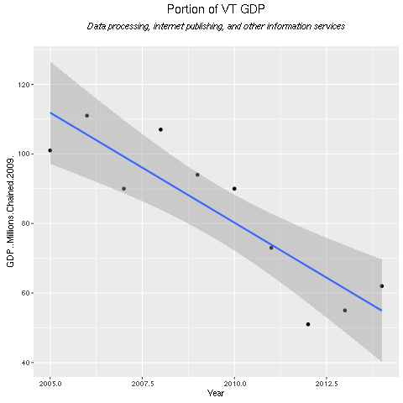
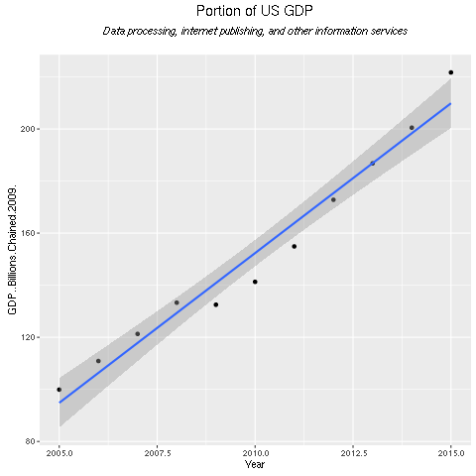
Same Industry, Different Views

Slide 5
Idea: The Buddy System
IT should be ubiquitous
  Useful to all sectors
Partner IT in Vermont with more successful industries
  Learn
  Sell
  Collaborate

Slide 6
Find Your Buddy
Model all sectors
  Linear Regression
  Direction, Strength, and Consistency
Find Top 10 in VT and Top 10 in US
  The intersection contains our finalists

Slide 7
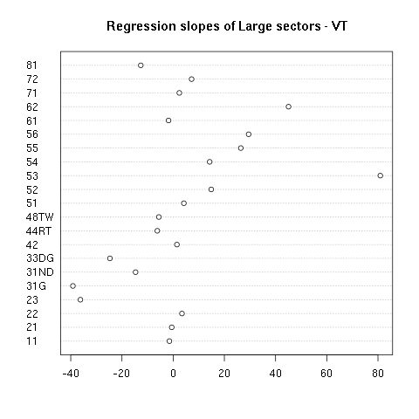
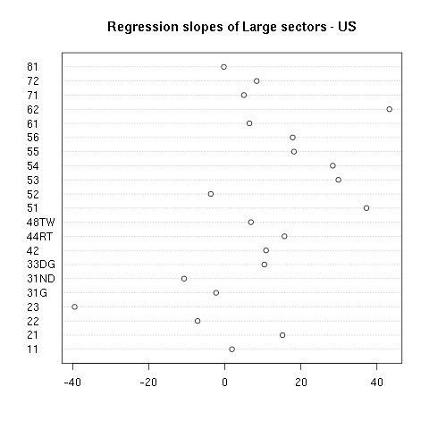
Model Candidate Sectors

Slide 8
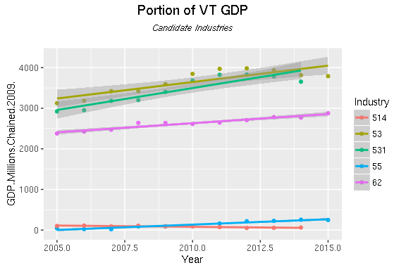
Finalists in VT

Slide 9
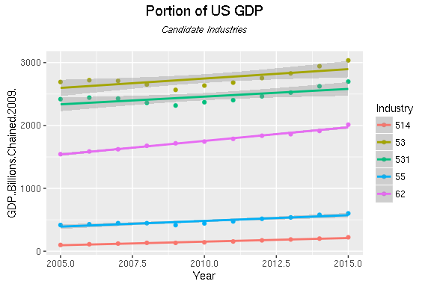
Finalists in US

Slide 10
Health Care and Social Assistance
Real estate is a big player,
  But it is unpredictable
Healthcare shows consistent growth

Slide 11
Potential Methods of Co-operation
Hosting cross discipline conferences
Creating shared incubation space
Create grants to encourage IT firms to solve healthcare problems

Slide 12
Further Analysis Directions
Better understanding of work force
Research into cause of GDP loss
Case study analysis

Slide 13
More Info and Sources
Project at: https://github.com/brennap/cis-512
Bureau of Economic Analysis: http://www.bea.gov/API/bea_web_service_api_user_guide.htm

