Slide 1
The application of syndromic surveillance methods to the detection of ‘interesting’ time series events
Detecting changes in behaviour in terrorism (specifically changes in intensity) using the electronic terrorist incident databases.
Dr. Peter Brennan B.Sc, H.Dip, M.Sc, Ph.D

Slide 2
Detecting changes in behaviour in terrorism (specifically changes in intensity) using the GTD (Global Terrorism Database), an overview.
A number of different modelling techniques were used to detect ‘interesting’ count time series events relating to changes in in intensity in terrorism.
An electronic terrorist incident database, the GTD (Global Terrorism Database) is used to provision data.
This data is joined to other data sources such as (fas.org ) and CRS (Congressional Research Service) regarding US troop levels in Iraq and Afghanistan.

Slide 3
Why is detecting changes in behaviour in terrorism (specifically changes in intensity) using the GTD (Global Terrorism Database) important?
Being able to detect changes in intensity is important from a number of standpoints, these include:
  Economic reasons, to being able to adjust terrorism re-insurance/insurance rates based on data.
  To enable governments to make counter terrorist interventions based upon specific outbreaks of terrorism.
  To enable terrorism research such as intervention/backlash modelling by being able to detect the effect of specific counter terrorist strategies by analysing whether outbreaks where detected after a particular intervention.

Slide 4
What is terrorism?
A definition of terrorism “utilization and/or the perceived menace of violence whose aim is to further a political agenda” a more useful definition includes the fact it is carried out by non state actors.
This is basically how the GTD defines terrorism.
This is controversial as it excludes incidents carried out by states or state sponsored para military units.

Slide 5
The GTD and terrorist incident databases.
Terrorist incident databases allow large n open, reproducible and transparent research into terrorism. They also enable a shift away from small n studies to large n quantitative studies.
The GTD is the most complete terrorist incident database as it is a continuation of the PGIS (Pinkerton Global Intelligence Services) database, dating back to 1970. It has widely been used for research into terrorism.
It is based on secondary sources (media reports) processed by expert/machine semi supervised system.

Slide 6
Work undertaken
An initial exploratory analysis was carried out using a mix of modelling techniques (supervised and unsupervised techniques) and data visualizations.
After the preliminary modelling phase, a number of machine learning methods based upon detection of ‘interesting’ count time series events.
These include outbreaks, outliers syndromic outbreaks.

Slide 7
Initial data understanding using data visualization and unsupervised methods.
Exploratory and data visualizations uncovered a number of relationships. Used a mix of data analysis and data mining.
A regio-temporal shift in terrorism using thematic maps.
A temporal-attack vector, weapon type relationships (1994 is strongly associated with attacks using weapon types sabotage equipment and mellee weapons against facilities and infrastructure) using multiple correspondence analysis.

Slide 8
Exploratory and modelling techniques
Regression (both various count and linear and robust regression on log transformed count data) was carried out to try and model increases in terrorist intensity (deaths due to terrorism). These models suffered from incorrect specification and lack of generalizability.
HMM’s used to model count time series, these proved very useful in modelling changes in behaviour as different epochs in the data. However these are unsupervised methods and also lack generalizability and can be hard to understand by non statistically trained analysts.

Slide 9
Modelling count time series data
A mix of syndromic surveillance methods, time series outlier techniques and EDM techniques used to detect mean and gradual shifts.
Methods allow the decomposition of time count time series signal into different events.
Through the creation of alarm plots allows easy diagnosis of outbreaks in terrorism.

Slide 10
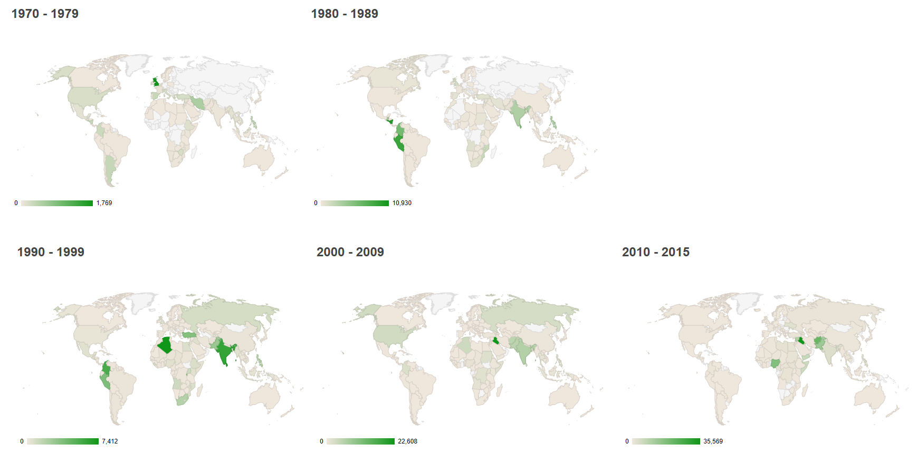
Regio temproal shift in terrorism 1970 to 2016

Slide 11
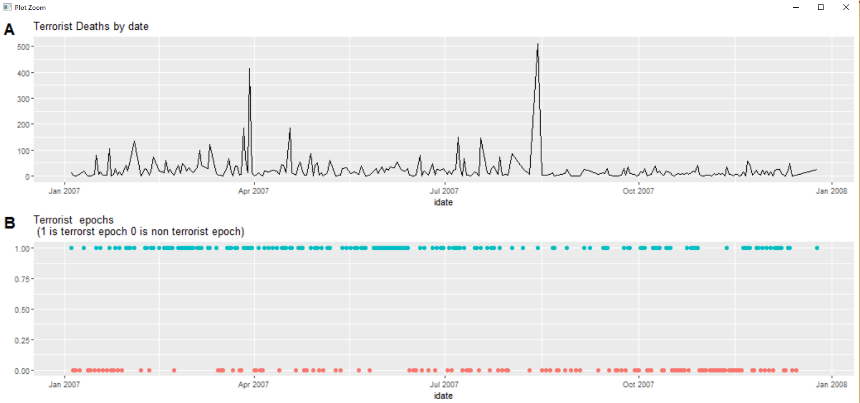
Use of HMM’s to model different terrorist epochs in terrorism in Iraq 2007

Slide 12
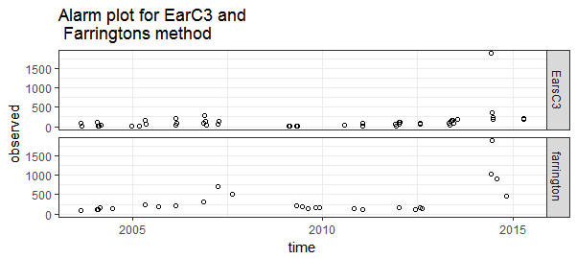
Alarms plots based on different syndromic surveillance methods

Slide 13
Conclusion
Syndromic surveillance methods allow detection of outbreaks in terrorism, these can be supplemented with other count time series analysis methods such as RAD (for outlier detection) and SURUS (mean shifts or gradual shifts) .
This serves to give a deeper understanding of changes in intensity or behaviour related to terrorism. The methods are also generalizable and can be applied easily across multiple countries and regions (purrr)

