Slide 1

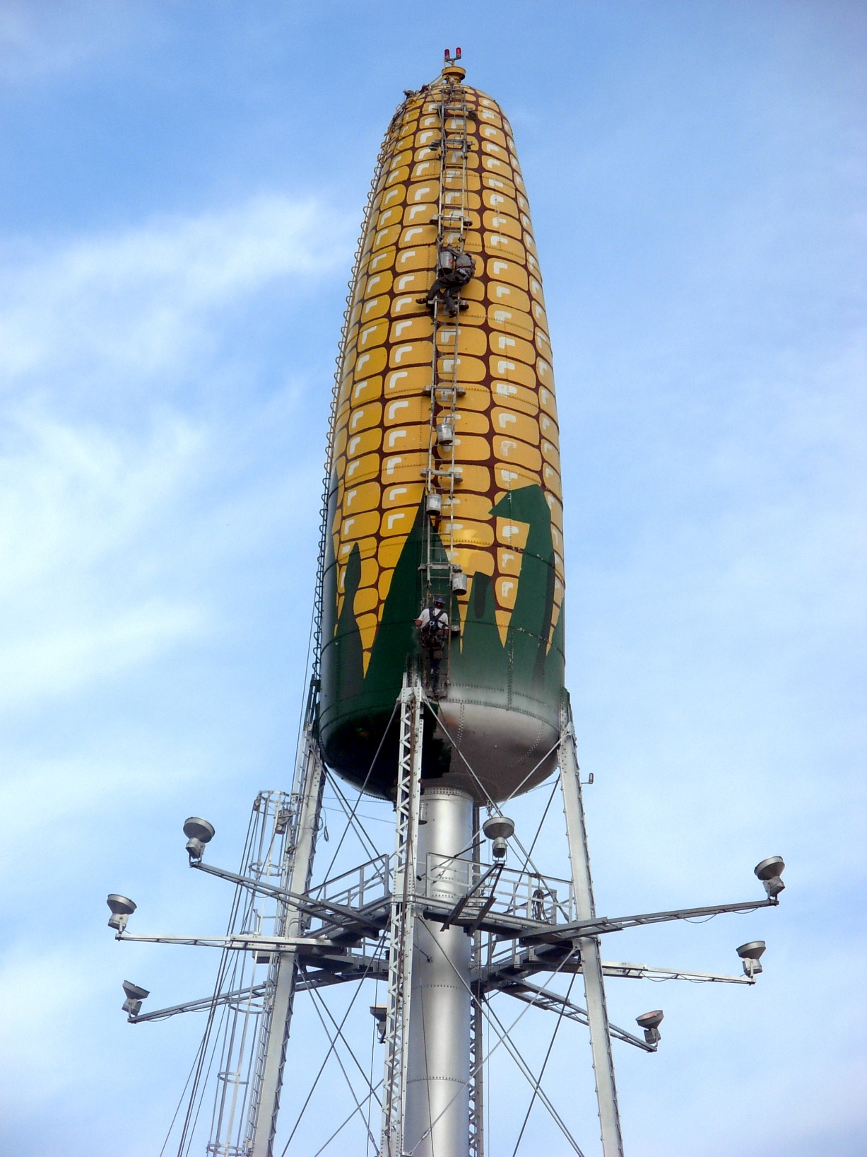
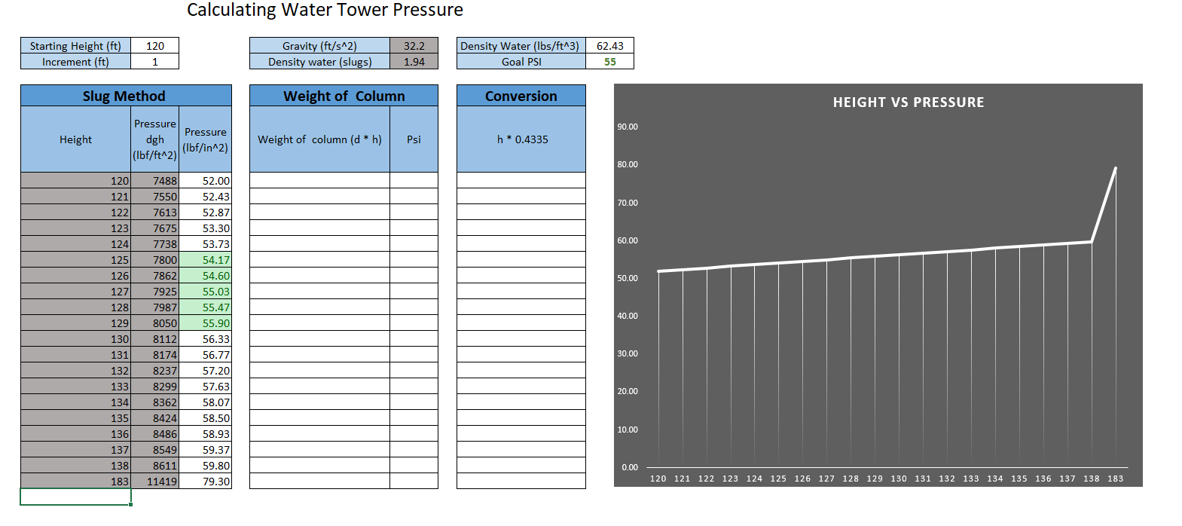
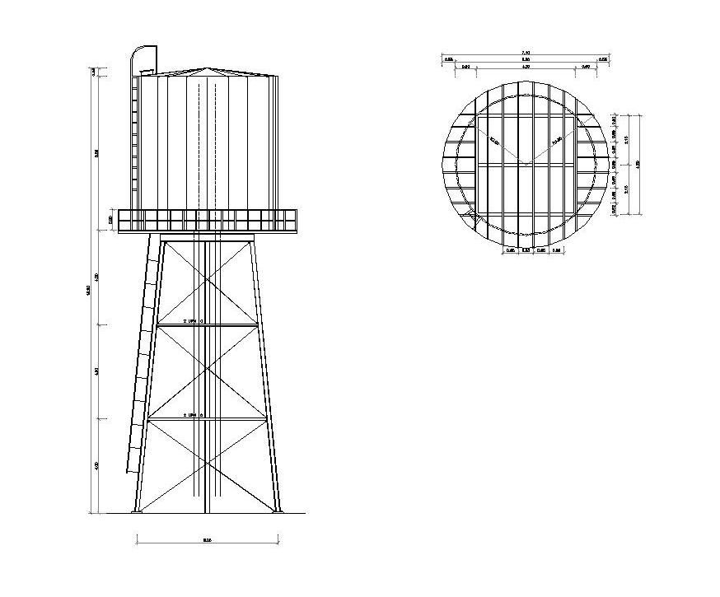
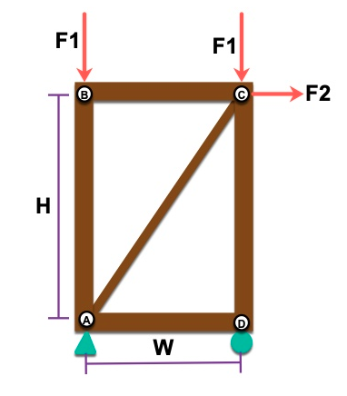
Water Tower Design Project Brennen Green
^{First Year Engineering}.
INTRODUCTION
Sizing the Tank
Pressure in the Waterline
Further Design Considerations
We were asked to design a water tower and perform all the necessary calculation needed to do so. Over the course of the previous two months we learned the necessary parameters that go into designing a water tower. This includes the truss calculations needed to hold the water tower up, the necessary parameters to ensure we have a sufficient and safe amount of water stored in the tower, and finally we learned how to draw the technical drawings required to let other engineers and construction workers know exactly how to build our tower.
To find the necessary volume of a water tower we needed to consider several factors that will help us provide water to the development area. These factors were the population of the area, the daily demand for water per capita, emergency water needs (fire water flow for 5 hours daily and a surplus of water incase the water plant cannot provide), and the amount needed at peak daily demand.
By adding these factors together we were able to arrive at a total volume necessary of 327.6 m^3 in order to properly provide water for our service area.
Water Towers work to provide water with a specific amount of pressure to the pipes which our routed to various different outputs in the development area. This pressure is important, too little and it’ll drip out drop by drop, too much and it can be come dangerous.
In order to find the perfect amount of water pressure we need to calculate the height over our water above the ground using the formula
P = ρgh
For water towers, the general range of 50-80 psi provides a favorable amount of water pressure to the customer. Using an excel spreadsheet we calculated the water pressure at various different heights to find our optimum water pressure of 79 psi
Given the nature of any item which helps support the infrastructure of society. There’s things that must change with time that needs to be taken into consideration for future revisions.
While we have developed a system of which will support out current population and development area. It’s important to recognize this area may change over time. Knowing society is constantly growing in many ways, the population, development, and many other factors of our development area may change. Creating flexibility in our design is important for these reasons.
As-well, while our design is great for the bare minimum. There’s many environmental and physical aspects we failed to consider and should consider for future revisions of out water tower. The biggest environmental factor could be things such as hurricanes, tornadoes, fires, etc. How can we design our tower to withstand these natural phenomena.
Forces in the Truss
Given the nature of construction, anything we construct in the naturally occurring world will undergo many constant and varying forces that, if not considered, will be disastrous for our tower.
These forces are often called static forces. They’re the most constant forces acting on our tower, and therefor cause the most degradation over time of our tower.
In order to build a tower with the capability to withstand these elements of nature, we have to do calculations on our tower to ensure we reach and nice equilibrium of the forces acting upon it.
Orthographic View
FUTURE WORK
There’s no point in designing a tower that will fail once built due to lack of material consideration. One of the most important factors to developing our tower will be the choice of materials used.
The material used in development must be rust resistant, strong but not brittle, and able to handle wind force on a constant basis. Using things that degrade with ease such as copper, raw iron, wood, or many other things is a bad idea.
In this section, insert an orthographic drawing of a water tower
Design Process
In order to design the water tower we had to come together as a team and create as many viable ideas as we could for developing our tower.
Once we had developed several strong and agreed upon ideas, we had to prototype and test these ideas as well as put research into what could be possible flaws within them.
After we concluded our research and felt we had arrived upon our best solution and design for our water tower then we were ready to move on and begin calculating the many factors discussed in this poster needed for the water tower to function optimally.
We calculated the magnitudes such that:
Ax = 150N
Ay = 7340N
Dy = 7340N
Fab = 7340N
Fad = 0N
Fdc = 0N
Fcd =7340N
References
https://www.pinterest.com/pin/372532200405811369/ (ortho drawing)

