Slide 1

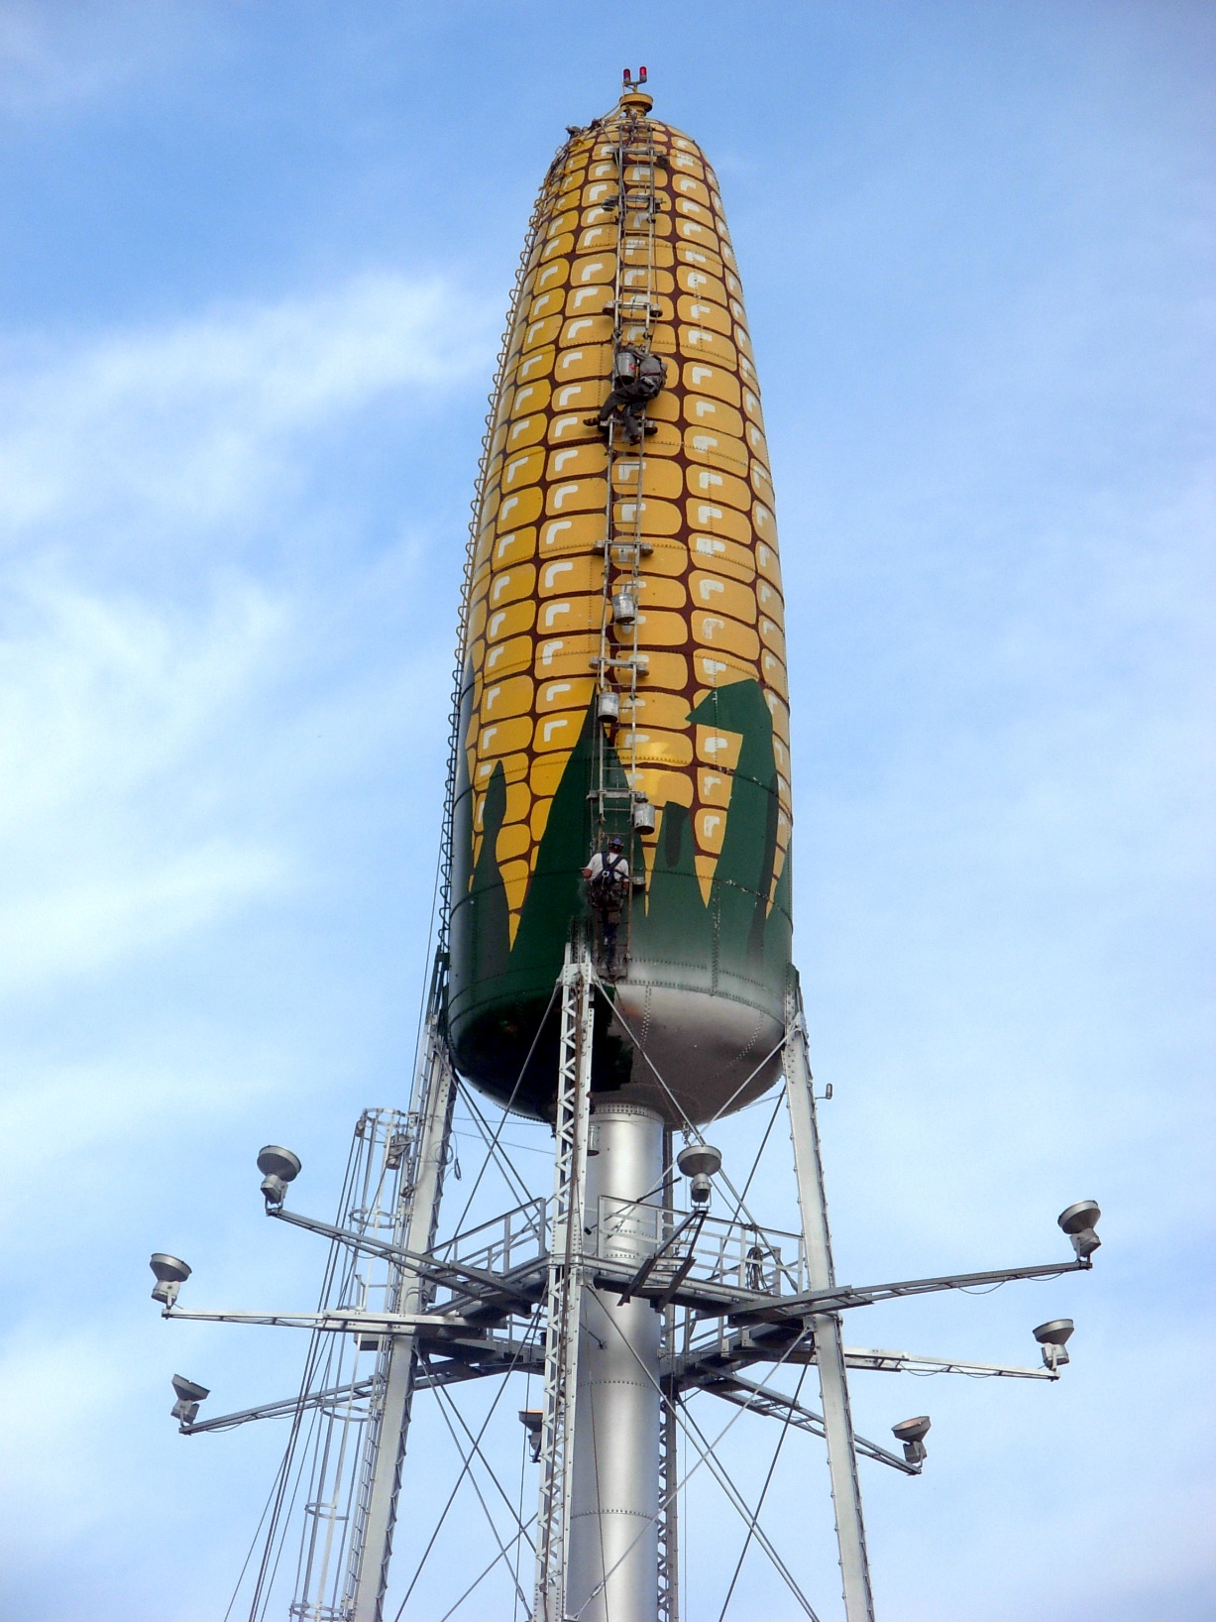
Title of Water Unit Project Here Author Name Here
Department Association/Major here.
INTRODUCTION
Sizing the Tank
Pressure in the Waterline
Further Design Considerations
We were asked to design a water tower and perform all the necessary calculation needed to do so. Over the course of the previous two months we learned the necessary parameters that go into designing a water tower. This includes the truss calculations needed to hold the water tower up, the necessary parameters to ensure we have a sufficient and safe amount of water stored in the tower, and finally we learned how to draw the technical drawings required to let other engineers and construction workers know exactly how to build our tower.
In homework 4, you performed a series of calculations to find the size of the water tower tank based on specific inputs for your development area. Use this section to describe the methodology used to size the water tower tank. Discuss the sizing of the tank and any relevant information about the size and design of it.
In homework 7, you were asked to develop a spreadsheet that indicates the change in the pressure of water in the pipe vs. the change in height of the water in the tank. Provide a discussion about how this was calculated, why this knowledge is important, relate it to conservation of energy, and provide a copy of the table you created.
In this section identify further considerations that might need to be included in your design
Forces in the Truss
In homework 5, you performed calculations in a truss system that would hold an elevated water tank. Provide a discussion about the calculations you performed and identify reasons why doing these calculations was necessary.
Orthographic View
FUTURE WORK
Use this section to identify what other considerations should be included to develop this project.
In this section, insert an orthographic drawing of a water tower
Design Process
Use this space to discuss the parts of the engineering design process that went into developing the design for a water tower. Use images if you want.
References
Use this section to include links to any outside information you used to complete your work

