Slide 1

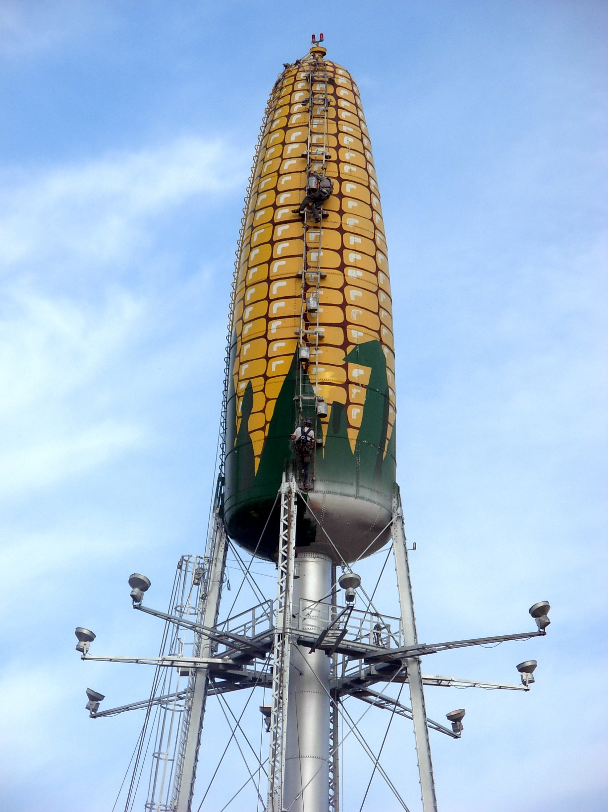
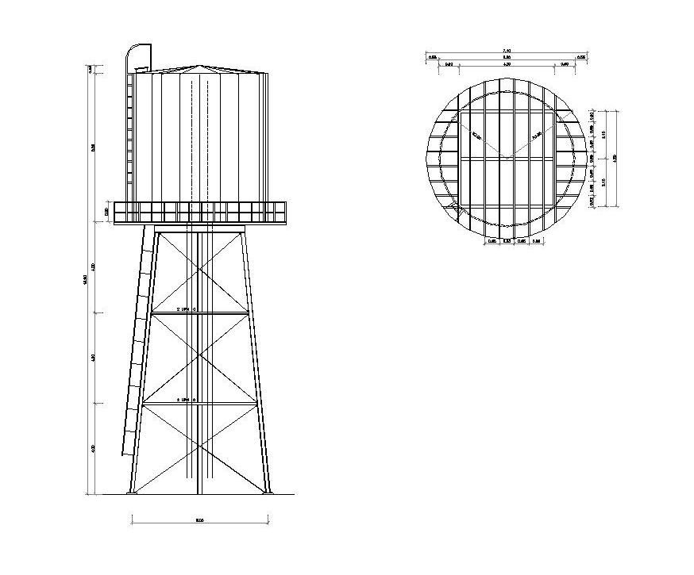
Title of Water Unit Project Here Author Name Here
Department Association/Major here.
INTRODUCTION
Sizing the Tank
Pressure in the Waterline
Further Design Considerations
We were asked to design a water tower and perform all the necessary calculation needed to do so. Over the course of the previous two months we learned the necessary parameters that go into designing a water tower. This includes the truss calculations needed to hold the water tower up, the necessary parameters to ensure we have a sufficient and safe amount of water stored in the tower, and finally we learned how to draw the technical drawings required to let other engineers and construction workers know exactly how to build our tower.
To find the necessary volume of a water tower we needed to consider several factors that will help us provide water to the development area. These factors were the population of the area, the daily demand for water per capita, emergency water needs (fire water flow for 5 hours daily and a surplus of water incase the water plant cannot provide), and the amount needed at peak daily demand.
By adding these factors together we were able to arrive at a total volume necessary of 327.6 m^3 in order to properly provide water for our service area.
In homework 7, you were asked to develop a spreadsheet that indicates the change in the pressure of water in the pipe vs. the change in height of the water in the tank. Provide a discussion about how this was calculated, why this knowledge is important, relate it to conservation of energy, and provide a copy of the table you created.
In this section identify further considerations that might need to be included in your design
Forces in the Truss
In homework 5, you performed calculations in a truss system that would hold an elevated water tank. Provide a discussion about the calculations you performed and identify reasons why doing these calculations was necessary.
Orthographic View
FUTURE WORK
Use this section to identify what other considerations should be included to develop this project.
In this section, insert an orthographic drawing of a water tower
Design Process
In order to design the water tower we had to come together as a team and create as many viable ideas as we could for developing our tower.
Once we had developed several strong and agreed upon ideas, we had to prototype and test these ideas as well as put research into what could be possible flaws within them.
After we concluded our research and felt we had arrived upon our best solution and design for our water tower then we were ready to move on and begin calculating the many factors discussed in this poster needed for the water tower to function optimally.
References
https://www.pinterest.com/pin/372532200405811369/ (ortho drawing)

