Slide 1
Evolutronic Life
Software Project
Systems Implementation
Markus Appel
Maximilian Brenner
Dirk Jerke
cs12

Slide 2
Outline
Idea & Motivation
Design
Architecture
Organisation & Workflow

Slide 3
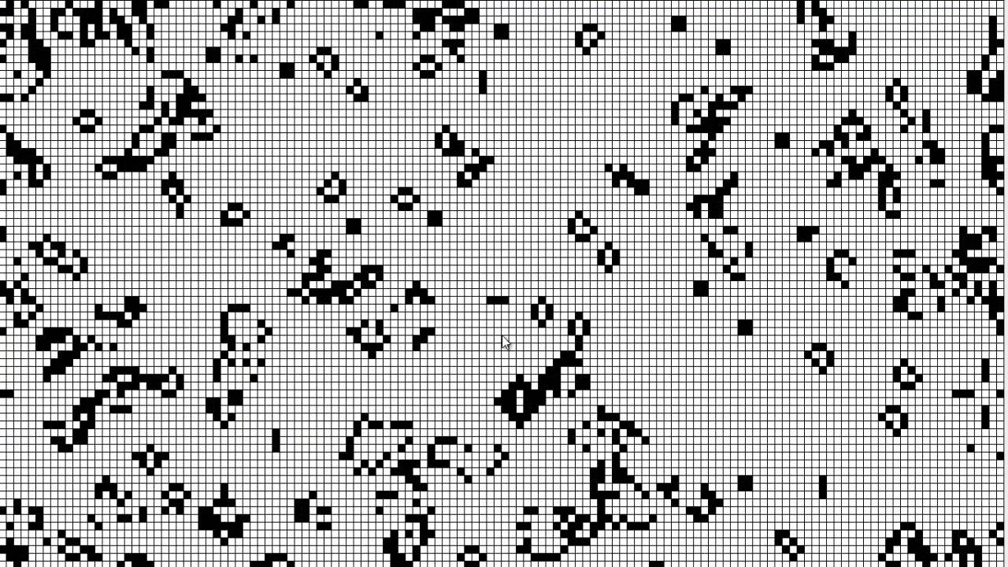
Idea & Motivation
Conway's Game of Life

Slide 4
Key Design Concepts
Character based display of an environment
Environment is a host for different life forms
Life forms are moving, eating and reproducing
Life forms can evolve and die
Groups of life forms struggle for dominance
Never ending cycle of generations

Slide 5
Life Forms: Vegetation
ʷ → ʬ → ϒ
grass → bush → tree
3 levels
Vegetation spreads
Vegetation rises in level

Slide 6
Life Forms: Herbivore
җ → Җ → Ӝ
small → big → smart
3 levels
Herbivores eat vegetation
Herbivores rise in level when reproducing

Slide 7
Life Forms: Carnivore
ԅ → ԇ → ʡ
small → big → smart
3 levels
Carnivores eat herbivores
Carnivores rise in level when reproducing

Slide 8
Creature Levels - Effects
Vegetation: higher level...
provides more food
increasingly blocks movement of animals
Animals: higher level...
Provides more food (Herbivore)
Eats more food, lives longer, is smarter

Slide 9
Animal Intelligence
Animals are capable to perform pathfinding
      Search for food
      Search for a mating partner
      Move in the correct direction
Higher level → higher intelligence
Higher intelligence → better pathfinding
Better pathfinding → greater field of view

