Slide 1
Raytracing!
A Math 424 Final Project by Brennan Seymour

Slide 2
How does it work?
Raytracing is a rendering technique – that is – it’s goal is to generate a 2d image of a 3d scene.
There are other ways of doing this, but a raytracer simulates natural light transport by tracing rays of light.
This is very computationally expensive, but looks really good, since its process is built off of real physics.

Slide 3
The Process
For every pixel, a corresponding ray is sent out of the camera.
To determine where the ray collides, every object in the scene is checked to see whether this ray collides with it. The closest collision is chosen as the ray’s actual destination.
Then, we figure out a color and reflection from this collision, based on the material of the object we hit.
This is repeated until we intersect with a light source – in this case the only light source is the background.
All the colors we’ve intersected with are attenuated together to build the final color of our pixel.

Slide 4
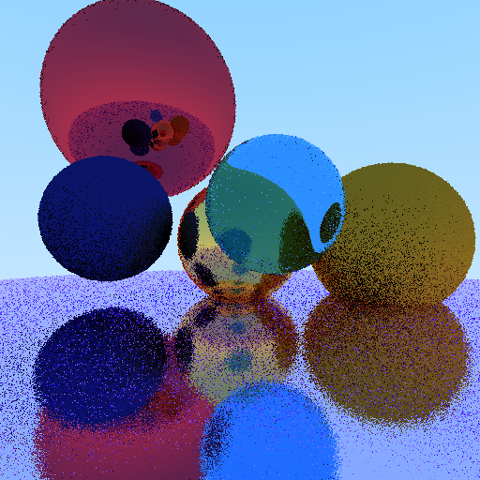

Graininess!?!?!
One ray per pixel
64 rays per pixel
As you can see, randomness introduced in our reflections causes an awful graininess.
This can be remedied by casting many slightly-altered rays per pixel and averaging the results.

Slide 5
Materials
Diffuse – reflect light in fairly random directions. Results in a matte surface.
Specular – reflect light directionally. Add a bit of perturbance for a metallic sheen.
Dielectric – reflect or refract based on a Schlick approximation. Refracts (bends) light going through it.

Slide 6
Bounded Volume Hierarchy
Full disclosure: I’ve written a raytracer in the past.
This time around, I’ve added a novel feature to speed up the engine with high object counts – Bounded Volume Hierarchy!
Instead of checking each ray’s collision with every object in the scene, we can partition the scene recursively into bounding boxes.
Then if we don’t collide with a given bounding box, we can safely ignore it and all its contents.
If I have time at the end, I’ll do some whiteboard drawing about this.

Slide 7
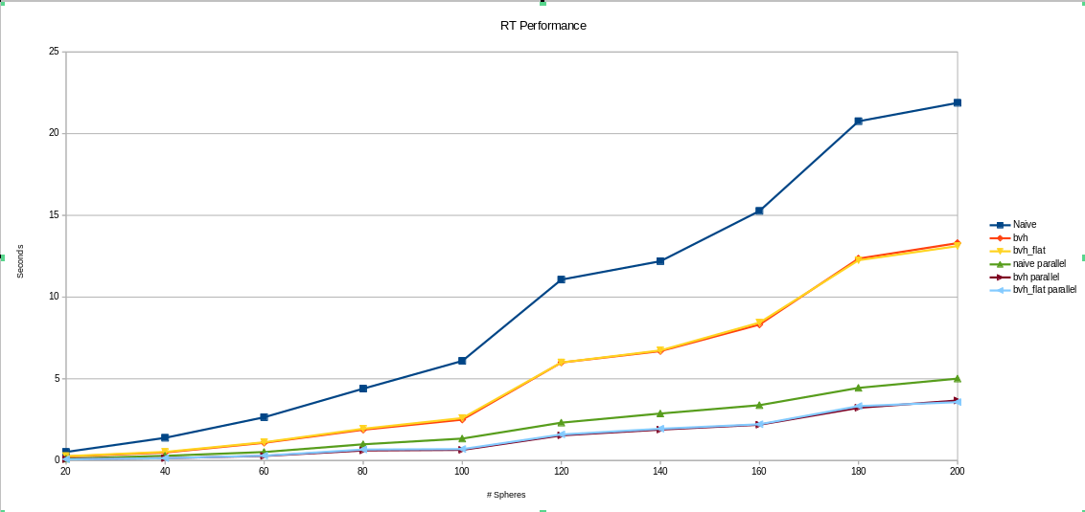
Performance
Tests were run five times each on an 8-core machine, rendering a 256x256 image with 16x supersampling. Each test had a varying number of random spheres.

Slide 8

Pics!

Slide 9
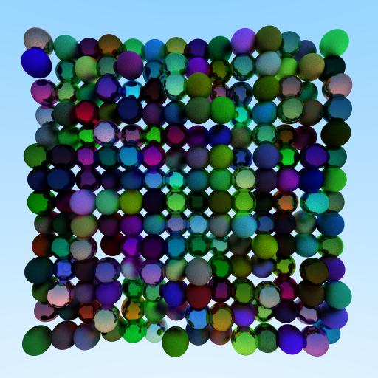
Pics!

Slide 10
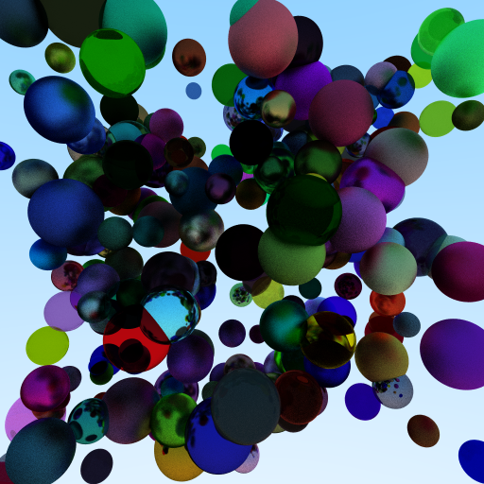
Pics!

