Slide 1


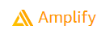

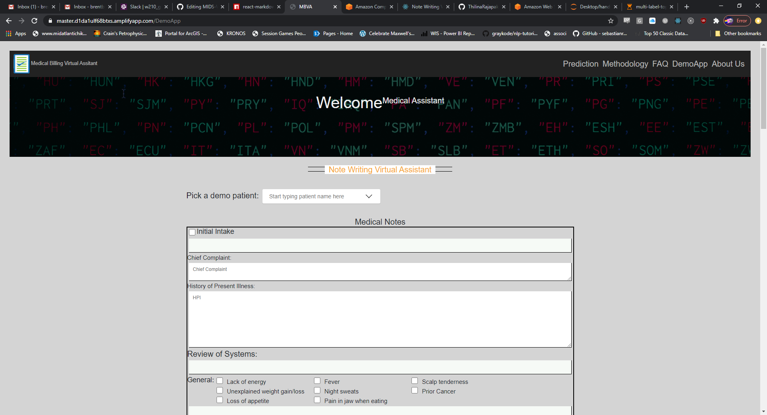

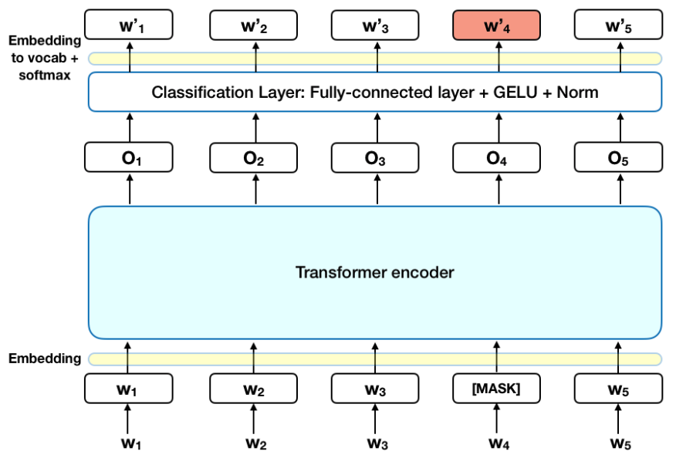

Text Query
JS + React
Clinical BERT
“What billing codes should be present?”
Text Query
JS + React
Business Logic

