Slide 1

My Secure Password App
Authors: Jakub jancek, Mike webb, brent chiaramonti,
Raza mohammed

Slide 2
Background Information
Hard to remember all your passwords
Leads to insecure passwords
Password management program
All developers in the group have JavaFX experience
None of them had experience:
Databases
password security practice

Slide 3
Desired Features
Store passwords for websites and applications
Password generator
Options include, length, alphanumeric characters, special characters.
Standalone application
Only one user per application
Master Password
Store passwords securely

Slide 4
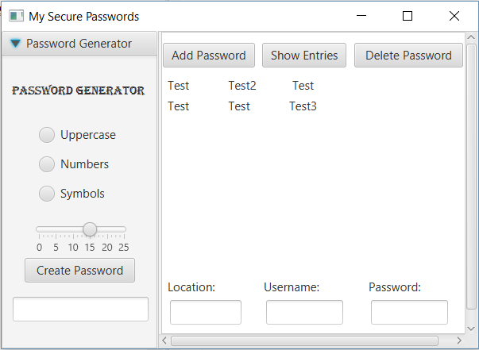
Implemented Features
Password Generator
Database created and functional
Store Passwords in database
Master password used to login
Check master password against database
Display list of passwords

Slide 5
Future Implementations
More security!
Encryption/decryption of data in database
Allow multiple users
Increase storage
Integrate with web browser and other desktop applications
Integrate with mobile devices
Increased usability

Slide 6
Questions?

Slide 7
Sequence Diagram

Slide 8
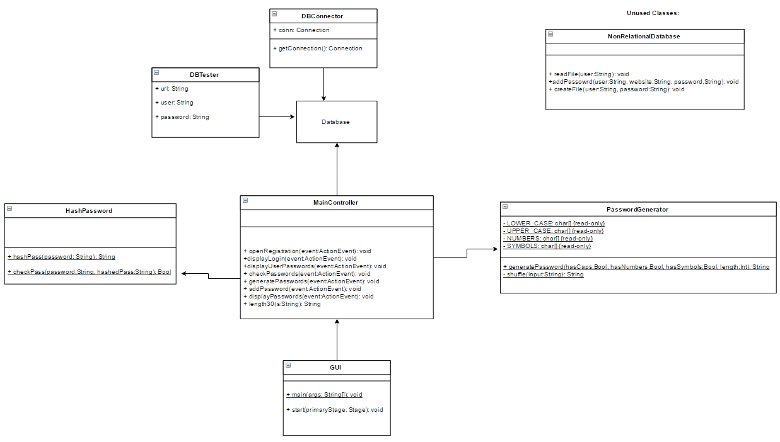
Class Diagram

Slide 9
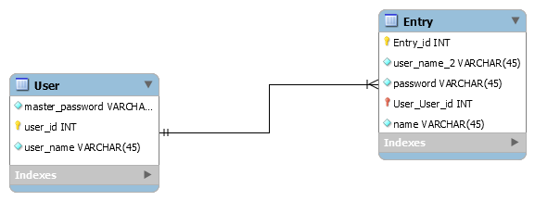
EER Diagram

