Slide 1
Intro to CSS3
Supplemental Material:
http://www.w3schools.com/css3/default.asp
http://www.css3.info/preview/
http://www.zenelements.com/blog/css3-introduction/

Slide 2
Yipee… CSS3
The newest version of CSS, CSS3, is now available with spotty coverage in only most recent browsers
If you plan to use CSS3, provide fallback code for browsers that do not support it

Slide 3
What’s New So Far ?????
Advanced selectors
Rounded corners
Text and box shadows
Imported fonts
Gradients
Multiple background images
Multi-column layout
Transform, transition and animation

Slide 4
Browser Compatibility Examples
To see how a different browser may display CSS3 properties
  View the following page in different browsers to see compatibility
http://www.designshack.co.uk/tutorialexamples/css3/css3examples.html

Slide 5

Backwards Compatibility
CSS3 will be backwards compatible
– web browsers will always continue to support CSS2
The main impacts of CSS3 as it starts to be supported will:
  Allow for new design features
  (animation or gradients for instance)
  Help to achieve current design features
  in a much easier way
  (multi-columns or rounded corners)

Slide 6
CSS3 Browser Prefix Notation
Different browsers may have build-in notation for CSS3 properties
  -moz for Mozilla-based browsers
  -webkit for Safari & Google Chrome
  -o for Opera
Free tool that can examine your code and add prefixes for you
  http://prefixmycss.com/

Slide 7
CSS3 Borders
CSS3 takes borders to a new level with:
  multiple border colors
  border images
  rounded corners
  gradients
  box shadows
Let’s look at each of these in a bit more detail, using examples where possible

Slide 8
CSS3 border-colors property
CSS2 allowed you to specify a border-color for the top, bottom, left and right
CSS3 border-colors allows you to provide a color for each pixel of the border
  If you have border with 6 pixel width, then you can define 6 different colors for each part of the border

Slide 9
CSS3 border-image property
Create a basic border that can act as a default for browsers that do not support border-image
-webkit-border-image: url(image.png) A B type;
  A = slice height
  B= slice width
  type= whether the border is: repeat/round/stretch
Source: http://www.zenelements.com/blog/css3-border-image/

Slide 10
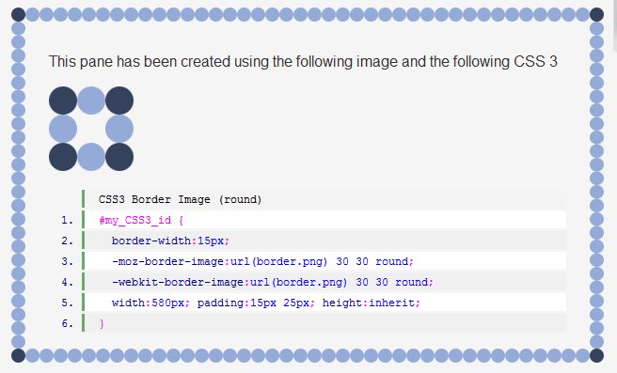
CSS3 border-image (round) Ex1
Source: http://www.zenelements.com/blog/css3-border-image/

Slide 11
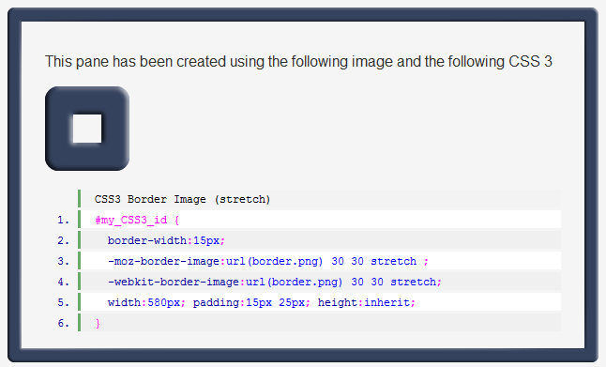
CSS3 border-image (stretch) Ex2
Source: http://www.zenelements.com/blog/css3-border-image/

Slide 12
CSS3 border-radius
The CSS3 border-radius property allows you to add rounded, elliptical corners to your design elements
Does not need images or multiple divs
Can set each corner separately
or do all at once
Provide the radius in length or percentage
Supported by most browsers after 2005, use –moz for pre 2005 Firefox

Slide 13
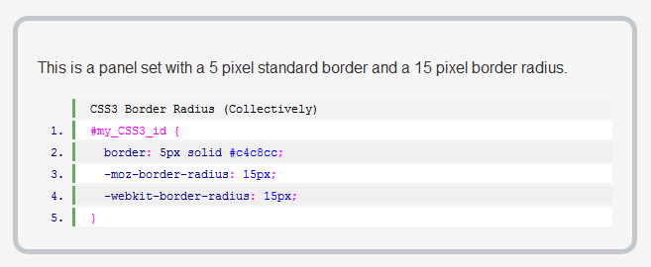
border-radius (rounded at once)
Source: http://www.zenelements.com/blog/css3-border-radius-rounded-corners/

Slide 14
border-*-*-radius properties
Set these properties individually with:
  border-bottom-left-radius
  border-bottom-right-radius
  border-top-left-radius
  border-top-right-radius
Provide the horizontal and/or vertical radius in length or percentage
  border-top-left-radius: 15px;
  border-bottom-right-radius: 10% 5%;

Slide 15
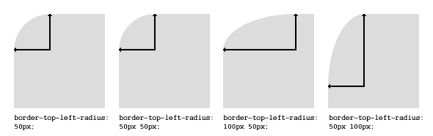
Examples: border-*-*-radius
If either value is 0, corner is squared
Source: http://www.css3.info/preview/rounded-border/

Slide 16
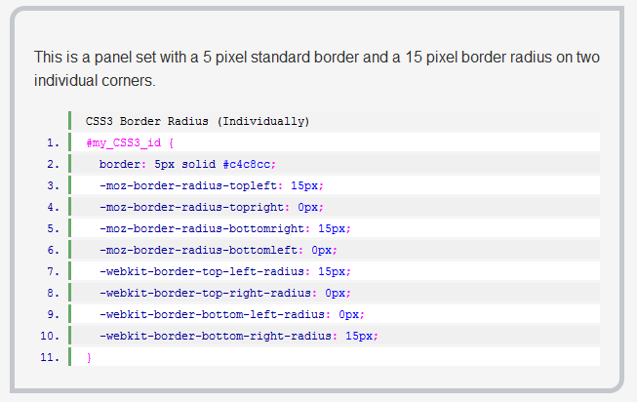
border-radius (one at a time)
Source: http://www.zenelements.com/blog/css3-border-radius-rounded-corners/

Slide 17
border-radius values
The first set of values define the horizontal radii for all four corners.
An optional second set of values, preceded by a ‘/’, define the vertical radii for all four corners.
If only one set of values are supplied, these are used to determine both the vertical and horizontal equally.

Slide 18
CSS3 box-shadow property
Shadows have been available in CSS2, but only supported in Safari
Now with CSS3, shadows can be applied to borders, images and text
box-shadow: Apx Bpx Cpx #XXX;
  Apx = x-axis
  Bpx= y-axis
  Cpx= shadow cast length/feathering
  #XXX = color of shadow

Slide 19
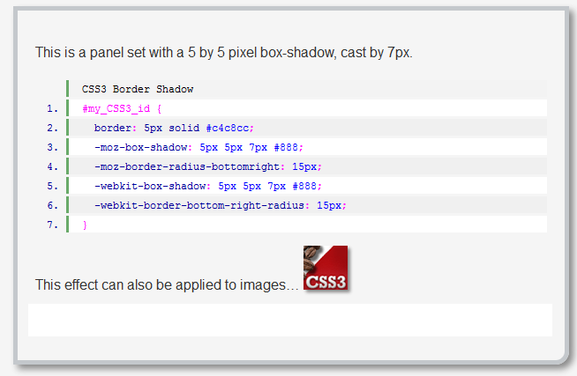
box-shadow Example
Source: http://www.zenelements.com/blog/css3-box-shadow/

Slide 20
CSS3 Backgrounds
New CSS3 background properties include:
  background size
  multiple background images
  gradient backgrounds
These new features allow greater control of the background element and will provide designers with a whole array of new possibilities.

Slide 21
CSS3 Multiple Backgrounds
A web designer can specify multiple background images for a box element by simply using a comma separated list
Can use the background-image and background-position properties
Can also use just the background-property
This is not a widely used CSS3 property
Source: http://www.css3.info/preview/multiple-backgrounds/

Slide 22
Multiple Backgrounds cont.
You can specify all of the above properties in a single declaration, but the most commonly used
are image, position and repeat
background: url(example.jpg) top left no-repeat,
url(example2.jpg) bottom left no-repeat,
url(example3.jpg) center center repeat-y;
The first image will be the one “closest”
to the user

Slide 23
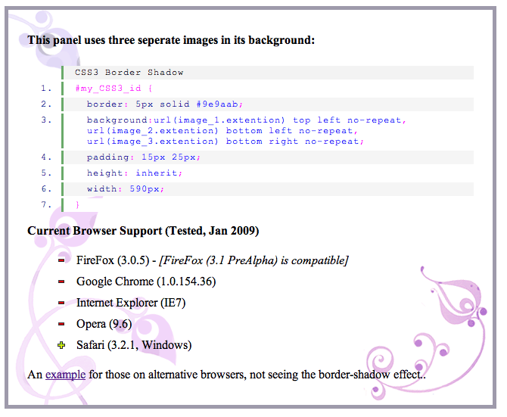
Multiple background-images
Example
Source: http://www.zenelements.com/blog/css3-background-images/

Slide 24
CSS3 Gradients
CSS3 can be used to create gradient backgrounds
Gradients can be linear or
radial (from the center outward)
  Linear gradients define two colors and percentages of fading
  Radial gradients are more complex defining a center point, primary and secondary colors
Source: http://www.zenelements.com/blog/css3-gradients/

Slide 25
CSS Linear Gradients
Gradients make use of the background property
background:-moz-linear-gradient
(pos, #AAA B, #XXX Y);
  pos = first color position, giving direction
  #AAA = primary color
  B = where the fade begins (%)
  #XXX = secondary colour
  Y = where the fade begins (%)
Source: http://www.zenelements.com/blog/css3-gradients/

Slide 26
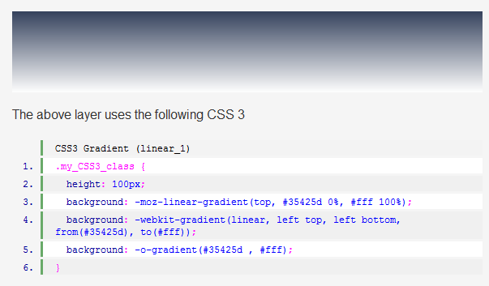
CSS3 Linear Gradient Ex1
Source: http://www.zenelements.com/blog/css3-gradients/

Slide 27
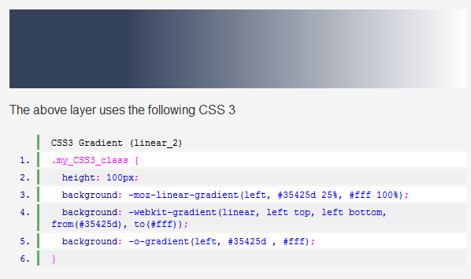
CSS3 Linear Gradient Ex2
Source: http://www.zenelements.com/blog/css3-gradients/

Slide 28
CSS3 Radial Gradients
These are much more complex than linear gradients and may take more experimentation
Create a central point, a primary color and a secondary color
  background: -moz-radial-gradient
  background: -webkit-gradient and from and to colors

Slide 29
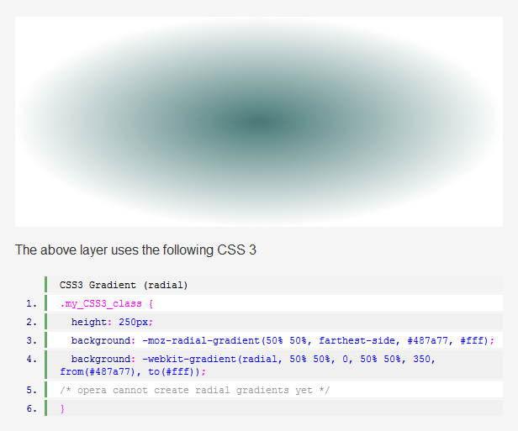
CSS3 Radial Gradient
Example
Source: http://www.zenelements.com/blog/css3-gradients/

Slide 30
CSS3 Multiple Column Layout
This new CSS3 selector lets you achieve multi-column layouts without having to use multiple divs
The browser interprets the properties and creates the columns, giving the text a newspaper-like flow
Can specify width, count, gap and rule between
Source: http://www.zenelements.com/blog/css3-multiple-columns/

Slide 31
Multiple Columns (width)
You can specify your columns on width and provide the gap between them
Uses the width of the containing element to determine how many columns will fit
  -moz-column-width: 15em;
  -moz-column-gap: 2em;
  -webkit-column-width: 15em;
  -webkit-column-gap: 2em;
Source: http://www.zenelements.com/blog/css3-multiple-columns/

Slide 32
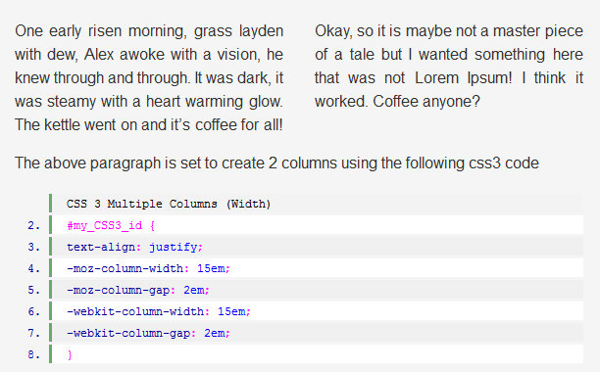
Multiple Columns (width) Ex
Source: http://www.zenelements.com/blog/css3-multiple-columns/

Slide 33
Multiple Columns (count)
You can specify your columns on count and provide the gap between them
Uses the width of the containing element to determine the width of the columns
  -moz-column-count: 3;
  -moz-column-gap: 1.5em;
  -moz-column-rule: 1px solid #CCC;
  -webkit-column-count: 3;
  -webkit-column-gap: 1.5em;
  -webkit-column-rule: 1px solid #CCC;

Slide 34
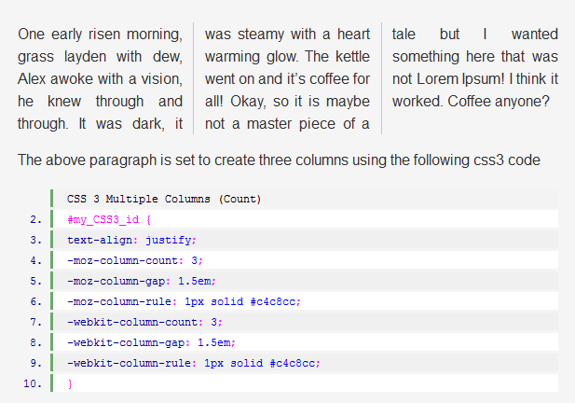
Multiple Columns (count) Ex
Source: http://www.zenelements.com/blog/css3-multiple-columns/

Slide 35
CSS3 Embedded Fonts
If you want to extend your choice of fonts beyond the “web-safe” fonts and do some great headings without images, use CSS3 and an embedded @font-face
The @font-face attribute was available in CSS2, but CSS3 is giving it further emphasis
However, this new feature brings bring copyright into debate as only properly licensed fonts should be used

Slide 36
CSS3 @font-face Font Formats
CSS3 can display type using several font formats:
  truetype (.ttf for CSS3 browsers)
  opentype (.otf)
  embedded-opentype (.eot for IE)
  scalable-vector-graphic (.svg, .svgz)
You can also apply text-shadow effects (more on this next)

Slide 37
INFO 2420 Embedded Fonts
There are many free or openly licensed fonts available
If you use an embedded font on your pages, add comments to document the source and licensing for these fonts
Your instructor will make a folder of openly-licensed, free fonts available for projects and practices, only use these!

Slide 38
Embedded Font Sources
Open Font Library – are licensed as libre software for commercial and non-commercial uses
  http://openfontlibrary.org/
1001 Free Fonts – read attached documentation for each font to get specific licensing information
  http://www.1001freefonts.com/

Slide 39
Where to place font files?
The .ttf font file and the .eot file
must be on the same server as
your web pages
Create a font folder in your folder
and place files there
For IE, you will need to create
an .eot file from the .ttf file
  You can use a TTF to EOT converter like: http://www.kirsle.net/wizards/ttf2eot.cgi

Slide 40
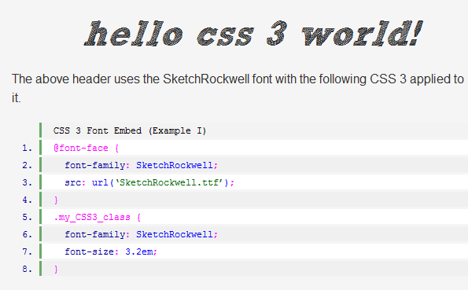
CSS3 @font-face Example
Source: http://www.zenelements.com/blog/css3-embed-font-face/

Slide 41
EOT shall be first!!!
When you want both the .eot and the .tff fonts to be used follow this order:
  src: local (‘BleedingCowboys’) looks for font on the local machine
@font-face{
font-family:'BleedingCowboys';
src: url('fonts/BleedingCowboys.eot');
src: local('BleedingCowboys'), url('fonts/BleedingCowboys.ttf') format('truetype') ;
}

Slide 42

CSS3 text-shadow property
Like the box-shadow property, we can apply shadows to text using the CSS3 text-shadow property
text-shadow: Apx Bpx Cpx #XXX;
  Apx= x-axis (horizontal distance)
  Bpx=y-axis (vertical distance)
  Cpx= cast length/feathering (blur radius)
  #XXX= color of the shadow

Slide 43
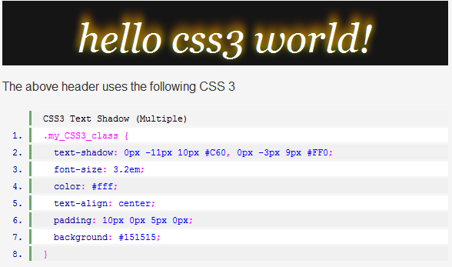
CSS3 text-shadow Example
Source: http://www.zenelements.com/blog/css3-text-shadow/

Slide 44
CSS3 text-shadow and RGBA
For -webkit-based browsers, you can use rgba values instead of hex code colors as the fourth value.
The last number stands for transparency and can be set between 0.0 and 1.0 so you can make the text-shadow more subtle:
  text-shadow: 1px 1px 1px rgba(50,50,50, .5);

Slide 45
Examples of CSS3 text-shadows
http://www.kremalicious.com/2008/04/make-cool-and-clever-text-effects-with-css-text-shadow/
  Apple-style engraved shadow
  Glowing shadows
  Mysterious shadows
  Milkey shadows
  Multiple shadows

Slide 46
CSS3 Word Wrapping
If a word is too long to fit within one line of an area, it expands outside the area
This isn’t a very common occurrence, but does crop up from time to time
The new word wrapping ability allows you to force the text to word-wrap even if it means splitting it mid-word
  word-wrap: break-word;

Slide 47
CSS3 transform property
Use CSS3 to transform elements
in a page
  rotate – provide number of degrees
  skew – skew, skewx, or skewy
  scale – scale, scalex, or scaley

Slide 48
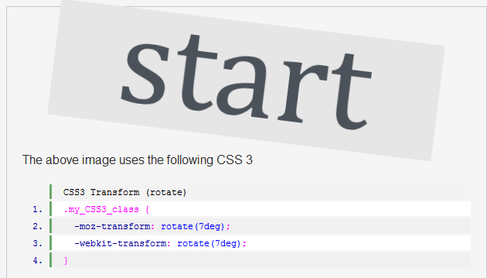
CSS3 transform - rotate
Source: http://www.zenelements.com/blog/css3-transform/

Slide 49
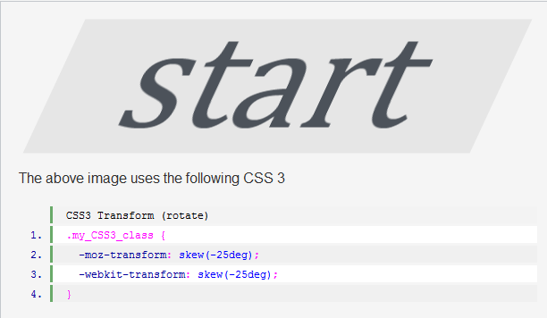
CSS3 transform – skew
Source: http://www.zenelements.com/blog/css3-transform/

Slide 50
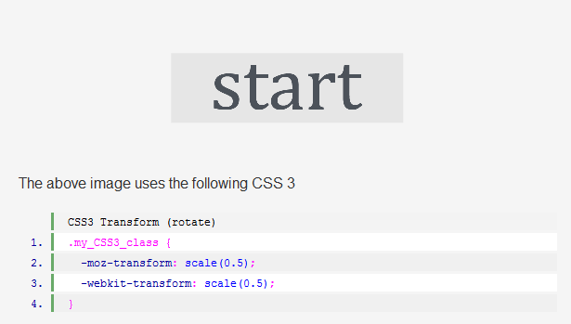
CSs transform - scale
Source: http://www.zenelements.com/blog/css3-transform/

Slide 51
CSS3 transition property
Use the CSS3 transition property to give action to elements on a page, such as change in color, or motion
The basic syntax for a transition is: property, duration, and type
transition: color .5s ease-in;
  property
  duration
  type
Source: http://www.zenelements.com/blog/css3-transition/

Slide 52

CSS3 transition (motion)
Example
Go to the Source to see the motion: http://www.zenelements.com/blog/css3-transition/

Slide 53
RGBA and Opacity
RGBA lets you specify not only the RGB color but also the opacity (Alpha) of the color
An element with an opacity/alpha of 1.0 will be fully opaque (visible) while one with opacity/alpha 0.0 will be invisible
Any value in between 1.0 and 0.0 will determine how transparent the color or object is against the background

Slide 54
RGBA Best Practices
Some browsers still don’t support it, so it’s good practice to specify before the RGBA color another color without transparency
Specify RGB values between 0-255 or in percentages
Specify alpha value between 1.0 and 0.0, i.e. 0.5 for 50% opacity

Slide 55
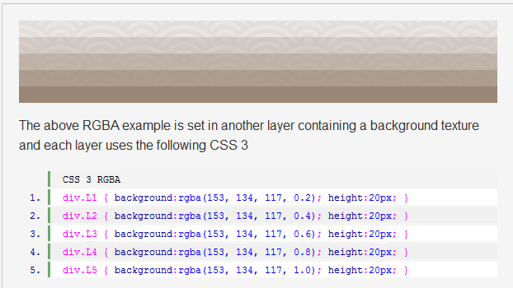
CSS3 RGBA Example
Source: http://www.zenelements.com/blog/css3-rgb-rgba-color-opacity/

Slide 56
Intro to CSS3 Summary
CSS3 is the latest generation of Cascading Style Sheets
While there are many new and exciting properties and features in CSS3, not all current browsers support these
Make sure to provide alternative fallback code if the feature is not supported

Slide 57

Have Fun
with CSS3!

