Slide 1
PowerShell Objects
Pictorial description of Objects, Properties and Methods

Slide 2

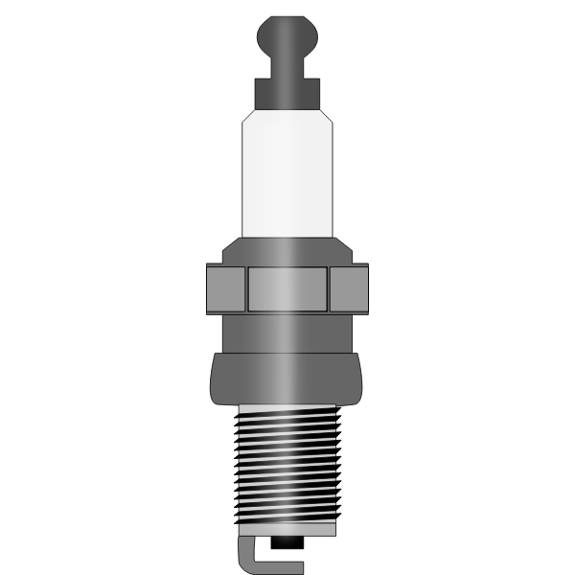
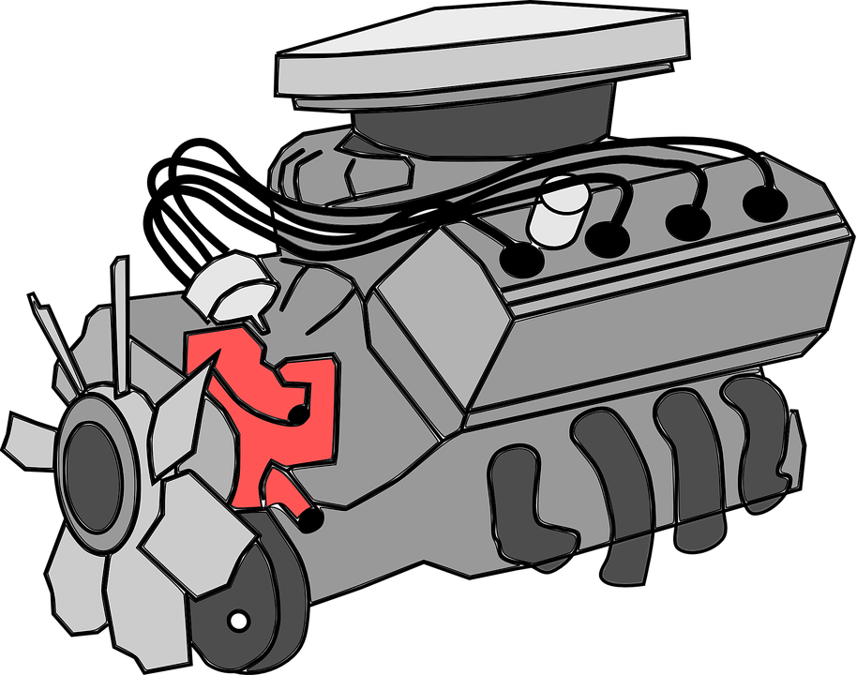

Objects contain Properties and Methods
Car Object
Engine Object
Sparkplug Object
Properties:
Engine
Door
Wheel
Tyre
Make
Model
Methods:
Start
Stop
Turn
Accelerate
Brake
…
Properties:
Piston
Sparkplug
Fan
Crank
Size
Type
Methods:
Start motor
Stop motor
Pump fuel
Ignite spark
…
Properties:
Make
Model
Gap
Car Assembly
Methods:
Spark
Properties are also objects that have their own properties
and methods

Slide 3
Understanding Commands
Key commands to make PowerShell easier

Slide 4


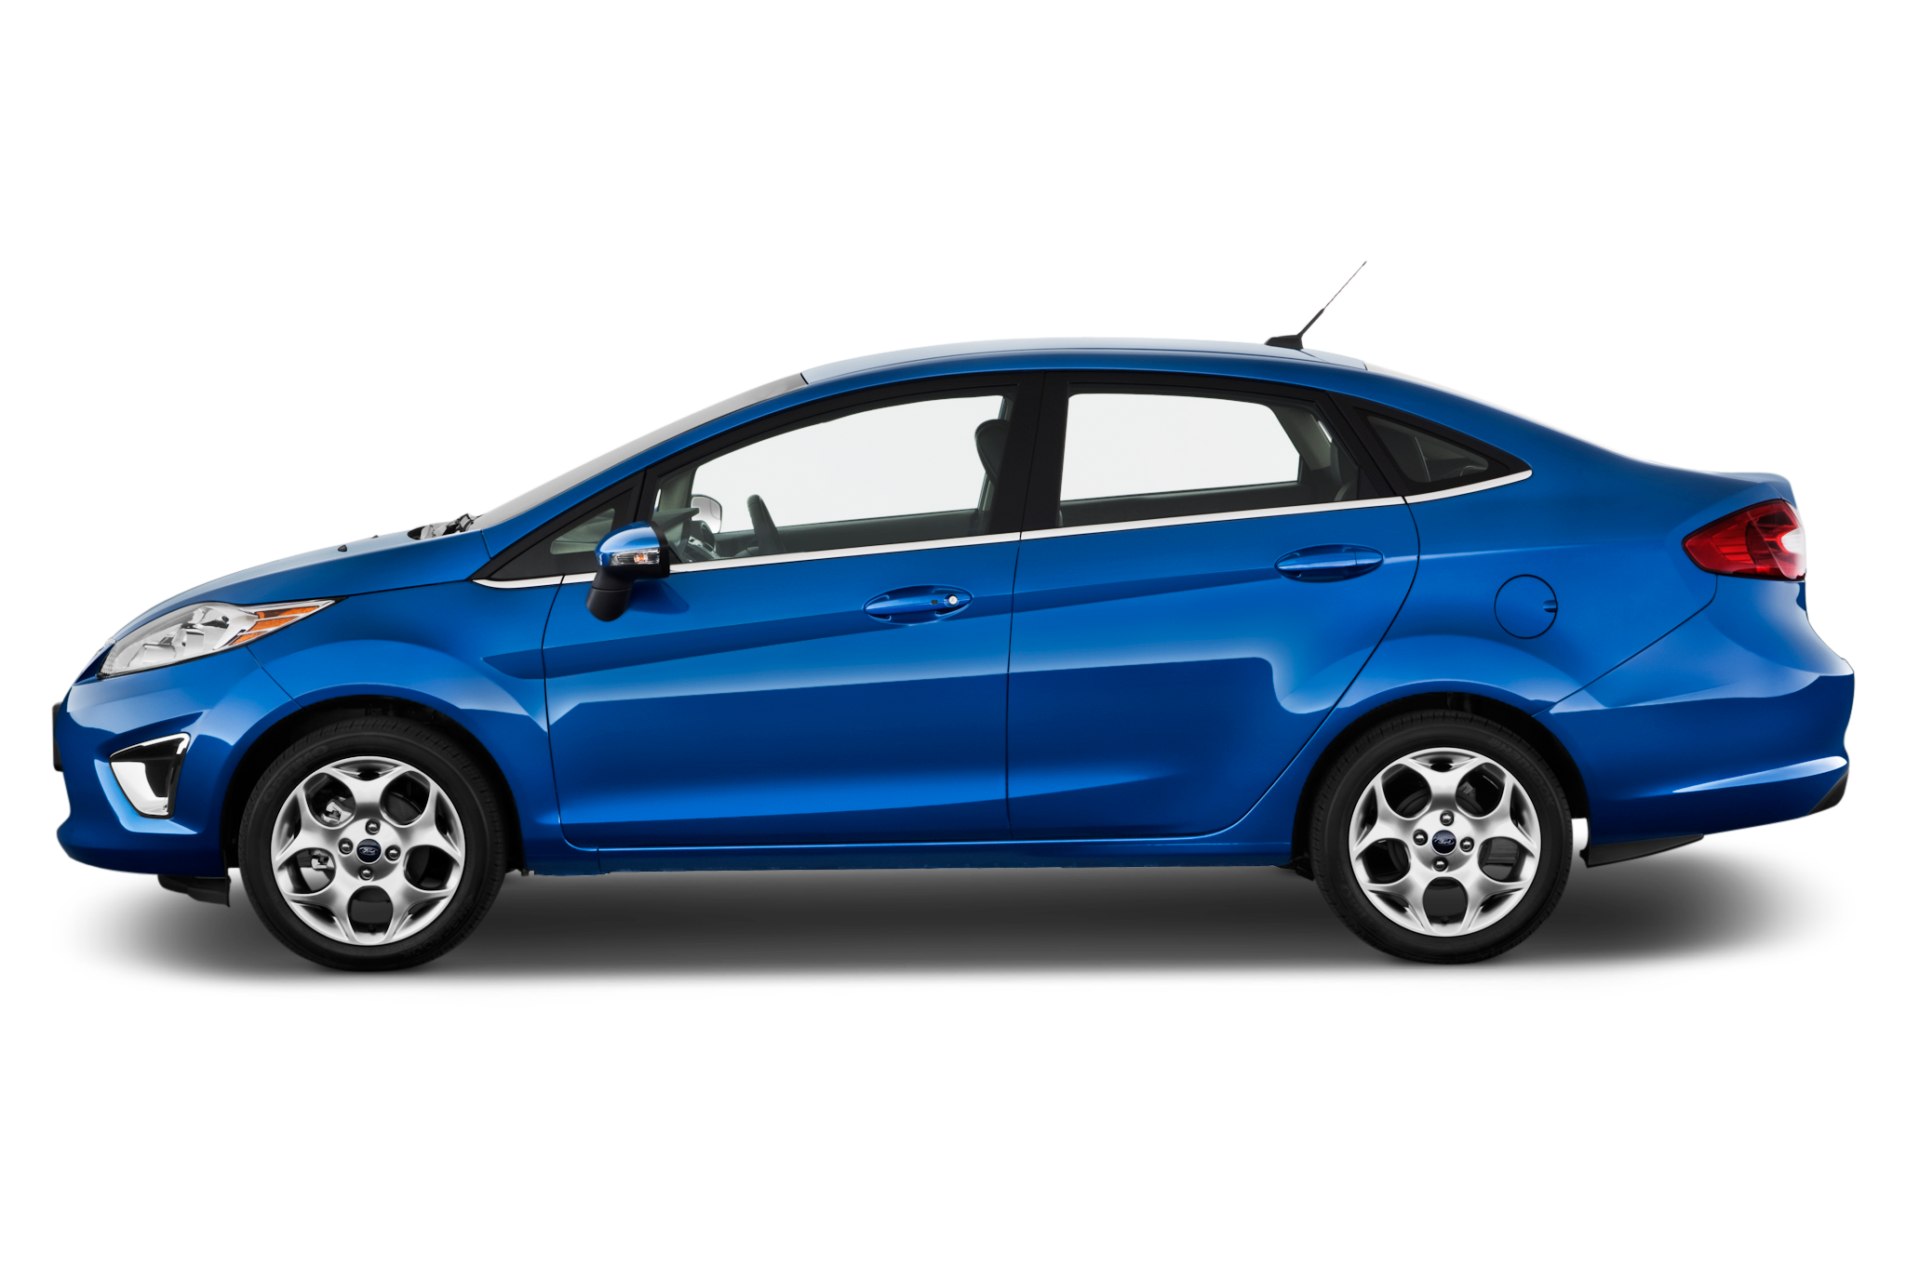


A PowerShell Command is like a factory
Input
Command
Result
Notes:
A PowerShell command is like a factory in that it takes in input (or raw materials).
The input is sent to the Command, which we are likening to a factory
The factory then uses those inputs to produce a Resulting object, we might liken that to a car

Slide 5
Key PowerShell Commands
Get-Help
Discovers the inputs required Leather, Metal, Paint, etc
Get-Command Finds the right factory for the job Example: Car manufacturing
Get-Member Shows the resulting object produced by the factory
Notes:
There are key PowerShell commands that can assist you in:
Get-Command - helps find the correct command
Get-Help - Discovers what inputs are needed, that are used by the command
Get-Member - Shows what object the command has created

Slide 6
Pipelines in PowerShell
Pictorial Explanation ByValue vs ByPropertyName

Slide 7


ByValue Pipeline
Car Assembly
Spray Painter
The output of the Car Assembly Plant (Entire Car) can be used by the Spay Painter
Similar to ByValue Pipe lines

Slide 8
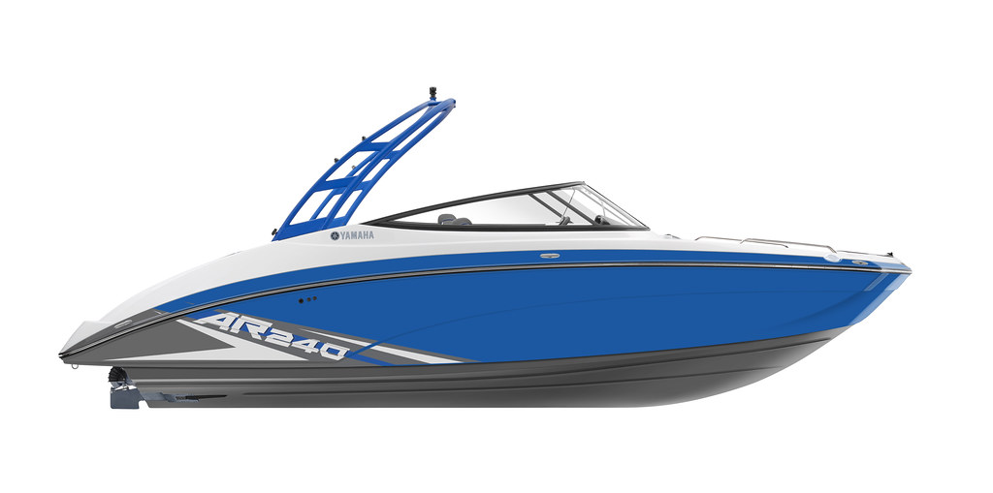

ByPropertyName Pipeline
1
2
2
Car Assembly
Boat Builder
1. The output of the Car Assembly Plant (Entire Car) cannot be used by the boat builder
2. But, if we chopped up the car we could use the engine and steering wheel to help build the boat
Similar to ByPropertyName Pipelines

