Slide 1
Asymmetric Encryption

Slide 2



Bob and Alice

Slide 3


Bob shares public key
Private
Public
Public

Slide 4
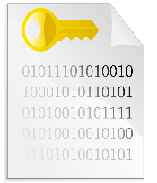
Alice encrypts data
Public
Private
Public

Slide 5
Alice sends secure file
Private
Public

Slide 6
Bob decrypts file
Private
Public

Slide 7
Asymmetric Issues
BAD
CPU intensive
Slow to encrypt large data
GOOD
Split keys
Large key

Slide 8
Symmetric Encryption
GOOD
Fast encryption
Secure
BAD
Single key (for both encryption and decryption)
How to pass key becomes the problem

Slide 9


Alice encrypts with Sym Key

Slide 10
Alice sends secure file to Bob

Slide 11

Bob cannot decrypt

Slide 12
Hybrid system
GOOD
Uses fast encryption
Secure using Public and Private keys
Avoids having to pass Sym key without security

Slide 13

Asym and Sym key hybrid
Public
Private
Public

