Slide 1
Marketing Analytics – 450 Section 55
Solo 2 Deep Dive - Sync Session
Feb 6, 2019

Slide 2
Some basics before we start
Memory-based utility vs Experience-based utility (Kahneman & Thaler)
Choice architecture by Cass Sunstein/Richard Thaler (Nudge)
‘Predictably Irrational’ by Daniel Ariely
Assume that the survey design is ‘correct’ and focus on the analysis
Not 3 fixed products, but 108 products were shown and needs
to understand the preferences of all pairs of features
Free book ‘Urban Travel Demand’ by Daniel McFadden
We will use Chapter 5 for interpretation of multinomial models
Understand detailed preferences of each individual person, rather
than just identifying one specific tablet design – getting INSIGHTS
Domain experts with marketing, psychology + data scientists
need to discuss these topics ahead of designing the survey
This will ensure the best possible survey design

Slide 3
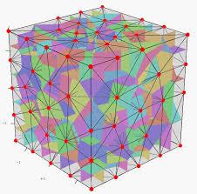
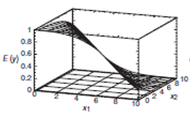
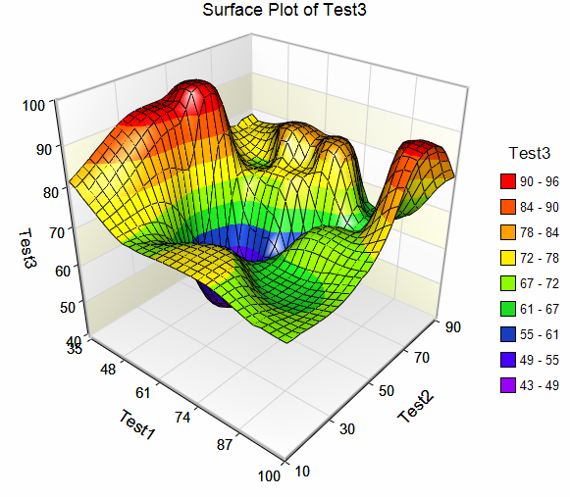
Let us look at the ‘big picture’!
We showed different tablet designs with 5 distinct features with multiple levels
Imagine a 5 dimensional space with 324 nodal points, which is the ‘feature space’
We picked 108 nodal points and each node has ‘like/do not like’ response
Remember the task design so that we have only 36 choice sets
With MNLR model, the response became Odds Ratio
With dummy variables, we have 14 predictors with 11 main-effect factors
Imagine a ‘surface’ of Log Odds Ratio in this 12-dimensional space
This is the Model of the response, conceptually
‘Slope’ of the response surface with respect to every axis tells us the ‘impact’
The key is to evaluate the ‘impact’ which are the betas
Likelihood function is a function of betas, which can be written with the data
With MLE method, maximize the likelihood function to solve for betas
With Bayesian methods, we compute posterior = likelihood function*prior for the betas
(ie) We know the functional form of the posterior (ie) ‘bumpy’ surface – function of the betas
Using MCMC, we simulate the values of betas (Metropolis-Hastings)
If we take the average of betas as estimates, then we understand the ‘impact’ of every feature on OR
We do extensive post processing, in order to get insights

Slide 4
Creating Summary Information in R
‘apply’ command is used to get summary information such as row
means, col means, etc. if the data is in a Matrix format
‘aggregate’ command is used to get summary information if the
Data is in a ‘data frame’ format – eg. In Solo 1, we used it to get
Centroids of clusters

Slide 5
Actual Data - Preferences
Resp.data.v3 -> 424 rows, columns 4 thru 39 -> provides 36 responses for each person
Task V3 -> 108 rows, 7 columns -> choice.set, choice.ID, screen, RAM, processor,
Price, brand
> apply(resp.data.v3[4:39], 2, function(x){tabulate(na.omit(x))})
DCM1_1 DCM1_2 DCM1_3 DCM1_4 DCM1_5 DCM1_6 DCM1_7 DCM1_8 DCM1_9 DCM1_10
[1,] 93 316 218 125 157 70 81 65 100 25
[2,] 242 45 180 28 132 83 182 85 21 307
[3,] 89 63 26 271 135 271 161 274 303 92
DCM1_11 DCM1_12 DCM1_13 DCM1_14 DCM1_15 DCM1_16 DCM1_17 DCM1_18 DCM1_19
[1,] 271 192 77 151 18 65 22 64 41
[2,] 113 217 75 148 140 207 130 68 276
[3,] 40 15 272 125 266 152 272 292 107
DCM1_20 DCM1_21 DCM1_22 DCM1_23 DCM1_24 DCM1_25 DCM1_26 DCM1_27 DCM1_28
[1,] 303 225 114 183 37 71 32 109 34
[2,] 42 147 25 88 88 177 103 19 308
[3,] 79 52 285 153 299 176 289 296 82
DCM1_29 DCM1_30 DCM1_31 DCM1_32 DCM1_33 DCM1_34 DCM1_35 DCM1_36
[1,] 312 189 88 164 27 44 35 86
[2,] 67 209 43 121 114 207 116 36
[3,] 45 26 293 139 283 173 273 302

Slide 6
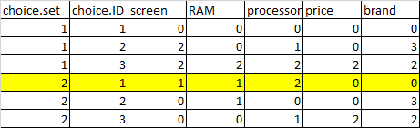



What were the preferred choices using raw data?
Scr 7”, RAM 16 gB,
Proc 2.5 GHZ,
Price $199, STC
316 out
of 424
312 out
of 424
Scr 7”, RAM 16 gB,
Proc 2.5 GHZ,
Price $199, Gaggle
Scr 10”, RAM 8 gB,
Proc 2 GHZ,
Price $199, Somesong
308 out
of 424
307 out
of 424
Scr 10”, RAM 8 gB,
Proc 2 GHZ,
Price $199, STC
Screen: 3 levels: 5”, 7”, 10”
RAM: 3 levels: 8 gB, 16 gB, 32 gB
Processor: 3 levels: 1.5, 2, 2.5 GHZ
Price: 3 levels: $199, $299, $399
Brand: 4 levels: STC, Somesong, Pear, Gaggle
Note: Top 4 picked options

Slide 7

How did we define the dummy variables?
Remember from 410:
X1 = 1, if 7”
= -1, otherwise
X2 = 1, if 10”
= -1, otherwise
(This means that for 5” screen, x1 = x2 =-1)
5” is baseline & coded as (-1,-1) instead of (0,0)
5-in screen is baseline (-1,-1)
7-in screen corresponds to (1, 0)
10-in screen corresponds to (0, 1)
Note: Interaction terms are just products of 2 dummy variables
Note:
‘Effects coding’ similar to regression, intercept=grand mean, slopes=delta from grand mean
‘Dummy coding’ – intercept=baseline, slopes= delta from baseline
‘Contrast coding’ – slopes, intercepts are based on contrasts defined

Slide 8

How did we define the dummy variables?
Model is: Y = β1X1 + β2X2 + … + β14X14
Y = β1X1 + β2X2 + …
Y = β1, for 7”
Y = β2, for 10”
Y = 0, for 5”
Y = β1X1 + β2X2 + …
Y = β1 - β2, for 7”
Y = - β1 + β2, for 10”
Y = - β1 - β2, for 5”
Y = β1X1 + β2X2 + …
Y = β1, for 7”
Y = β2, for 10”
Y = - β1 - β2, for 5”

Slide 9
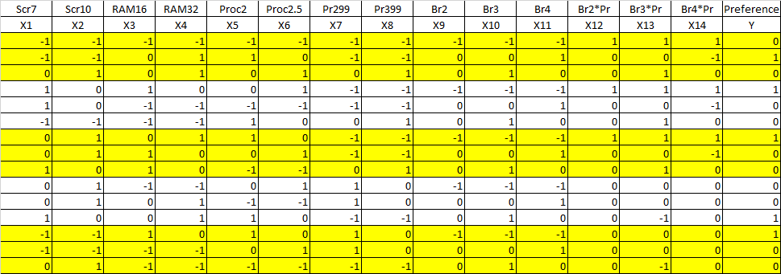
Data Format – both X and Y – for each respondent
X variables
Response Y

Slide 10
Estimating the betas using Bayesian Methodology
Multinomial Logistic Model is:
E(Y) = log(p/(1-p)) = β1X1 + β2X2 +… + β14X14, where X’s are dummy variables
MCMC is a general approach to simulate from posterior distributions of all the β’s

Slide 11
Prediction of Preferences -2
Let us say, we compute the means of each beta
In our model, we can use the means as estimates of the betas
Model is: Y_{ij} = X_{ij}β + ε_{ij}
Now we substitute the beta’s with our means
Then we can convert the log(odds) to probabilities of preferences
P(Yi = j) = exp(X_{ij}β) / Σ_{j} exp(X_{ij}β)

Slide 12
Solo 2 Choice Probabilities: (Quick & Dirty)
You have your design matrix X.matrix…….. 108 X 14
This beta vector is 14 X 1.
Suppose you calculate posterior means for each β & for each subject
> betameans=apply(testrun2$betadraw[,,701:1000],c(1,2),mean) 424x14
This matrix is 424 X 14 (424 people, each person has 14 betas)
Remember the model Y = log (odds) = X β
Next, we are going to calculate X times the means for every subject
xbeta=X.matrix%*%t(betameans) remember the model: E(Y) = X*beta
108X14 14X424 -> 108X424
This is 108 rows of X by 1 column for 424 subjects
%*% means matrix multiplication. t() means transpose

Slide 13


Q & D Quick choice probabilities
Putting subjects in rows with choice sets “stacked” within subjects
> xbeta2=matrix(xbeta,ncol=3,byrow=TRUE) -> 108X424 matrix -> 3 column matrix
xbeta2 is 15,264 X 3 is
Exponentiating xbeta2:
> expxbeta2=exp(xbeta2)
This is still 15,264 X 3, but is now
424*36 = 15,264
Log(OR) = Y = xbeta
OR = exp(xbeta)

Slide 14
Q & D Quick choice probabilities
Next, we are going to divide each row in expbeta2 by its sum to get predicted choice probabilities:
> rsumvec=rowSums(expxbeta2) --- remember the denominator
> pchoicemat=expxbeta2/rsumvec
Use max.col() to find predicted choices
You can use these results to calculate GOF metrics such as AUC, and other useful measures
A question: how would you generate predicted probabilities that reflect model parameter uncertainty, eg. Of the β_{i}’s?

Slide 15
Model: E(Y) = X.Beta
Choice Prediction
108x14 * 14x424
> xbeta=X.matrix%*%t(betameans)
> str(betameans) num [1:424, 1:14]
> dim(xbeta)
[1] 108 424
Model for each of 424 individuals
424*108 = 45,792
> xbeta2=matrix(xbeta,ncol=3,byrow=TRUE)
> dim(xbeta2)
[1] 15264 3
15,264 * 3 = 45,792
424 * 36 = 15,264
> expxbeta2=exp(xbeta2)
> rsumvec=rowSums(expxbeta2)
> pchoicemat=expxbeta2/rsumvec
> head(pchoicemat)
[,1] [,2] [,3]
[1,] 1.571796e-05 0.8064158410 0.1935684410
[2,] 9.919306e-01 0.0002950036 0.0077744385
[3,] 8.659727e-01 0.1338871906 0.0001400617
[4,] 3.527156e-03 0.0005338628 0.9959389816
[5,] 9.233043e-01 0.0763489595 0.0003467619
[6,] 1.259898e-02 0.7173308872 0.2700701365
>
> dim(pchoicemat)
[1] 15264 3

Slide 16
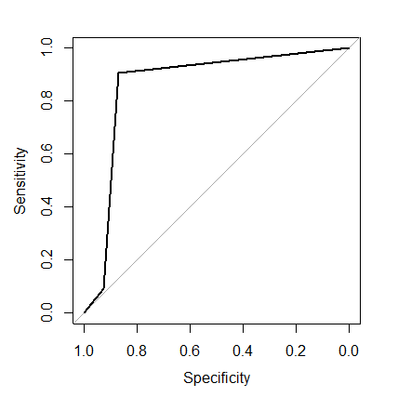
Choice Prediction – max.col option, GOF
> custchoice <- max.col(pchoicemat)
> str(custchoice)
int [1:15264] 2 1 1 3 1 2 2 3 1 2 ...
>
> ydatavec <- as.vector(t(ydata))
> str(ydatavec)
int [1:15264] 2 1 1 3 1 2 2 3 1 2 ...
>
>
> table(custchoice,ydatavec)
ydatavec
custchoice 1 2 3
1 3667 432 219
2 224 3736 224
3 313 421 6028
>
> require("pROC")
> roctest <- roc(ydatavec, custchoice, plot=TRUE)
>
> auc(roctest)
Area under the curve: 0.8612
Predicted choice
Actual choice
Confusion Matrix
Diagonal is ‘correct’ classification: 3650+3716+6044 = 13,410
Total Number= 424*36 choice sets = 15,264
Accuracy % = 13,410/15,264 = 87.8%

Slide 17
Prediction for 36 choice sets
Using Individual Respondent’s model
m <- matrix(custchoice, nrow =36, byrow=F) -> 15,264X1 -> 36X424
m2 <- t(m)
apply(m2, 2, function(x){tabulate(na.omit(x))})
[,1] [,2] [,3] [,4] [,5] [,6] [,7] [,8] [,9] [,10] [,11] [,12] [,13] [,14]
[1,] 86 343 235 108 188 69 71 59 105 30 301 197 60 177
[2,] 246 30 167 15 110 55 189 71 12 307 91 214 68 129
[3,] 92 51 22 301 126 300 164 294 307 87 32 13 296 118
[,15] [,16] [,17] [,18] [,19] [,20] [,21] [,22] [,23] [,24] [,25] [,26]
[1,] 18 50 21 57 36 325 263 103 208 28 56 35
[2,] 117 219 116 61 278 31 114 13 59 71 185 83
[3,] 289 155 287 306 110 68 47 308 157 325 183 306
[,27] [,28] [,29] [,30] [,31] [,32] [,33] [,34] [,35] [,36]
[1,] 94 35 326 218 78 177 22 33 25 67
[2,] 8 309 56 185 34 104 90 219 99 27
[3,] 322 80 42 21 312 143 312 172 300 330

Slide 18
Predictions based on overall beta means, for 36 choice sets
[,1] [,2] [,3]
[1,] 10 407 8
[2,] 421 2 0
[3,] 322 102 0
[4,] 35 2 387
[5,] 275 83 66
[6,] 3 23 398
[7,] 59 188 177
[8,] 2 17 405
[9,] 22 0 402
[10,] 2 420 2
[11,] 412 12 1
[12,] 160 264 0
[13,] 29 6 389
[14,] 182 189 53
[15,] 2 59 362
[16,] 39 276 109
[17,] 2 38 384
[18,] 24 1 400
[19,] 5 412 7
[20,] 419 4 1
[21,] 265 159 0
[22,] 17 1 406
[23,] 213 97 114
[24,] 1 16 407
[25,] 48 181 195
[26,] 2 15 408
[27,] 16 0 407
[28,] 3 417 4
[29,] 415 8 1
[30,] 202 222 0
[31,] 24 4 397
[32,] 187 167 70
[33,] 2 42 380
[34,] 34 267 123
[35,] 2 33 389
[36,] 18 0 405
betavec=matrix(betameansoverall,ncol=1,byrow=TRUE)
xbeta=X.matrix%*%(betavec)
dim(xbeta)
xbeta2=matrix(xbeta,ncol=3,byrow=TRUE)
dim(xbeta2)
expxbeta2=exp(xbeta2)
rsumvec=rowSums(expxbeta2)
pchoicemat=expxbeta2/rsumvec
pchoicemat
pchoicemat2 <- round(pchoicemat*424,digits=0)
pchoicemat2

Slide 19
Pooling the betas from ALL the respondents
Apply command is used to compute summary information for matrices
> betameansoverall <- apply(betadraw1[,,701:1000],c(2),mean)
> betameansoverall
[1] -0.187655146 0.451968506 0.102008303 0.632065094 0.980891644
[6] 1.288111324 0.320807921 -2.986922923 -0.143338333 0.085888744
[11] -0.270692993 0.122192499 0.054248306 0.002582457
Model based on all the respondents:
Y = log(OR) = log(p/(1-p)) = -0.1876*X1 + 0.4519*X2 + 0.1020*X3 + 0.6320*X4 + 0.9808*X5 + 1.2881*X6 + 0.3208*X7 – 2.9869*X8 – 0.1433*X9 + 0.0858*X10 - 0.2760*X11 + 0.1221*X12 + 0.0542*X13 + 0.0025*X14

Slide 20
Model Interpretation
Model is:
Y = log(p/(1-p)) = -0.1777*X1 + 0.4485*X2 + 0.1001*X3 + 0.6139*X4 + 0.9596*X5
+ 1.2522*X6 + 0.3083*X7 – 2.9369*X8 – 0.1748*X9 + 0.0487*X10 - 0.3160*X11 +
0.0997*X12 + 0.0307*X13 + 0.0050*X14
Interpretation:
Beta 1 = -0.1777
The odds of preference of a 2.5GHZ processor is exp(1.2511) = 3.4943 times greater than that of NOT preference. For 2.5 GHZ processor, probability of preference is 249% higher than
that of non preference.
The odds of preference of a price $399 is exp(-2.9369) = 0.0530 times greater than that of NOT preference. (ie) The probability of preference of a price of $399 is 5% that of
that of Non preference

Slide 21
How do we get the coefficients for the baselines?
Model is:
Y = log(p/(1-p)) = -0.1777*X1 + 0.4485*X2 + 0.1001*X3 + 0.6139*X4 + 0.9596*X5
+ 1.2522*X6 + 0.3083*X7 – 2.9369*X8 – 0.1748*X9 + 0.0487*X10 - 0.3160*X11 +
0.0997*X12 + 0.0307*X13 + 0.0050*X14
5-in screen is baseline (-1,-1)
7-in screen corresponds to X1 = 1
10-in screen corresponds to X2=1
For baseline screen of 5”, how do we determine the coefficient?
In the equation, we need plug in X1 = -1, and X2 = -1 & other X’s are zeros
(ie) log(OR) for 5 “ screen = -0.1777*(-1) + 0.4484*(-1) = 0.1777 – 0.4484 = -0.2708
(ie) -0.1777 + 0.4485 – 0.2708 = 0

Slide 22
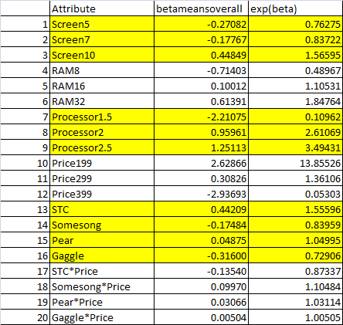
‘Full’ Model – ALL the coefficients
Log(OR) Odds Ratio (Pref/No Pref)
The odds of preference of a price of $199 is 13.85 times greater than that of NOT preferring.
The odds of preference of a price of $299 is 1.36 times greater than that of NOT preferring.
The odds of preference of a price of $399 is 0.05 times greater than that of NOT preferring.

Slide 23
‘Full’ Model – ALL the coefficients
Main Effect Interpretation: (ie) Comparison of levels
of an attribute:
Comparison of Screen 7 vs Screen 10:
For Scr7, log(OR)1 = -0.1777
For Sc10, log(OR)2 = 0.4485
Scr10 – Scr7 = log(OR)1 – log(OR)2 = log(OR1/OR2) = 0.626
OR1/OR2 = exp(0.626) = 1.87
If everything else is same, the Scr 10 – Scr 7 = 0.44849 – (-0.17767) = 0.62616; Exp(.62616) = 1.87
People prefer Screen 10, 1.87 times more than Screen 7
Comparison of Screen 7 vs Screen 5:
For Scr7, log(OR)1 = -0.1777
For Sc5, log(OR)2 = -0.2798
Scr7 – Scr5 = log(OR)1 – log(OR)2 = log(OR1/OR2) = 0.1021
OR1/OR2 = exp(0.1021) = 1.1075
If everything else is same,
People prefer Screen 7, 1.10 times more than Screen 5
OR They prefer Screen 7, 10% more than Screen 5

Slide 24
‘Full’ Model – ALL the coefficients
Interaction Interpretation:
If everything else is same, at pr=-1, then BR1 – BR2=
0.44 – (-0.17) + {Br1*Pr – Br2*Pr} =
0.6169 + { [(-0.135)-(0.099)]*-1} =
0.6169 + {0.2351} = 0.852; exp=2.34
If everything else is same, at pr=0, then BR1 –BR2=
0.44 – (-0.17) + {Br1*Pr – Br2*Pr} =
0.6169 + { [(-0.135)-(0.099)]*0} = 0.6169; exp=1.853
If everything else is same, at pr=1, then BR1 – BR2=
0.44 – (-0.17) + {Br1*Pr – Br2*Pr}=
0.6169 + [(-0.135)-(0.099)]*1=
0.6169 - 0.2351 = 0.3818; exp=1.46
Brand 1 is always preferred than Brand 2. But
Brand 1 is ‘more’ preferred to Brand 2 when
Price = $199 as opposed to Price=$299 or $399.
Which brand do people prefer? It depends on the
Price. Then we say there is an interaction between
Price & Brand. If all the interactions are 0, then
there is NO interaction between brand & price.

Slide 25
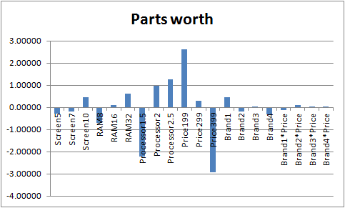
High Preferences (log odds) :
Screen10, RAM 16, Processor 2, Price $199, Brand 1 – One possible tablet design
Screen10, RAM 32, Processor 2.5, Price $299, Brand 1 – Another possible tablet design

Slide 26
Extra Scenarios

Slide 27
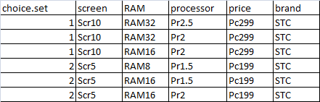
How do we predict the response for a new product design? Remember, we need to have 3 options in the choice set, to be consistent with the data we already have.
Dummy Coding
> ex_scen <- read.csv("extra-scenarios.csv")
> Xextra.matrix <- as.matrix(ex_scen[,c
+ ("V1","V2","V3","V4","V5","V6","V7","V8","V9",
+ "V10","V11","V12","V13","V14")])
>
>
>
> betavec=matrix(betameansoverall,ncol=1,byrow=TRUE)
> xextrabeta=Xextra.matrix%*%(betavec)
> xbetaextra=matrix(xextrabeta,ncol=3,byrow=TRUE)
> dim(xbetaextra)
[1] 2 3
>
> expxbetaextra=exp(xbetaextra)
> rsumvec=rowSums(expxbetaextra)
> pchoicemat=expxbetaextra/rsumvec
> pchoicemat
[,1] [,2] [,3]
[1,] 0.07883056 0.6744385 0.246730916
[2,] 0.48466762 0.5123991 0.002933325
Extra Scenario 1:
Preference shares are:
8%, 67%, 25%

Slide 28
Choice Models & Segmentation:
A Puzzler
Suppose you have HB choice model results:
Categorical predictors
respondent level β_{i}’s, etc.
You would like to identify market segments based on differences in choice model results, partworths
Question: Can you do this by clustering on the β_{i}’s or partworths? Why or why not?

Slide 29
Product Ownership – only difference is Z
###########product ownership logic starts here ################
zownertest=matrix(scale(zowner,scale=FALSE),ncol=1)
Data2=list(p=3,lgtdata=lgtdata,Z=zownertest)
testrun2=rhierMnlDP(Data=Data2,Mcmc=mcmctest)
dim(testrun2$Deltadraw)
apply(testrun2$Deltadraw[701:1000,],2,quantile,probs=c(0.10,0.25,0.5 ,0.75,0.90))
betameansoverall <- apply(testrun2$Deltadraw[701:1000,],2,mean)
betameans=apply(testrun2$betadraw[,,701:1000],c(1,2),mean)
xbeta=X.matrix%*%t(betameans)
xbeta2=matrix(xbeta,ncol=3,byrow=TRUE)
dim(xbeta2)
expxbeta2=exp(xbeta2)
rsumvec=rowSums(expxbeta2)
pchoicemat=expxbeta2/rsumvec
head(pchoicemat)

Slide 30
Prior Product Ownership – Does it impact preferences?
We are centering the zowner. Let me explain. If you look at the 'zowner' column from the original data set - total number rows = 424, Out of those, 68 of them have a value of 1, remaining 356 rows have a value of 0 (NA). Remember 1 means the person owns, 0 means the person does not own. Hence, if we calculate the mean of the zowner column, it is 68/424 = 0.1604. Print the 'zowner' & see this. Then we are centering z. This means we are transforming z to zownertest = z-0.1604. (ie) When z=0, then zownertest = -0.1604; when z=1, then zownertest = 1-0.1604 = 0.8396. Now, you print the zownertest, you will see this. This vector is used as a covariate in the algorithm.
Zowner is covariate.
Note: Deltadraw vs betadraw:
Deltadraw: Correlation of product ownership to the beta coefficients - For the understanding of the covariate you may use this;
Betadraw: Beta coefficients

Slide 31
Next Steps
Understand the code as much as possible
Understand the model – interpretation, prediction
Model validation
Goodness of fit
More iterations
Answer all the questions, with lots of detail
READ the questions and answer them – Do NOT make this an R exercise process, based on my document
Post your questions on Solo 2 Huddle
Next Wednesday, we will have sync session on ‘Solo 2 Integration’

Slide 32
Questions?

