Slide 1
Translating Linguistics into Application Interaction
Using Amazon Lex Deep Learning for Conversational Interaction with Data Analytics

Slide 2

In the Data world … we use syntax all day long...
But sometimes we just want a conversation...

Slide 3

…. To free up our ability to get the results we want
Amazon AWS has provided Lex, a Democratized Deep Learning Technology that powers Alexa, to be integrated into applications so we can use words and sentences to dictate commands and interaction

Slide 4
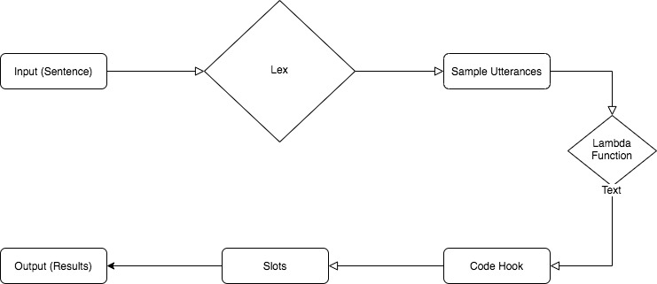
Intent be a Lambda Function tonight
The basic information flow Lex and how it integrates:

Slide 5
First Case Study… The Flower Shop with Brent Lee
He will show you how to order flowers demonstrating
•Intent
•Lambda Functions
•Utterances

Slide 6
Second Case Study… SQL Queries from English
The Utterances are the english sentence variants that the Intents refer to

Slide 7
Then End

