Slide 1

Intent: OrderFlowers
Lex matches the intent of ordering flowers and executes a script, and was customized to also include mentioning the items that are available.
In the function def validate order flowers, the item was modified so it won’t confuse the customer when they ask to order a non-existent item.

Slide 2


Lambda function
You specify a handler, like a function in your code, that AWS invokes when executing your code. For example, the code is the music sheet and the conductor is the handler that executes the music sheet. The band can be the function that executes the music sheet.

Slide 3
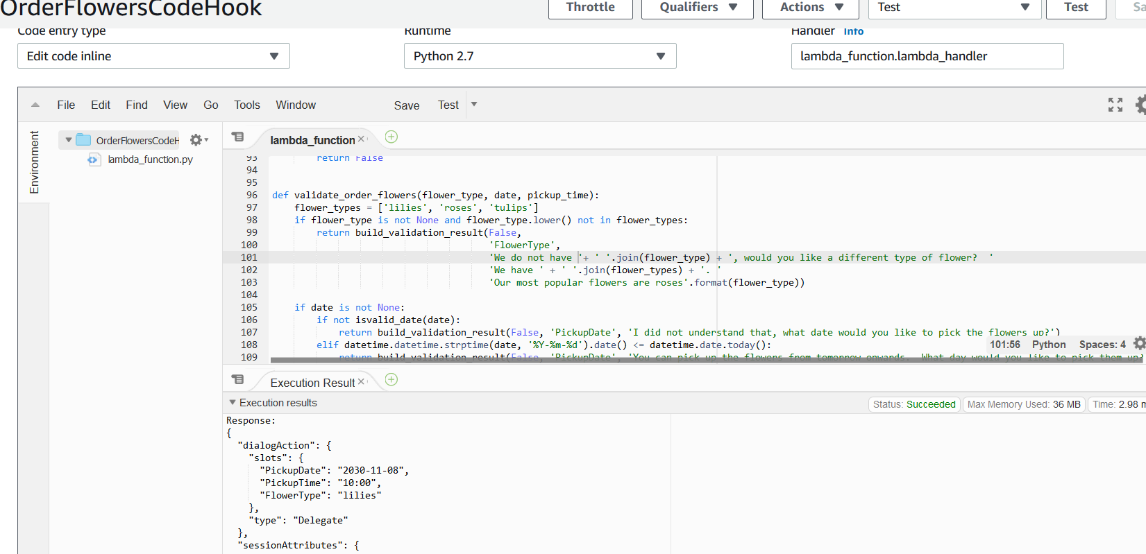
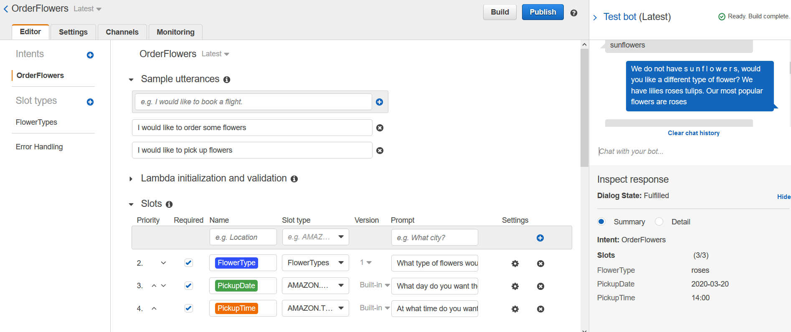

Slide 4
Utterances

Slide 5
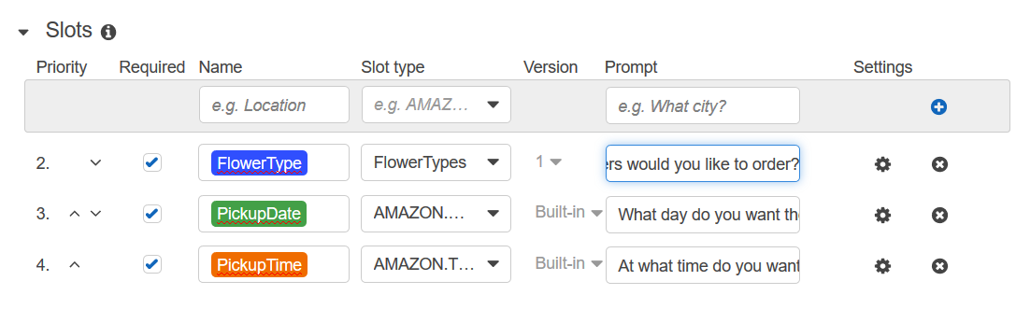
Slots

