Slide 1
Version 3.1
04/07/26

Slide 2




Context Engineering
(Because the Model isn't the Problem)
Presented by Brent Laster
Tech Skills Transformations LLC
© 2026 Brent C. Laster & Tech Skills Transformations LLC
All rights reserved

Slide 3




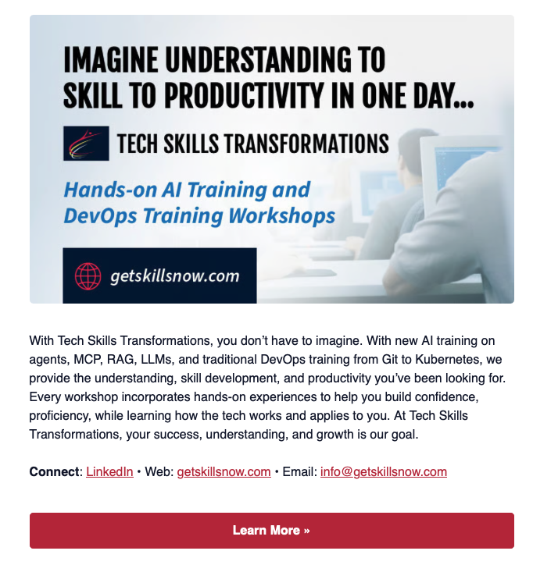
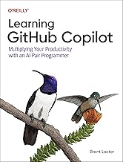

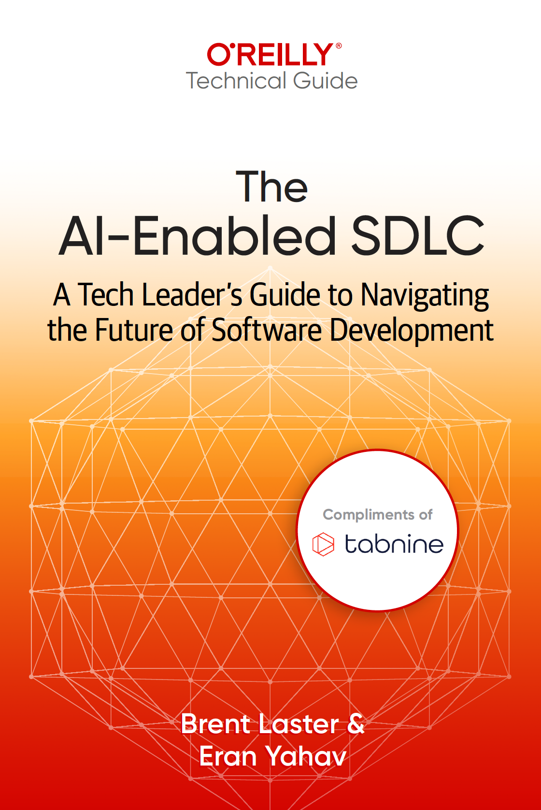

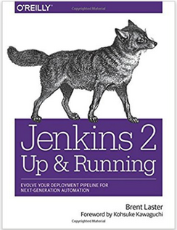






About me
Long career in corporate:
Principal Dev
Manager/Senior Manager
Director
Founder, Tech Skills Transformations LLC
https://getskillsnow.com
info@getskillsnow.com
LinkedIn: brentlaster
X: @BrentCLaster
Bluesky: brentclaster.bsky.social
GitHub: brentlaster

Slide 4

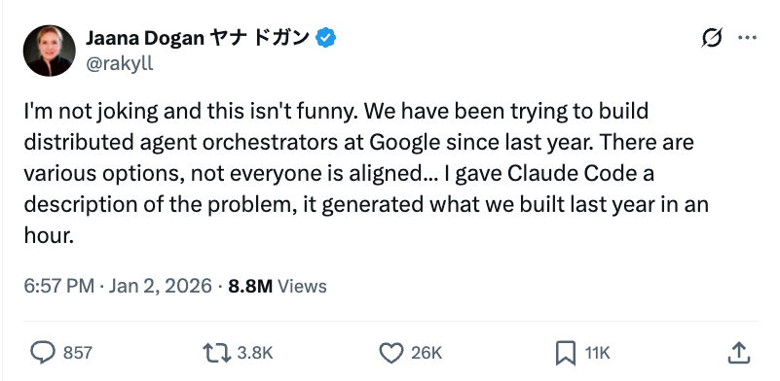
“This isn’t funny.”

Slide 5
"The AI Should Have Known What I Meant"
Without Context
With Context
> Fix the login bug
AI responds with generic authentication
boilerplate for the wrong framework,
wrong database, wrong everything.
The model isn't broken. It just
had no idea what you meant.
> Fix the login bug
+ codebase context, error logs,
auth schema, recent changes
AI identifies the exact session
token bug in the OAuth callback
and proposes a targeted fix.
Same model. Better context.

Slide 6
What Is Context Engineering?
"Building with language models is becoming less about finding the right words and more about answering: what configuration of context is most likely to generate the desired behavior?"
Context Engineering
The discipline of designing and managing the full information environment in which an AI system operates — including instructions, retrieved data, memory, tool descriptions, formatting, constraints, and workflow structure.
Source: Anthropic Engineering Blog, 2025

Slide 7
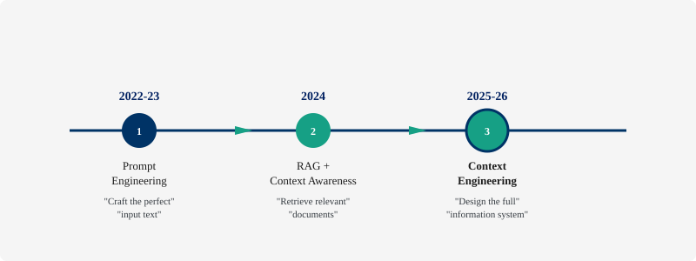
From Prompts to Systems
Prompt engineering is a subset of context engineering — not the other way around.

Slide 8
The Enterprise AI Moment
40%
But most enterprises are deploying agents before designing the environments those agents need to operate in.
of enterprise apps will feature
task-specific AI agents by late 2026
Teams that invest in context engineering now will have a structural advantage as agent adoption scales.
up from less than 5% in 2025
Source: Gartner, 2025

Slide 9


The Cost of Bad Context
Hallucinations
Wasted Compute
Unreliable Outputs
Eroded Trust
Models fabricate answers when context is missing or contradictory
Stuffing irrelevant tokens wastes money and latency
Inconsistent behavior from poorly structured inputs
Users stop using AI systems that can't be depended on
Context problems masquerade as model problems.

Slide 10
The Six Pillars of
Context Engineering
What actually goes into the model — and how to get it right

Slide 11






Six Pillars Overview
Instructions
System prompts, role definitions
Retrieval
RAG, context engines, search
Memory
Short-term, long-term, compression
Formatting
Structure, ordering, examples
Constraints
Guardrails, boundaries, rules
Decomposition
Splitting workflows across agents
Each pillar is a lever. Pull them together for maximum effect.

Slide 12
Pillar 1: Instructions & System Prompts
The foundation — telling the model who it is and how to behave
System prompts set identity, constraints, tone, and behavior
Vague instructions → vague outputs
"Be helpful" ≠ a good system prompt
Recipe: Role + Constraints + Output Format + Examples
"Be thoughtful and keep your context informative, yet tight."
— Anthropic Engineering Blog

Slide 13
System Prompts: Before & After
Before
After
You are a helpful assistant.
Please help the user with their
questions.
ROLE: Senior code reviewer
FOCUS: Python, Django, PostgreSQL
CONSTRAINTS: No framework
migrations. Follow PEP-8.
FORMAT: Return diff blocks
with severity ratings.
EXAMPLES: [2 canonical examples]
3 tokens of useful instruction
Zero constraints, no format, no role
Specific, bounded, formatted

Slide 14
The System Prompt Win
What a specific system prompt delivers
Before
Result
3-line generic prompt
"Consider adding error handling"
"This could be more efficient"
First review caught an actual
race condition in a database
connection pool
After
No model upgrade.
No new data.
Just a better system prompt.
Specific role + language stack +
coding standards + review format

Slide 15
Anti-Pattern: Tool Bloat
"If a human engineer can't definitively say which tool should be used in a given situation, an AI agent can't be expected to do better."
— Anthropic Engineering Blog
The fix: Fewer tools with clear boundaries > many overlapping tools
Curate diverse canonical examples, not a laundry list of edge cases
Remove overlapping tools — each one should have a clear, distinct purpose
Test: can you explain when to use each tool in one sentence?
Source: Anthropic, 2025

Slide 16
Pillar 2: Retrieval — The Right Information
From RAG to Context Engines
RAG is one of the most powerful tools for context engineering — but most implementations are naive
The chunking problem:
  Too small = no surrounding context for meaningful answers
  Too large = noisy embeddings, hard to pinpoint relevant info
The golden rule: "If a chunk makes sense to a human on its own, it will make sense to the model"
Source: RAGFlow Year-End Review, 2025

Slide 17
Three Retrieval Principles
The operational rules that fix most retrieval problems
1
Quality In = Quality Out
The bottleneck is what goes in,
not the embedding model
or vector database
2
Recency Matters
Add last-verified metadata;
filter deprecated docs
before they reach the model
3
Measure Impact
Track retrieval precision
alongside output accuracy;
if you aren't measuring,
you're guessing

Slide 18
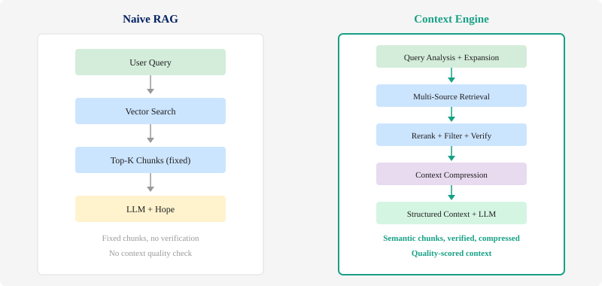
Naive RAG vs. Context Engine
A Context Engine is a system that intelligently selects, ranks, and compresses the most relevant information before sending it to the LLM — going beyond simple retrieval to deliver optimized, high-quality context.

Slide 19
Inside a Context Engine
How queries become high-quality, verified context — a 5-stage pipeline
STAGE 1
Query Analysis
Expand & classify the user query; determine intent and domain
STAGE 2
Multi-Source Retrieval
Embeddings, knowledge graphs, APIs, memory stores
STAGE 3
Rerank + Verify
Score relevance, check freshness, filter noise
STAGE 4
Compress
Summarize, deduplicate, trim to token budget
STAGE 5
Structured Context → LLM
System prompt + XML-tagged context + constraints + formatted output spec
Pillar Mapping: Stage 1 = Decomposition | Stage 2 = Retrieval | Stage 3 = Constraints | Stage 4 = Memory | Stage 5 = Instructions + Formatting
Each stage maps to one or more pillars. The engine orchestrates all six into a single pipeline.

Slide 20

The Retrieval Evolution (Practitioner Mental Model)
2024
2025
2026
Classic RAG
Vector
Orchestration
Context
Engines
Retrieve docs by
semantic similarity
Coordinate text,
relations, APIs
Retrieval + verify +
reason + access
Vector orchestration = coordinating multiple data sources (text embeddings, knowledge graphs, APIs) through a single retrieval layer, rather than relying on one vector store alone.
Source: RAGFlow, 2025 | SDG Group, 2026

Slide 21
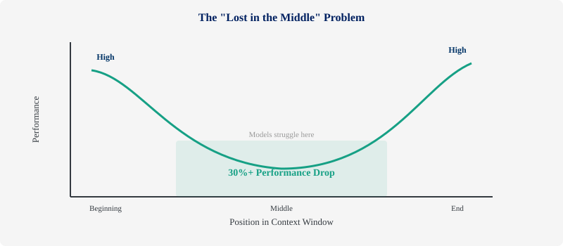
Pillar 3: Memory — What Persists
Key Insights
"Lost in the middle": models use middle-positioned info less effectively
Practical effect is consistent across models, even though the exact mechanism varies
Some teams report meaningful token savings through memory compression — results vary by task
Solution: hybrid memory — short-term (in-context) + long-term (vector DB)
Source: Stanford/UC Berkeley/Samaya AI, 2023 | Weaviate, 2025

Slide 22
Position Your Context Wisely
Practical takeaways from the lost-in-the-middle research
Beginning
Middle
End
High attention weight
from all subsequent tokens
Performance drops
significantly here
Benefits from
recency effect
Action: Front-load critical info. Back-load constraints and output format. Compress the middle aggressively.
Memory tip: Measure quality as you compress — not every context compresses well.

Slide 23
Context Layers Architecture
Working Context
Immediate prompt: system instructions, identity, history, tool outputs
Session
Durable log of the current interaction
Memory
Long-lived, searchable knowledge across sessions
Artifacts
Large binary/text data associated with user or session

Slide 24
Pillar 4: Formatting & Structure
Design principle:
Formatting Techniques That Matter
XML tags, JSON, markdown headers aren't cosmetic — they're functional boundaries the model uses
Position critical info at the beginning and end of context (primacy/recency)
Few-shot: curate diverse canonical examples, not a laundry list of edge cases
Less is more: prune irrelevant context ruthlessly
focused tokens
often outperform
much larger
unfocused tokens
Source: FlowHunt/Anthropic, 2025

Slide 25
Structure Changes Everything
Unstructured Input
Structured Input
Here's some data about our users.
John signed up last Tuesday and
he's been having issues with the
checkout flow. Also we changed the
payment API on Monday. The error
rate went up 15%. Sarah from QA
says it might be the new SSL cert.
Please investigate and fix.
<issue>
<symptom>
15% error rate increase
</symptom>
<timeline>
Mon: payment API change
Tue: user reports begin
</timeline>
<hypothesis>
SSL cert change (QA team)
</hypothesis>
</issue>

Slide 26

Pillar 5: Constraints & Guardrails
Telling the model what NOT to do is as important as telling it what to do
Output Format
Behavioral
Domain
Safety
JSON schema, response length limits, required fields
No speculation, cite sources, escalate uncertainty
Stay within approved topics, reject out-of-scope requests
PII handling, content policies, compliance rules
Source: Anthropic, 2025 | Kubiya, 2025

Slide 27
Context Smells: Red Flags to Watch For
If you recognize these patterns, context — not the model — is likely the problem.
Prompt sprawl
Bad chunking
Accumulated instructions nobody owns or reviews
Fixed chunks that break semantic boundaries
Weak role definition
Unstructured context
Generic identity with no domain specifics
Raw data straight to the model with no structure
Retrieval noise
Premature model upgrades
Irrelevant docs dumped regardless of the question
Scaling up without measuring the real bottleneck
How many of these describe a system you work with right now?

Slide 28
Diagnose Your System
Five-step triage ladder — start at the top, work down
1
Is the instruction specific enough?
2
Is retrieval pulling relevant info?
3
Is the context structured?
4
Are constraints explicit?
5
Should this task be decomposed?
Only if all five are solid → then ask if the model itself is the bottleneck

Slide 29
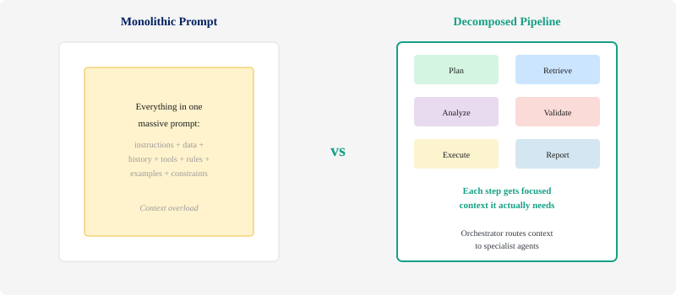
Pillar 6: Workflow Decomposition

Slide 30



Four Context Strategies
Write
Select
Compress
Isolate
Persist important info outside the context window for later use
Retrieve only what's relevant — don't dump everything in
Summarize and trim to save space — meaningful token savings in many cases
Use multi-agent systems to separate concerns and focus context
These strategies work together — the best systems combine all four.

Slide 31
Multi-Agent Context Architecture
By 2027, one-third of agentic AI implementations will combine agents with different skills to manage complex tasks.
The pattern: An orchestrator agent routes tasks to specialist agents, each with focused, tailored context.
Orchestrator Agent
Data Agent
Code Agent
Research Agent
QA Agent
Each agent gets only the context it needs — no overload, no confusion.
Source: Gartner, 2025

Slide 32
[LIVE DEMO] Context Engine in Action: Same Question, Three Levels of Context

Slide 33
Does It Actually Work? The evidence that better context can outperform bigger models on benchmarked agentic tasks

Slide 34
The Naive Support Bot
15–30%
The Typical Setup
AI customer support chatbot — built in an afternoon
✗ Instructions “You are a helpful customer support agent”
✗ Retrieval RAG pulls from entire docs library, unfiltered
✗ Memory No session persistence
✗ Constraints No guardrails, no output structure
Result: Hallucinated features, inconsistent answers, eroded trust
reported hallucination rate
with no context engineering applied
Illustrative scenario based on documented industry patterns

Slide 35
Support Bot: The Six-Pillar Fix
Applying all six pillars to the naive setup — same model, different context
Instructions
Retrieval
Memory
Specific role +
"if not in docs,
say you don't know"
Verified, current
product docs only +
recency weighting
Session persistence
so customers don't
repeat themselves
Formatting
Constraints
Decomposition
XML tags separating
capabilities, limitations,
and pricing
Never speculate;
escalate billing
questions to humans
Classify → Retrieve
→ Generate
(3-step pipeline)
Result: Hallucination rates drop to low single digits | Same model | Weeks, not months

Slide 36
ACE: Context Engineering > Fine-Tuning
+10.6%
ACE Framework
Stanford | SambaNova | UC Berkeley
86.9% average latency reduction
In that benchmarked setup, matched GPT-4.1 agents (IBM) on AppWorld — without fine-tuning
Key insight: Treats contexts as evolving playbooks that accumulate and refine strategies through generation, reflection, and curation
improvement on agentic benchmarks (one benchmarked setup)
by engineering context — not fine-tuning
Source: Stanford/SambaNova/UC Berkeley (arXiv:2510.04618), 2025

Slide 37
Context Beats Model Upgrades
ACE research confirms what practitioners see in production
Benchmark Evidence
Production Pattern
ACE Framework: +10.6%
improvement on benchmarks
Matched GPT-4.1 agents
without fine-tuning
86.9% latency reduction
Support bot scenario: double-digit
hallucination rates → low single digits
Same pattern: better context,
not bigger models
Fix context first, measure,
then decide
Whether benchmarks or production, the pattern holds: engineer the context first.

Slide 38
When the Model Actually IS the Problem
Context engineering is powerful — but it's not magic. Intellectual honesty matters.
Context is the bottleneck when:
Model capability matters for:
Output varies wildly across similar inputs
Model hallucinates despite having access to correct data
Adding more context makes things worse, not better
Same model works great for other teams
Switching models doesn't fix the core issue
Deep multi-step reasoning chains
Complex code generation and debugging
Multilingual or cross-lingual tasks
Multimodal understanding (vision, audio)
Novel creative synthesis
The rule: fix context first. Measure. Then decide if you need a bigger model.
27

Slide 39
When to Use Each Approach
Setup Effort
Cost
Iteration Speed
Best For
Context Engineering
Low — hours to days
Minimal — no compute, no labeled data
Fast — change prompts, test immediately
Most production issues, hallucination, inconsistency
Fine-Tuning
Medium — days to weeks
Moderate — GPU compute + labeled data
Slow — retrain on each model update
Specialized domain tone, rare formats
Bigger Model
Low — swap API endpoint
High — ongoing per-token cost increase
Instant — but expensive at scale
Reasoning depth, code quality, multimodal
Framework based on production experience and ACE research, 2025
Start with context engineering. Escalate only when measured evidence says you need to.

Slide 40
The Decision Tree
How to decide: context engineering, fine-tuning, or bigger model?
Does the model understand the problem?
No →
Upgrade the model
Yes ↓
Is context complete and well-structured?
No →
Context engineer
Yes ↓
Does the model still struggle?
No →
You’re done!
Yes
↓
Consider fine-tuning
Hybrid strategies are common: many systems combine context engineering with targeted fine-tuning.

Slide 41


It Takes a Village
Unlike prompt engineering, context engineering requires cross-disciplinary collaboration:
Data Engineers
Domain Experts
AI Engineers
Design retrieval pipelines, manage knowledge bases, optimize chunking strategies
Curate knowledge graphs, define constraints, validate context quality
Architect context flows, build agent systems, tune prompt + context interactions

Slide 42
The Monday Morning Playbook 7 things you can do this week to improve your AI systems

Slide 43
Your Playbook (1 of 2)
1
Audit Your Context (All Pillars)
Map every piece of information flowing into your AI system. You can't fix what you can't see.
2
Fix Your System Prompts (Pillar 1)
Be specific: role + constraints + output format + examples. Kill "be helpful".
3
Chunk Smarter (Pillar 2)
Use semantic boundaries, not fixed token counts. Each chunk should make sense on its own.
4
Position Critical Info (Pillar 3-4)
Front-load and back-load important context. The middle is where information goes to die.

Slide 44
Playbook: Structure & Memory
Expanding on Playbook #3 (Chunk Smarter) & #4 (Position Critical Info) — the two most-overlooked quick wins
A
Map Your Information Architecture
Where does critical info live? Working context? Session? Long-term memory?
Draw it on a whiteboard. You'll find important info duplicated in 3 places or missing from all.
B
Structure Your Most Common Prompts
Take your 5 most frequent tasks. Add XML, JSON, or markdown headers.
30 seconds per prompt. Error rates can drop dramatically.

Slide 45
Your Playbook (2 of 2)
5
Compress Thoughtfully (Pillar 3)
Memory compression can meaningfully reduce token usage — but measure quality to ensure nothing important is lost.
6
Decompose Workflows (Pillar 6)
Break complex tasks into focused steps. Each step gets tailored context, not the kitchen sink.
7
Measure Context Quality (All Pillars)
Track context relevance scores alongside model accuracy. Context quality drives output quality.
Start with ONE system. Audit its context this week. You'll be surprised what you find.

Slide 46
How Do You Know It's Working?
Measuring context quality — not just model accuracy
Output Quality Metrics
Context Health Metrics
Accuracy
Retrieval Precision
Does the system produce correct outputs?
What % of retrieved context is actually useful?
Relevance
Coverage
Are responses relevant to the actual question?
Does the context cover all needed information?
Consistency
Redundancy
Does the system produce consistent outputs across similar inputs?
How much duplicate information is in the context?
Confidence
Latency
How confident is the model in its responses?
Less context → faster, cheaper responses
Context quality drives output quality. Track both.
Representative case: task success improved 58% → 76% after context restructuring (consistent with ACE research findings).

Slide 47
Your Five-Step Eval Recipe
Start measuring tomorrow — one lever at a time
1
Choose 20 representative tasks from production
2
Freeze the model — don't change it
3
Change exactly one context lever
4
Score accuracy, relevance, and latency
5
Repeat with the next lever
One lever at a time, measured against the same baseline.

Slide 48
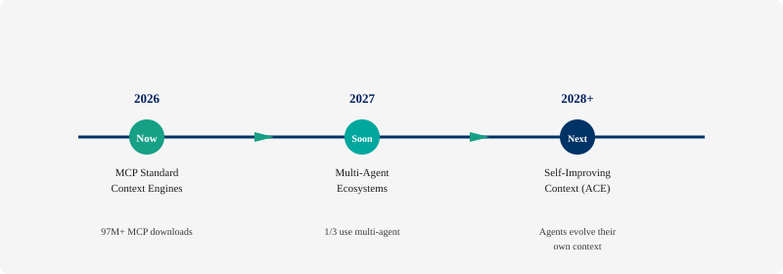
The Road Ahead
By 2027, "context engineer" may be as common a role as "data engineer".

Slide 49
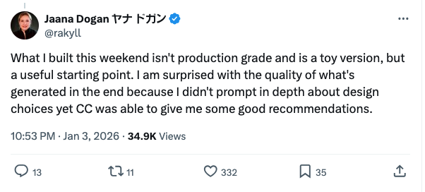
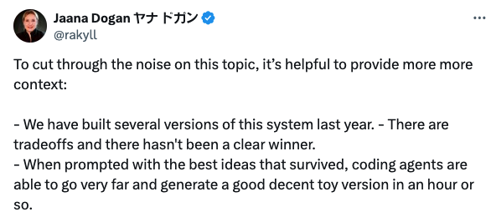
What the post claimed – and what the follow-ups clarified
Claim (compressed): “Claude Code generated something close to what we built last year… in ~1 hour.”
Context embedded in the thread:
  “We’ve been trying to build distributed agent orchestrators… since last year”
  Follow-up: “not production grade… toy version”
  Follow-up framing: “we built several versions last year” (iteration happened)

Slide 50
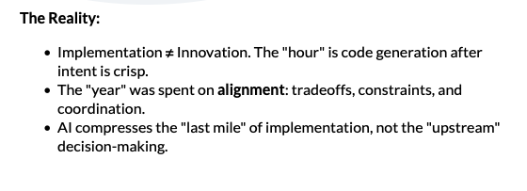
What the post claimed – and what the follow-ups clarified
Claim (compressed): “Claude Code generated something close to what we built last year… in ~1 hour.”
Context embedded in the thread:
  “We’ve been trying to build distributed agent orchestrators… since last year”
  Follow-up: “not production grade… toy version”
  Follow-up framing: “we built several versions last year” (iteration happened)

Slide 51
Now the AI Knows
What You Mean
The model often wasn't the main problem.
The context was.
And now you know how to fix it.
Audit, prune, structure, measure. Start this week with one system.

Slide 52
Questions?
36

Slide 53

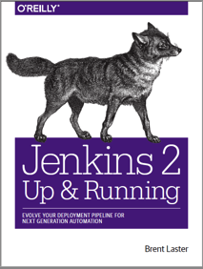


That’s all - thanks!
Contact: training@getskillsnow.com
techskillstransformations.com
getskillsnow.com

