Slide 1
Version 2.8 04/03/26

Slide 2



CAI
Presented by Brent Laster
Tech Skills Transformations LLC
© 2026 Brent C. Laster & Tech Skills Transformations LLC
All rights reserved

Slide 3



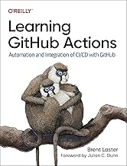

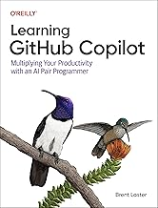

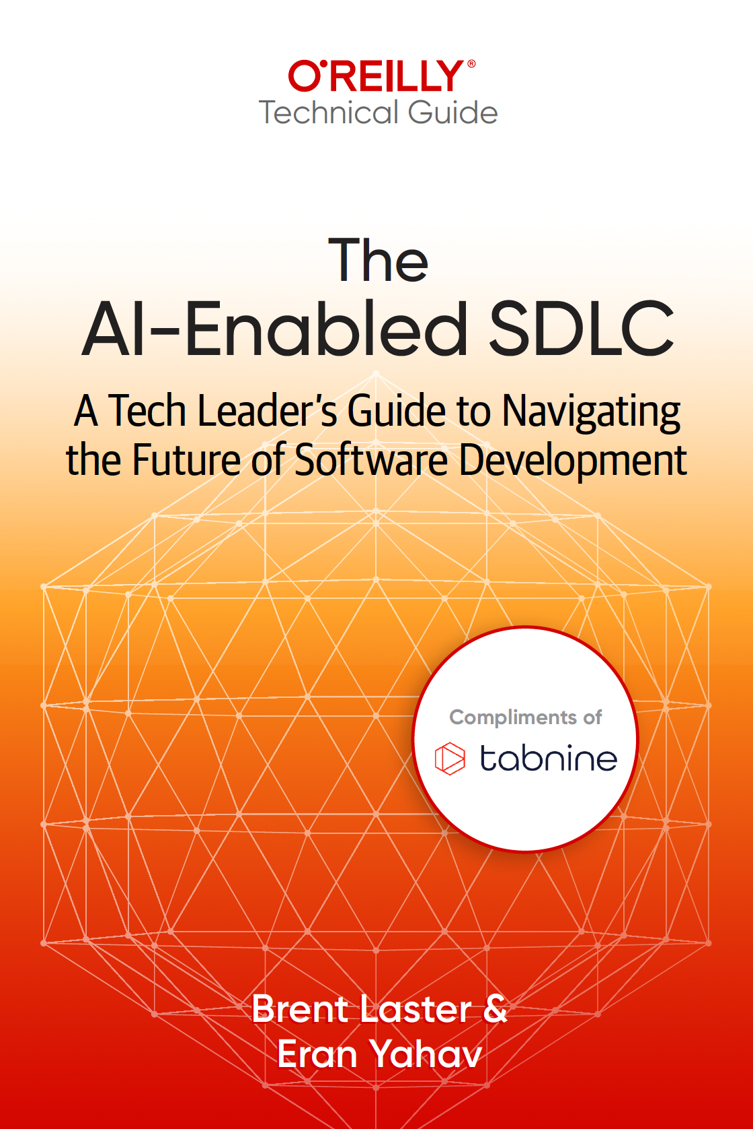
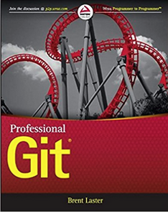
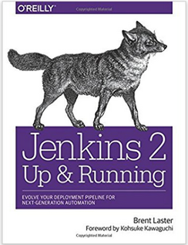






About me
Long career in corporate:
Principal Dev
Manager/Senior Manager
Director
Founder, Tech Skills Transformations LLC
https://getskillsnow.com
info@getskillsnow.com
LinkedIn: brentlaster
X: @BrentCLaster
Bluesky: brentclaster.bsky.social
GitHub: brentlaster

Slide 4
Your Pipeline Is Still Dumb
Today's CI/CD pipelines:
Build → Test → Pass/Fail → Deploy or Don't
Binary. No reasoning. No learning. No memory.
Meanwhile, developers are using AI for code gen, testing, docs — but the pipeline itself hasn't learned a thing.
The CI/CD pipeline is the natural home for AI — it already touches every stage of delivery.
3

Slide 5
From CI/CD to CI/CD + CAI
CI/CD Today
CI/CD + CAI
Build → Test → Deploy
Automated but unintelligent
Same pipeline for every change
No reasoning, no adaptation
Build → AI Analysis → Test → AI Triage → Deploy → AI Monitor
Adds a reasoning layer
Adapts to each change
Captures signal from every run
AI coding assistants boost output 21%, but organizational delivery gains require pipeline intelligence.
Source: DORA State of AI-Assisted Software Development, 2025
4

Slide 6
What Early Adopters Are Reporting
Up to 80%
21%
25-40%
98%
cycle time reduction (reported
in specific contexts)*
more tasks completed
with AI coding assistants
MTTR reduction with
AIOps (enterprise case studies)
more PRs merged
with AI assistants (DORA)
Reported results from reviewed literature and case studies — directional examples, not universal benchmarks | Sources: DORA 2025, MDPI 2025, Enterprise AIOps
5

Slide 7
What Is Continuous AI?
A practical framing for AI-augmented delivery systems
Continuous AI is the use of AI inside software delivery workflows to continuously analyze changes, adapt validation, improve triage, and learn from outcomes across repeated pipeline runs.
A working pattern name for this talk, not a formal industry standard.
AI in a pipeline
AI-assisted CI/CD
Continuous AI (CAI)
One-shot: add a ChatGPT call to one step
→
Multi-step: AI helps at build, test, deploy stages
→
Feedback system: every run makes the pipeline smarter
CAI learning types: inference-only (analysis) → retrieval-updated (RAG enrichment) → policy-refined (threshold calibration from outcomes)
6

Slide 8
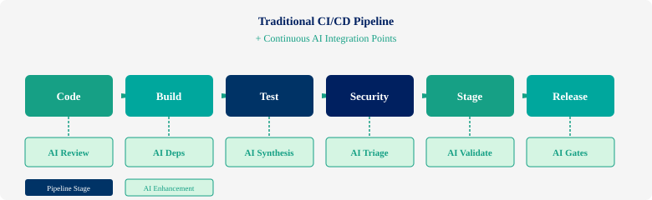
Where AI Fits in the Pipeline
Seven integration points — each one is an opportunity to add intelligence.
7

Slide 9







Seven AI Integration Points
Code
AI code review, style checks, vulnerability detection
Build
AI dependency analysis, compatibility prediction
Test
AI test synthesis, intelligent selection, self-healing
Security
AI vulnerability triage, risk prioritization
Stage
AI validation, log summarization, canary analysis
Release
AI release gates, risk-based deployment decisions
Monitor
AI anomaly detection, auto-remediation, feedback
8

Slide 10
Six Patterns for Continuous AI Practical ways to embed AI into your build and deployment workflows

Slide 11
Pattern 1: AI-Assisted Test Synthesis
Let AI write the tests you're not writing.
Traditional: developers write tests manually → coverage gaps everywhere
AI test synthesis: analyze code changes, generate targeted tests
Test intelligence: only run tests impacted by the change → up to 80% cycle time reduction*
Self-healing tests: detect UI/env changes, auto-repair broken scripts → significant maintenance reduction*
Reported in specific contexts — directional, not universal | Source: MDPI CI/CD Optimization Study, 2025
10

Slide 12
AI Test Synthesis in GitHub Actions
name: AI Test Synthesis
on: [pull_request]
jobs:
ai-tests:
runs-on: ubuntu-latest
steps:
- uses: actions/checkout@v4
- name: Get changed files
id: diff
run: |
git diff --name-only origin/main > changed.txt
- name: AI generates tests
run: |
cat changed.txt | ai-test-gen \
--model claude-sonnet \
--context ./src \
--output ./tests/generated/
- name: Run all tests
run: pytest tests/ --tb=short
How it works:
1. PR triggers workflow
2. Diff identifies changed files
3. AI analyzes changes + codebase context
4. Generates targeted test cases for new/modified code
5. Runs full suite including generated tests
Pattern sketch — not production hardening
11

Slide 13
AI Testing Tools Landscape
Mabl
Qodo
DiffBlue Cover
BrowserStack
AI-generated UI tests, auto-healing, CI/CD native
Unit test generation from code analysis
AI Java unit test generation at scale
Test observability + auto root-cause analysis
+ GitHub Copilot, Cursor, Claude Code for AI-assisted test writing in your IDE
12

Slide 14

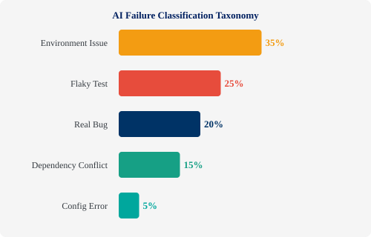
Pattern 2: Intelligent Failure Classification
Stop manually triaging build failures.
AI classifies every failure:
Type: env, flaky, real bug, deps, config
Severity: P0-P4 auto-assignment
Root cause: grouped + linked
MTTR: 30-50% faster
LogSage (2025): LLM-based framework for CI/CD failure detection + remediation
Case-study ranges — results vary by context | Sources: DevOps.com, 2025 | arXiv (LogSage), 2025
13

Slide 15
Failure Triage: Before & After
Before (Manual)
After (AI Triage)
1. Build fails
2. Dev reads 10,000-line log
3. Googles error message
4. Figures out: env issue
5. Restarts pipeline manually
Time: 30-60 minutes
1. Build fails
2. AI reads full log in seconds
3. Classifies: "env issue — Docker image cache stale"
4. Auto-restarts with cache clear
5. Comments on PR with summary
Time: 2-3 minutes
14

Slide 16
Failure Classification: Code
- name: AI Failure Classification
if: failure()
run: |
# Extract last 500 lines of log
tail -500 build.log > failure.txt
# AI classifies the failure
RESULT=$(curl -s https://api.anthropic.com/v1/messages \
-H "x-api-key: ${{ secrets.CLAUDE_KEY }}" \
-d '{
"model": "claude-sonnet-4-6",
"messages": [{
"role": "user",
"content": "Classify this CI failure.
Categories: env|flaky|bug|deps|config
Output JSON: {type, severity, summary,
suggested_action}\n'"$(cat failure.txt)"'"
}]
}')
# Post to PR as comment
gh pr comment $PR --body "$RESULT"
Key points:
Runs only on failure
Extracts relevant log tail
LLM classifies with structured JSON
Posts result as PR comment
Could also auto-retry for env issues
Pattern sketch — not production hardening
15

Slide 17

Pattern 3: Automated Log Summarization
Before
After (AI Summary)
[2026-03-17 14:23:01] npm WARN
[2026-03-17 14:23:01] npm WARN
[...10,847 more lines...]
[2026-03-17 14:28:15] Error:
ENOMEM: not enough memory
[2026-03-17 14:28:15] Build failed
Build failed: out of memory Root cause: Node process exceeded 4GB limit during TypeScript compilation of 847 files. Fix: Increase runner memory or
split compilation into chunks.
Developer spends 15-30 min reading logs
3-sentence summary in 5 seconds
16

Slide 18
Log Summarization + Slack Notification
- name: Summarize failure
if: failure()
run: |
SUMMARY=$(cat build.log | tail -200 | \
claude --model sonnet -p "Summarize this
CI failure in 3 sentences: root cause,
impact, suggested fix. Be specific.")
# Post to Slack
curl -X POST $SLACK_WEBHOOK \
-d "{\"text\": \"🔴 Build #$RUN failed\n
$SUMMARY\"}"
# Also comment on PR
gh pr comment $PR_NUM \
--body "## AI Build Summary\n$SUMMARY"
Lowest effort, highest visibility win.
This is the #1 pattern I recommend starting with. It's:
Simple to implement
Immediately visible to the team
Saves real time every day
Builds trust in AI pipeline steps
17

Slide 19

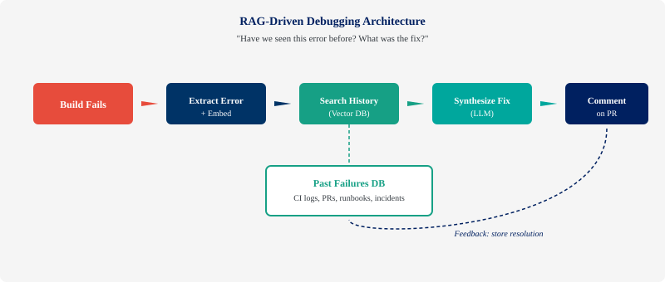
Pattern 4: RAG-Driven Debugging
18

Slide 20
Give Your Pipeline Memory
When a build fails, the first question is always: "Have we seen this before?"
RAG debugging answers that question with your actual history — not guesses.
1
Index
2
Embed
3
Search
4
Synthesize
Build a vector DB of past CI failures, PRs, runbooks, incident reports
When a failure occurs, extract the error + embed it as a query vector
Find similar past failures in your history — "this looks like PR #4521"
LLM reads the matches + proposes a fix, linking to past resolutions
This is the institutional memory most teams lose when people leave.
19

Slide 21
RAG Debug Pipeline Step
- name: RAG Debug Lookup
if: failure()
env:
PINECONE_KEY: ${{ secrets.PINECONE_KEY }}
run: |
# Extract error signature
ERROR=$(grep -A5 "Error:" build.log | head -10)
# Embed and search past failures
MATCHES=$(python rag_search.py \
--query "$ERROR" \
--index ci-failures \
--top-k 3)
# LLM synthesizes fix from matches
FIX=$(echo "$MATCHES" | claude -p \
"Based on these past failures and their
resolutions, suggest a fix for the
current error. Link to past PRs.")
gh pr comment $PR --body "## 🔍 RAG Debug
$FIX"
The power:
Your pipeline learns from every failure. The more it runs, the smarter it gets.
Vector DB sources:
Past CI logs
Resolved PRs
Incident reports
Runbook docs
Stack Overflow answers
Pattern sketch — not production hardening
20

Slide 22

Pattern 5: Risk Scoring
Not all changes are created equal. Why give every PR the same pipeline?
AI analyzes each change for risk:
Files touched — core logic vs. docs vs. config
Blast radius — how many services/users affected
Test coverage — new code with zero tests = high risk
Prior failure similarity — does this change resemble past incidents?
Change complexity — lines changed, cyclomatic complexity delta
High Risk
Full suite + security + manual gate
Medium Risk
Targeted tests + standard checks
Low Risk
Fast-track: smoke tests only
Teams report significant build time savings by focusing CI resources on high-risk changes.
Source: Enterprise CI/CD case studies, 2025
21

Slide 23
Risk-Based Pipeline Routing
- name: Calculate risk score
id: risk
run: |
SCORE=$(python risk_scorer.py \
--pr $PR_NUM \
--factors files,coverage,author,complexity)
echo "score=$SCORE" >> $GITHUB_OUTPUT
echo "level=$([ $SCORE -gt 7 ] && echo high \
|| ([ $SCORE -gt 3 ] && echo medium \
|| echo low))" >> $GITHUB_OUTPUT
- name: Full test suite (high risk only)
if: steps.risk.outputs.level == 'high'
run: pytest tests/ --full-suite
- name: Smoke tests (low risk)
if: steps.risk.outputs.level == 'low'
run: pytest tests/smoke/ --fast
Intelligent resource allocation:
Spend CI time where it matters most.
High-risk PRs get the full treatment. Low-risk docs changes don't wait 45 min for tests they don't need.
22

Slide 24
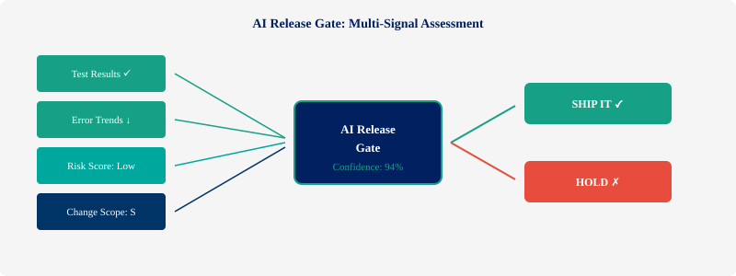
Pattern 6: AI-Powered Release Gates
"Ship or hold?" becomes a data-driven recommendation, not a gut feeling.
23

Slide 25
Multi-Signal Release Assessment
Traditional gates: binary pass/fail on tests + coverage threshold.
AI gates: multi-signal assessment across all available data.
Signal | Threshold | Current
Test pass rate | >= 99.5% | ✓ 99.8%
Error trend (24h) | Decreasing | ✓ -12%
Risk score | < 7/10 | ✓ 4/10
Change scope | < 500 lines | ✓ 127 lines
Security vulns | 0 critical | ✓ 0 found
Canary health | > 95% | ✓ 98.2%
Example policy output | 5/6 signals favorable | Confidence: HIGH — Recommend: SHIP
24

Slide 26
Release Gate Configuration
release_gate:
model: claude-sonnet-4-6
signals:
- test_results:
source: junit-results.xml
threshold: pass_rate >= 99.5
- error_trend:
source: datadog
window: 24h
threshold: trend == "decreasing"
- risk_score:
source: risk_scorer
threshold: score < 7
- security:
source: snyk
threshold: critical == 0
- canary:
source: launchdarkly
threshold: health >= 95
decision:
ship_if: all_pass AND confidence_band == HIGH
hold_if: any_critical_fail
escalate_if: confidence_band == MEDIUM
Declarative config
Define your signals and thresholds. The AI evaluates them as a whole — not just individual pass/fail, but the combination and context.
Pattern sketch — not production hardening
25

Slide 27
Where CAI Can Go Wrong
Failure modes every team should plan for
Hallucinated triage
False gate confidence
Secret leakage
AI misclassifies a real bug as a flaky test — team ignores a production issue
94% confidence score hides a critical edge case the model didn't evaluate
Logs and diffs sent to external AI contain tokens, keys, or internal architecture
Stale RAG data
Cost and latency
Autonomy creep
Knowledge base returns outdated fixes — bad historical data gets amplified
Model calls in hot CI paths add 30-60s per step — multiplied across all PRs
AI moves from advisory to auto-remediation without explicit governance approval
Mitigation: Start every AI step as advisory. Add guardrails before granting autonomy.
26

Slide 28
Guardrails Every CAI Pipeline Needs
The Autonomy Ladder
1
Advisory
2
Approval Assist
3
Enforced Gate
→
→
AI suggests, human decides. Start here.
AI recommends, human approves or overrides.
AI decides within policy bounds. Human override always available.
Essential Guardrails
Human override on every AI decision — always available, clearly surfaced
Audit trail — log every AI recommendation, confidence score, and outcome
Secret filtering — scrub tokens, keys, and PII before sending data to models
Latency budgets — set hard limits on model call time per pipeline step
Evaluation metrics — measure precision/recall of triage, track false positive rates
Rollback strategy — if the AI layer misbehaves, the pipeline still works without it
Deterministic first — use AI only where interpretation, synthesis, or ranking adds value
27

Slide 29
Common CAI Anti-Patterns
What not to do — lessons from failed implementations
🔓
🤖
🎯
Raw Logs to Public LLMs
Skip Advisory Mode
Trust Confidence Blindly
Sending unredacted build logs
(with secrets) to external APIs
Letting AI auto-remediate
before humans trust the outputs
Treating heuristic scores
as probabilistic truth
🌊
📦
Five Steps Before One
Uncurated RAG
Adding all AI patterns at once
instead of validating each
Using RAG without version tags,
recency weighting, or curation
If you recognize any of these in your current setup, fix them before adding more AI steps.
28

Slide 30
Safe Auto-Remediation for Known Failures
Constrained automation for failure classes with proven, repeatable fixes
🔄
Stale Docker Cache
Remediation Guardrails
Auto-clear + rebuild on known
cache-invalidation patterns
✅ Only for classified, repeatable failure types
✅ Rollback on remediation failure
✅ Audit trail: what was auto-fixed and why
✅ Human notification on every auto-action
✅ Max 1 auto-retry per failure per run
🔐
Expired Test Fixture
Regenerate from fixture template
when TTL exceeded
⚙️
Missing Staging Config
Pull from vault + inject when
non-secret env var absent
Autonomy Progression
🛡️
CVE Auto-Triage
Suggest fix → Auto-fix + notify → Auto-fix + audit only
Start left. Move right only with data.
Cluster vulns by reachability
and suppress known false positives
Constrained remediation pattern — start advisory, prove reliability, then automate
29

Slide 31
CAI in Action: One PR, Six Patterns
A developer pushes a risky config change to the payment service...
1
2
3
4
5
6
Test Synthesis
Build Fails
AI Classifies
Log Summary
RAG Finds Fix
Gate Holds
AI generates 12 edge-case tests for the config parser
→
3 new tests fail on an env variable mismatch
→
Failure type: config error. Severity: P2. Not flaky.
→
Posted to Slack: "Config KEY_VAULT_URL missing in staging"
→
Similar issue in PR #3847 — resolved by adding env to deploy manifest
→
Risk score 8/10. Release gate: HOLD. Dev fixes and re-runs.
Feedback loop: The resolved config fix enriches the RAG knowledge base. Next time, the fix is suggested instantly.
30

Slide 32
Putting It All Together The complete CAI pipeline — from commit to production

Slide 33

The Complete CAI Pipeline
Commit
Build
Test
Validate
Release
Deploy
AI Code Review
Vuln Detection
AI Deps Analysis
Risk Scoring
AI Test Synthesis
Failure Classification
Log Summarization
RAG Debug
AI Release Gate
Confidence Score
Canary Analysis
Auto-Rollback
Feedback Loop: every failure, fix, and deployment outcome feeds back into the system
The pipeline gets smarter over time — this is "continuous" in the truest sense.
32

Slide 34
The Feedback Loop
Every stage generates data that makes the next run smarter:
Failed tests → train the failure classifier
Resolved PRs → enrich the RAG debugging knowledge base
Deployment outcomes → refine the risk scoring model
Rollbacks → update release gate thresholds
This is what separates CAI from "AI in CI" — it's not a one-shot addition. It's a learning system that improves with every cycle.
33

Slide 35
The Smallest Useful CAI Stack
CI Runner
Redaction
Model Gateway
Vector Store
Policy Engine
Audit Log
GitHub Actions
GitLab CI
Jenkins
→
Strip secrets
Sanitize logs
Mask PII
→
Rate limits
Retry logic
Fallback rules
→
Past failures
Resolutions
Runbooks
→
Thresholds
Approval rules
Escalation
→
Every decision
Inputs + outputs
Override history
Human Approval Point Every AI decision flows through a human review gate. The stack above handles the plumbing — redaction, routing, caching, audit. Humans handle judgment.
Key decisions: Hosted API vs. private model | Log retention policy | Prompt versioning | Fallback when model unavailable | Data residency
Minimum infrastructure for production CAI | Not shown: secret redaction, cost controls, model fallback, timeout handling
34

Slide 36
A Minimal CAI Workflow in One Repo
What the file tree looks like when you put it all together
my-service/
├─ .github/workflows/
│ ├─ ci.yml # standard CI + AI steps
│ └─ release-gate.yml # multi-signal gate
├─ scripts/
│ ├─ redact_logs.py # strip secrets
│ ├─ classify_failure.py
│ ├─ summarize_log.py
│ └─ risk_scorer.py
├─ rag/
│ ├─ index_failure.py # ingest to vector DB
│ └─ query_similar.py # semantic search
├─ policy/
│ ├─ release_gate.yaml # thresholds + rules
│ └─ risk_weights.yaml # scoring config
└─ metrics/
└─ cai_dashboard.json # eval tracking
CI Workflow
GitHub Actions YAML with AI steps wired in as failure handlers
Scripts
Python CLI tools — each one is a single-purpose AI step
RAG Layer
Vector DB indexing + retrieval for institutional memory
Policy
Declarative YAML — version-controlled, auditable, reviewable
Metrics
Track triage time, summary accuracy, gate overrides
Everything here is a text file in your repo — no special infrastructure on day one
35

Slide 37
Where CAI Pays for Itself
Match AI investment to pipeline value — not every step needs a frontier model
CAI Task
Model Tier
Latency Budget
ROI Signal
Log Summarization
Small / Fast
Async OK
High — saves every developer minutes daily
Failure Classification
Small / Fast
< 30s
High — eliminates manual triage
RAG Debug Lookup
Embedding + retrieval
< 10s
Medium — compounds over time
Test Synthesis
Frontier model
Minutes OK
Medium — quality varies by codebase
Risk Scoring
Small model or heuristic
< 5s
High — immediate pipeline routing
Release Gate
Frontier (high-stakes)
< 60s
High — but only after trust is built
Start with high-ROI, low-cost tasks (log summarization, failure classification). Reserve frontier models for high-stakes decisions.
36

Slide 38
Real Tools for Real Pipelines
Buy mature tooling for standard stages | Build custom AI for your specific patterns
Pipeline Stage | Tools Available Today
Code Review | GitHub Copilot, Claude Code, Cursor, CodeRabbit
Testing | Mabl, BrowserStack, Cypress AI, Qodo, DiffBlue
Security | Snyk, Checkmarx, SonarQube AI, Semgrep
Feature Flags | LaunchDarkly, Split, Flagsmith
Custom AI Steps | OpenAI API, Anthropic API, Claude CLI
Monitoring | Datadog AI, New Relic AIOps, Grafana ML
Integration | MCP (Model Context Protocol) — leading standard
You don't need to build everything from scratch. The ecosystem is here.
37

Slide 39
Why CAI Needs a Standard Tool Interface
Model Context Protocol (MCP) is becoming a leading standard for connecting AI to enterprise tools.
Problem: Each AI step needs different data — code, logs, metrics, configs. Without a standard, you write custom integrations for every tool. MCP solves this with one protocol for all AI-to-tool connections.
Broad ecosystem support across major AI platforms | Adopted by Anthropic, OpenAI, Google, Microsoft
38

Slide 40
Getting Started:
The Monday Morning Plan
1
Log Summarization
Lowest effort, highest visibility. Start here.
Easy
2
Failure Classification
Add to your flakiest pipeline first.
Easy
3
RAG Debug Knowledge Base
Start indexing past failures today.
Medium
4
Risk Scoring
Even a simple heuristic beats treating all PRs the same.
Medium
5
AI Test Synthesis
Start with one project, one test type.
Medium
6
AI Release Gates
The capstone — build once you trust the signals.
Advanced
39

Slide 41
Don't Boil the Ocean
Pick one pattern. One pipeline. One team.
Get it working. Show the results. Let it spread.
The best CAI implementations start small and grow organically — not with a mandate from above.
40

Slide 42
How You Know CAI Is Helping
Triage Time
AI Summary Acceptance
Repeated Failures
Minutes from red build to root cause
% of summaries devs find accurate
Same failure seen > once before fix
↓ 50%+ from baseline
> 85% usefulness rating
↓ as RAG matures
Build Minutes Saved
Gate Override Rate
False Hold Rate
CI time avoided by risk routing
How often humans override AI rec
Safe releases flagged as risky
Track weekly, report monthly
< 10% = well-calibrated
Track + tune thresholds
Measure before you automate. Establish baselines in advisory mode, then track improvement as you mature.
Review these metrics quarterly. If numbers aren’t improving, the feedback loop is broken.
41

Slide 43
Five-Step Evaluation Methodology
Apply this loop to every CAI pattern before promoting from advisory to assisted
1
2
3
4
5
Baseline
Advisory Mode
Compare
Track
Promote
Measure your current process before turning on AI
→
Run AI in recommend mode — humans decide
→
Measure AI outcomes vs. human outcomes on same tasks
→
Monitor false positives and false negatives over time
→
Move to assisted mode only after measured trust
This five-step loop applies to every CAI pattern. Don’t skip steps — each one builds the trust data for the next.
43

Slide 44
Your CAI Adoption Path
Day 1
Log summaries
PR comments
Basic triage assist
Human-in-the-loop
Day 30
Failure classification
Dashboarding
Safe auto-remediation
Human-on-the-loop
Day 90
RAG memory
Policy-bounded gates
Risk-scored deploys
Human-over-the-loop
Start with the simplest win: summarize logs and comment on PRs. Prove value in week one.
Add classification and dashboards once you trust the summaries. Measure triage time reduction.
Graduate to retrieval memory and policy gates only after earning trust with data.
42

Slide 45
From CI/CD
to CI/CD + CAI
Your pipeline doesn't have to be dumb anymore.
Turn "AI in development" into Continuous AI.
Pick one pattern. Add one AI step to one pipeline. See what happens.
43

Slide 46
Questions?
44

Slide 47
That's all — thanks!
Brent Laster
Tech Skills Transformations LLC
Contact: training@getskillsnow.com
techskillstransformations.com
getskillsnow.com
Books by Brent Laster
Professional Git
Learning GitHub Copilot
Learning GitHub Actions
© 2026 Brent C. Laster & Tech Skills Transformations LLC
45

Slide 48
Three Levels of AI Integration
The progression from one-shot to closed-loop
1
AI in a Pipeline Single AI step, useful but doesn't get smarter
2
AI-Assisted CI/CD Multiple AI steps sharing context across stages
3
CAI: Closed-Loop Every outcome trains the system — continuous intelligence
The feedback loop is what makes it continuous
6b

Slide 49
Log Summarization: Before → After
Twenty minutes of setup. Highest visibility pattern.
Before
After
"Build #4521 failed" Useless notification. Open a 10,000-line log. Search manually.
"TypeScript compilation OOM on 847 files. Fix: increase runner to 8GB or split. Confidence: 94%" Actionable intelligence.
Always link back to the full raw log — summaries can miss secondary warnings
16b

Slide 50
Five Risk Scoring Factors
Every change gets the scrutiny it deserves — no more, no less
Files Touched Core logic = high; Docs = low
Blast Radius Services and users affected
Test Coverage Zero tests on new code = auto-flag
Failure Similarity Resembles past incidents?
Change Complexity Lines changed + cyclomatic delta
High risk → full suite + security + manual gate | Low risk → smoke tests, merged in minutes
21b

Slide 51
Six CAI Failure Modes
Know these before you deploy — every one is preventable
Hallucinated Triage AI misclassifies a real bug as flaky
False Gate Confidence Precise number that isn't omniscient
Secret Leakage Logs with API keys sent to models
Stale RAG Outdated fixes for old versions
Cost/Latency Creep Unchecked scaling of AI calls
Autonomy Creep Trust drifts until nobody reviews
Mitigation: human oversight + version-controlled boundaries + regular accuracy checks
26b

Slide 52
The Autonomy Ladder: Three Levels
Trust is earned through demonstrated reliability
1
Advisory
2
Approval Assist
3
Enforced Gate
AI recommends, human decides. Always start here. No exceptions.
AI auto-approves routine, escalates unusual. After weeks of proven reliability.
AI has decision authority. After months of accuracy. Only for well-understood, low-risk scenarios.
27b

Slide 53
Sarah's PR: Six Patterns Applied
One intelligent system — each component makes the others more effective
1
Test Synthesis Caught the edge case
2
Classification Diagnosed the failure
3
Summarization Communicated in 10 seconds
4
RAG Lookup Found the fix from 3 months ago
5
Risk Scoring Flagged the severity
6
Release Gate Shipped safely with human sign-off
30b

Slide 54
Six-Component CAI Stack
Two to three weeks for a basic pilot
CI Runner No changes — use what you have
Redaction Layer Build first, before anything touches a model
Model Gateway The difference between a demo and production
Vector Store The memory layer for RAG
Policy Engine Your guardrails in code
Audit Log Every AI decision recorded
Start with redaction + model gateway, layer in the rest as you mature
34b

Slide 55
Six CAI Metrics &amp; Targets
Start with just two: classifier precision and gate override rate
Triage Time Your headline metric
Build Minutes Saved Gets budget approval
AI Summary Acceptance Your quality indicator
Repeated Failures Feedback loop health
Gate Override Rate Trust barometer #1
False Hold Rate Trust barometer #2
These two numbers tell you if the system is earning trust or losing it
41b

Slide 56
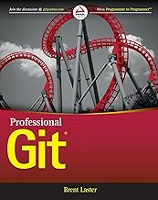
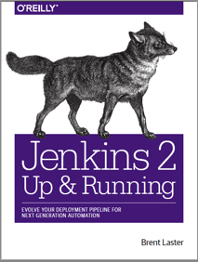


That’s all - thanks!
Contact: training@getskillsnow.com
techskillstransformations.com
getskillsnow.com

