Slide 1
Version 2.8 04/03/26

Slide 2



We're All Using AI, But We're Not Enjoying It
Presented by Brent Laster
Tech Skills Transformations LLC
© 2026 Brent C. Laster & Tech Skills Transformations LLC
All rights reserved

Slide 3

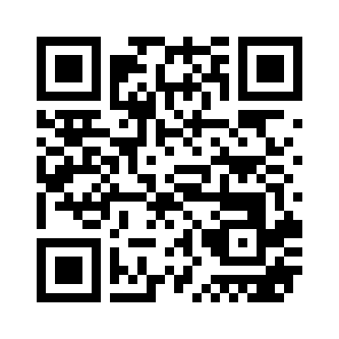

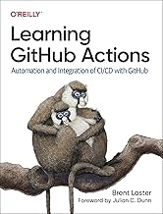
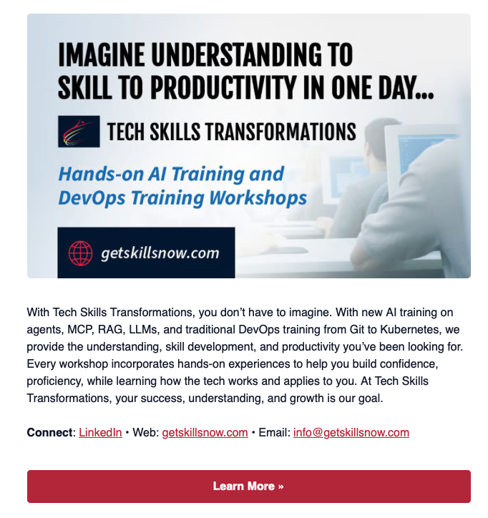
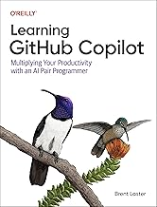
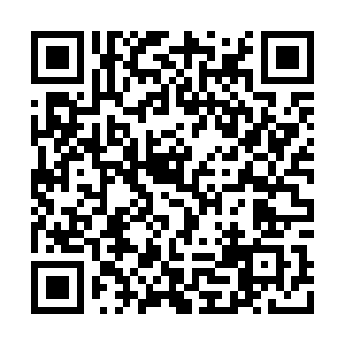
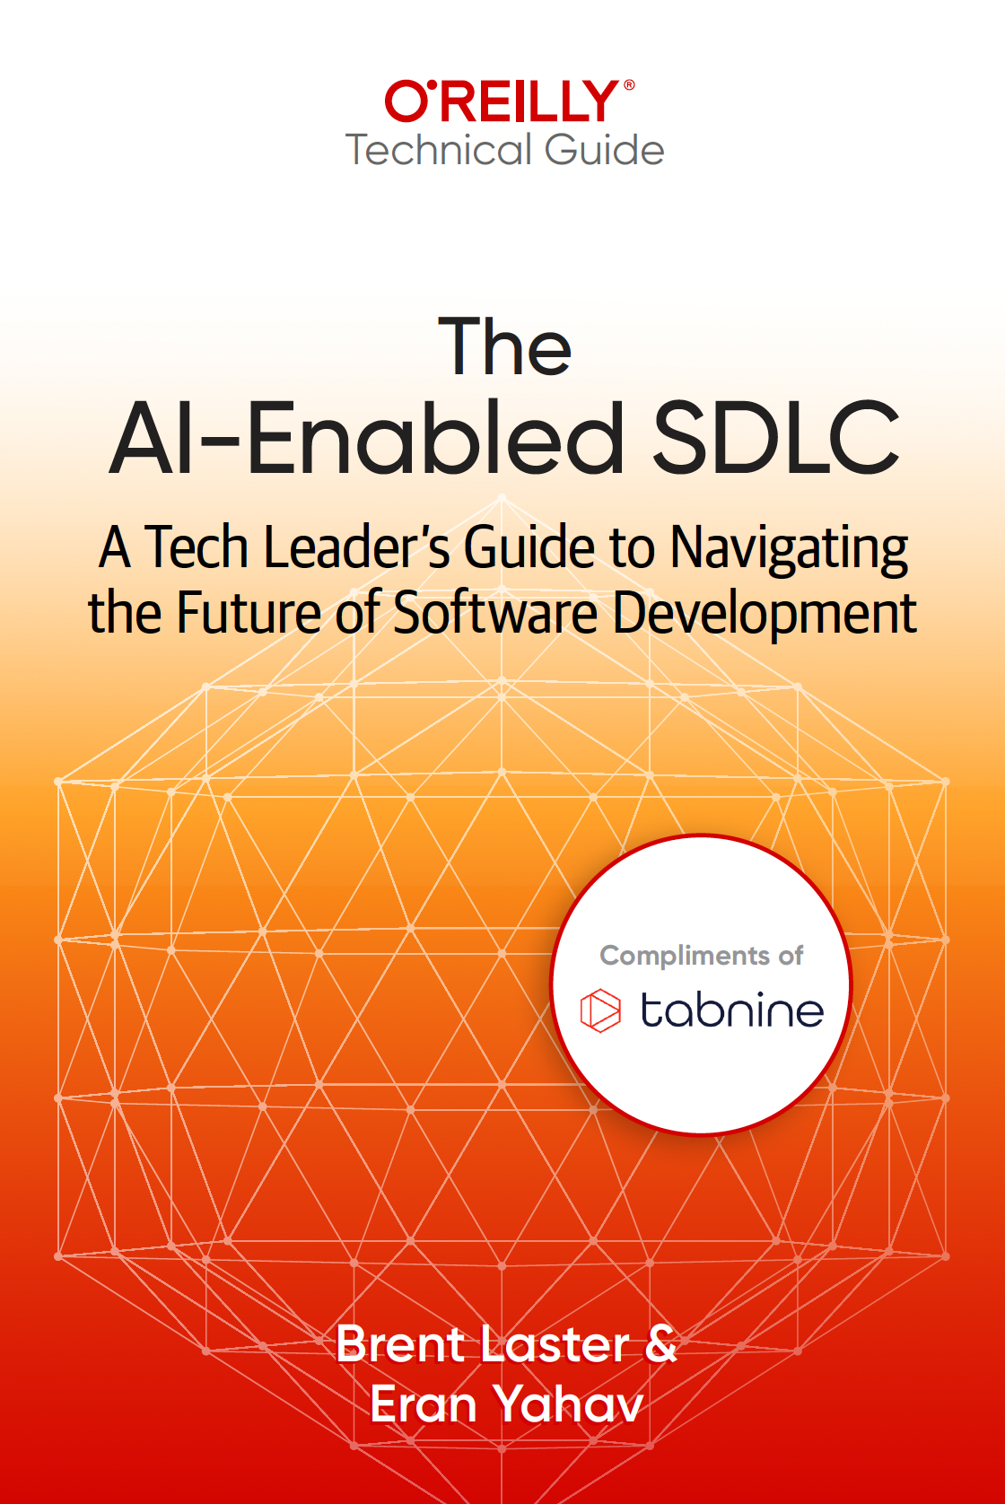
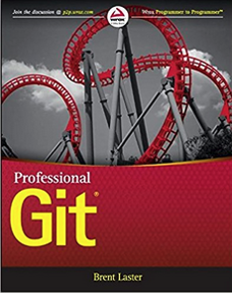
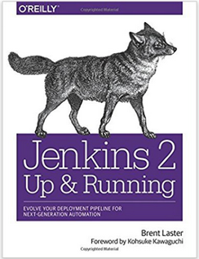



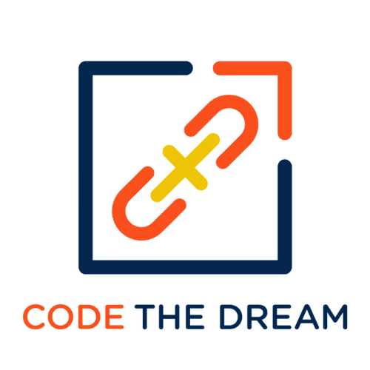


About me
Long career in corporate:
Principal Dev
Manager/Senior Manager
Director
Founder, Tech Skills Transformations LLC
https://getskillsnow.com
info@getskillsnow.com
LinkedIn: brentlaster
X: @BrentCLaster
Bluesky: brentclaster.bsky.social
GitHub: brentlaster

Slide 4
A Show of Hands
52%
But...
-18%
of employees now use AI
at work daily or weekly
drop in worker confidence
in using technology at work
That number is growing fast.
Sources: Qualtrics Employee Experience Trends, 2026 | ManpowerGroup Global Talent Barometer, 2026
3

Slide 5
The AI Productivity Paradox
~3 in 4
Only 1 in 3 developers trust
AI output accuracy;
46% actively distrust it
52% of workers more worried than hopeful about AI in their workplace
of executives report difficulty
scaling AI to repeatable ROI
Collaboration time increased notably. Focused work sessions fell 9% after AI adoption.
We're using it more. We're enjoying it less.
Sources: KPMG CEO Outlook, 2026 | Stack Overflow Developer Survey, 2025 | Pew Research Center, 2025 | ActivTrak, 2026
4

Slide 6
The Test That Passed
"You asked your AI copilot to write a unit test for your authentication module. It generated a beautiful test — correct syntax, proper assertions, good structure. It passed on the first run.
Three days later, a security review reveals the test never validated the actual edge case — the token expiry path. The AI tested the happy path perfectly and skipped the part that mattered.
Based on a pattern seen across engineering teams. That gap between looking right and being right is what this talk is about.
5

Slide 7
The Test Details
What the AI test covered:
• Token validation returns 200 for valid input
• Endpoint exists, HTTP structure correct
• Standard happy-path assertions
What it never touched:
• Expired tokens • Wrong issuer • Revoked sessions
• Application-specific threat model edge cases
“The code compiles” and “the code passes” aren’t the same as “the code is correct for this team.”
Correctness is application-specific — generic tests miss team-specific requirements.
5b

Slide 8
Why Does AI Feel So Hard? Five barriers between adoption and enjoyment

Slide 9





Five Barriers
Poorly Integrated
Tools
Unclear
Workflows
Unrealistic
Expectations
Cognitive
Overload
Pressure to
Keep Up
Let's look at each one.
7

Slide 10
Barrier 1: Too Many Tools, Not Enough Glue
5+
Efficiency tends to improve up to ~3 tools,
then
then switching costs outweigh gains
Result: Widespread "shadow AI" use when official tools are weak or slow
AI tools per team (observed pattern)
(often up from just a couple not long ago)
Every new tool means new mental models, new quirks, new limitations. The switching cost is real.
Sources: BCG/HBR, 2026 | Qualtrics, 2026
8

Slide 11
The Three-Tool Threshold
Operating heuristic: standardize on 2-3 primary tools and go deep rather than spreading thin.
Source: BCG/HBR, 2026 (illustrative)
9

Slide 12
The Engineer's AI Toolbox (Today)
1
IDE Copilot
The Overlap Problem
Inline completions
2
Chat Interface
3 of 5 tools generate code
2 of 5 summarize context
Each has its own interface
None share context with each other
Result: you're the integration layer
ChatGPT, Claude, Gemini
3
Code Search / RAG
Codebase Q&A
4
Review Assistant
PR review
5
Ticket Summarizer
JIRA/Linear summaries
Based on BCG/HBR 2026 observed patterns
10

Slide 13
Barrier 2: Nobody Told Us Where AI Fits
Most teams bolt AI onto existing workflows instead of redesigning for human+AI collaboration.
The result: a hammer looking for a nail.
Bolted On
Integrated
Old workflow + AI shoved in somewhere
AI used for tasks it's bad at
Tasks where AI excels get ignored
"Use AI for everything" mandate
Workflow redesigned for collaboration
AI handles what it's best at
Humans handle judgment and empathy
Clear roles for each player
11

Slide 14
Engineering Workflow: Three Realities
Traditional
Bolted-On AI
Human + AI
1. Read ticket
2. Design approach
3. Write code
4. Write tests
5. Submit PR
6. Address review
7. Deploy
1. Read ticket
2. Ask AI to design
3. AI writes code
4. AI writes tests
5. Manually verify ALL output
6. Re-prompt 3 times
7. Submit PR (finally)
1. Read ticket + feed context to AI
2. Design together (you lead)
3. AI drafts code, you review
4. AI drafts tests, you add edge cases
5. Submit PR with confidence
6. AI assists review response
7. Deploy
The middle column is where most teams are stuck. The right column is the goal.
12

Slide 15
Barrier 3: The Promise vs. The Reality
Many
The #1 Developer Frustration
"AI solutions that are almost right but not quite"
— 45% of developers (Stack Overflow, 2025)
"Almost right" is often worse than wrong — it looks correct, you trust it, and then it breaks downstream.
organizations still struggle to show
repeatable AI ROI beyond pilots
— MIT/Wharton research, 2025
Sources: MIT/Wharton GenAI ROI Study, 2025 | Stack Overflow Developer Survey, 2025
13

Slide 16
When AI Code Looks Right But Isn't
AI-Generated Code
def validate_token(token):
"""Validate JWT token."""
try:
payload = jwt.decode(
token, SECRET_KEY, algorithms=["HS256"]
)
return payload
except jwt.InvalidTokenError:
return None
# Looks correct. Passes linter.
# Missing: expiry check, issuer
# validation, audience scope
What app-specific checks are missing?
No expiry validation
No issuer check
No audience scope
No token revocation check
Illustrative pattern:
It compiled. It passed tests.
It shipped. A security review caught it.
"A gorgeous kitchen where none of the drawers open."
14

Slide 17
PR Summary — Looks Right But Isn’t
AI-generated PR summary:
“Refactored retry mechanism for improved clarity.”
What actually changed:
• Retry logic for payment processing
• Backoff delays modified
• Failure recovery path changed
The reviewer approved without reading the diff closely — because the summary made it sound safe.
It wasn’t wrong. It was incomplete.
The “almost right” problem at the process level — incomplete AI output passes the credibility threshold.
13b

Slide 18
Barrier 4: AI Brain Fry Is Real
1 in 7
Reported Impact (heavy AI users)
+14% mental effort
+12% mental fatigue
+19% information overload
+33% decision fatigue
Workers with brain fry are more likely to want to quit.
workers report mental fatigue
from AI tool usage
BCG/HBR "AI Brain Fry" study, 2026
Reported findings: BCG/HBR, March 2026
15

Slide 19
The Developer Brain Fry Cycle
1
2
3
4
Prompt
Inspect
Compare
Patch
Write detailed prompt with context
Read AI output line by line
Check against requirements
Fix what AI got wrong
5
6
7
Re-run
Re-validate
Context-Switch
Test the patched version
Did the fix break something else?
Now do it again for the next task
This cycle repeats for every AI interaction. Multiply by 10+ daily tasks.
16

Slide 20
Where the Time Actually Goes
BCG research on AI-heavy organizations:
• Collaboration time: +14%
• Focused work time: −11%
For an engineer, 11% of focused time = 3–4 hours/week.
That’s architecture time. Deep-thinking time.
The added collaboration: context-rebuilding, re-explaining, validating outputs, re-prompting.
A tool meant to save mental effort increases cognitive load when the verification tax exceeds the budget.
Source: BCG, 2024 — directional findings, not universal benchmarks.
15b

Slide 21
The Verification Tax
When reviewing AI output takes longer than creating it manually
Human Verification
AI Generation
~15 min
~2 min
Net time savings: negative
The tools multiply, but the deep-focus time shrinks.
15c

Slide 22
Quick Check
Which barrier is hitting
your team the hardest?
1. Tool Sprawl
2. Unclear Workflows
3. Unrealistic Expectations
4. Brain Fry / Overload
5. Pressure to Keep Up
17

Slide 23
Barrier 5: The Pressure to Keep Up
52% of US workers more worried than hopeful about AI at work
BCG: skill erosion is a top workforce concern as AI takes over routine tasks
Dev fear: "Am I falling behind my peers?"
Teams that lack AI training: lower usage, lower confidence, higher anxiety
But: Strong leadership support moves AI positivity from 15% → 55%
Sources: Pew Research Center, 2025 | BCG Global AI Report, 2025
18

Slide 24
Five Achievable Shifts Small changes that restore control, clarity, and even enjoyment

Slide 25





The Five Shifts
Better
Task Design
Lighter
Mental Models
Context-First
Prompting
Workflow
Pairing
Small
Guardrails
Let's make these concrete.
20

Slide 26
Each Shift Addresses a Barrier
1. Too Many Tools
Shift 1 (Right Jobs) + Shift 5 (Guardrails)
→
2. Unclear Workflows
Shift 1 (Right Jobs) + Shift 4 (Workflow Pairing)
→
3. Promise vs Reality
Shift 2 (Mental Models) + Shift 3 (Context-First)
→
4. Brain Fry
Shift 2 (Mental Models) + Shift 5 (Guardrails)
→
5. Pressure
Shift 5 (Guardrails, especially training)
→
21

Slide 27
Shift 1: Assign AI the Right Jobs
Not every task needs AI — and not every task that can use AI should.
The Delegation Test
Would you explain this task to a capable intern with no context?
If you wouldn't delegate it to an intern without a 20-minute briefing, don't delegate it to AI without providing that same context.
Good AI tasks: high-volume, pattern-based, first drafts, data synthesis, reformatting
Bad AI tasks: ambiguous judgment, empathy-heavy comms, novel strategy, anything politically sensitive
22

Slide 28
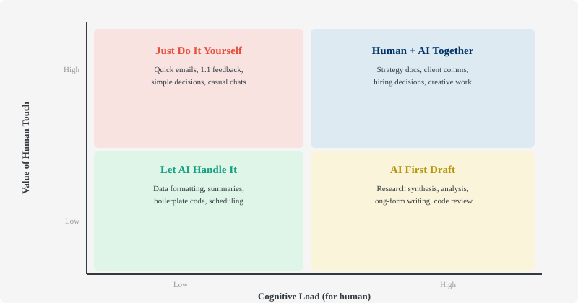
The Task Matrix
23

Slide 29



Know Your AI Sweet Spots
Scaffolding
Code Explanation
Pattern Work
Security Reviews
Architecture
Test stubs, CI/CD configs, API route boilerplate
Unfamiliar codebases, PR summaries, doc generation
Refactoring known patterns, migration stubs, regex
Auth logic, crypto, access control — human must lead
System design tradeoffs, performance tuning, tech debt
AI Sweet Spots Keep Human
24

Slide 30
Shift 2: Lighter Mental Models
You don't need to understand transformers to use AI well.
You need calibrated expectations.
The "Confident Intern" Model
Fast. Willing. Sometimes wrong. Always needs review. Great for first drafts, dangerous for final decisions.
Anti-pattern: Treating AI output as final.
Better pattern: AI as first draft, you as editor.
25

Slide 31
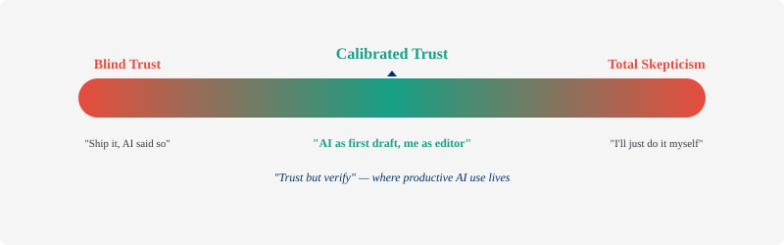
Finding the Trust Sweet Spot
When teams adopt calibrated trust, anxiety drops and adoption improves.
26

Slide 32
Shift 3: Context-First Prompting
Most prompting advice focuses on wording tricks. The real leverage is in context.
1
Context
2
Task
3
Constraints
What does the AI need to know?
Background, data, audience, constraints
What do you want it to do?
Be specific about the deliverable
What should it NOT do?
Format, tone, length, boundaries
"If the AI doesn't know what you mean, it's not dumb — it's under-informed."
27

Slide 33
Context Makes the Difference
Without Context
With Context
"Write unit tests for the
authentication module."
MODULE:
JWT auth (Python/Flask)
EDGE CASES:
Expired tokens, invalid issuer,
missing scopes, revoked sessions
FRAMEWORK:
pytest + fixtures
CONSTRAINT:
Each test one assertion
Result: Generic happy-path tests. Misses token expiry, role-based access, rate limiting, and session invalidation.
Result: Comprehensive test suite covering security edge cases. Ready with minimal edits.
3-4 rounds of re-prompting needed.
30 extra seconds of context saves 20 minutes of re-prompting.
28

Slide 34
Exercise: Spot the Missing Context
A developer sends this prompt. What context is missing?
"Refactor the database query in users.py to be faster.
It's running slow in production."
What's missing? (Think for 10 seconds...)
1. Current query + schema structure
4. Data volume (100 rows? 10M rows?)
2. Database engine (Postgres? MySQL? Mongo?)
5. Existing indexes and constraints
3. How slow? (100ms? 10s? What's acceptable?)
6. Read-heavy or write-heavy workload?
Without this context, the AI will suggest generic optimizations that may not apply to your specific case.
29

Slide 35
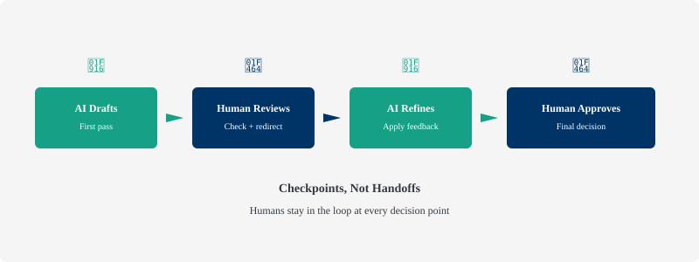
Shift 4: Workflow Pairing
Stop bolting AI onto old workflows. Redesign the workflow for collaboration.
30

Slide 36
Case Study: AI-Assisted Code Review
What Happened
What They Changed
Team enabled AI review on all PRs
AI approved PRs that looked clean
Subtle concurrency bug shipped
Human reviewers started rubber-stamping ("AI already checked it")
Review quality dropped significantly
AI reviews run first (catches formatting, basic issues)
Human reviews focus on logic, edge cases, architecture
AI flags areas of concern for human attention
For high-impact reviews: AI doesn't approve alone
Review quality improved markedly
Composite pattern from multiple teams. The fix: defining clear roles for human and AI.
31

Slide 37




Shift 5: Small But Meaningful Guardrails
Guardrails aren't about fear — they're about confidence.
The 3-Tool Rule
Time-Box It
AI-Free Time
Review Habit
Train People
Pick 3 tools. Master them. Drop the rest.
10 min max per AI attempt. Not helping? Stop.
Protect focus blocks with no AI interruption.
Never ship AI output unread.
5+ hours of hands-on training transforms confidence.
Sources: BCG/HBR, 2026 | BCG, 2025
32

Slide 38

Training Changes Everything
What "support" means:
5+ hours of hands-on AI training
Clear communication about roles
Picking fewer, better tools
Permission to say "AI isn't helping here"
15%
55%
AI positivity
without leadership
support
AI positivity
with strong leadership
support
Source: BCG AI at Work, 2025
33

Slide 39
When AI Actually Shines for Engineers
Boilerplate & Scaffolding
Config files, API route stubs, Dockerfile templates, CI/CD YAML. The stuff you've written 100 times. Let AI handle it.
Code Explanation & Docs
Understanding unfamiliar codebases, generating docstrings, writing README sections. AI excels at reading and summarizing.
Test Generation (with context)
When given proper context — schema, edge cases, framework — AI generates solid test foundations you can build on.
AI isn't the problem. Using AI for the wrong tasks is the problem.
34

Slide 40
Legacy System Example — AI as Documentation
New engineer joins. Legacy Java service: 10,000 lines, minimal docs, scattered authentication logic.
Traditional: 2 weeks reading code, asking questions, building a mental model.
AI-powered: Feed core auth classes to AI with context —
“Explain the authn/authz flow. Show entry points, middleware chain, where tokens are validated.”
Structured walkthrough in 30 minutes.
Not replacing the engineer. Giving them a head start.
AI as an index-builder — the engineer still does the thinking.
34b

Slide 41
Lead the Shift: Augmentation, Not Automation
Don't mandate AI adoption without support. Augment, don't automate. Here's how:
Train People
Pick Fewer Tools
Explain the Why
Invest in real, hands-on AI training. Not a 30-min webinar — structured, practical learning.
Standardize on 2-3 AI tools. Go deep instead of wide. Reduce switching costs.
Don't just deploy AI. Explain which tasks, which tools, what changes, and what stays human.
35

Slide 42
Your Sane Adoption Playbook
What to do this week:
1
Audit your AI tools
List every AI tool. Keep your best 3.
2
Pick one workflow to redesign
Where does AI create friction? Redesign with clear roles.
3
Define your red-zone tasks
Where should AI NOT lead? Security, architecture, sensitive comms.
4
Require one human review checkpoint
One person reads every AI output before it ships. No exceptions.
5
Schedule 5 hours of real training
Hands-on, structured, with your actual tools.
36

Slide 43
Using AI AND
Enjoying It
The goal isn't more AI.
The goal is less friction.
AI feels good when you give it the right work.
Pick one workflow this week. Redesign it using the five shifts. See how it feels.
37

Slide 44
Questions?
38

Slide 45
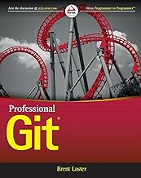
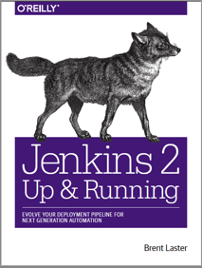

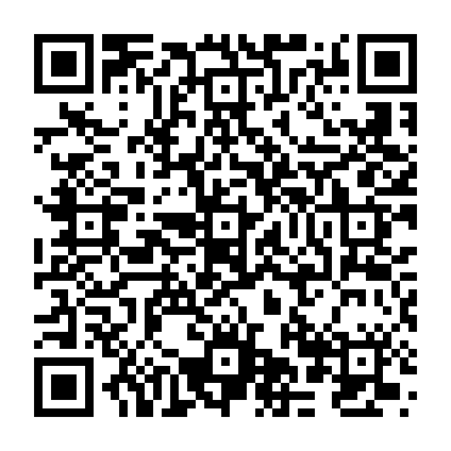
That’s all - thanks!
Contact: training@getskillsnow.com
techskillstransformations.com
getskillsnow.com

