Slide 1
Version 2.14
04/16/26

Slide 2




CI/CD in the Age of CAI
Presented by Brent Laster
Tech Skills Transformations LLC
© 2026 Brent C. Laster & Tech Skills Transformations LLC
All rights reserved

Slide 3



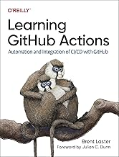

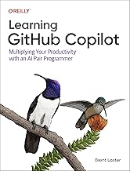

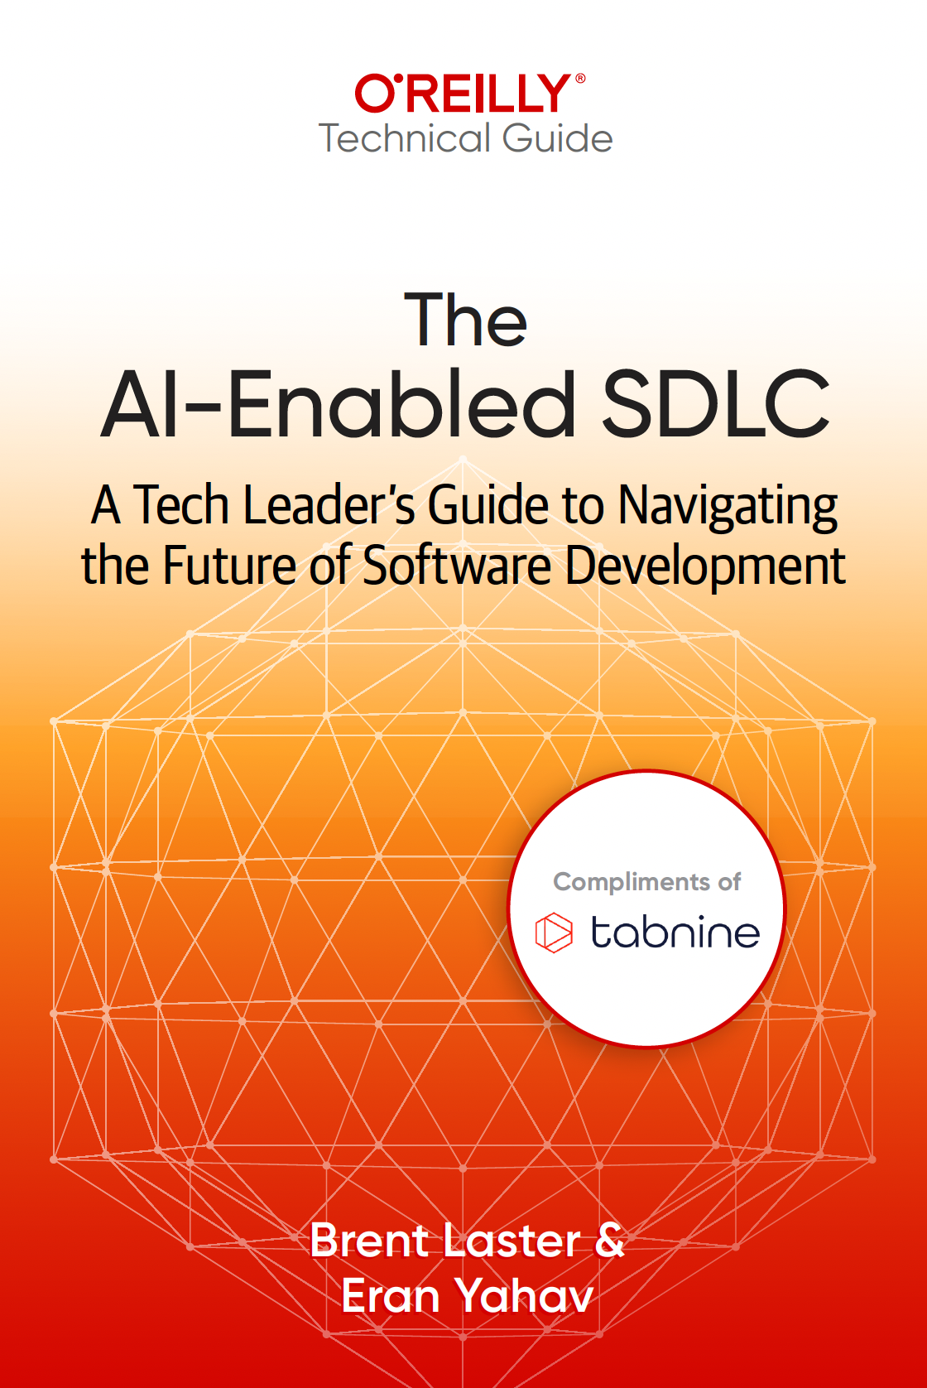
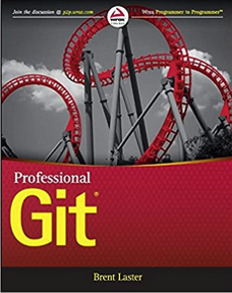
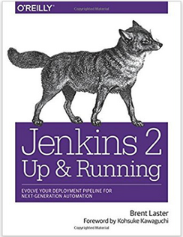






About me
Long career in corporate:
Principal Dev
Manager/Senior Manager
Director
Founder, Tech Skills Transformations LLC
https://getskillsnow.com
info@getskillsnow.com
LinkedIn: brentlaster
X: @BrentCLaster
Bluesky: brentclaster.bsky.social
GitHub: brentlaster

Slide 4
Your Pipeline Is Still Dumb
Today's CI/CD pipelines:
Build → Test → Pass/Fail → Deploy or Don't
Binary. No reasoning. No learning. No memory.
Meanwhile, developers are using AI for code gen, testing, docs — but the pipeline itself hasn't learned a thing.
The CI/CD pipeline is the natural home for AI — it already touches every stage of delivery.

Slide 5
The 40-Minute Cache Hunt
A scenario that plays out constantly across the industry
Late Tuesday. A PR gets merged. CI fails with a misleading timeout error.
2 developers. 40 minutes. Combing through logs.
Root cause: a stale Docker cache. Something that had happened before. Been fixed before. But nobody remembered.
A system with memory would have solved it in seconds.
Up to 15% of all CI failures are cache-related before proper caching strategies
Source: techbuddies.io CI cache case study

Slide 6
Here’s My Thesis
The CI/CD pipeline is the natural home for AI.
Why?
Structured data: logs, test results, metrics, diffs. • Deterministic, repeatable runs.
The perfect place to embed automated reasoning and continuous improvement.
For the next 75 minutes, I’ll show you exactly what I mean.

Slide 7
From CI/CD to CI/CD + CAI
CI/CD Today
CI/CD + CAI
Build → Test → Deploy
Automated but unintelligent
Same pipeline for every change
No reasoning, no adaptation
Build → AI Analysis → Test → AI Triage → Deploy → AI Release Gates
Adds a reasoning layer
Adapts to each change
Captures signal from every run
AI coding assistants boost output 21%, but organizational delivery gains require pipeline intelligence.
Source: DORA State of AI-Assisted Software Development, 2025

Slide 8
The DORA Signal: Why CAI Matters Now
Developer output is up. Organizational delivery is flat.
+21%
~0%
Individual output
Developers completed 21% more tasks with AI coding assistants
Delivery throughput
Organizational delivery metrics stayed essentially flat
AI speeds up code creation. The bottleneck shifts downstream — to delivery.
Source: DORA 2025 State of AI-Assisted Software Development

Slide 9
The CAI Adoption Gap
Plan vs. Do — a 5-to-1 gap between intention and execution
75%
16%
Plan to use AI in CI/CD
of development teams
Actually doing it today
in production pipelines
The gap between aspiration and adoption is what this talk is about.
Source: JetBrains 2025 Developer Survey

Slide 10
What Early Adopters Are Reporting*
Up to 80%
21%
98%
25-40%
cycle time reduction (reported
in specific contexts)*
more tasks completed
with AI coding assistants
more PRs merged
with AI assistants (DORA)
MTTR reduction with
AIOps (enterprise case studies)
Reported results from reviewed literature and case studies — directional examples, not universal benchmarks | Sources: DORA 2025, MDPI 2025, Enterprise AIOps

Slide 11
What Is Continuous AI?
A practical framing for AI-augmented delivery systems
Continuous AI is the use of AI inside software delivery workflows to continuously analyze changes, adapt validation, improve triage, and learn from outcomes across repeated pipeline runs.
A working pattern name for this talk, not a formal industry standard.

Slide 12
Three CAI Learning Mechanisms
How your pipeline gets smarter over time
1
Inference-Only
AI analyzes fresh each time
with no memory of past runs
2
Retrieval-Updated
RAG knowledge base grows with
every resolved failure — better
context over time
3
Policy-Refined
Thresholds and gate parameters
adjust based on actual deployment
outcomes
Most teams start inference-only and add the others as they mature
† Policy-refined: aspirational — no published production implementations as of 2025. Most teams operate at inference-only or retrieval-updated.

Slide 13

The Levels of AI Integration
The progression from one-shot to closed-loop
1
AI in a Pipeline
A single AI step. Useful, but static — it doesn't get smarter over time.
Ex: A code review bot running the same prompt on every PR
2
AI-Assisted CI/CD
Multiple AI steps sharing context. Steps are connected & aware of each other.
Ex: Test generator informs failure classifier; risk scorer drives release gate
3
CAI: Closed-Loop
Every outcome trains the system — continuous intelligence.
Ex: Failed tests improve classifier. Resolved PRs enrich knowledge base.
FEEDBACK LOOP

Slide 14
Where AI Fits in the Pipeline
Traditional CI/CD Pipeline
+ Continuous AI Integration Points
Code
Build
Test
Security
Stage
Release
AI Review
AI Deps
AI Synthesis
AI Triage
AI Validate
AI Gates
Pipeline Stage
AI Enhancement
Seven integration points — each one is an opportunity to add intelligence.

Slide 15







Seven AI Integration Points
Code
AI code review, style checks, vulnerability detection
Build
AI dependency analysis, compatibility prediction
Test
AI test synthesis, intelligent selection, self-healing
Security
AI vulnerability triage, risk prioritization
Stage
AI validation, log summarization, canary analysis
Release
AI release gates, risk-based deployment decisions
Monitor
AI anomaly detection, auto-remediation, feedback

Slide 16
A Running Scenario
Sarah submits a PR to update database connection pooling
Pool size: 50 → 200 | Timeout: 30s → 60s
Core infrastructure code that every microservice depends on.
In a traditional pipeline, this gets the same treatment as everything else.
In a CAI pipeline, every pattern touches this PR differently.
We’ll follow Sarah’s PR through all six patterns.

Slide 17
Six Patterns for Continuous AI
(Includes some practical/current and some aspirational/under development)

Slide 18
Pattern 1: AI-Assisted Test Synthesis
Let AI write the tests you're not writing.
Traditional: developers write tests manually → coverage gaps everywhere
AI test synthesis: analyze code changes, generate targeted tests
Test intelligence: only run tests impacted by the change → up to 80% cycle time reduction*
Self-healing tests: detect UI/env changes, auto-repair broken scripts → significant maintenance reduction*
Reported in specific contexts — directional, not universal | Source: MDPI CI/CD Optimization Study, 2025 | Priceline/Mabl: 80K monthly test runs, 85% maintenance reduction

Slide 19
Sarah’s Test Case Outcome
AI-generated tests for Sarah’s pool-size PR: pool 50→200, timeout 30s→60s
1. Connection-timeout edge case — Probes both sides of the new 60s boundary: idle connection at 59s vs. 61s.
2. Pool exhaustion under concurrent load — Simulates 250 concurrent requests against a 200-connection pool.
3. Configuration validation ★ — Pool size vs. driver max. This is the test that catches the exact failure a human wouldn’t have written.
The AI thinks of the edge cases you don’t — consistently, on every PR.

Slide 20
AI Test Synthesis in GitHub Actions
name: AI Test Synthesis
on: [pull_request]
jobs:
ai-tests:
runs-on: ubuntu-latest
steps:
- uses: actions/checkout@v4
- name: Get changed files
id: diff
run: |
git diff --name-only origin/main > changed.txt
- name: AI generates tests
run: |
cat changed.txt | ai-test-gen \
--model claude-sonnet \
--context ./src \
--output ./tests/generated/
- name: Run all tests
run: pytest tests/ --tb=short
How it works:
1. PR triggers workflow
2. Diff identifies changed files
3. AI analyzes changes + codebase context
4. Generates targeted test cases for new/modified code
5. Runs full suite including generated tests
Pattern sketch — not production hardening

Slide 21

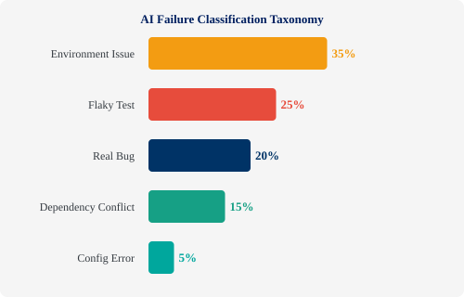
Pattern 2: Intelligent Failure Classification
Stop manually triaging build failures.
AI classifies every failure:
Type: env, flaky, real bug, deps, config
Severity: P0-P4 auto-assignment
Root cause: grouped + linked
MTTR: 30-50% faster
LogSage (2025): LLM-based framework for CI/CD failure detection + remediation
Case-study ranges — results vary by context | Sources: DevOps.com, 2025 | arXiv (LogSage), 2025 | LogSage/ByteDance: 1.07M CI executions, 80%+ precision (2025)

Slide 22
Failure Triage: Before & After
Before (Manual)
After (AI Triage)
1. Build fails
2. Dev reads 10,000-line log
3. Googles error message
4. Figures out: env issue
5. Restarts pipeline manually
Time: 30-60 minutes
1. Build fails
2. AI reads full log in seconds
3. Classifies: "env issue — Docker image cache stale"
4. Auto-restarts with cache clear
5. Comments on PR with summary
Time: 2-3 minutes

Slide 23
Failure Classification: Code
- name: AI Failure Classification
if: failure()
run: |
# Extract last 500 lines of log
tail -500 build.log > failure.txt
# AI classifies the failure
RESULT=$(curl -s https://api.anthropic.com/v1/messages \
-H "x-api-key: ${{ secrets.CLAUDE_KEY }}" \
-d '{
"model": "claude-sonnet-4-6",
"messages": [{
"role": "user",
"content": "Classify this CI failure.
Categories: env|flaky|bug|deps|config
Output JSON: {type, severity, summary,
suggested_action}\n'"$(cat failure.txt)"'"
}]
}')
# Post to PR as comment
gh pr comment $PR --body "$RESULT"
Key points:
Runs only on failure
Extracts relevant log tail
LLM classifies with structured JSON
Posts result as PR comment
Could also auto-retry for env issues
Pattern sketch — not production hardening

Slide 24

Pattern 3: Automated Log Summarization
Before
After (AI Summary)
[2026-03-17 14:23:01] npm WARN
[2026-03-17 14:23:01] npm WARN
[...10,847 more lines...]
[2026-03-17 14:28:15] Error:
ENOMEM: not enough memory
[2026-03-17 14:28:15] Build failed
Build failed: out of memory
Root cause: Node process exceeded
4GB limit during TypeScript
compilation of 847 files.
Fix: Increase runner memory or
split compilation into chunks.
Developer spends 15-30 min reading logs
3-sentence summary in 5 seconds

Slide 25
Log Summarization: Before → After
Twenty minutes of setup. Highest visibility pattern.
Before
After
"Build #4521 failed"
Useless notification.
Open a 10,000-line log.
Search manually.
"TypeScript compilation OOM
on 847 files. Fix: increase
runner to 8GB or split.
Confidence: 94%"
Actionable intelligence.

Slide 26
Sarah’s Phone: What the Team Sees
Sarah’s build fails. Here’s the Slack message — imagine reading it on your phone.
#eng-ci-alerts
CI Bot APP 9:47 PM
⚠ Build failed — PR #5032 (Sarah Chen)
Root cause: connection pool size 200 exceeds async driver max of 150.
Suggested fix: reduce pool size to 150 or switch to async driver config.
Confidence: 94%
Full log → build-4521.log
👍 4 🙏 2 👉 1 thread reply
Nobody opened a log. Nobody context-switched. Everyone knows what happened and what to do.

Slide 27
Testimonial: Log RCA with AI
“
I had a customer with a large multi-node HA Postgres cluster that was having some intermittent issues that were generating errors in the logs. Sometimes, after restart the issues would go away. They sent me a dump of all of the logs across all nodes both before and after restart of the cluster. If I were to manually review all of the logs and attempt to track behavior across all nodes for the time period in question to make a root cause determination and remediation suggestion it would have taken me the better part of a week.
Instead, I used an AI skill that I had created that specialized in Postgres and other ancillary apps to do a root cause analysis. I then used a peer to review its findings. The end result is that within an hour I had emailed the customer with a detailed, vetted explanation explaining what happened, why it happened and how to fix it. Thus saving me dozens of hours of work.
“within an hour I had emailed the customer with a detailed, vetted explanation… saving me dozens of hours of work.”

Slide 28
Log Summarization + Slack Notification
- name: Summarize failure
if: failure()
run: |
SUMMARY=$(cat build.log | tail -200 | \
claude --model sonnet -p "Summarize this
CI failure in 3 sentences: root cause,
impact, suggested fix. Be specific.")
# Post to Slack
curl -X POST $SLACK_WEBHOOK \
-d "{\"text\": \"🔴 Build #$RUN failed\n
$SUMMARY\"}"
# Also comment on PR
gh pr comment $PR_NUM \
--body "## AI Build Summary\n$SUMMARY"
Lowest effort, highest visibility win.
This is the #1 pattern I recommend starting with. It's:
Simple to implement
Immediately visible to the team
Saves real time every day
Builds trust in AI pipeline steps

Slide 29
Your First Win: Start Here, Then Scale
Log summarization is the pattern to start with — and the pitch to fund the rest
Why this one first?
• 20 minutes to a working proof-of-concept.
• Immediately visible to the whole team.
• Saves real time every single day.
• Builds trust in AI pipeline steps before you add more.
When the team sees accurate summaries, they ask for more.
The VP Pitch
✗ Don’t say:
“I need six months and a team of five for an AI-powered autonomous deployment system.”
✓ Say:
“I added a thing to Slack that tells us why builds fail in plain English. It took me a day.”
Then watch them come back asking for more.
Fund a CAI program one undeniable win at a time.

Slide 30

Pattern 4: RAG-Driven Debugging
RAG-Driven Debugging Pipeline
Have we seen this error before? What was the fix?
1
2
3
4
5
Build Fails
Extract Error
+ Embed
Search History
LLM Suggests Fix
Comment on PR
Past Failures DB
CI logs, PRs, runbooks, incidents
Feedback: store resolution
Source Trust — Weight Your Own History Higher Than Public Sources
Tier 1 ● Highest weight
Resolved PRs, runbooks, incident reports, commit messages
Tier 2 ● Medium weight
Internal wikis, ADRs, team docs, onboarding guides
Tier 3 ● Lowest weight, tagged
Stack Overflow, public blog posts, LLM general knowledge

Slide 31
Give Your Pipeline Memory
When a build fails, the first question is always: "Have we seen this before?"
RAG debugging answers that question with your actual history — not guesses.
1
Index
2
Embed
3
Search
4
Synthesize
Build a vector DB of past CI failures, PRs, runbooks, incident reports
When a failure occurs, extract the error + embed it as a query vector
Find similar past failures in your history — "this looks like PR #4521"
LLM reads the matches + proposes a fix, linking to past resolutions
This is the institutional memory most teams lose when people leave.
† Emerging pattern — building blocks (vector DBs, embeddings, CI logs) are mature; no published end-to-end CI/CD production case studies as of 2025.

Slide 32
RAG Debug Pipeline Step
- name: RAG Debug Lookup
if: failure()
env:
PINECONE_KEY: ${{ secrets.PINECONE_KEY }}
run: |
# Extract error signature
ERROR=$(grep -A5 "Error:" build.log | head -10)
# Embed and search past failures
MATCHES=$(python rag_search.py \
--query "$ERROR" \
--index ci-failures \
--top-k 3)
# LLM synthesizes fix from matches
FIX=$(echo "$MATCHES" | claude -p \
"Based on these past failures and their
resolutions, suggest a fix for the
current error. Link to past PRs.")
gh pr comment $PR --body "## 🔍 RAG Debug
$FIX"
The power:
Your pipeline learns from every failure. The more it runs, the smarter it gets.
Vector DB sources:
Past CI logs
Resolved PRs
Incident reports
Runbook docs
Stack Overflow answers
Pattern sketch — not production hardening

Slide 33

Pattern 5: Risk Scoring
Not all changes are created equal. Why give every PR the same pipeline?
AI analyzes each change for risk:
Files touched — core logic vs. docs vs. config
Blast radius — how many services/users affected
Test coverage — new code with zero tests = high risk
Prior failure similarity — does this change resemble past incidents?
Change complexity — lines changed, cyclomatic complexity delta
High Risk
Full suite + security + manual gate
Medium Risk
Targeted tests + standard checks
Low Risk
Fast-track: smoke tests only
Teams report significant build time savings by focusing CI resources on high-risk changes. | Meta DRS (internal, metrics unpublished). Most implementations are heuristic-based.
Source: Enterprise CI/CD case studies, 2025

Slide 34
Two PRs, Two Treatments
Risk scoring turns one pipeline into the right pipeline for each change
Sarah’s PR: DB pool config
Other PR: README typo fix
Risk: 8/10
Risk: 1/10
Signals:
• Core infrastructure file
• High blast radius — every service
• Matches prior production incidents
Treatment: full test suite + security scan + manual approval.
Signals:
• Docs-only path
• No runtime blast radius
• No historical failure pattern
Treatment: smoke tests only. Merged in 3 minutes.
Every change gets the scrutiny it deserves — no more, no less.

Slide 35
Five Risk Scoring Factors
Every change gets the scrutiny it deserves — no more, no less
Files Touched
Core logic = high;
Docs = low
Blast Radius
Services and users
affected
Test Coverage
Zero tests on new
code = auto-flag
Failure Similarity
Resembles past
incidents?
Change Complexity
Lines changed +
cyclomatic delta
High risk → full suite + security + manual gate | Low risk → smoke tests, merged in minutes

Slide 36
Risk-Based Pipeline Routing
- name: Calculate risk score
id: risk
run: |
SCORE=$(python risk_scorer.py \
--pr $PR_NUM \
--factors files,coverage,author,complexity)
echo "score=$SCORE" >> $GITHUB_OUTPUT
echo "level=$([ $SCORE -gt 7 ] && echo high \
|| ([ $SCORE -gt 3 ] && echo medium \
|| echo low))" >> $GITHUB_OUTPUT
- name: Full test suite (high risk only)
if: steps.risk.outputs.level == 'high'
run: pytest tests/ --full-suite
- name: Smoke tests (low risk)
if: steps.risk.outputs.level == 'low'
run: pytest tests/smoke/ --fast
Intelligent resource allocation:
Spend CI time where it matters most.
High-risk PRs get the full treatment. Low-risk docs changes don't wait 45 min for tests they don't need.

Slide 37
Pattern 6: AI-Powered Release Gates
Risk Score: Low
Change Scope: Small
AI Release Gate
Confidence: 94%
SHIP IT ✓
Test Coverage: 92%
HOLD ✗
Complexity: Medium
Rollback Plan: Ready
"Ship or hold?" becomes a data-driven recommendation, not a gut feeling.
† Most aspirational pattern in this talk — vendors announced AI-assisted gates but no published adoption metrics. Start advisory.

Slide 38
Multi-Signal Release Assessment
Traditional gates: binary pass/fail on tests + coverage threshold.
AI gates: multi-signal assessment across all available data.
Signal | Threshold | Current
Test pass rate | >= 99.5% | ✓ 99.8%
Error trend (24h) | Decreasing | ✓ -12%
Risk score | < 7/10 | ✓ 4/10
Change scope | < 500 lines | ✓ 127 lines
Security vulns | 0 critical | ✓ 0 found
Canary health | > 95% | ✓ 98.2%
Example policy output | 5/6 signals favorable | Confidence: HIGH — Recommend: SHIP

Slide 39
Release Gate Configuration
release_gate:
model: claude-sonnet-4-6
signals:
- test_results:
source: junit-results.xml
threshold: pass_rate >= 99.5
- error_trend:
source: datadog
window: 24h
threshold: trend == "decreasing"
- risk_score:
source: risk_scorer
threshold: score < 7
- security:
source: snyk
threshold: critical == 0
- canary:
source: launchdarkly
threshold: health >= 95
decision:
ship_if: all_pass AND confidence_band == HIGH
hold_if: any_critical_fail
escalate_if: confidence_band == MEDIUM
Declarative config
Define your signals and thresholds. The AI evaluates them as a whole — not just individual pass/fail, but the combination and context.
Pattern sketch — not production hardening

Slide 40
Where CAI Can Go Wrong
Failure modes every team should plan for
Hallucinated triage
False gate confidence
Secret leakage
AI misclassifies a real bug as a flaky test — team ignores a production issue
94% confidence score hides a critical edge case the model didn't evaluate
Logs and diffs sent to external AI contain tokens, keys, or internal architecture
Stale RAG data
Cost and latency
Autonomy creep
Knowledge base returns outdated fixes — bad historical data gets amplified
Model calls in hot CI paths add 30-60s per step — multiplied across all PRs
AI moves from advisory to auto-remediation without explicit governance approval
Mitigation: Start every AI step as advisory. Add guardrails before granting autonomy.

Slide 41
Guardrails Every CAI Pipeline Needs
The Autonomy Ladder
1
Advisory
2
Approval Assist
3
Enforced Gate
→
→
AI suggests, human decides. Start here.
AI recommends, human approves or overrides.
AI decides within policy bounds. Human override always available.
Essential Guardrails
Human override on every AI decision — always available, clearly surfaced
Audit trail — log every AI recommendation, confidence score, and outcome
Secret filtering — scrub tokens, keys, and PII before sending data to models
Latency budgets — set hard limits on model call time per pipeline step
Evaluation metrics — measure precision/recall of triage, track false positive rates
Rollback strategy — if the AI layer misbehaves, the pipeline still works without it
Deterministic first — use AI only where interpretation, synthesis, or ranking adds value

Slide 42
Common CAI Anti-Patterns
What not to do — lessons from failed implementations
🔓
🤖
🎯
Raw Logs to Public LLMs
Skip Advisory Mode
Trust Confidence Blindly
Sending unredacted build logs
(with secrets) to external APIs
Letting AI auto-remediate
before humans trust the outputs
Treating heuristic scores
as probabilistic truth
🌊
📦
Five Steps Before One
Uncurated RAG
Adding all AI patterns at once
instead of validating each
Using RAG without version tags,
recency weighting, or curation
If you recognize any of these in your current setup, fix them before adding more AI steps.
28

Slide 43
Sarah's PR: Six Patterns Applied
One intelligent system — each component makes the others more effective
1
Test Synthesis
Caught the
edge case
2
Classification
Diagnosed
the failure
3
Summarization
Communicated
in 10 seconds
4
RAG Lookup
Found the fix
from 3 months ago
5
Risk Scoring
Flagged the
severity
6
Release Gate
Shipped safely
with human sign-off
† Patterns 1–3 have published production case studies. Patterns 4–6 are architecturally sound with available tooling but earlier in production adoption.

Slide 44
CAI in Action: One PR, Six Patterns
A developer pushes a risky config change to the payment service...
1
2
3
4
5
6
Test Synthesis
Build Fails
AI Classifies
Log Summary
RAG Finds Fix
Gate Holds
AI generates 12 edge-case tests for the config parser
→
3 new tests fail on an env variable mismatch
→
Failure type: config error. Severity: P2. Not flaky.
→
Posted to Slack: "Config KEY_VAULT_URL missing in staging"
→
Similar issue in PR #3847 — resolved by adding env to deploy manifest
→
Risk score 8/10. Release gate: HOLD. Dev fixes and re-runs.
Feedback loop: The resolved config fix enriches the RAG knowledge base. Next time, the fix is suggested instantly.

Slide 45
Putting It All Together The complete CAI pipeline — from commit to production

Slide 46

The Complete CAI Pipeline
Commit
Build
Test
Validate
Release
Deploy
AI Code Review
Vuln Detection
AI Deps Analysis
Risk Scoring
AI Test Synthesis
Failure Classification
Log Summarization
RAG Debug
AI Release Gate
Confidence Score
Canary Analysis
Auto-Rollback
Feedback Loop: every failure, fix, and deployment outcome feeds back into the system
The pipeline gets smarter over time — this is "continuous" in the truest sense.
† Full architecture is the destination — no published case studies of all six layers running together in production. Build incrementally.

Slide 47
The Feedback Loop
Every stage generates data that makes the next run smarter:
Failed tests → train the failure classifier
Resolved PRs → enrich the RAG debugging knowledge base
Deployment outcomes → refine the risk scoring model
Rollbacks → update release gate thresholds
This is what separates CAI from "AI in CI" — it's not a one-shot addition. It's a learning system that improves with every cycle.
33

Slide 48
The Smallest Useful CAI Stack
CI Runner
Redaction
Model Gateway
Vector Store
Policy Engine
Audit Log
GitHub Actions
GitLab CI
Jenkins
→
Strip secrets
Sanitize logs
Mask PII
→
Rate limits
Retry logic
Fallback rules
→
Past failures
Resolutions
Runbooks
→
Thresholds
Approval rules
Escalation
→
Every decision
Inputs + outputs
Override history
Human Approval Point Every AI decision flows through a human review gate. The stack above handles the plumbing — redaction, routing, caching, audit. Humans handle judgment.
Key decisions: Hosted API vs. private model | Log retention policy | Prompt versioning | Fallback when model unavailable | Data residency
Minimum infrastructure for production CAI | Not shown: secret redaction, cost controls, model fallback, timeout handling

Slide 49
Six-Component CAI Stack
Two to three weeks for a basic pilot
CI Runner
No changes —
use what you have
Redaction Layer
Build first, before
anything touches a model
Model Gateway
The difference between
a demo and production
Vector Store
The memory layer
for RAG
Policy Engine
Your guardrails
in code
Audit Log
Every AI decision
recorded
Start with redaction + model gateway, layer in the rest as you mature

Slide 50
A Minimal CAI Workflow in One Repo
What the file tree looks like when you put it all together
my-service/
├─ .github/workflows/
│ ├─ ci.yml # standard CI + AI steps
│ └─ release-gate.yml # multi-signal gate
├─ scripts/
│ ├─ redact_logs.py # strip secrets
│ ├─ classify_failure.py
│ ├─ summarize_log.py
│ └─ risk_scorer.py
├─ rag/
│ ├─ index_failure.py # ingest to vector DB
│ └─ query_similar.py # semantic search
├─ policy/
│ ├─ release_gate.yaml # thresholds + rules
│ └─ risk_weights.yaml # scoring config
└─ metrics/
└─ cai_dashboard.json # eval tracking
CI Workflow
GitHub Actions YAML with AI steps wired in as failure handlers
Scripts
Python CLI tools — each one is a single-purpose AI step
RAG Layer
Vector DB indexing + retrieval for institutional memory
Policy
Declarative YAML — version-controlled, auditable, reviewable
Metrics
Track triage time, summary accuracy, gate overrides
Everything here is a text file in your repo — no special infrastructure on day one
35

Slide 51
Where CAI Pays for Itself
Match AI investment to pipeline value — not every step needs a frontier model
CAI Task
Model Tier
Latency Budget
ROI Signal
Log Summarization
Small / Fast
Async OK
High — saves every developer minutes daily
Failure Classification
Small / Fast
< 30s
High — eliminates manual triage
RAG Debug Lookup
Embedding + retrieval
< 10s
Medium — compounds over time
Test Synthesis
Frontier model
Minutes OK
Medium — quality varies by codebase
Risk Scoring
Small model or heuristic
< 5s
High — immediate pipeline routing
Release Gate
Frontier (high-stakes)
< 60s
High — but only after trust is built
Start with high-ROI, low-cost tasks (log summarization, failure classification). Reserve frontier models for high-stakes decisions.
36

Slide 52
Real Tools for Real Pipelines
Buy mature tooling for standard stages | Build custom AI for your specific patterns
Pipeline Stage | Tools Available Today
Code Review | GitHub Copilot, Claude Code, Cursor, CodeRabbit
Testing | Mabl, BrowserStack, Cypress AI, Qodo, DiffBlue
Security | Snyk, Checkmarx, SonarQube AI, Semgrep
Feature Flags | LaunchDarkly, Split, Flagsmith
Custom AI Steps | OpenAI API, Anthropic API, Claude CLI
Monitoring | Datadog AI, New Relic AIOps, Grafana ML
Integration | MCP (Model Context Protocol) — leading standard
You don't need to build everything from scratch. The ecosystem is here.

Slide 53
Getting Started: The Monday Morning Plan
Ordered by effort and impact:
1. Log Summarization — Lowest effort, highest visibility. 20 min of work.
2. Failure Classification — Add to your flakiest pipeline first.
3. RAG Debug Knowledge Base — Start indexing today, even before building the query interface.
4. Risk Scoring — Start with a simple heuristic.
5. AI Test Synthesis — Pick one project, one test type.
6. Release Gates — The capstone. Build once you trust the other signals. Start advisory.
Start with #1 tomorrow morning. Let the results make the case for the rest.

Slide 54
Don't Boil the Ocean
Pick one pattern. One pipeline. One team.
Get it working. Show the results. Let it spread.
The best CAI implementations start small and grow organically — not with a mandate from above.

Slide 55
How You Know CAI Is Helping
Triage Time
AI Summary Acceptance
Repeated Failures
Minutes from red build to root cause
% of summaries devs find accurate
Same failure seen > once before fix
↓ 50%+ from baseline
> 85% usefulness rating
↓ as RAG matures
Build Minutes Saved
Gate Override Rate
False Hold Rate
CI time avoided by risk routing
How often humans override AI rec
Safe releases flagged as risky
Track weekly, report monthly
< 10% = well-calibrated
Track + tune thresholds
Measure before you automate. Establish baselines in advisory mode, then track improvement as you mature.
Review these metrics quarterly. If numbers aren’t improving, the feedback loop is broken.

Slide 56
Evaluation Methodology
Five-step loop applies to every CAI pattern before promoting from advisory to assisted
1
2
3
4
5
Baseline
Advisory Mode
Compare
Track
Promote
Measure your current process before turning on AI
→
Run AI in recommend mode — humans decide
→
Measure AI outcomes vs. human outcomes on same tasks
→
Monitor false positives and false negatives over time
→
Move to assisted mode only after measured trust
This five-step loop applies to every CAI pattern. Don’t skip steps — each one builds the trust data for the next.

Slide 57
Your CAI Adoption Path
Not in phases or years — in concrete milestones
Day 1
Log summaries + PR comments.
Human-in-the-loop.
Prove value in the first week.
Day 30
Failure classification + dashboarding.
Human-on-the-loop.
Measure triage time reduction.
Day 90
RAG memory + advisory release gates.
Human-over-the-loop.
Graduate only after earning trust.
Each stage earns the trust that justifies the next. Don’t skip ahead.

Slide 58
From CI/CD
to CI/CD + CAI
Your pipeline doesn't have to be dumb anymore.
Turn "AI in development" into Continuous AI.
Pick one pattern. Add one AI step to one pipeline. See what happens.
43

Slide 59
Questions?
44

Slide 60
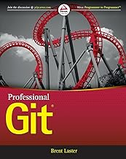
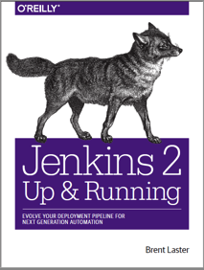


That’s all - thanks!
Contact: training@getskillsnow.com
techskillstransformations.com
getskillsnow.com

