Slide 2

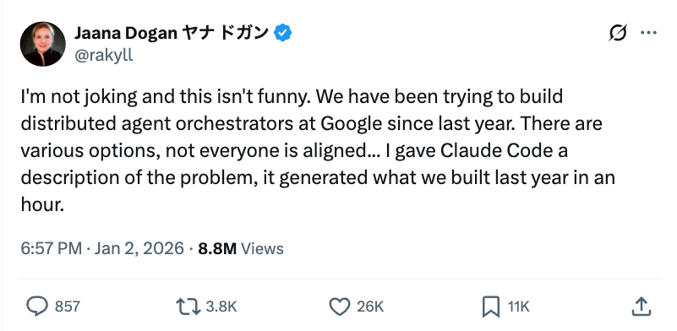
"This isn't funny."

Slide 3
"This isn't funny."
MYTH or REALITY?
What's your immediate reaction?
What do you think "1 year" vs "1 hour" actually refers to?

Slide 4
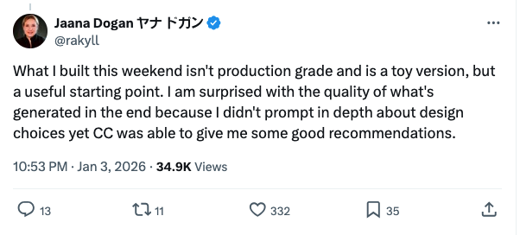
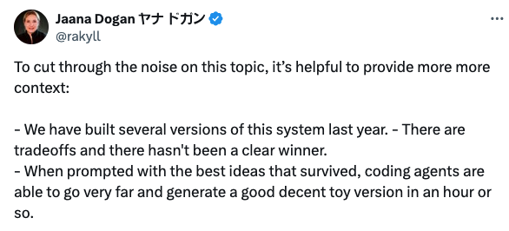
What the post claimed – and what the follow-ups clarified
Claim (compressed): “Claude Code generated something close to what we built last year… in ~1 hour.”
Context embedded in the thread:
“We’ve been trying to build distributed agent orchestrators… since last year”
Follow-up: “not production grade… toy version”
Follow-up framing: “we built several versions last year” (iteration happened)

Slide 5
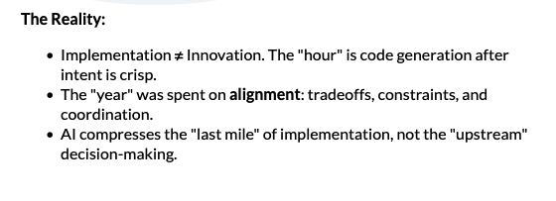
What the post claimed – and what the follow-ups clarified
Claim (compressed): “Claude Code generated something close to what we built last year… in ~1 hour.”
Context embedded in the thread:
“We’ve been trying to build distributed agent orchestrators… since last year”
Follow-up: “not production grade… toy version”
Follow-up framing: “we built several versions last year” (iteration happened)

Slide 6
Context & Context Engineering
The Information Environment of AI Models
Context is the complete set of information available to an AI model when processing a request. Context Engineering is the practice of designing, structuring, and managing it for performance, accuracy, and safety.
The Context Window (128K Tokens)
Why Context Matters
System Instructions
~2K
1
Shapes Responses
Role, rules, constraints
Determines what the model "sees" and how it interprets requests
Conversation History
2
Enables Memory
~40K
Conversation history allows multi-turn interactions
Past messages & responses
3
Grounds Knowledge
Retrieved Documents
~60K
Retrieved documents reduce hallucinations
RAG data & context
4
Attack Surface
Tools & Schemas
~10K
Everything in context is visible and can be manipulated
Available tool definitions
5
Costs Money
Current Query
~16K
You pay for every token on every API call
User's active request
Core Principles
Relevance: Include only what's necessary
Priority: Most important info first & last
Structure: Clear organization and formatting
Key Insight: Context is both the model's knowledge base AND its security boundary. Managing it well is critical for performance, cost, and safety.
Notes:
CHANGE: Combined 2 slides ('What is Context?' + 'Context Engineering') into one. Kept the context window breakdown table (5 components with token counts), 'Why Context Matters' list (5 items), and added Core Principles (Relevance, Priority, Structure) from the deleted Context Engineering slide. Combined both definitions into a single banner. Deleted the redundant 'Context Engineering' slide.

Slide 7
Context Rot
When Context Windows Decay Over Time
What is Context Rot?
Progressive degradation of context quality as conversations grow longer, leading to inconsistencies, hallucinations, and reduced performance.
The Decay Process:
Turn 1-5
✓ Clean Context
✓ High Accuracy
Turn 10-20
⚠ Noise Building
⚠ Some Drift
Turn 30+
✗ Context Rot
✗ Hallucinations
Root Causes:
Mitigation Strategies:
Information Overload
→ Context Pruning: Remove old/irrelevant messages
Too much history dilutes relevance
Contradictions
→ Summarization: Compress history into summaries
Old info conflicts with new context
Stale References
→ Session Reset: Start fresh after N turns
Outdated data treated as current
Lost Focus
→ Sliding Window: Keep only recent context
Original intent buried in noise

Slide 8
Context Risk & Defenses
Security & Operational Risks + Defense in Depth
1. Information Leakage
2. Context Injection
3. Context Overflow
• Sensitive data exposed via prompt injection
• Malicious instructions embedded in RAG docs
• Important instructions dropped at token limits
• Cross-user context bleeding in shared systems
• Goal hijacking via manipulated history
• Safety guardrails evicted from context
• System prompts leaked via adversarial queries
• Adversarial context poisoning in multi-turn
• Unpredictable behavior when limits exceeded
Defense in Depth for Context Security
1
2
3
4
5
Input Sanitization
Context Isolation
Token Budget Mgmt
Output Filtering
Audit Logging
Scan and validate all context inputs
Separate user contexts; no cross-contamination
Reserve space for critical instructions
Redact sensitive data before responses
Track context changes for forensics
Best Practices
🔒 Least Privilege Context
🔐 Context Encryption
📋 Regular Context Audits
Only include data the model needs to complete its task
Encrypt sensitive context data at rest and in transit
Review what's being stored and for how long
Notes:
CHANGE: Combined 2 slides ('Context Risk' + 'Defending Against Context Risk') into one. Top section: 3 risk categories (Information Leakage, Context Injection, Context Overflow) with severity color coding and key bullets. Bottom section: 5 defense layers (Input Sanitization, Context Isolation, Token Budget Mgmt, Output Filtering, Audit Logging) + 3 best practice cards (Least Privilege, Encryption, Regular Audits). Deleted the 'Defending Against Context Risk' slide.

