Slide 1


Slide 2
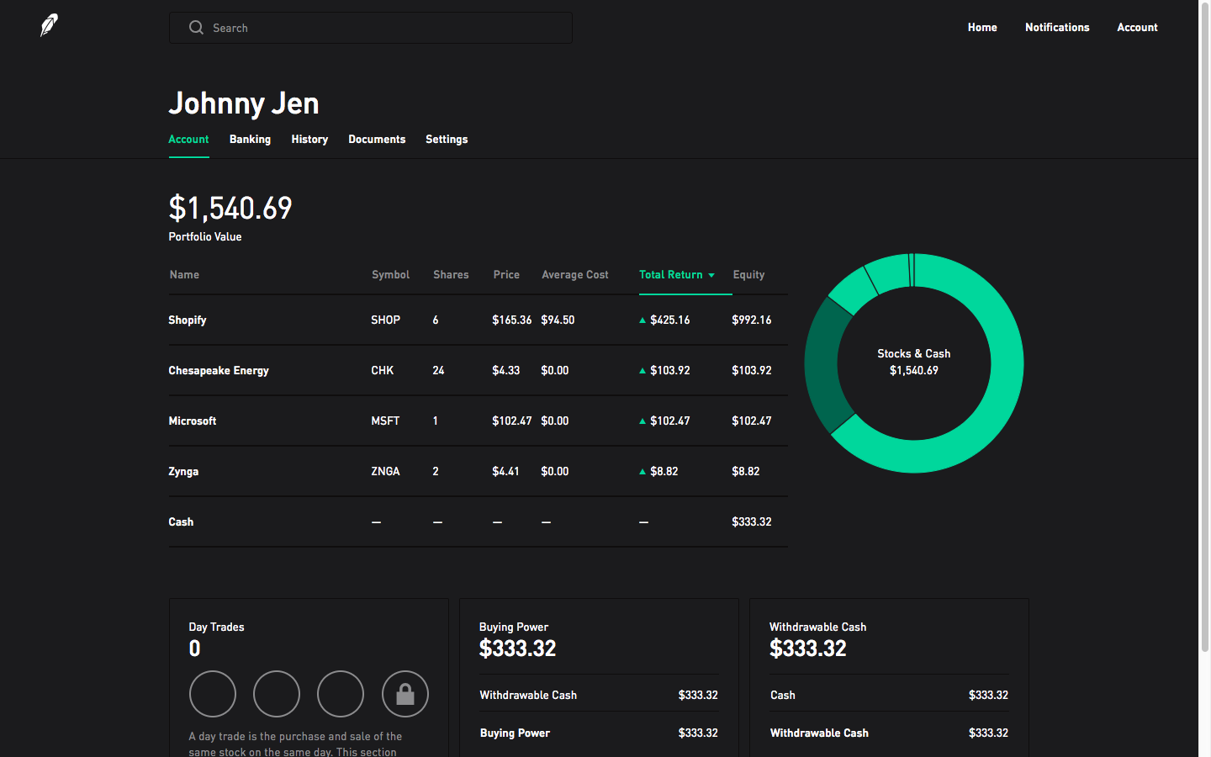
Robinhood
Founded in 2013 by 2 Electrical Engineers who formerly developed High Frequency Trading (HFT) platforms for institutions
Vladamir Tenev and Baiju Bhatt
Latest financing round was July of 2019 which had a $7.6 Billion valuation
Offering commission free trading from your mobile device in as little as 10 minutes
Targeting Millennial and Gen X retail investors

Slide 3
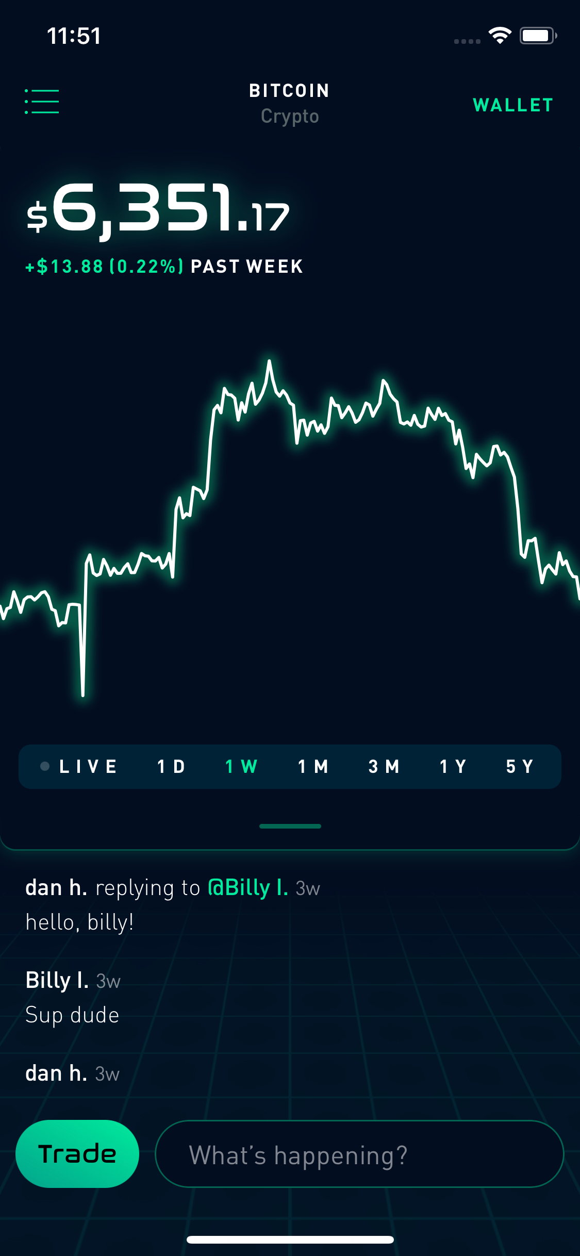
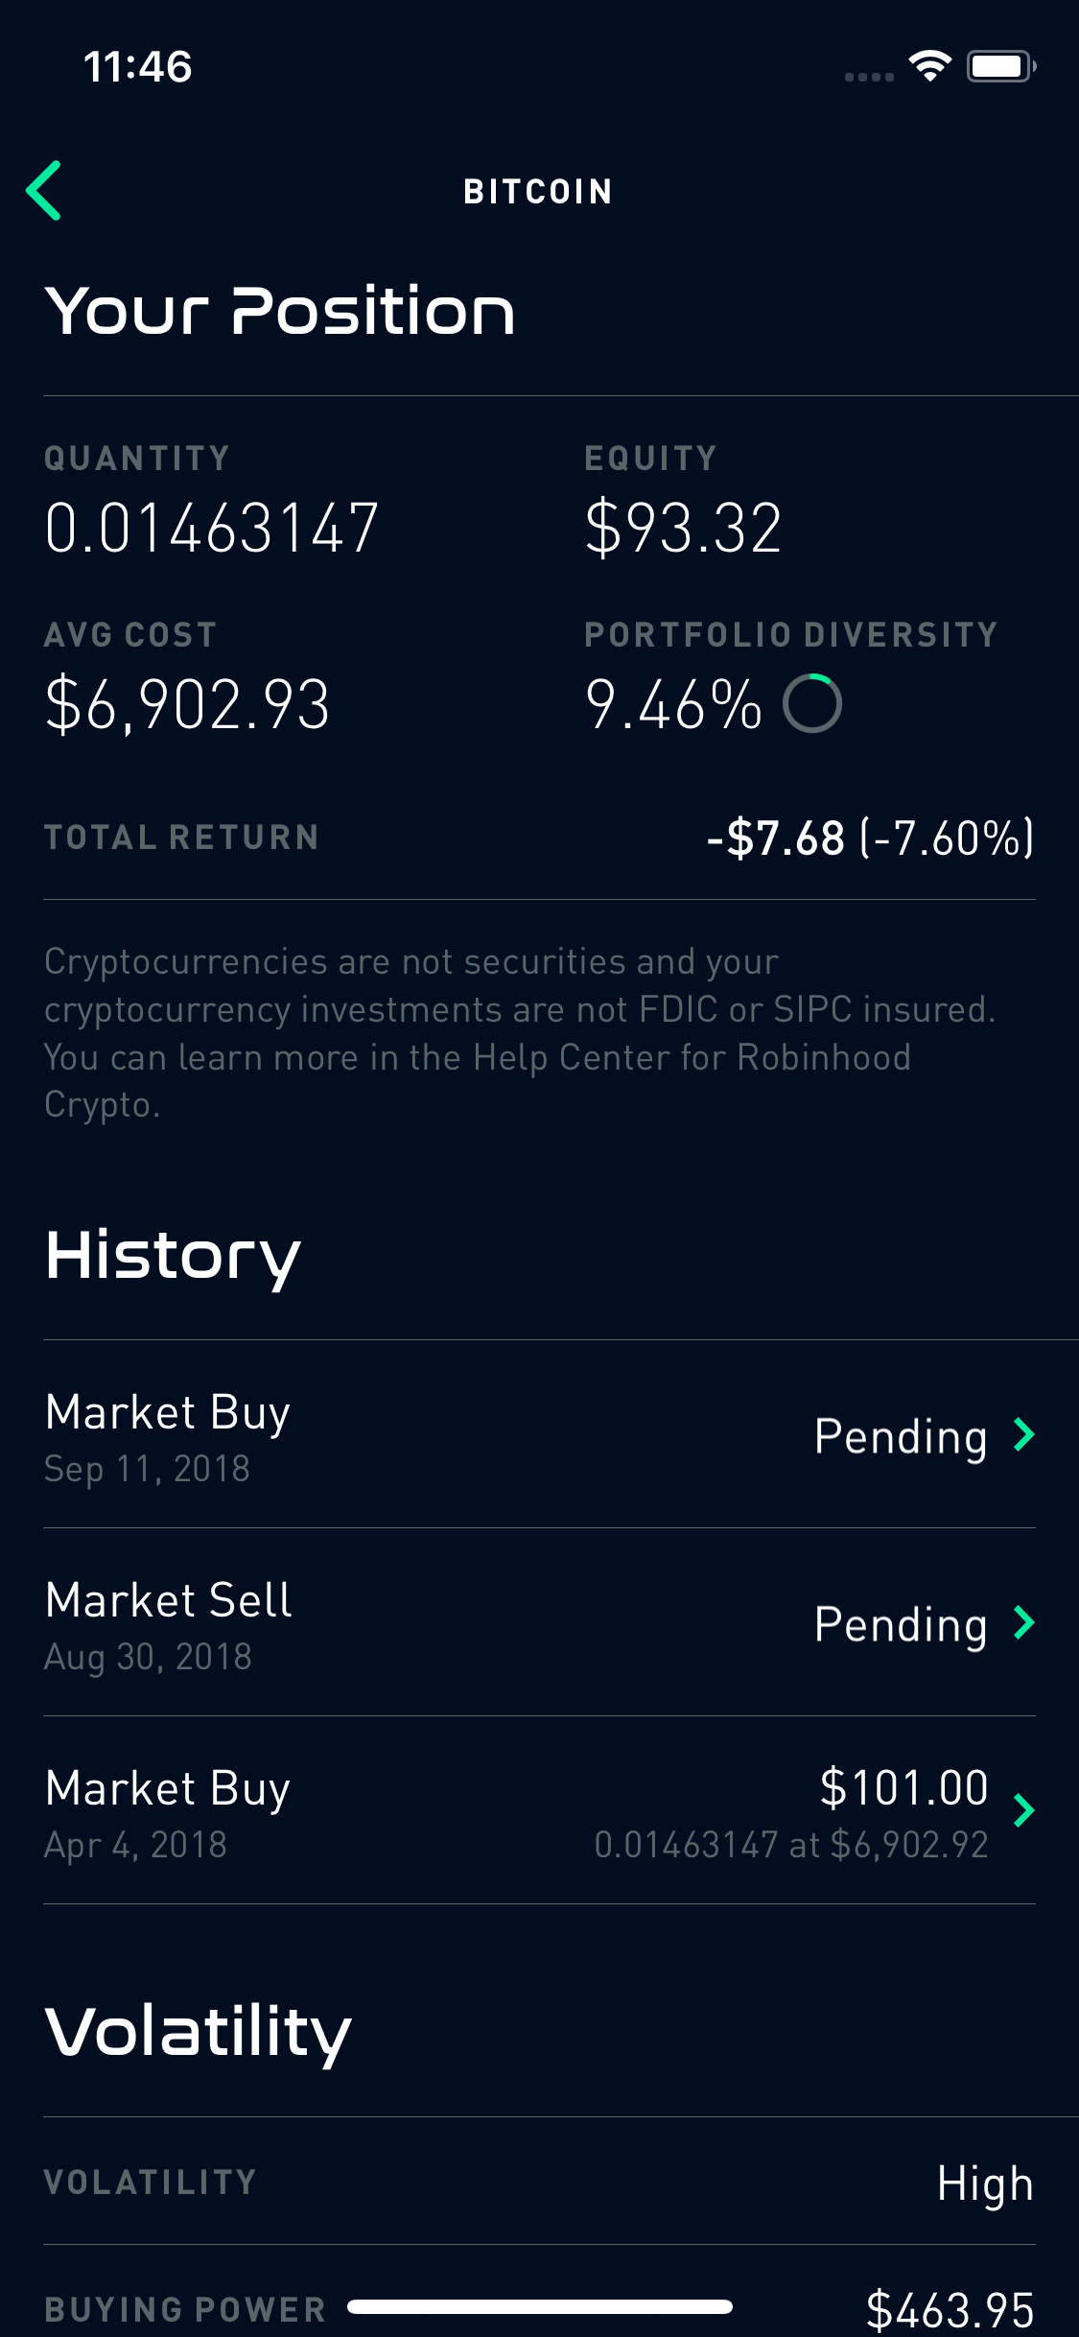
Robinhood is ahead of competitors offering crypto assets
Competitors such as TD Ameritrade, ETrade or Fidelity do not offer investments in crypto assets
The only mutual fund you can buy that has crypto exposure is GBTC (Grayscale Bitcoin Trust) only after changing risk tolerances to your portfolio
Robinhood has first mover advantage over the major brokerages by offering this asset class to retail investors

Slide 4
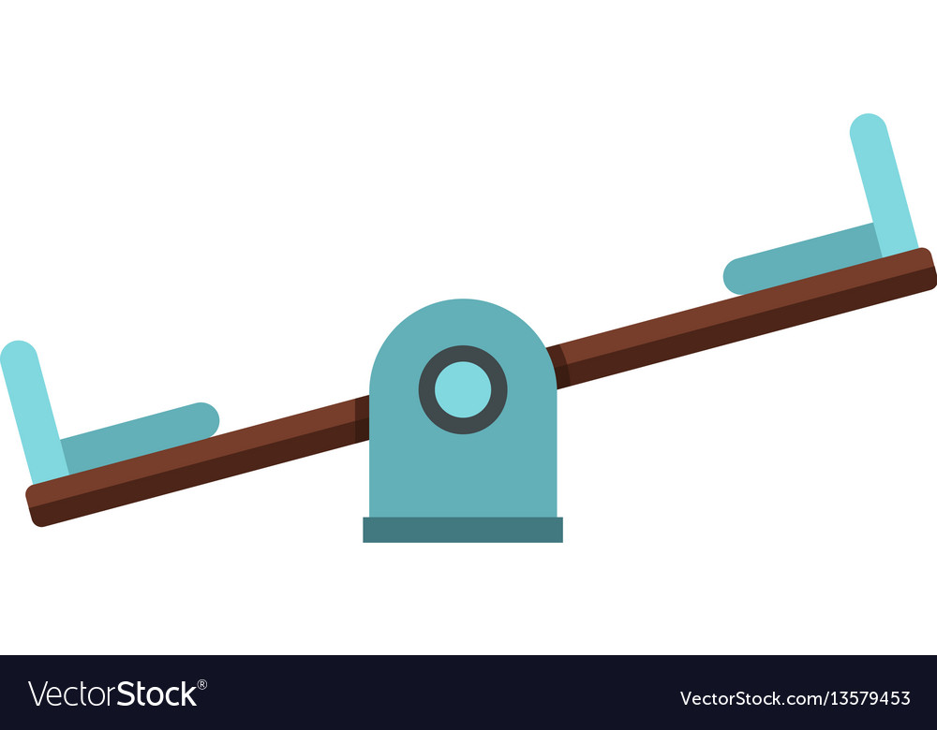
Does Robinhood really offer Free Trades?
Implicit Costs
Explicit Costs

Slide 5
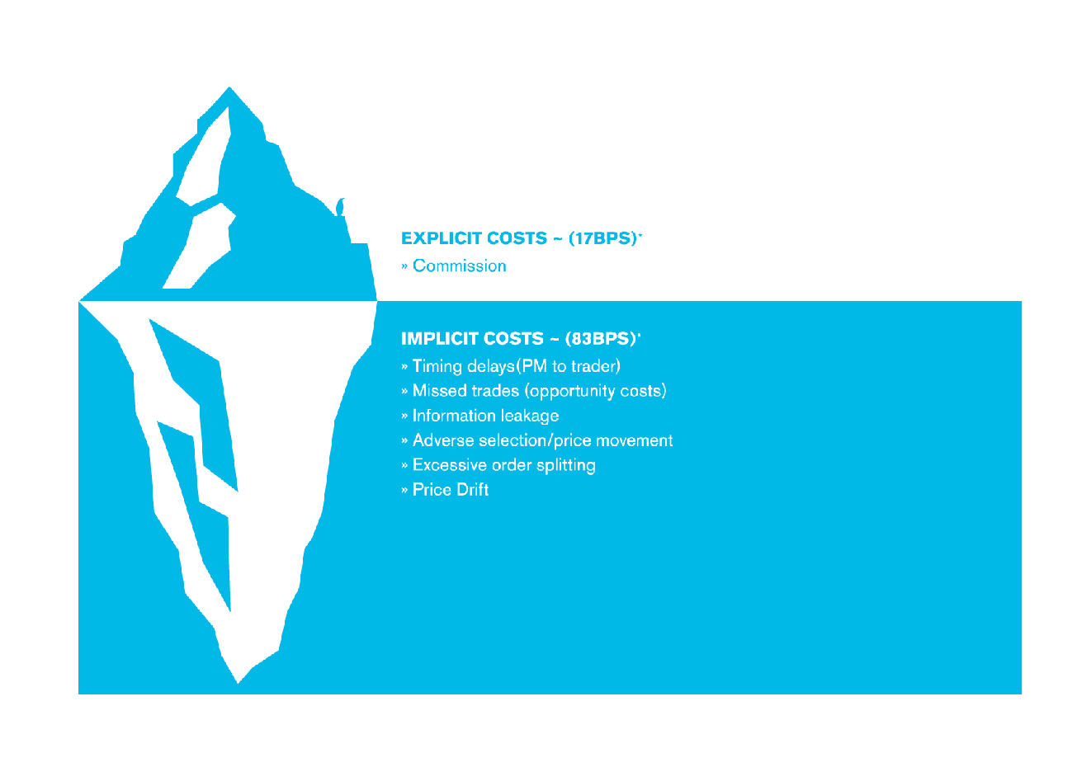
Robinhood Cost Analysis
Explicit= known cost/ commission
Implicit= market impact, delay/timing, opportunity cost
Bid-Ask Spreads
Liquidity motivated traders meeting market order demand of retail investors

Slide 6
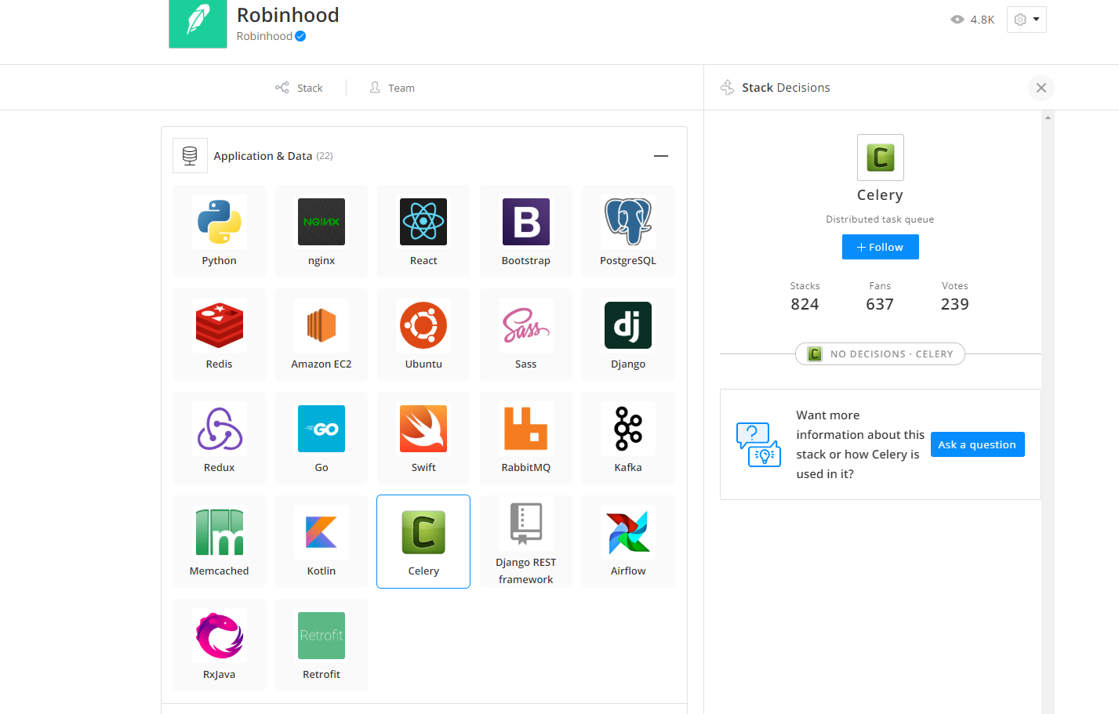
Technology Stack- Application and Data

Slide 7
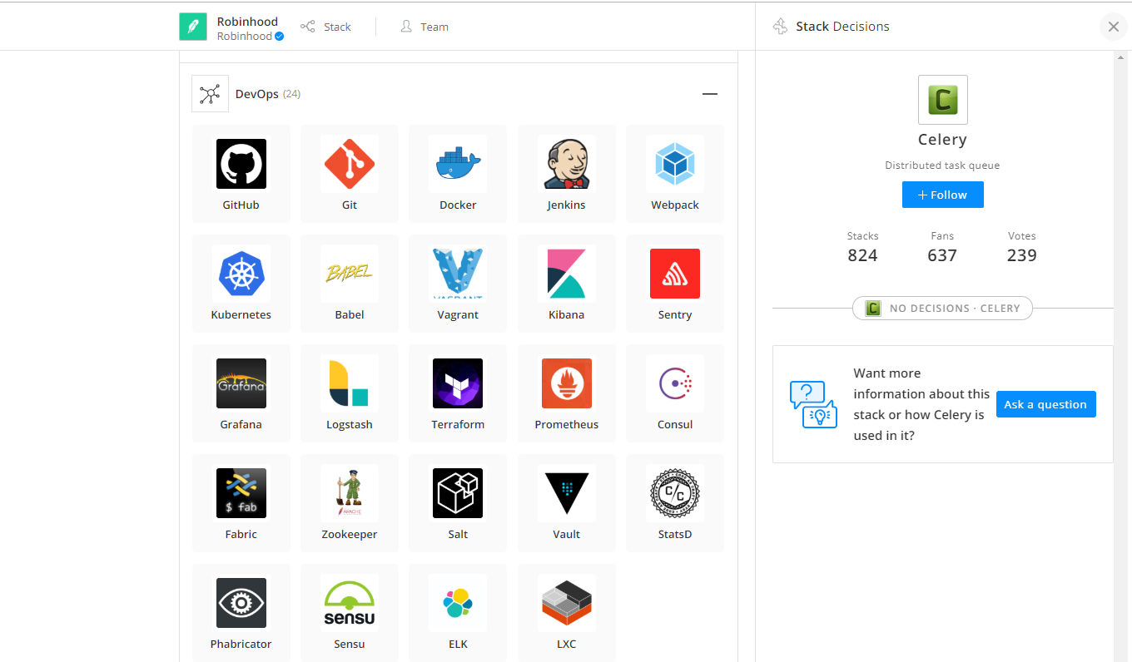
Technology Stack- DevOps

Slide 8
Sources
Robinhood Image
Implicit Iceberg Image
Robinhood Website
Robinhood App

